Slide 1


GOVERNMENT COLLEGE OF ENGINEERING,
ERODE
NAME OF THE STUDENT : Gokulnath G
NAAN MUDHALVAN REG NO: aut7311106l04
Under the mentor of
Dr. M. Sathyakala
Assistant professor , Dept of IT Department of Information Technology(IT)
Department of Electronics and Communication Engineering
Government College of Engineering
Erode ,Vasavi College post,TamilNadu-638316,
Affiliated to Anna University ,Chennai.

Slide 2

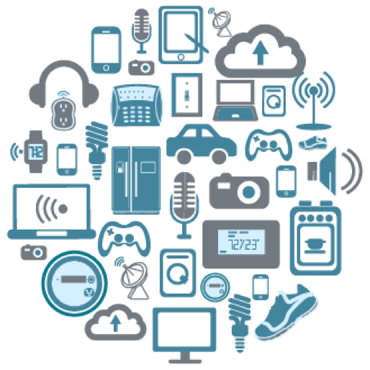
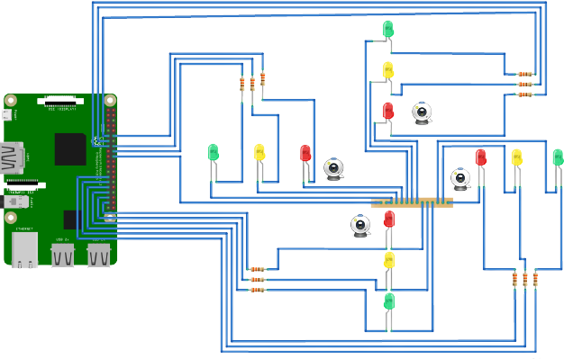
TRAFFIC MANAGEMENT SYSTEM
PHASE 5

Slide 3
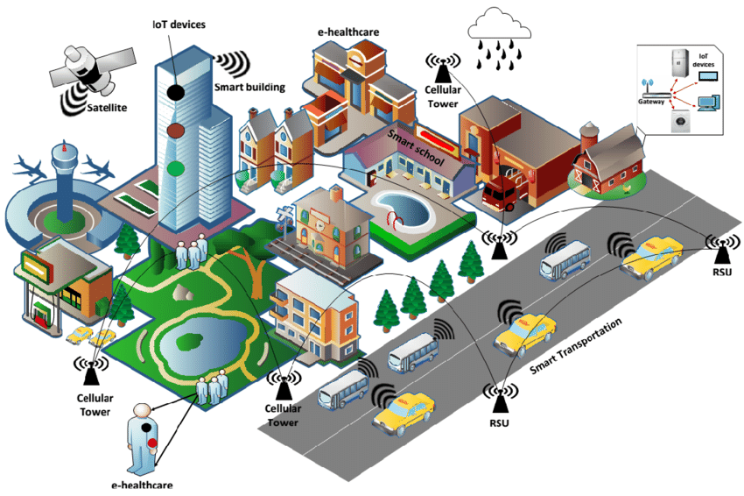
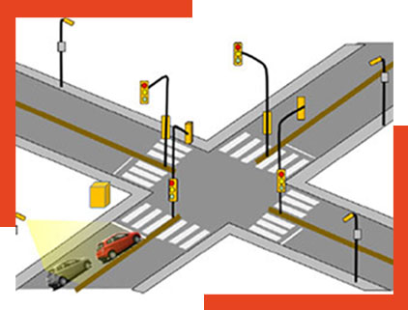
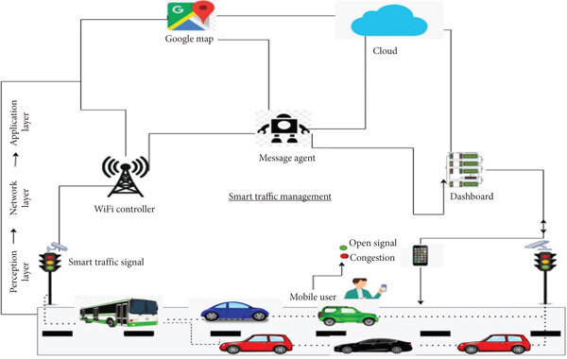
Project Objectives:
The primary objectives of this IoT-based traffic management system are to improve traffic flow, reduce congestion, enhance safety, and provide real-time traffic data for analysis. The project aims to achieve these objectives by monitoring traffic conditions, optimizing signal timings, and providing data for traffic management and planning.

Slide 4
BLOCK DIAGRAM

Slide 5
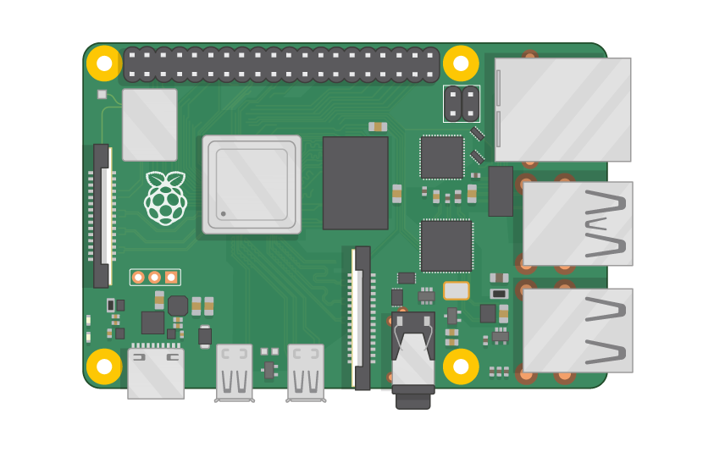
Raspberry pi Board

Slide 6
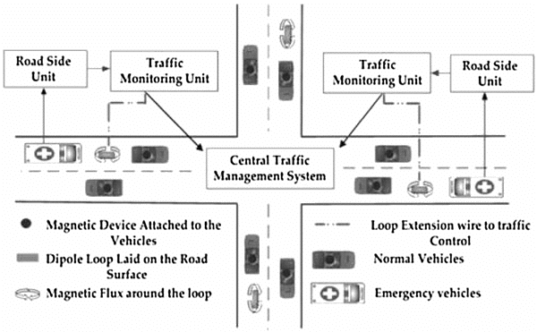

Slide 7
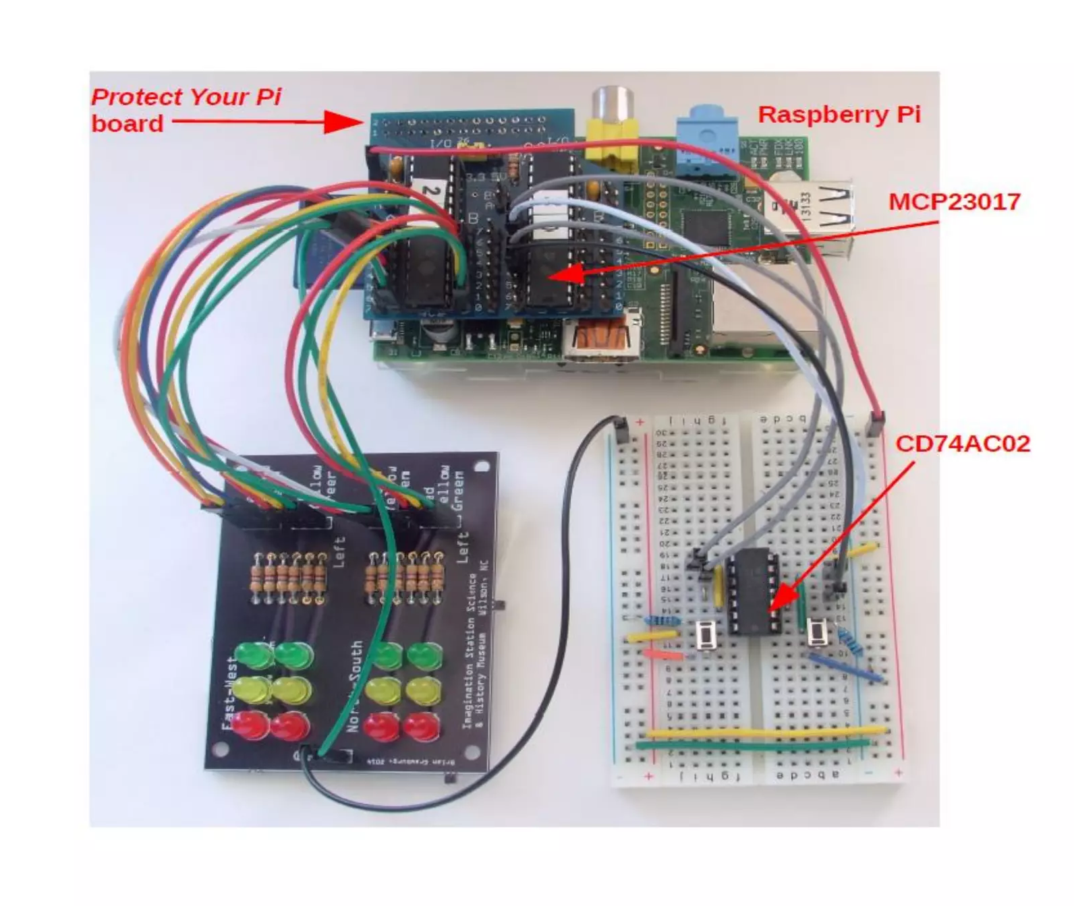

Slide 8
IoT Device Setup:
Sensors:
Various sensors to monitor traffic conditions:
Traffic flow sensors (ultrasonic or infrared sensors to detect vehicle presence and count)
Environmental sensors ( weather and pollution sensors)
Cameras for license plate recognition and traffic
monitoring

Slide 9
Vehicle Detection Sensors:
These can include inductive loop sensors, ultrasonic sensors, or cameras for detecting the presence and count of vehicles at intersections.
Communication:
Connect the microcontrollers to a communication network
( Wi-Fi, 4G/5G) to transmit data to the central platform.
Speed Measurement:
Put two sensors on the road, with some space between them. When a car drives over the first sensor, it starts a timer
CCTV CAMERS:
CCTV cameras are strategically placed at key intersections, highways, and busy roads to monitor traffic conditions in real-time. Operators can observe the flow of traffic, identify congestion or accidents, and take appropriate actions.

Slide 10
Hardware Approach:
Components required:
Raspberry pi
GPS
Proximity Sensors
Pressure Sensors
Accelerometers
Power from 5V DC to DC setup- 2xAA
Software Approach:
Software applications can be used for simulation:
MQTT
ThingSpeak
WOKW

Slide 11
Platform Development:
1.Data Collection and Storage:
Set uped a cloud-based platform to store data from IoT devices.
2.Data Processing:
Implemented data processing algorithms to analyze traffic data, calculate traffic flow, and detect congestion or incidents.
3.Traffic Control Logic:
Developed traffic signal control algorithms to optimize signal timings based on real-time traffic conditions.

Slide 12
4.User Interface: Created a web-based dashboard for traffic management personnel to monitor traffic conditions, view real-time data, and make manual adjustments.
5.Data Sharing: Provide APIs or data streams for sharing traffic data with relevant authorities and for public information.
6.Security and Authentication: Implement security measures to protect the system from unauthorized access or cyber threats.

Slide 13
#define RED 1
#define YELLOW 5
#define GREEN 9
void setup()
{
pinMode(RED, OUTPUT);
pinMode(YELLOW, OUTPUT);
pinMode(GREEN, OUTPUT);
}
void loop() {
digitalWrite(GREEN, HIGH);
delay(3000);
digitalWrite(GREEN, LOW);
digitalWrite(YELLOW, LOW);
digitalWrite(RED, HIGH);
delay(2500);
digitalWrite(RED, LOW);
digitalWrite(YELLOW, HIGH);
delay(1000);
digitalWrite(YELLOW, LOW);
}
Raspberry pi

Slide 14
{
"version": 1,
"author": "redmi 10",
"editor": "wokwi",
"parts": [
{ "type": "wokwi-esp32-devkit-v1", "id": "esp", "top": -35.61, "left": -141.49, "attrs": {} },
{
"type": "wokwi-led",
"id": "led1",
"top": -119.92,
"left": -79.8,
"attrs": { "color": "red" }
},
{
"type": "wokwi-led",
"id": "led2",
"top": -118.47,
"left": -50.75,
"attrs": { "color": "yellow" }
},

Slide 15
{
"type": "wokwi-led",
"id": "led3",
"top": -119.94,
"left": -17.55,
"attrs": { "color": "green" }
}
],
"connections": [
[ "esp:TX0", "$serialMonitor:RX", "", [] ],
[ "esp:RX0", "$serialMonitor:TX", "", [] ],
[ "led1:A", "esp:D2", "green", [ "v0" ] ],
[ "led1:C", "esp:GND.1", "green", [ "v0" ] ],
[ "led2:A", "esp:D4", "green", [ "v0" ] ],
[ "led2:C", "esp:GND.1", "green", [ "v0" ] ],
[ "led3:C", "esp:GND.1", "green", [ "v0" ] ],
[ "led3:A", "esp:D12", "green", [ "v0" ] ]
],
"dependencies": {}
}

Slide 16
Code Implementation:
Code for Raspberry Pi to capture data from sensors and transmit it to the central platform.
Developed algorithms for data analysis, traffic flow monitoring, and congestion detection.
Implemented traffic signal control logic to adjust signal timings based on real-time data.
Created a user-friendly web-based dashboard for real-time monitoring and control.
Developed API’s(Application Programming Interface) for data sharing and integration with external systems.
Implemented security features to protect the system from cyber threats.

Slide 17
Importing libraries and setting up GPIO
(General Purpose Input and Output)
The code begins by importing the Rpi.GPIO library for Raspberry Pi GPIO control and the time.sleep function for adding delays.It defines various pins for magnetic sensors (hallpin1 to hallpin33) and LEDs (LED1 to LED32).It disables warnings and sets the GPIO mode to use physical pin numbers on the Raspberry Pi.It configures the pins for input (sensors) or output (LEDs) and initializes the LEDs to be initially turned off.

Slide 18
Sensor Reading:
The code enters an infinite loop, where it continuously reads the state of the magnetic sensors .For each sensor, it checks whether it is detecting a magnetic field (True) or not (False) and sets corresponding variables (a1 to d3) to 1 or 0 accordingly It prints messages indicating whether each sensor detected a magnet or not.

Slide 19
Sleep and Loop:
After all the comparisons are made and LEDs are potentially activated, the code sleeps for 2 seconds before looping back to read the sensor values again . In summary, this program monitors multiple magnetic sensors and activates specific sets of LEDs based on which sensors detect the strongest magnetic fields. The LEDs are turned on for a fixed duration of 15 seconds and then turned off. The program continues to monitor and update the LED states in response to changes in the magnetic field detected by the sensors

Slide 20
Data-Sharing Platform:
Central Server or Cloud Storage:
A centralized database or cloud storage to store all incoming data from IoT devices.
2.Data Processing and Analytics
Data processing algorithms to analyze incoming traffic data, detect incidents ( accidents, congestion), and predict traffic patterns.
3.Real-time Data Streaming:
Implemented real-time data streaming to ensure that traffic information is promptly available for decision-making.

Slide 21
4.Traffic Control Logic:
Algorithms for optimizing traffic signal timings and managing traffic flow based on the analyzed data.
5.User Interface (Web Dashboard or Mobile App):
A web-based dashboard or mobile application for traffic management personnel to monitor real-time traffic data, control traffic signals, and make manual adjustments.
6.Data Sharing and APIs:
Develop APIs for sharing traffic data with other relevant authorities, navigation apps, and public information dissemination.
7.Security and Authentication:
Implement robust security measures to ensure the integrity and confidentiality of the data and system.

Slide 22
Workflow:
IoT devices, such as sensors and cameras, collect data on traffic conditions and environmental factors.
The data is transmitted to a central server or cloud storage.
Data processing algorithms analyze the incoming data to monitor traffic flow, detect incidents, and predict congestion.
Real-time traffic data is made available through a user interface, such as a web dashboard.
Traffic management personnel can use the dashboard to monitor and control traffic conditions, make manual adjustments, and optimize traffic signals.
Traffic control logic automatically adjusts traffic signals based on real-time data.
APIs facilitate data sharing with relevant authorities, navigation apps, and the public.
Security measures protect the system from unauthorized access or cyber threats.

Slide 23
Conclusion
This integrated approach can significantly improve traffic management, reduce congestion, and enhance safety by providing real-time data for decision-making and control. Traffic management authorities can react more effectively to incidents, adapt to changing traffic patterns, and optimize traffic flow in real time.

