Slide 1
BUSINESS ANALYTICS & SEGMENTATION REPORT
Customer shopping behavior analysis
This report evaluates 3,900 customer purchases to show who buys, what they buy, and how to turn one-time shoppers into repeat customers.
You will learn where revenue comes from, which customer groups matter most, and which actions to take next.
Source: Customer Behavior Dashboard report · SQL feature engineering · Power BI
Notes:
Introduce the project: an end-to-end evaluation of 3,900 consumer purchase transactions, combining exploratory data analysis, relational feature design, and commercial recommendations.

Slide 2

Contents
This project analyzes 3,900 purchases to show who buys, what they buy, and how to grow repeat sales.
Purpose and dataset
01
Customer profile
02
The business questions, built on 3,900 purchases across customer, purchase, and shopping-behavior records.
Demographics, categories, and geography across the buyer base.
SQL findings
Data preparation and PostgreSQL workflow
04
03
Who spends most, which categories lead, and how discounts, subscriptions, and shipping shape repeat buying.
Clean, consistent tables, business-ready dimensions, and SQL queries.
Core commercial question: Identifying the operational levers that convert single-item promotional shoppers into sustained repeat buyers.
Recommendations and next steps
06
Power BI dashboard
05
Interactive views of revenue, ratings, and category demand.
Targeted discounts and loyalty offers, starting with a test that turns single-purchase shoppers into repeat buyers.
02
Notes:
Walk through the agenda in order: project purpose, dataset, data preparation, SQL analysis, then the dashboard and recommendations. Close by noting that the findings support targeted marketing rather than generic discounting.

Slide 3




DATA STRUCTURE & SCHEMA
The dataset combines customer, purchase, and shopping-behavior signals
A structured transaction matrix containing 3,900 records and 18 dimensions covering the customer lifecycle.
Customer fields
Purchase fields
Behavior fields
Age, gender, location, and subscription status establishing base customer identity.
Item, category, amount, season, size, color, shipping type, and payment method.
Discount use, promo code use, previous purchases, purchase frequency, and review rating.
Scope: Demographic
Scope: Transactional
Scope: Engagement
3,900 rows and 18 columns. Customers range from age 18 to 70 (mean 44.07); the average purchase is $59.76 and the average review rating is 3.75.
03
Notes:
Explain the three data layers: identity demographics, transaction details, and engagement signals. Emphasize how combining these three tiers enables multi-dimensional segmentation.

Slide 4
Subscriptions, loyalty, and repeat buying shape the customer base
Subscribers: 1,053 customers averaging $59.49 per purchase, generating $62,645 in total revenue.
Non-subscribers: 2,847 customers averaging $59.87 per purchase, generating $170,436 in total revenue.
Loyalty: 3,116 loyal customers, 701 returning customers, and 83 new customers.
Repeat buyers: 958 subscribers and 2,518 non-subscribers. Express orders average $60.48 versus $58.46 for Standard shipping.
04
Notes:
Walk through the core baseline metrics: middle-aged customer concentration (44.1 years), reliable ticket sizes ($59.76), solid baseline satisfaction (3.75), and the distinct male-heavy transaction volume.

Slide 5
PIPELINE INTEGRITY
Data preparation made the analysis consistent and reusable
Four rigorous hygiene steps ensured structural reliability prior to analytical modeling.
01
02
03
04
Data ingestion & inspection
Category-based imputation
Schema standardization
Redundancy reduction
Verified that promo-code use duplicated discount information and dropped the redundant field.
Loaded the transactional data with pandas and reviewed structure with info() and describe().
Checked missing values and imputed 37 missing review ratings with the median rating for each product category.
Standardized column names into snake case for cleaner analysis, readability, and documentation.
Standardization and deduplication prevented skewed frequency coefficients while preserving all 3,900 valid transactional instances.
05
Notes:
Explain the preparation methodology: how pandas was used for structural audits, category-specific median imputation for the 37 null ratings, and why promo code fields were discarded as exact duplicates of discount application.

Slide 6

ANALYTICAL TRANSFORMATION
Feature engineering created business-ready dimensions
Transforming raw log values into granular, queryable relational structures.
Demographic bucketing
Created age groups to compare revenue across meaningful customer segments (Young Adult, Middle-aged, Adult, Senior).
Temporal recency normalization
Created purchase-frequency-days from the purchase-frequency field to establish quantifiable cadences.
Relational database deployment
Loaded the cleaned DataFrame into PostgreSQL so the business questions could be answered with repeatable SQL queries.
06
Notes:
Highlight the transition from raw transactional flat files to engineered features: demographic cohorting, frequency conversion to numeric day metrics, and the migration to PostgreSQL for auditable SQL analysis.

Slide 7
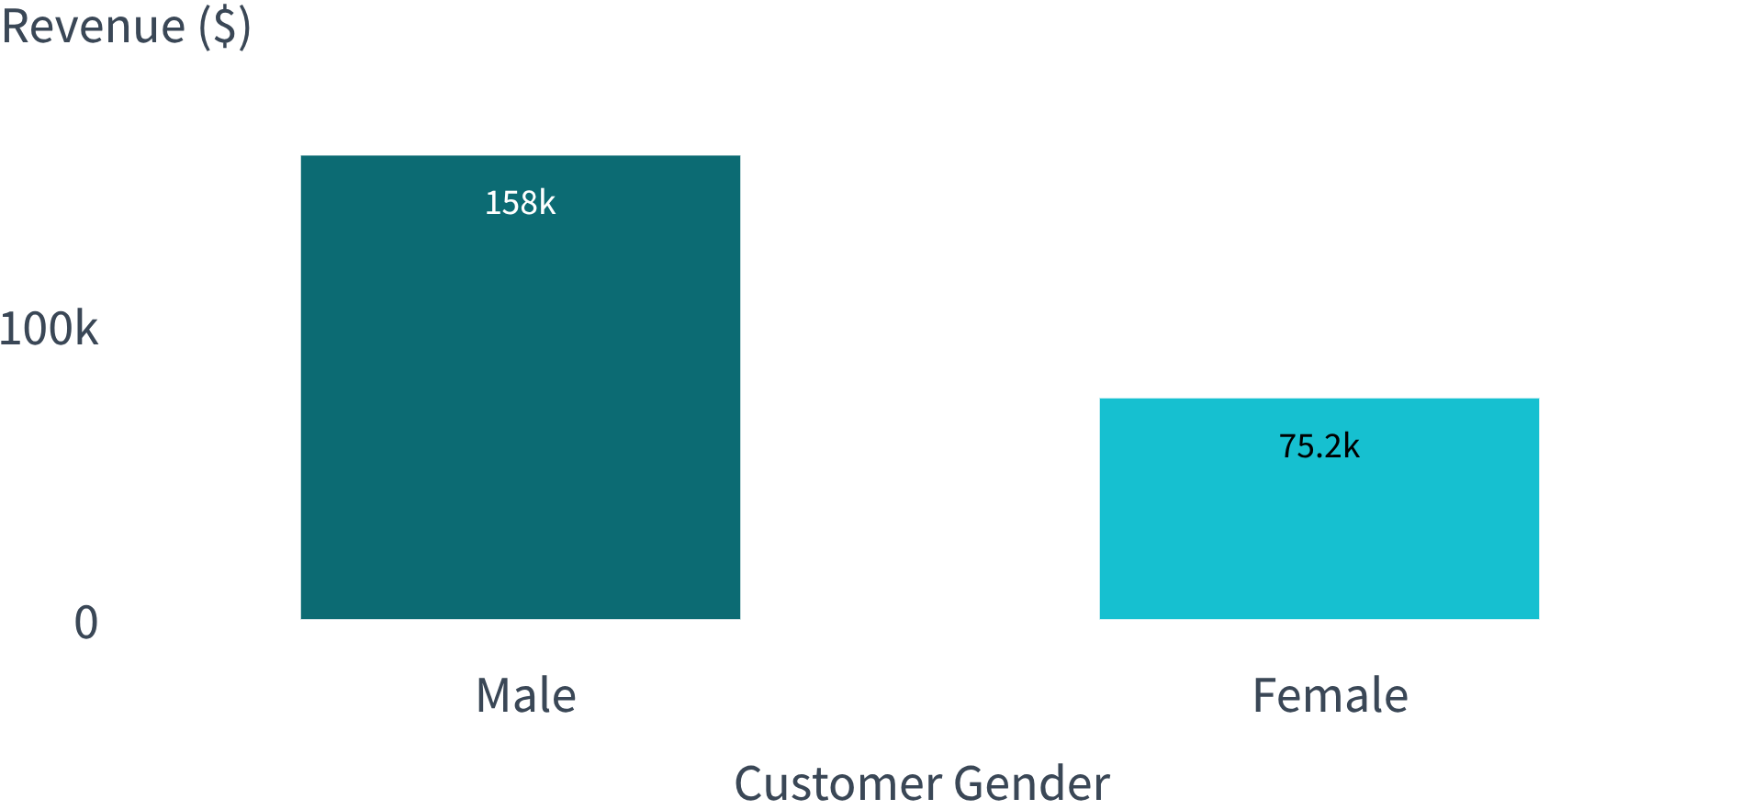
GENDER SEGMENTATION
Revenue is concentrated in male customers, but the comparison is straightforward
AVERAGE VALUE PER TRANSACTION
$59.54 vs $60.25
Male avg ($59.54) vs Female avg ($60.25)
The revenue difference stems almost entirely from customer volume rather than individual willingness to spend. The result is useful as a baseline for segmentation, read alongside category, age, and purchase-frequency patterns.
Exact SQL revenue totals: Male $157,890 across 2,652 buyers; Female $75,191 across 1,248 buyers.
07
Notes:
Clarify that while male revenue is more than double female revenue ($158K vs $75K), the average spend per purchase is essentially identical ($59.54 vs $60.25). The gap is volume, not ticket size.

Slide 8
Discounts can coexist with high-value purchases
839 customers used discounts and still spent above the average purchase amount, so discounts are not limited to low-value baskets.
Most discount-dependent products: Hat 50.00%, Sneakers 49.66%, Coat 49.07%, Sweater 48.17%, and Pants 47.37%.
The commercial question is whether these discounts create incremental demand or simply reduce margin on purchases that would have happened anyway.
839
customers
08
Notes:
Discuss the 839 customers who used discounts and still spent above the average purchase amount. Ask whether discounts create incremental demand or simply reduce margin on purchases that would have happened anyway.

Slide 9
SATISFACTION VS VELOCITY
Product ratings and category demand reveal different kinds of winners
Measure | Products
Top-rated products | Gloves 3.86, Sandals 3.84, Boots 3.82, Hat 3.80, and Skirt 3.78
Top products by category | Jewelry, Sunglasses, Belt, Blouse, Pants, Shirt, Sandals, Shoes, Sneakers, Jacket, and Coat
Ratings can guide positioning and advocacy, while order volume should guide inventory and campaign scale.
09
Notes:
Compare ratings against volume: Gloves and Sandals lead in consumer sentiment, but Pants and Blouses drive total fulfillment load. Allocate marketing for advocacy versus inventory for velocity.

Slide 10
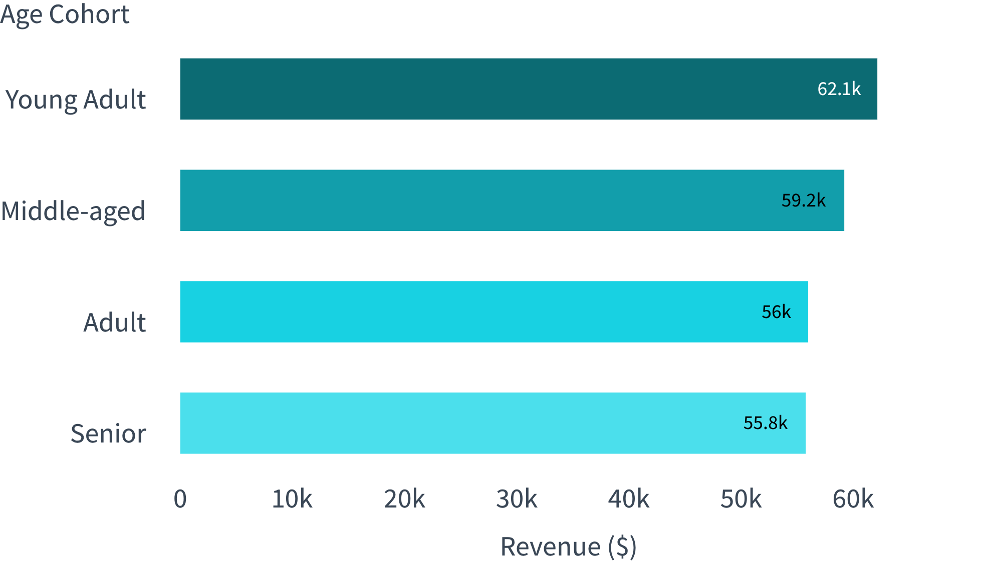
POWER BI DASHBOARD & RECOMMENDATIONS
Clothing leads the dashboard, so the next step is segment-specific action
$104K
Power BI dashboard: 3.9K customers, $59.76 average purchase, 3.75 average rating; clothing revenue from 1,737 sales
Recommendations
Aim discounts at discount-dependent products, not broadly.
Use ratings for advocacy and order volume for inventory and campaign scale.
Turn single-purchase shoppers into subscribers and repeat buyers through a loyalty offer test.
Age-group revenue is tight ($55K–$62K), so segment-specific campaigns beat one-size messaging. Next step: pilot a loyalty offer for single-purchase shoppers and track repeat purchases.
Revenue by age group: Young Adult $62,143; Middle-aged $59,197; Adult $55,978; Senior $55,763.
10
Notes:
Synthesize category and cohort distributions: Clothing is the undisputed volume anchor ($104K revenue, 1,737 sales). Age group revenues are tightly clustered between $55K and $62K, proving broad appeal across generations.

