Slide 1

ANTENNAS AND 5G CELLULAR COMMUNICATION
Project Based Learning
Towards Real-World 6G Drone Communication: Position and Camera Aided Beam Prediction
Guiding Faculty
Dr. K. A. Nethravathi
Assistant Professor
Electronics and Communication Engineering
RV College of Engineering
Team Members
Dhruv Miraskar (1RV23EC038)
Gokul P (1RV24EC403)

Slide 2
INTRODUCTION
UAVs are expected to play an important role in future 6G networks, enabling applications such as aerial surveillance, delivery, emergency response, and high-speed connectivity.
mmWave communication can provide high data rates, but its highly directional nature requires accurate beam alignment between the drone and the base station.
Conventional beam-training techniques search through multiple beams, resulting in significant training overhead and latency, particularly when the drone is moving at high speed.
Information such as the drone’s position, height, distance, and RGB camera images can provide useful environmental and spatial information for predicting the optimal communication beam.
This work explores a deep-learning-based multimodal approach that combines position and visual information to predict beam indices, with the aim of reducing beam-training overhead and improving reliable real-world drone communication

Slide 3
LITERATURE REVIEW
slno | Paper (Author, Year, Venue) | Input | Output | Novelty | Limitations
1 | Sensing-Aided 6G Drone Communications: Real-World Datasets and Demonstration Gouranga Charan and Ahmed Alkhateeb, 2025 — IEEE Open Journal of the Communications Society | RGB, GPS, height, distance, speed, pitch, roll, mmWave beam measurements | Beam index (Q = 32); Top-k accuracy; future beam prediction | Real-world drone beam prediction and tracking; multimodal sensing; 86.32% Top-1 beam prediction accuracy | Limited real-world trials; single-user setting; performance varies with flight conditions; further validation across environments and drone platforms needed
2 | Towards Real-World 6G Drone Communication: Position and Camera Aided Beam Prediction — Gouranga Charan, Andrew Hredzak, 2022 — IEEE | RGB, GPS, Height, Distance | Beam index (Q=32), Top-k accuracy | First real-world drone beam prediction; 86.32% top-1 | Single-user; one location; degrades at low height/high speed
3 | DeepSense 6G: A Large-Scale Real-World Multi-Modal Sensing and Communication Dataset Ahmed Alkhateeb, Gouranga Charan, Tawfik Osman, Andrew Hredzak 2022 | RGB, LiDAR, Radar, GPS, mmWave, IMU | 40+ scenarios, 1M+ samples | World's first large-scale multi-modal dataset | Expensive; only 2 countries; 1 drone scenario

Slide 4
LITERATURE REVIEW
slno | Paper (Author, Year, Venue) | Input | Output | Novelty | Limitations
4 | Vision-Aided 6G Wireless Communications: Blockage Prediction and Proactive Handoff — Gouranga Charan, Muhammad Alrabeiah, Ahmed Alkhateeb — 2021 — IEEE | RGB sequences, mmWave beams | Blockage, Handoff, Latency, Rate | Proactive blockage/handoff; 87% accuracy; 5.5× latency cut | Synthetic data; single-user; LOS required
5 | A Deep Learning Approach to Location- and Orientation-Aided 3D Beam Selection for mmWave Communications — Sajad Rezaie, Elisabeth de Carvalho, Carles Navarro Manchón — 2020 | 3D position, 3D orientation | Beam pair, ESE | Orientation-aware 3D beam selection; ST/MT/EMT | Indoor only; ray-tracing; no mobility
6 | MmWave Beam Prediction with Situational Awareness: A Machine Learning Approach — Yuyang Wang, Murali Narasimha, Robert W. Heath Jr. — 2018 | RSU + vehicle locations | Beam power, Beam index | Situational awareness; regression vs classification | Synthetic; 2D street; 64 beams only

Slide 5
LITERATURE REVIEW
slno | Paper (Author, Year, Venue) | Input | Output | Novelty | Limitations
7 | Millimeter Wave Base Stations with Cameras: Vision-Aided Beam and Blockage Prediction — Muhammad Alrabeiah, Andrew Hredzak, Ahmed Alkhateeb — 2020 — IEEE | RGB, Sub-6 GHz | Beam index, Blockage, Detection | First VAWC framework; ~90% beam; ~96% detection | Synthetic; single-user; no mobility
8 | Position and Machine Learning-Aided Beam Prediction and Selection Technique in Millimeter-Wave Cellular System — Mohammed Saquib Khan, Qasim Sultan, Yong Soo Cho — 2020 | Distance, AoA, AoD | Next beam, Rate, Handover | Position-based next beam; OPS; 5.77 bps/Hz gain | Simulation; single BS; LOS assumed
9 | Deep Learning Coordinated Beamforming for Highly-Mobile Millimeter Wave Systems — Ahmed Alkhateeb, Sam Alex, Paul Varkey, Ying Li, Qi Qu, Djordje Tujkovic — 2018 | Omni uplink pilots | RF beam vectors, Effective rate | Coordinated BF with DL; omni pilots; NLOS support | Ray-tracing; single user; no experiments

Slide 6
Key Equations
Conventional beam training for highly mobile 6G drones incurs prohibitive overhead and latency, and existing sensing-aided methods are single-timestep, statically fused, and not reliability-aware. This project develops a temporal, multimodal, reliability-aware deep-learning framework using camera and drone telemetry to predict current and future optimal beams while maintaining near-optimal received power

Slide 7
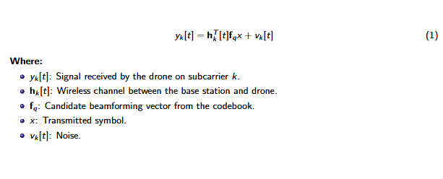
Key Equations
1. Received Signal

Slide 8
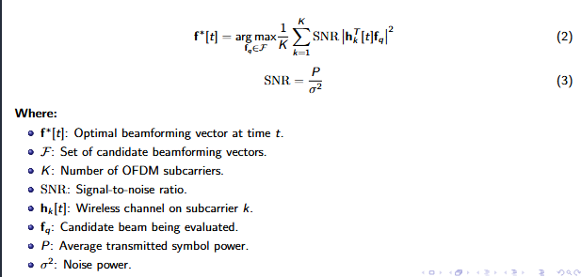
Key Equations
2. Optimal Beam Selection

Slide 9
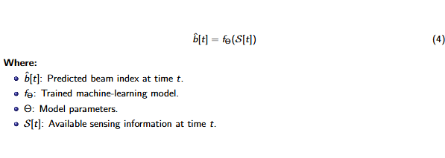
Key Equations
4. Sensing-Aided Beam Prediction

Slide 10
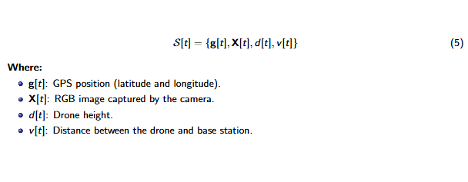
Key Equations
5. Sensing Input

Slide 11
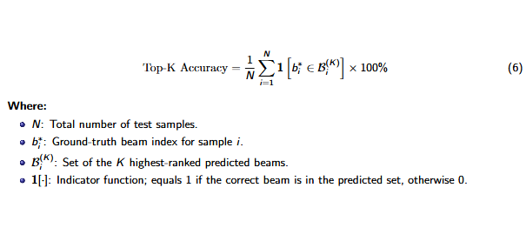
Key Equations
6. Top-K Accuracy

Slide 12
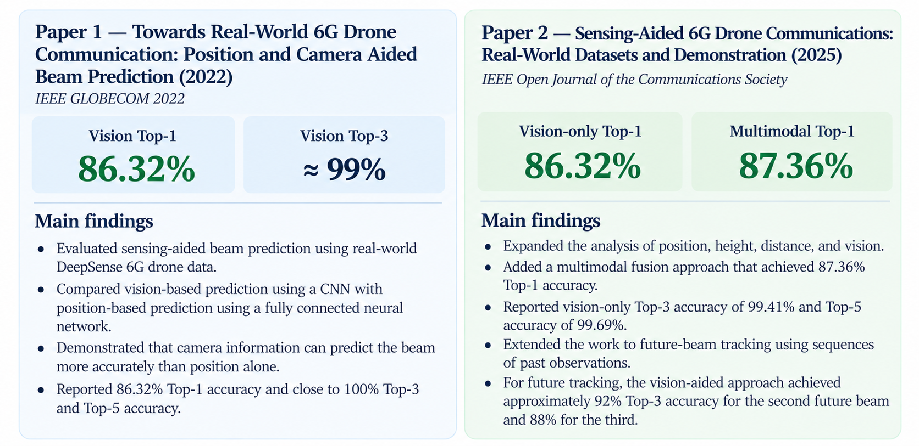
Experimental Results

Slide 13
Experimental Results
Parameter | Base Paper (2022) | Expanded Sensing Paper (2025)
Main objective | Current beam prediction | Current beam prediction and future-beam tracking
Input data | Camera images, GPS, height and distance | Vision, position and additional spatial information
Vision model | CNN-based model | ResNet-50-based model
Position model | Fully connected neural network | Position-based neural networks
Multimodal fusion | Separate vision- and position-aided approaches | Combines vision and position information
Vision Top-1 accuracy | 86.32% | 86.32%
Multimodal Top-1 accuracy | No equivalent fused result reported | 87.36%
Main contribution | Demonstrates real-world sensing-aided beam prediction | Extends multimodal prediction and evaluates future-beam tracking

Slide 14
OBJECTIVES
Develop a temporal multimodal model using camera, GPS, height, distance, speed, and orientation data for UAV beam prediction.
Implement reliability-aware sensor fusion to dynamically utilize the most reliable sensing modality under varying flight conditions.
Evaluate beam prediction performance under different UAV speeds, altitudes, and sensing conditions using real-world DeepSense 6G data.
Reduce beam-training overhead while evaluating prediction accuracy, received-power loss, and computational efficiency.

Slide 15
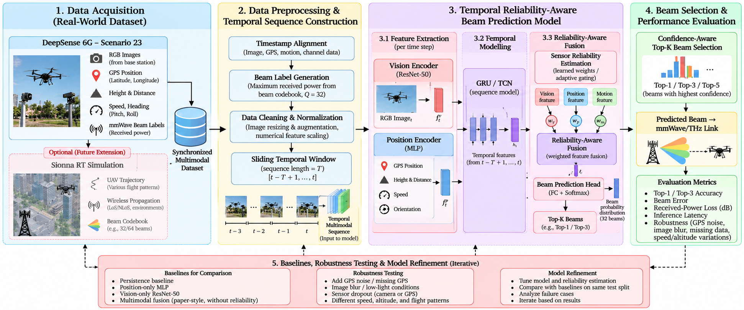
METHODOLOGY

Slide 16
PROPOSED METHODOLOGY UPDATE
1. Forecast the next beam
2. Use both sensing streams
Use the last 8 synchronized samples to predict the next logged beam (about 142 ms median ahead). This makes the task a real forecast instead of reproducing the final input label.
Fuse RGB frames with all 11 telemetry features. Fit scaling on training sequences only; keep the existing sequence-level train / validation / test split.
3. Model reliability over time
4. Make beam changes count
Use a frozen ResNet-50 frame encoder, sensor MLP, learned visual-versus-sensor gate, and GRU. Add modality dropout. Remove horizontal flips unless beam labels are remapped.
Estimate whether the beam will change, then combine the previous-beam prior with the learned next-beam distribution. Tune this combination on validation data only.
TEST THE SAME FUTURE WINDOWS
Compare with persistence: top-1 / top-3 / top-5, macro-F1, received-power regret, inference latency, and accuracy by flight condition.
Existing project test results: persistence top-1 68.54%; static multimodal top-1 47.20%. Proposed model score: pending a fresh run.

Slide 17
REFERENCES
[1] G. Charan, A. Hredzak, C. Stoddard, B. Berrey, M. Seth, H. Nunez, and A. Alkhateeb, "Towards real-world 6G drone communication: Position and camera aided beam prediction," in Proc. IEEE Global Communications Conference (GLOBECOM), 2022, pp. 1–6.
[2] L. Bariah, L. Mohjazi, S. Muhaidat, P. C. Sofotasios, G. K. Kurt, H. Yanikomeroglu, and O. A. Dobre, "A prospective look: Key enabling technologies, applications and open research topics in 6G networks," IEEE Access, vol. 8, pp. 174792–174820, 2020.
[3] T. S. Rappaport, Y. Xing, O. Kanhere, S. Ju, A. Madanayake, S. Mandal, A. Alkhateeb, and G. C. Trichopoulos, "Wireless communications and applications above 100 GHz: Opportunities and challenges for 6G and beyond," IEEE Access, vol. 7, pp. 78729–78757, 2019.
[4] S. Hur, T. Kim, D. J. Love, J. V. Krogmeier, T. A. Thomas, and A. Ghosh, "Multilevel millimeter wave beamforming for wireless backhaul," in Proc. IEEE GLOBECOM Workshops (GC Wkshps), Houston, TX, USA, 2011, pp. 253–257.
[5] A. Alkhateeb, O. El Ayach, G. Leus, and R. W. Heath, "Channel estimation and hybrid precoding for millimeter wave cellular systems," IEEE J. Sel. Topics Signal Process., vol. 8, no. 5, pp. 831–846, Oct. 2014.
[6] S. Jayaprakasam, X. Ma, J. W. Choi, and S. Kim, "Robust beam-tracking for mmWave mobile communications," IEEE Commun. Lett., vol. 21, no. 12, pp. 2654–2657, Dec. 2017.
[7] A. Alkhateeb, S. Alex, P. Varkey, Y. Li, Q. Qu, and D. Tujkovic, "Deep learning coordinated beamforming for highly-mobile millimeter wave systems," IEEE Access, vol. 6, pp. 37328–37348, 2018.
[8] M. S. Khan, Q. Sultan, and Y. S. Cho, "Position and machine learning-aided beam prediction and selection technique in millimeter-wave cellular system," in Proc. Int. Conf. Inf. Commun. Technol. Converg. (ICTC), 2020, pp. 603–605.
[9] M. Alrabeiah, A. Hredzak, and A. Alkhateeb, "Millimeter wave base stations with cameras: Vision-aided beam and blockage prediction," in Proc. IEEE 91st Veh. Technol. Conf. (VTC2020-Spring), 2020, pp. 1–5.
[10] Y. Wang, M. Narasimha, and R. W. Heath, "MmWave beam prediction with situational awareness: A machine learning approach," in Proc. IEEE 19th Int. Workshop Signal Process. Adv. Wireless Commun. (SPAWC), 2018, pp. 1–5.

