Slide 1


SRI RAMAKRISHNA ENGINEERING COLLEGE
[Educational Service : SNR Sons Charitable Trust]
[Autonomous Institution, Reaccredited by NAAC with ‘A+’ Grade
][Approved by AICTE and Permanently Affiliated to Anna University, Chennai] [ISO 9001:2015 Certified and all eligible programmes Accredited by NBA] VATTAMALAIPALAYAM, N.G.G.O. COLONY POST,COIMBATORE 641 022
DEPARTMENT OF INFORMATION TECHNOLOGY
Emotion Identification using Audio files
PROJECT MEMBERS: |  | PROJECT GUIDE:
V.GOKUL | (1905027) | Mrs. N.Saranya,
R.GOKUL PRASANTH | (1905028) | Assistant Professor(Sl.G)
M.KISSORE KUMAR | (1905040) | Department of Information Technology

Slide 2
AGENDA
INTRODUCTION
LITERATURE SURVEY
PROBLEM DEFINITION
OBJECTIVES
PROPOSED SYSTEM
BLOCK DIAGRAM
MODULES
SOFTWARE REQUIREMENTS
RESULTS
CONCLUSION
REFERENCE

Slide 3
INTRODUCTION
Emotion identification is a field of study that aims to develop algorithms and systems that can
automatically identify the emotions conveyed by a speaker's voice.
This application has a wide range of applications such as human computer interaction, voice-
controlled devices and speech therapy.
Emotion can play an important role in decision making. If emotion can be recognized properly then
a system can act accordingly.

Slide 4
LITERATURE SURVEY
TITLE | AUTHOR | YEAR | METHODOLOGY
Speech Emotion Recognition by utilizing speech signals | Narayan | 2020 | Domain specific recognition by utilizing speech signals from call centre application. Detecting negative and non-negative emotion are the main focus of this research.
Speech Emotion Recognition using Random forest to trees method | Rong et al | 2017 | Presented an ensemble random forest to trees method with a high number of features for emotion recognition without referring any linguistic information remains an unclosed problem. This method is applied on small size of data with high number of features.
Identifying emotions by representing hierarchical computational structure | Lee et al | 2011 | It represent a hierarchical computational structure to identify emotions. The main concept of different level in tree is to solve the classification task in easiest way

Slide 5
PROBLEM STATEMENT
To identify the type of emotion from user’s speech. The user has to upload the audio file and based on the emotion expressed in the audio the algorithm will do the prediction.

Slide 6
OBJECTIVES
To develop a system that can accurately classify emotions such as happiness, sadness, anger, and neutral.
To build a model to recognize emotion from speech using librosa , sklearn library etc.
To develop a web application that gets audio file as input and type of emotion as output.

Slide 7
PROPOSED SYSTEM
In this project, MFCC(Mel frequency cepstral coefficients) has been used as the feature for classifying the speech data
into various emotion categories employing artificial neural networks.
The usage of the Neural Networks provides us the advantage of classifying many different types of emotions in a variable length of audio signal in a real time environment.
The performance of the model will be evaluated using metrics.
This technique manages to establish a good balance between computational volume and performance accuracy of the real-time processes.

Slide 8
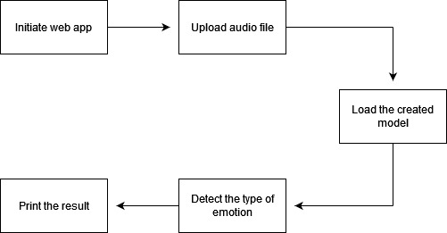
BLOCK DIAGRAM

Slide 9
MODULES
Preprocess the dataset
Preprocess the dataset using the librosa library
Build the model
Build the model using the Multi Layer Perceptron neural network
Model integration
The model is then integrated with the web using the python flask framework
Print the results
Find the type of emotion expressed in the audio and print the results in the web app screen

Slide 10


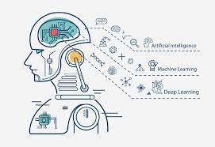
SOFTWARE REQUIREMENTS
Python flask
Machine Learning
HTML,CSS and JS

Slide 11
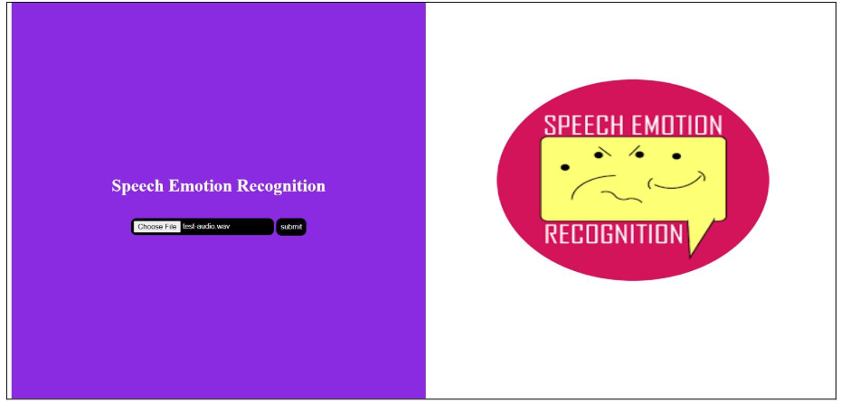
RESULTS

Slide 12

RESULTS

Slide 13
CONCLUSION
Multilayer Perceptron and librosa has been used for emotion detection through speech.
The proposed system detects the type of emotions in the audio uploaded.
The proposed system can be embedded inside a web application to provide the type of emotion in the audio uploaded.
The proposed system can be enhanced by adding multiple audio inputs.

Slide 14
REFERENCE
[1] Rong et al., (2017), ‘Speech emotion recognition methods’, AIP Conference Proceedings. [2] Narayan, (2020), ‘Speech Emotion Recognition using Support Vector Machine’, Scholar, volume 1 [3] Lee et al., (2011), ‘Emotion recognition using a hierarchical binary decision tree approach’ Research Gate, volume 53 [4] L. Chen et al., (2012) “Speech emotion recognition: Features and classification models,” Digit. Signal Process., vol. 22, no. 6, pp. 1154–1160 [5] T. L. Nwe et al., (2003), “Speech emotion recognition using hidden Markov models,” Speech Commun., vol. 41, no. 4, pp. 603–623

Slide 15
THANK YOU

