Slide 1

CENTRAL RESERVATION SYSTEM
By TECH SPARTANS

Slide 2
SYNOPSIS
Introduction to CRS
Why CRS ?..
How CRS is Implemented
Keyfeatures of CRS
Advantages of CRS
Case study on Pegasus CRS system
Limitations to Overcome
Our Approach towards CRS and Plans of Implementation
Technology

Slide 3
INTRODUCTION TO CRS
A Central Reservation System, or CRS, is a technology that lies at the heart of a hotel’s functions. It’s a computerized system that contains the hotel’s availability, rates, and inventory (ARI) data and helps manage online and offline bookings. With the help of the channel manager that we discuss below, it distributes the hotel information to various sales channels — such as GDSs, OTAs, independent travel agents, and its own website, — synchronizes reservations, and processes transactions.

Slide 4

WHY CRS?...
Reasons to use CRS
Open your hotel to Million guests.
Get full Control of your inventory booking.
Increase your hotel revenue
Helps on your case study

Slide 5
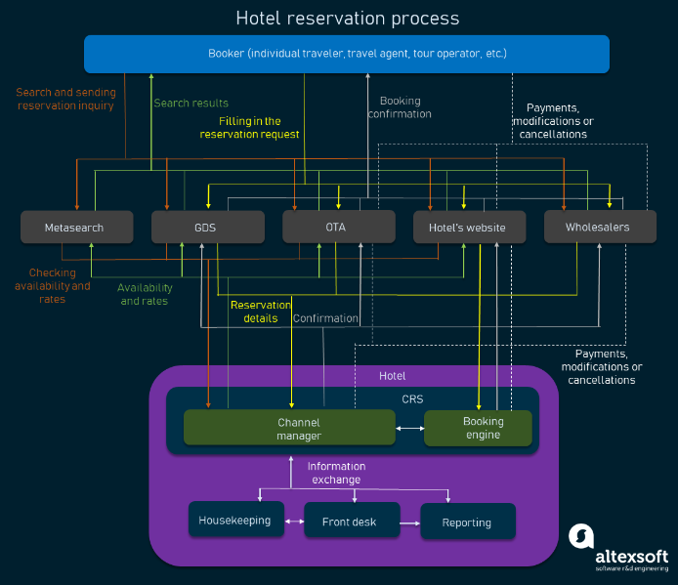
HOW CRS IS IMPLEMENTED

Slide 6
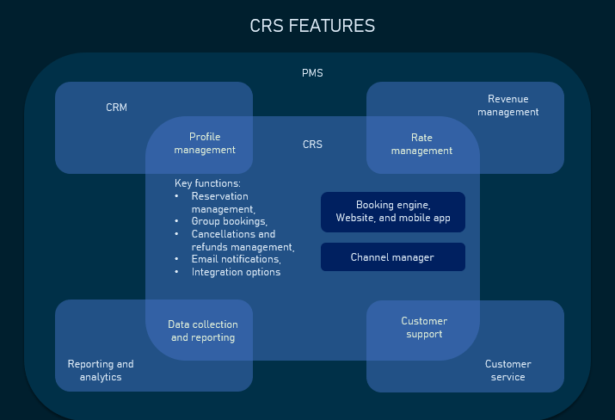
KEY FEATURES OF CRS
Reservations management and synchronization
Email notifications
Group bookings
Cancellations and refund management
Integration options

Slide 7
ADVANTAGES OF CRS
Better customer relationship
Synchronization of information
Increases flexibility and efficiency
Saves time and money
Keeping track of reservations
Ease of use and secure payment

Slide 8
CASE STUDY ON PEGASUS CRS
In 2019, Pegasus merged with Travel Tripper, bringing the two companies’ industry-leading solutions into one platform and enhancing service and support across its global customer base. Hotels will now benefit from the innovative cloud-based solutions that Travel Tripper has advanced in reservations and e-commerce, in addition to the highly successful global sales program and powerful new business intelligence platform developed by Pegasus. All of that is backed by our five-star dedicated account service and 24/7 support across our global customer base of 120 countries and counting.

Slide 9
LIMITATIONS TO OVERCOME
Influx of new customers.
Not all online booking systems are created equal.
Avoid booking systems that don’t bring you new quality customers.

Slide 10
OUR APPROACH AND PLANS TOWARDS CRS
1. User stories (Description of application from user perspective)
2. Features of the application
3. Flowchart
4. Architecture
5. Development step

Slide 11

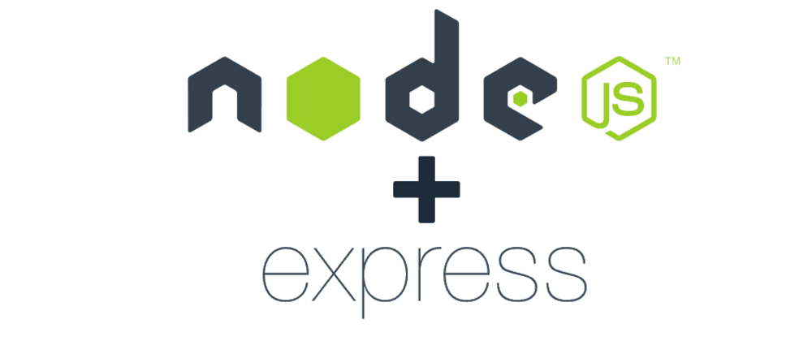


TECHNOLOGY
Frontend:
React Js with Material UI
Backend
NodeJs with Express Js
Database
MongoDB with Mongoose
Cloud Service
AWS Essentials

Slide 12


Slide 13


