Slide 1

Identifying Insurance Claim Frauds Detection using Machine Learning Technique
TEAM MEMBERS:
P. Gokul (412321104012)
M. Gokul Singh
(412321104013)
B. Gunasekar (412321104015)
B. Jayaraman
(412321104025)
GUIDED BY
K. Lakshmi M.E. Asst.Prof.
Sri Ramanujar Engineering College, Kolapakkam, Vandalur ,
Chennnai – 600127.

Slide 2

ABSTRACT
This project focuses on detecting fraudulent insurance claims using machine learning techniques. Fraudulent claims, particularly in the auto insurance sector through fake accident reports, pose significant financial risks. To address this, we utilize an insurance claim dataset and implement various machine learning algorithms using PySpark to classify and label suspicious claims. The project also includes a comparative analysis of the models based on performance metrics such as accuracy, precision, recall, and confusion matrix.

Slide 3
INTRODUCTION
Vehicle insurance fraud, particularly fake accident claims, is one of the most common and costly types of fraud.
Fraudulent claims lead to significant financial losses for insurers.
Manually investigating each claim is time-consuming, expensive, and not scalable due to the high volume of daily claims.
Machine learning offers a powerful solution by analyzing data to accurately classify claims as genuine or fraudulent.
This project focuses on applying machine learning techniques to detect vehicle insurance fraud effectively.

Slide 4
OBJECTIVE OF THE PROJECT
To creating a model that can accurately anticipate which transactions
might be fraudulent.
To build a classification methodology using machine learning technique to determine whether a customer is placing a fraudulent insurance claim by using historical data
To determine if a claim for insurance is legitimate or not.
To assess the effectiveness of the fraud detection algorithm

Slide 5
PROBLEM STATEMENT
It's hard to understand how different factors (like location, customer type, and sales process) affect fraud, as they don’t always follow a clear pattern.
Current methods use only a limited number of known rules and ignore
other useful information.
The model needs to be updated manually from time to time to keep up with changing fraud behaviors, which is slow and difficult.
Fraud cases are very rare (less than 1% of total claims), making them
hard to detect.

Slide 6
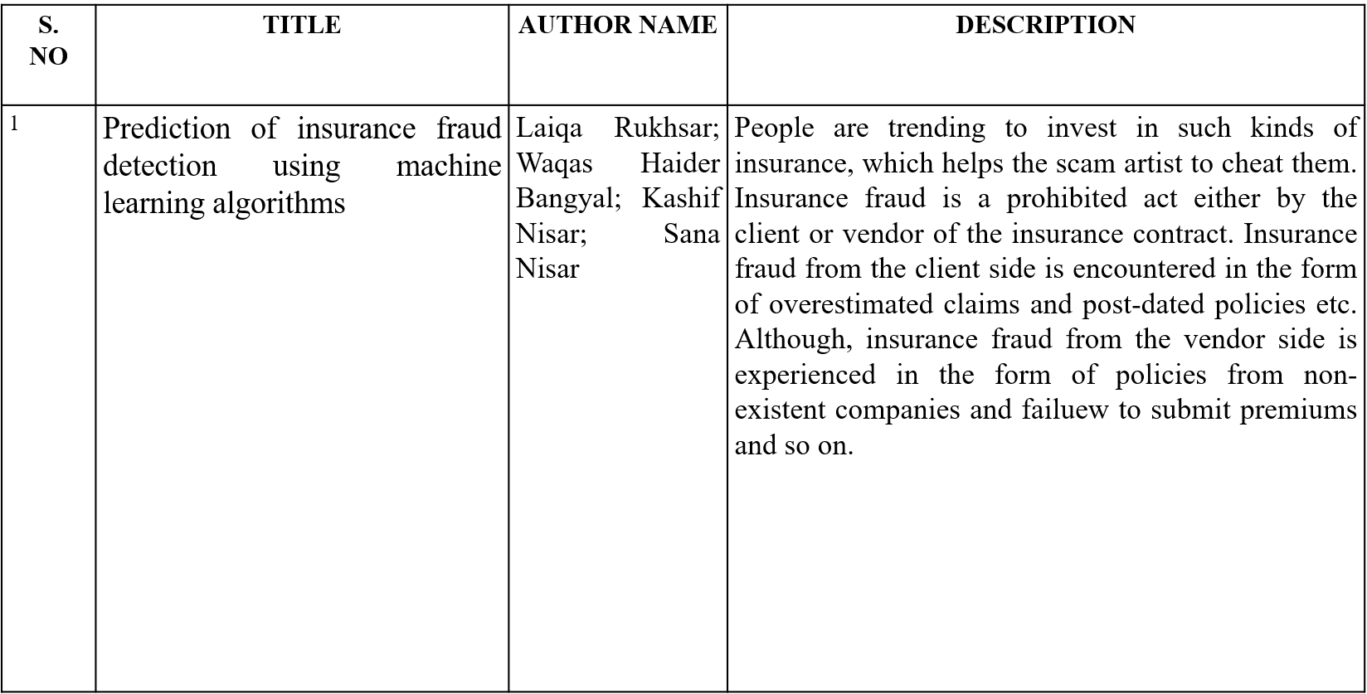
LITERATURE REVIEW

Slide 7
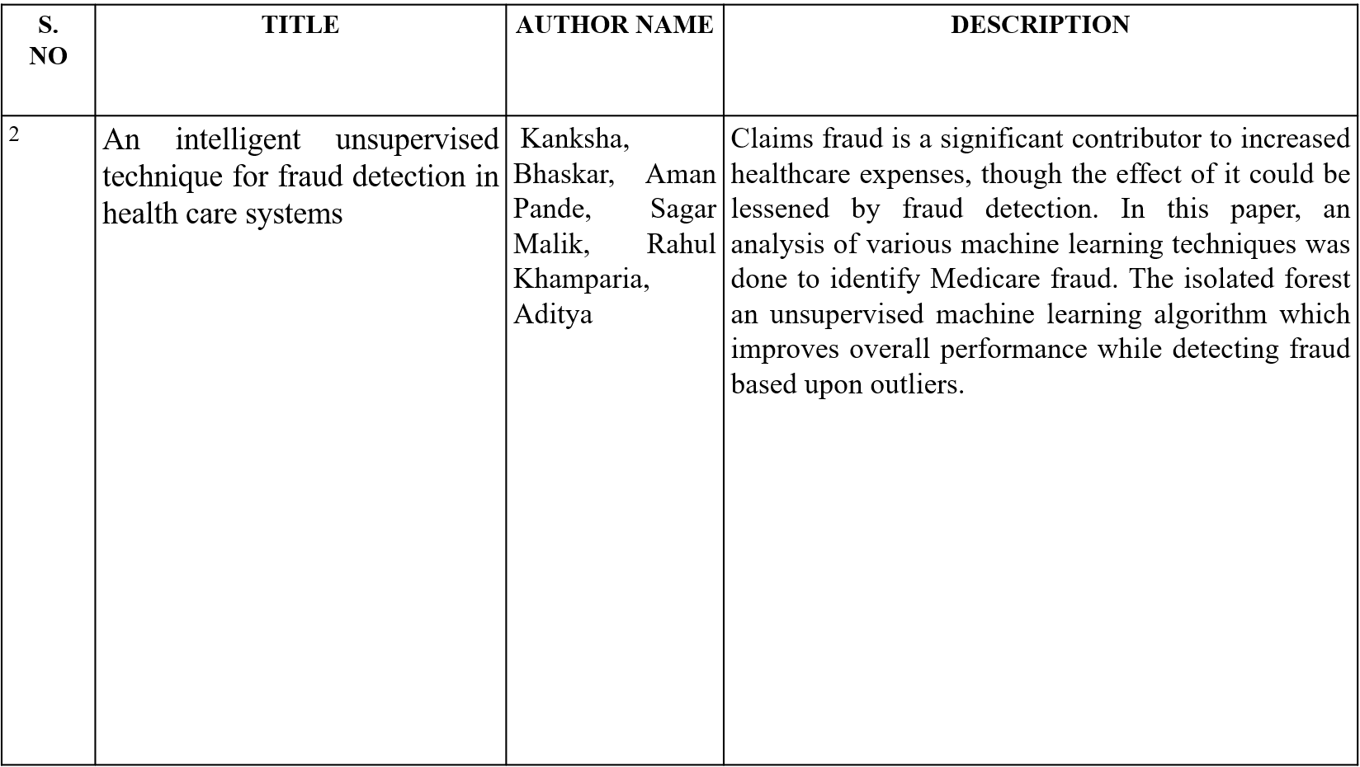

Slide 8
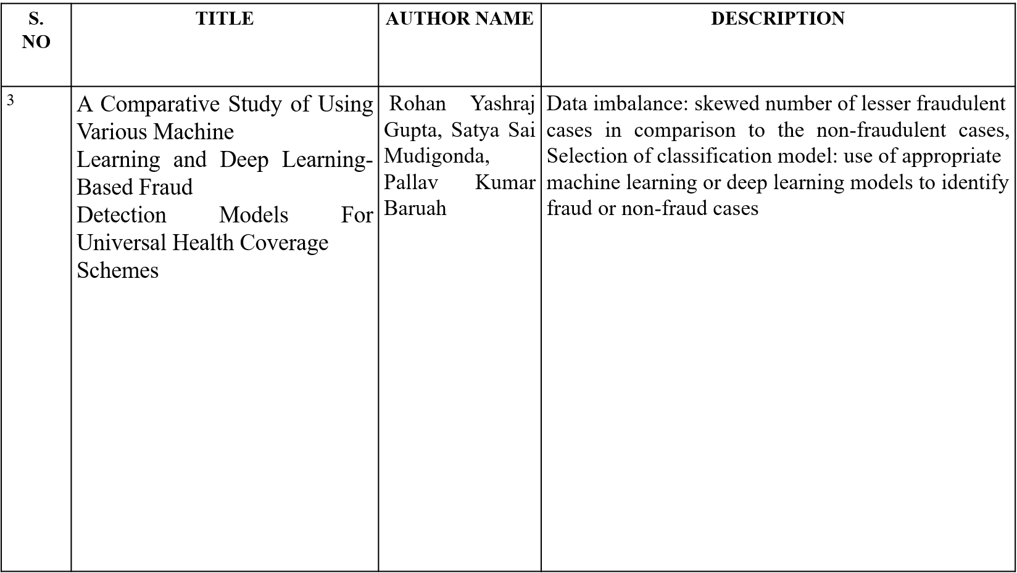
,

Slide 9
EXISTING WORK
Insurance fraud is increasing, as more people invest in insurance, creating opportunities for scammers.
Fraud by clients includes fake or overstated claims and using policies with false dates.
Recent advances in data processing and machine learning have improved fraud detection.
Data mining helps analyze large datasets to find useful insights.
Machine learning focuses on identifying patterns in data and improving decision-making processes.

Slide 10
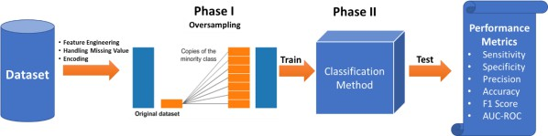
EXISTING BLOCK ARCHITECTURE

Slide 11
PROPOSED WORK
The dataset is collected, cleaned, and preprocessed before applying machine learning models.
Feature engineering is done to improve model performance and re-evaluated
based on results.
A prediction model is used to classify whether an insurance claim is fraudulent or not.
The system’s performance is evaluated using Precision, Recall, and F1-Score. Among all tested models, Decision Tree (DT) achieved the highest accuracy.

Slide 12


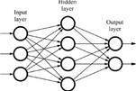

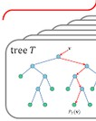

PROPOSED SYSTEM ARCHITECTURE
Input Dataset
Feature Selection
Classifiers
Evaluation
Fraud Claim
RF
Data set Collection
Feature Set
Classifiers
LR
No Fraud Claim

Slide 13
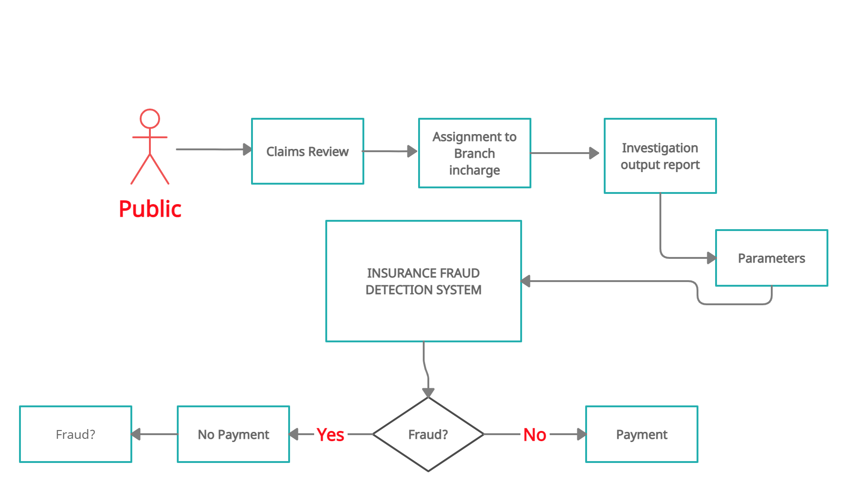
OVERALL SYSTEM FLOW

Slide 14
METHODOLOGY
Machine learning algorithms required for this project
Random Forest Logistic Regression

Slide 15
ALGORITHM / MODEL USED
Random Forest selects random features and samples rows to build multiple decision trees.
The number of trees is set using hyperparameter tuning.
For classification, the final output is based on the majority vote from all trees.
It is a widely used and effective algorithm, commonly applied in real-world
applications and Kaggle competitions.

Slide 16
ALGORITHM / MODEL USED
Logistic Regression uses the sigmoid function to predict probabilities.
It classifies the output (dependent variable) based on these probabilities.
Commonly used for binary classification problems.

Slide 17
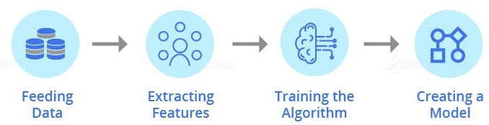
MODULES
Training Module
Data Collection Data pre-processing Model Training
Testing Module
Login Prediction
Deployment in Cloud

Slide 18
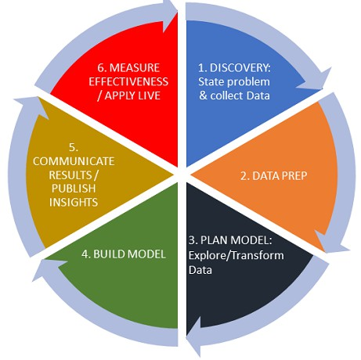
TRAINING MODULE
Data Collection & Validation
Data Pre-processing Model Training.
Login Prediction
Deployment in cloud platform as webapp

Slide 19
SYSTEM REQUIREMENTS
The requirement specification is a technical specification of requirements for the software
products. It is the first step in the requirements analysis process it lists the requirements of a particular software system including functional, performance and security requirements. The requirements also provide usage scenarios from a user, an operational and an administrative perspective.
HARDWARE REQUIREMENTS:
System : Pentium i3 Processor. Hard Disk : 500 GB.
Monitor : 15’’ LED
Input Devices : Keyboard, Mouse Ram : 4 GB
SOFTWARE REQUIREMENTS:
Operating system : Windows 10. Coding Language : Python 3.8 Web Framework : Flask

Slide 20




Proposed Block Diagram
Dataset
Data
Test
Pre-processing
Test
Model Classification
Fraud detection

Slide 21



Use Case Diagram
Data Collection
User
Pre-Processing
Fraud Claim
Insurance Fraud detection
No Fraud Claim

Slide 22
DFD Level – 1 Diagram
Login Page
Fraud Claim
Dataset Collection
Classification
Evaluation
No Fraud Claim
Signup Page

Slide 23

MODULES IMPLEMENTED

Slide 24
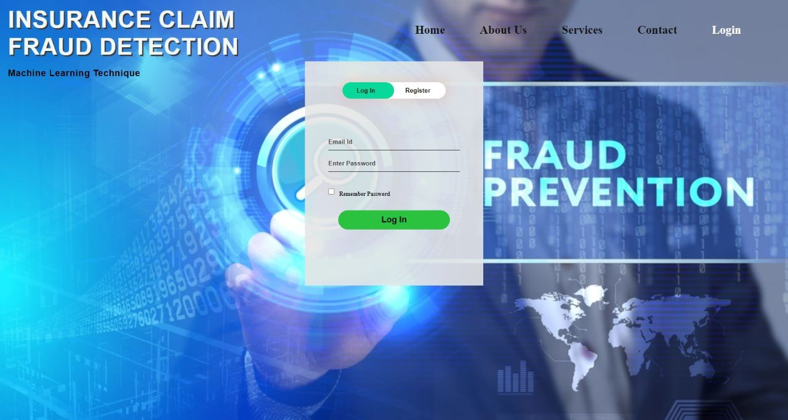
MODULES IMPLEMENTED

Slide 25
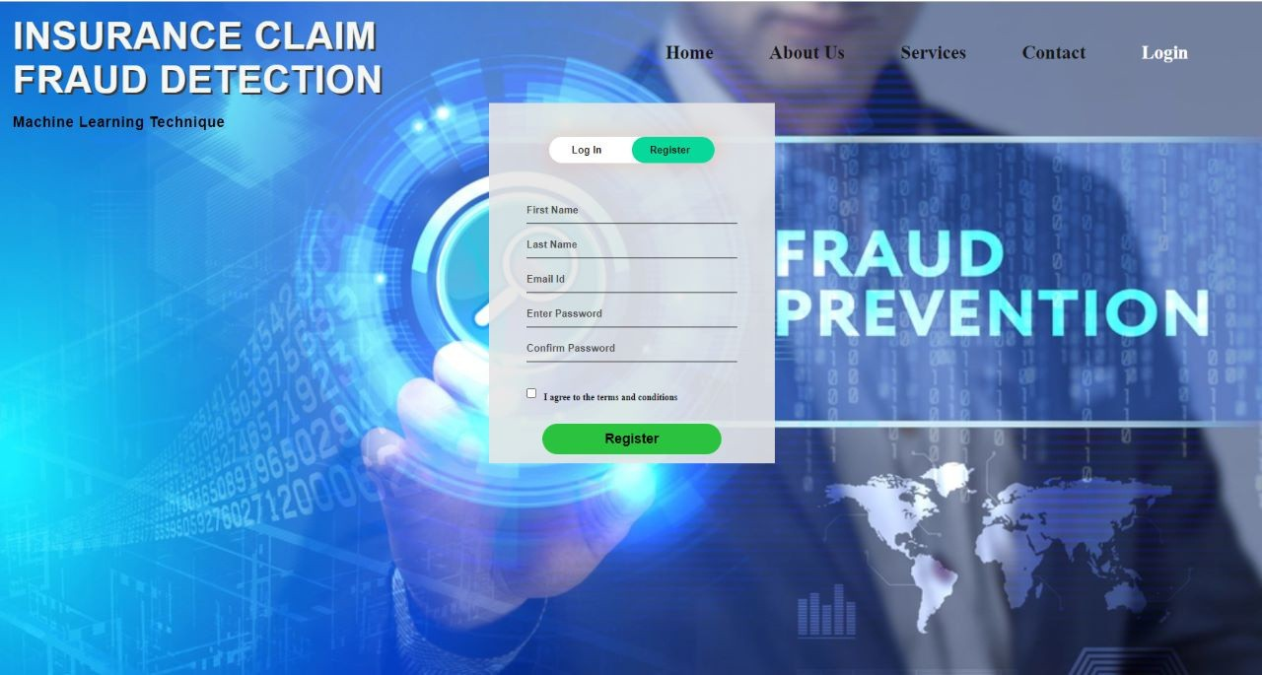
MODULES IMPLEMENTED

Slide 26
REFERENCES
Bhaskar A, Pande S, Malik R, Khamparia A. An intelligent unsupervised technique for fraud detection in health care systems. Intelligent Decision Technologies. 2021 Jan 1; 15(1):127-39.
Sathya M, Balakumar B. Insurance Fraud Detection Using Novel Machine Learning Technique. International Journal of Intelligent Systems and Applications in Engineering. 2022 Oct 1; 10(3):374- 81.
Rukhsar L, Bangyal WH, Nisar K, Nisar S. Prediction of insurance fraud detection using machine learning algorithms. Mehran University Research Journal of Engineering & Technology. 2022 Jan 1; 41(1):33-40.
Zhou X, Cheng S, Zhu M, Guo C, Zhou S, Xu P, Xue Z, Zhang W. A state of the art survey of data mining-based fraud detection and credit scoring. InMATEC Web of Conferences 2018 (Vol. 189, p. 03002). EDP Sciences.
Asgarian A, Saha R, Jakubovitz D, Peyre J. AutoFraudNet: A Multimodal Network to Detect Fraud in the Auto Insurance Industry. arXiv preprint arXiv:2301.07526. 2023 Jan 15.

Slide 27
Thank You

