Slide 1

Welcome

Slide 2
Diagnosis of Chronic Kidney and Liver Disease using Machine Learning with Hybrid Feature Selection
Project Members:
Abid Bin Ahosan¹, Forhadul Islam Shakil¹, Tania Sultana¹, Babu¹, Golam Masum¹
Supervised by: Khandaker Mohammad Mohi Uddin¹
¹Department of Computer Science and Engineering, Dhaka International University, Dhaka-1205, Bangladesh

Slide 3
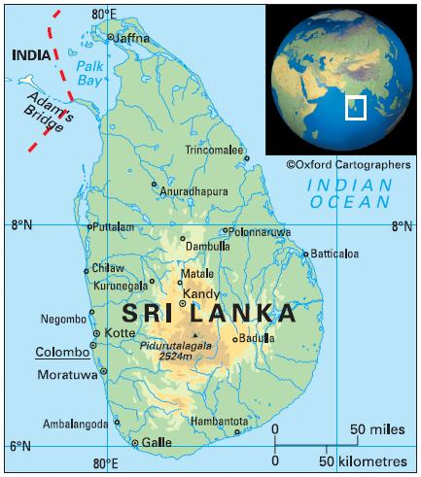
Table of Content
Problem statement
Objective
Related works
Contributions
Dataset
Proposed Method
Combine Feature Selection
Result and Discussion
Web Application
Conclusion
2/19/2024
3

Slide 4
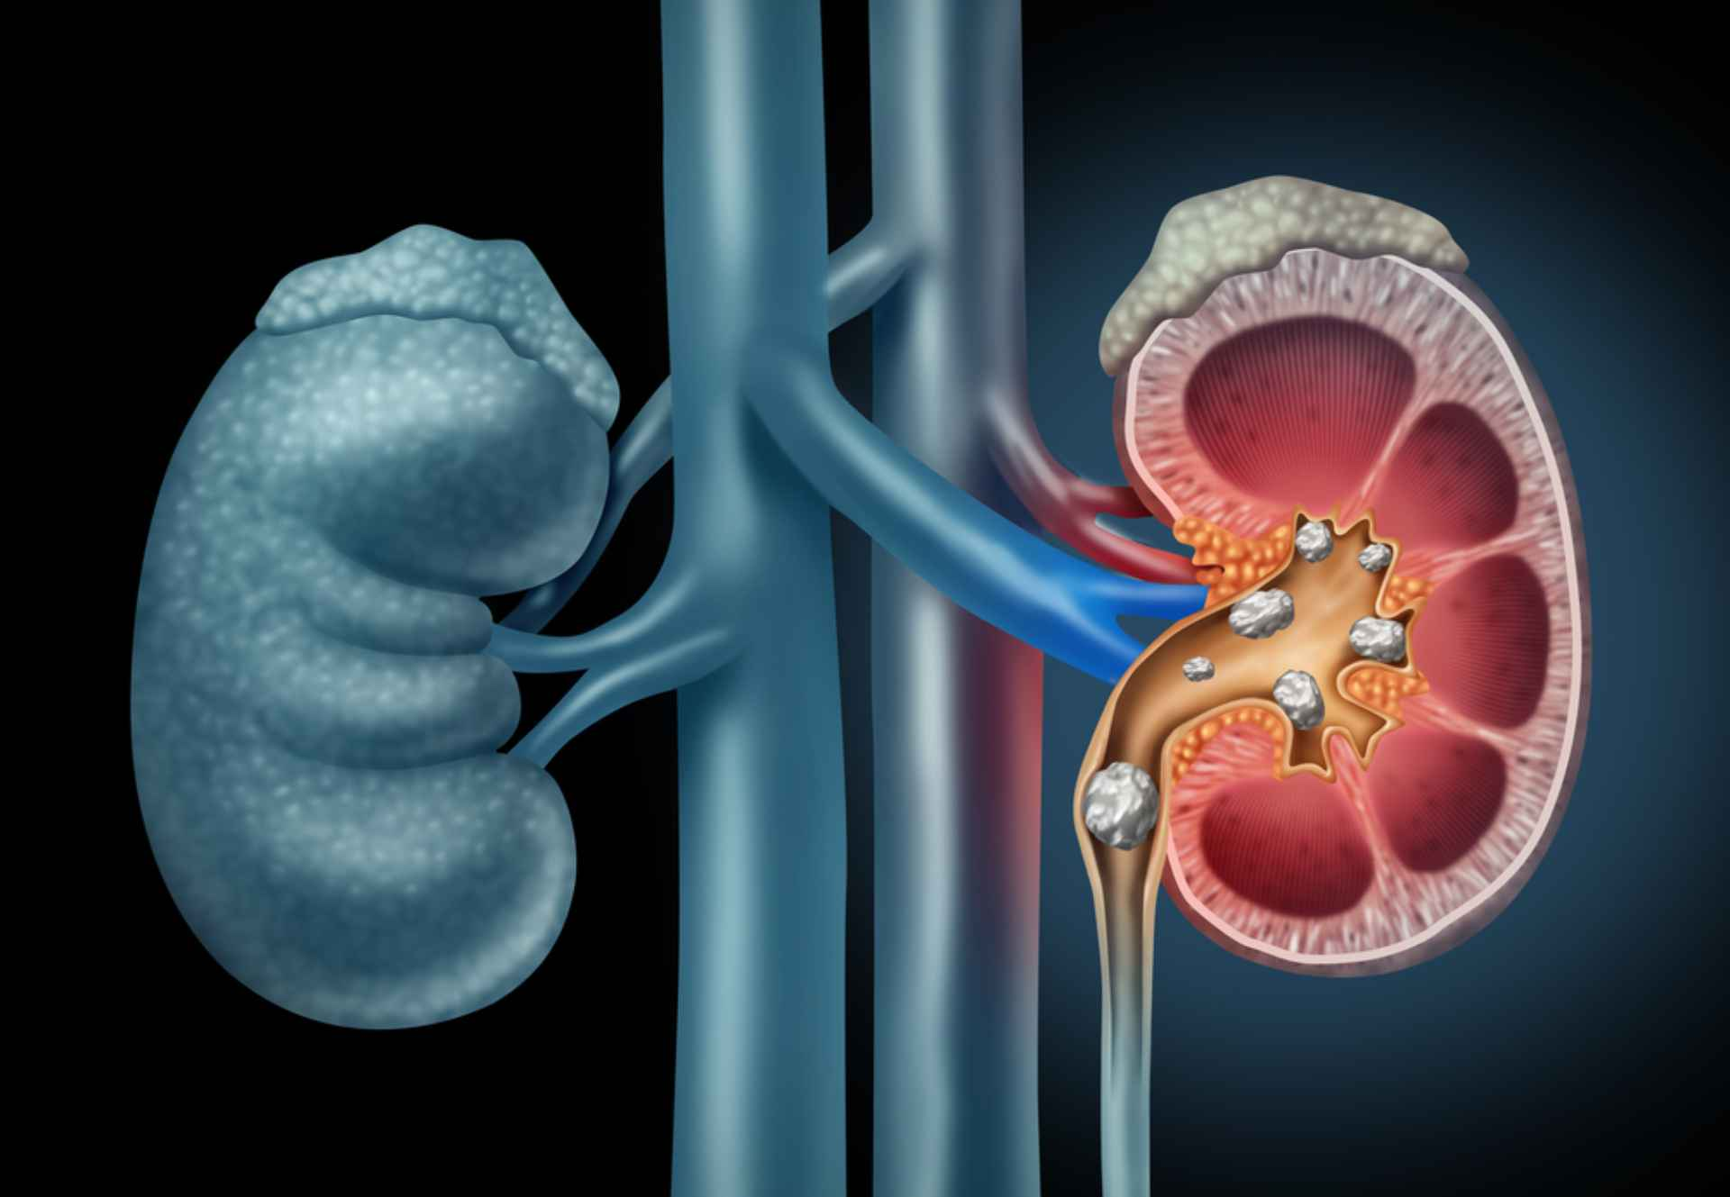
Problem Statement
Chronic Kidney Disease (CKD) is a progressive irreversible condition characterized by either a reduction in kidney function or kidney damage as a result of any cause that is present for more than three months.
Fig. 1. Kidney

Slide 5
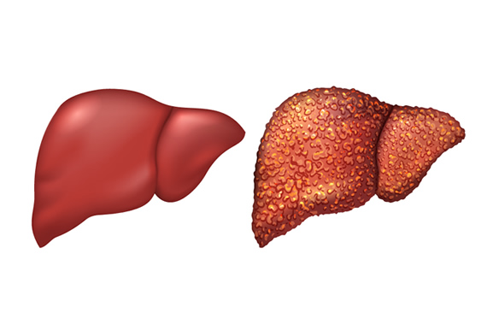
Problem Statement
Liver disease (LD) refers to a broad range of conditions affecting the liver, including inflammation, cirrhosis, and liver failure, often resulting from various factors such as infections, alcohol consumption, or metabolic disorders.
Fig. 2. Liver
2/19/2024
5

Slide 6
Objective
Increase Awareness.
Early Detection and Screening.
Promote Healthy Lifestyle Practices.
Improve Access to Healthcare.
Enhance Patient Education.
Collaborate with Healthcare Providers.

Slide 7
Related works (CKD)
J. Qin et al.[1] developed data assertion and a sample diagnostic. KNN is used for data assertion, 2020.
Silveira et al.[2] created a CKD prediction approach using a variety of resampling methods and ML algorithms. The synthetic minority oversampling technique (SMOTE), 2022.
Ebiaredoh-Mienye et al.[3] approach for improved medical diagnosis utilizing an enhanced sparse autoencoder (SAE) network with a soft max layer, 2020.
Yashfi, S.Y. et al.[4] proposed a technique for CKD risk prediction using data on 455 patients from the UCI Machine Learning repositor and the real time dataset from Khulna city medical college, 2020.
Almansour et al.[5] were proposed to diagnose CKD at an early stage using ANN, 2019.

Slide 8
Related works (CKD)
Kim et al. [6] have proposed a genetic algorithm (GA) based on Neural Networks (NN) for the diagnosis of CKD, 2021.
Sara et al. [7] employed two techniques, such as Hybrid Wrapper and Filter-Based FS (HWFFS) and Feature Selection (FS), to significantly select the features associated with CKD and reduce the dimensionality of the dataset, 2018.
Rady et al. [8] proposed a technique for diagnosis a dataset for CKD using PNN, MPL, 2019.
Polat et al. [9] employed the SVM approach to predict CKD with a two-approach wrapper and filter, 2017.
P. Ghosh et al. [10] used a reliable dataset and the assessment process of a ML system could identify this illness considerably more quickly with Linear Discriminant Analysis (LDA), 2020.
2/19/2024
8

Slide 9
Related works (LD)
A. Sokoliuk et al. [11] identified the Gradient Tree Boosting classifier as the most effective on a balanced dataset, 2020.
M. Azam et al. [12] explored the performance of KNN with feature selection techniques (KNNWFST), 2020.
A. Srivastava et al. [13] and R. Choudhary et al. [14] both advocated for the Logistic Regression (LR) model, 2021-2022.
C. Geetha et al. [15] highlighted that the Support Vector Machine (SVM), 2021.
G. Gajendran et al. [16] proposed a hybrid ML model named Mathematical Approach on Multilayer Feedforward Neural Network with Backpropagation (MAMFFN), 2020.
E. Dritsas et al. [17] introduced a voting classifier in their project, 2023.
2/19/2024
2/19/2024
9
9

Slide 10
Contributions (CKD)
Handling missing values.
Synthetic Minority Oversampling Technique (SMOTE).
Combined features selection approach.
Used 10 different machine learning algorithms.
Obtained highest accuracy of 99.19%
2/19/2024
10
2/19/2024
10

Slide 11
Contributions (LD)
Handling duplicate rows and missing values.
Synthetic Minority Oversampling Technique (SMOTE).
Used Pearson Correlation matrix feature selection approach.
Used 10 different machine learning algorithms.
Ensemble machine learning technique the LGBM classifier, performed better in terms of accuracy when compared to published works that used use of the same dataset.
2/19/2024
2/19/2024
11
11
2/19/2024
11

Slide 12
Dataset
The University of California, Irvine Machine Learning Repository [18] provided the CKD dataset used in this study, which contained information on 400 patients with CKD. The dataset of Indian Liver Patients' Records served as the foundation for LD [19] contains 583 participants in this particular dataset.
2/19/2024
12

Slide 13
General overview of the CKD dataset
Dataset Characteristics | Multivariate
Attribute Characteristics | Real
The number of features (Col in general) | 26
Number of instances | 400
Number of features with numeric values | 14
Number of categorical features | 12
Target column name | Classification
Instances are classified as | CKD/Not CKD
Number of classes defined as CKD | 250
Number of classes defined as NOT CKD | 150
Data source | UCI ML Repo
Table 1

Slide 14
General overview of the LD dataset
Dataset Characteristics | Multivariate
Attribute Characteristics | Real
The number of features (Col in general) | 11
Number of instances | 583
Number of features with numeric values | 10
Number of categorical features | 11
Target column name | Dataset
Instances are classified as | 1/2
Number of classes defined as LD | 416
Number of classes defined as NOT LD | 167
Data source | UCI ML Repo
Table 2

Slide 15
Data Processing
Handled if duplicate rows found.
The missing data are handled using the fillna approach.
Lebel Encoding method has been applied for converting value from string to numerical.
Handle imbalance dataset using SMOTE.
Data scaling in the dataset of LD.
2/19/2024
15

Slide 16
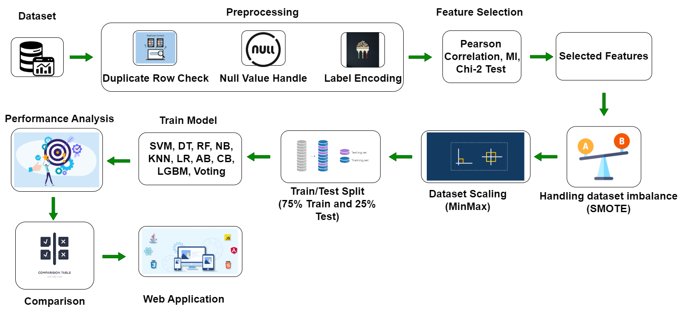
Methodology
2/19/2024
Fig. 3. Combine Workflow of the proposed methodology.
2/19/2024
16

Slide 17

Combine Feature Selection (CKD)
Pearson correlation analysis is conducted, and characteristics that are 80% or higher connected with others are eliminated. Using “SelectPercentaile”, the top 70% of important features were chosen and kept in $ε_{correlation}$ after getting sort by priority using chi2 test and Mutual Information. The characteristics for this investigation were $ε_{correlation}$ = {bp, sg, al, su, bgr, bu, sc, sod, pot, hemo, rc, htn, dm, appet, and pe}.
2/19/2024
2/19/2024
2/19/2024
17
17

Slide 18

Feature Selection (LD)
Pearson correlation analysis is conducted, and characteristics that are 80% or higher connected with others are eliminated. In this process only two features was found whose correlation value was more than 80%. So dropped one of them and kept the remaining important features in $ε_{correlation}$. The characteristics for this investigation were $df = \{ Age, Gender, TB, ALP, SGPT, SGOT, TP, ALB, AGR, Dataset\}$
2/19/2024
2/19/2024
2/19/2024
2/19/2024
18
18
18

Slide 19
Experiment and Result
For experimentation, 75% of the dataset is used for training, and the remaining 25% data used for testing purposes. The AdaBoost classifier produces the maximum accuracy of 99.19% with 100% recall, 99% F1-score, and 99% precision for CKD. The LightGBM classifier produces the maximum accuracy of 83.74% with 85% recall, 81% F1-score, and 78% precision for LD.
2/19/2024
2/19/2024
2/19/2024
19
19

Slide 20

Accuracy Measurement
Four outputs in the confusion matrix assess how well each classifier performs on positive and negative classes independently. False-negative (FN), true negative (TN), false positive (FP), and true positive (TP) are these results. The following formulas assist in determining the ML algorithms' accuracy, precision, recall and F-1 score.
$$AC=\frac{TN+TP}{TN+TP+FN+FP} ×100\%$$
$$P=\frac{TP}{TP+FP} ×100\%$$
$$R=\frac{TP}{TN+TP+FN+FP} ×100\%$$
$$F1 score=2 × \frac{P×R}{P+R} ×100\%$$
2/19/2024
2/19/2024
2/19/2024
2/19/2024
20
20
20

Slide 21
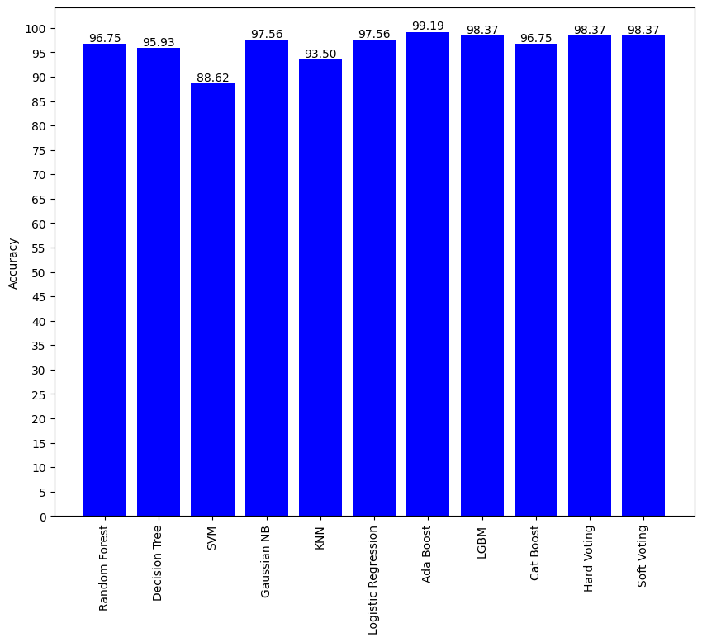
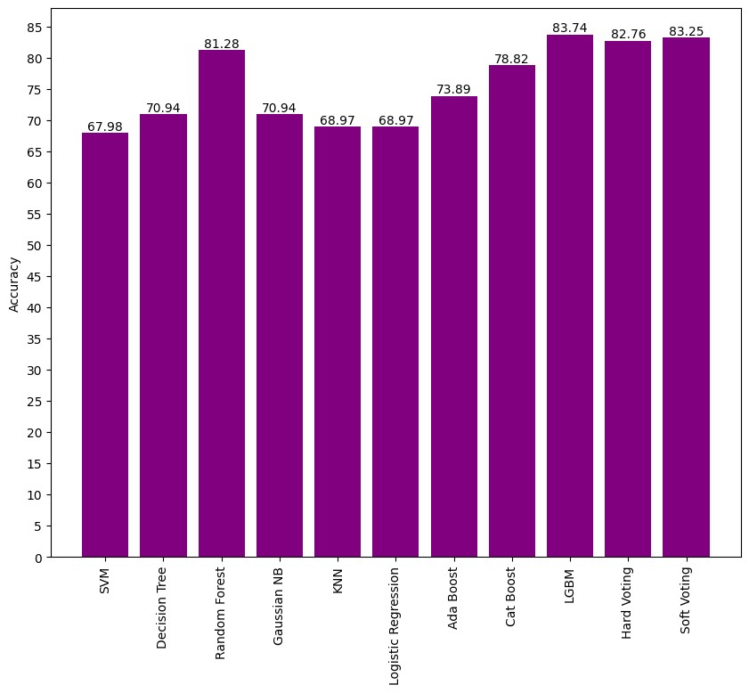

Accuracy of Different ML Classifiers
CKD
LD
Four outputs in the confusion matrix assess how well each classifier performs on positive and negative classes independently. False-negative (FN), true negative (TN), false positive (FP), and true positive (TP) are these results. The following formulas assist in determining the ML algorithms' accuracy, precision, recall F-1 score, and sensitivity.
$$AC=\frac{TN+TP}{TN+TP+FN+FP} ×100\%$$
$$P=\frac{TP}{TP+FP} ×100\%$$
$$R=\frac{TP}{TN+TP+FN+FP} ×100\%$$
$$F1 score=2 × \frac{P×R}{P+R} ×100\%$$
2/19/2024
Fig. 4. Accuracy percentage of ML classifiers.
2/19/2024
2/19/2024
2/19/2024
2/19/2024
21
21
21
21

Slide 22
Accuracy, Precision, Recall and F-1 score of different ML Classifiers (CKD)
Four outputs in the confusion matrix assess how well each classifier performs on positive and negative classes independently. False-negative (FN), true negative (TN), false positive (FP), and true positive (TP) are these results. The following formulas assist in determining the ML algorithms' accuracy, precision, recall F-1 score, and sensitivity.
$$AC=\frac{TN+TP}{TN+TP+FN+FP} ×100\%$$
$$P=\frac{TP}{TP+FP} ×100\%$$
$$R=\frac{TP}{TN+TP+FN+FP} ×100\%$$
$$F1 score=2 × \frac{P×R}{P+R} ×100\%$$
ML Classifier | Accuracy | Precision | Recall | F1-score
Support Vector Machines | 88.62% | 84% | 97% | 90%
Decision Tree Classifier | 95.93% | 97% | 96% | 96%
Random Forest Classifier | 96.75% | 100% | 94% | 97%
Naïve Bayes Classifier | 97.56% | 96% | 100% | 98%
KNN Classifier | 93.50% | 93% | 96% | 94%
Logistic Regression | 97.56% | 97% | 99% | 98%
Ada Boost Classifier | 99.19% | 100% | 99% | 99%
Cat Boost Classifier | 96.75% | 98% | 96% | 97%
LGBM Classifier | 98.37% | 98% | 96% | 97%
Voting Classifier | 98.37% | 99% | 99% | 99%
2/19/2024
2/19/2024
2/19/2024
2/19/2024
2/19/2024
2/19/2024
22
22
22
22
22

Slide 23
Accuracy, Precision, Recall and F-1 score of different ML Classifiers (LD)
Four outputs in the confusion matrix assess how well each classifier performs on positive and negative classes independently. False-negative (FN), true negative (TN), false positive (FP), and true positive (TP) are these results. The following formulas assist in determining the ML algorithms' accuracy, precision, recall F-1 score, and sensitivity.
$$AC=\frac{TN+TP}{TN+TP+FN+FP} ×100\%$$
$$P=\frac{TP}{TP+FP} ×100\%$$
$$R=\frac{TP}{TN+TP+FN+FP} ×100\%$$
$$F1 score=2 × \frac{P×R}{P+R} ×100\%$$
Classifiers | Accuracy | Precision | Recall | F-Measure | AUC
SVM | 67.98% | 67% | 79% | 73% | 75.3%
KNN | 68.97% | 69% | 79% | 73% | 71.6%
LR | 68.97% | 71% | 72% | 71% | 75.3%
GNB | 70.94% | 66% | 96% | 78% | 76.8%
DT | 72.91% | 75% | 75% | 75% | 72.7%
AdaBoost | 73.89% | 74% | 79% | 77% | 81.6%
RF | 77.83% | 79% | 83% | 81% | 87.7%
CatBoost | 78.82% | 78% | 85% | 81% | 88.0%
Voting | 83.25% | 83% | 86% | 85% | 90.2%
LGBM | 83.74% | 78% | 85% | 81% | 90.3%
2/19/2024
2/19/2024
2/19/2024
2/19/2024
2/19/2024
2/19/2024
2/19/2024
23
23
23
23
23
23

Slide 24
Evaluation of the suggested model's performance in comparison to earlier research (CKD)
Four outputs in the confusion matrix assess how well each classifier performs on positive and negative classes independently. False-negative (FN), true negative (TN), false positive (FP), and true positive (TP) are these results. The following formulas assist in determining the ML algorithms' accuracy, precision, recall F-1 score, and sensitivity.
$$AC=\frac{TN+TP}{TN+TP+FN+FP} ×100\%$$
$$P=\frac{TP}{TP+FP} ×100\%$$
$$R=\frac{TP}{TN+TP+FN+FP} ×100\%$$
$$F1 score=2 × \frac{P×R}{P+R} ×100\%$$
Reference | Accuracy | Precision | Recall | F1-score | Applied feature selection
J. Qin et al.[1] | 99.83% | 100% | 100% | 100% | No
Silveira et al. [2] | 98.99% | 99% | 99% | 98% | Yes
Ebiaredoh et al. [3] | 98% | 97% | 97% | 97% | Yes
Yashfi, S.Y. et al.[4] | 97.12% | 97% | 97% | 97% | Yes
Almansour et al.[5] | 99.75% | 100% | 99.60% | 99.70% | No
Kim et al. [6] | 95.40% | - | - | - | No
Sara et al. [7] | 90% | 95.24% | 90.91% | 93.02% | Yes
Rady et al. [8] | 96.70% | 98.75% | 100% | 99.37% | No
Polat et al. [9] | 98.50% | 97.90% | 97.80% | - | Yes
P. Ghosh et al. [10] | 99.80% | 98% | - | 99% | Yes
Our proposed model | 99.19% | 99% | 100% | 99% | Yes
2/19/2024
2/19/2024
2/19/2024
2/19/2024
2/19/2024
2/19/2024
2/19/2024
24
24
24
24
24
24

Slide 25
Evaluation of the suggested model's performance in comparison to earlier research (LD)
Four outputs in the confusion matrix assess how well each classifier performs on positive and negative classes independently. False-negative (FN), true negative (TN), false positive (FP), and true positive (TP) are these results. The following formulas assist in determining the ML algorithms' accuracy, precision, recall F-1 score, and sensitivity.
$$AC=\frac{TN+TP}{TN+TP+FN+FP} ×100\%$$
$$P=\frac{TP}{TP+FP} ×100\%$$
$$R=\frac{TP}{TN+TP+FN+FP} ×100\%$$
$$F1 score=2 × \frac{P×R}{P+R} ×100\%$$
Research work | Proposed Model | Accuracy
A. Sokoliuk et al. [11] | Gradient Tree Boosting | 72%
M. Azam et al. [12] | KNNWFST | 74%
A. Srivastava et al. [13] | LR | 75%
R. Choudhary et al. [14] | LR | 75%
C. Geetha et al. [15] | SVM | 75.04%
G. Gajendran et al. [16] | MAMFFN | 75.30%
E. Dritsas et al. [17] | Voting | 80.10%
Our Proposed Method | LGBM | 83.74%
2/19/2024
2/19/2024
2/19/2024
2/19/2024
2/19/2024
2/19/2024
2/19/2024
2/19/2024
25
25
25
25
25
25
25

Slide 26
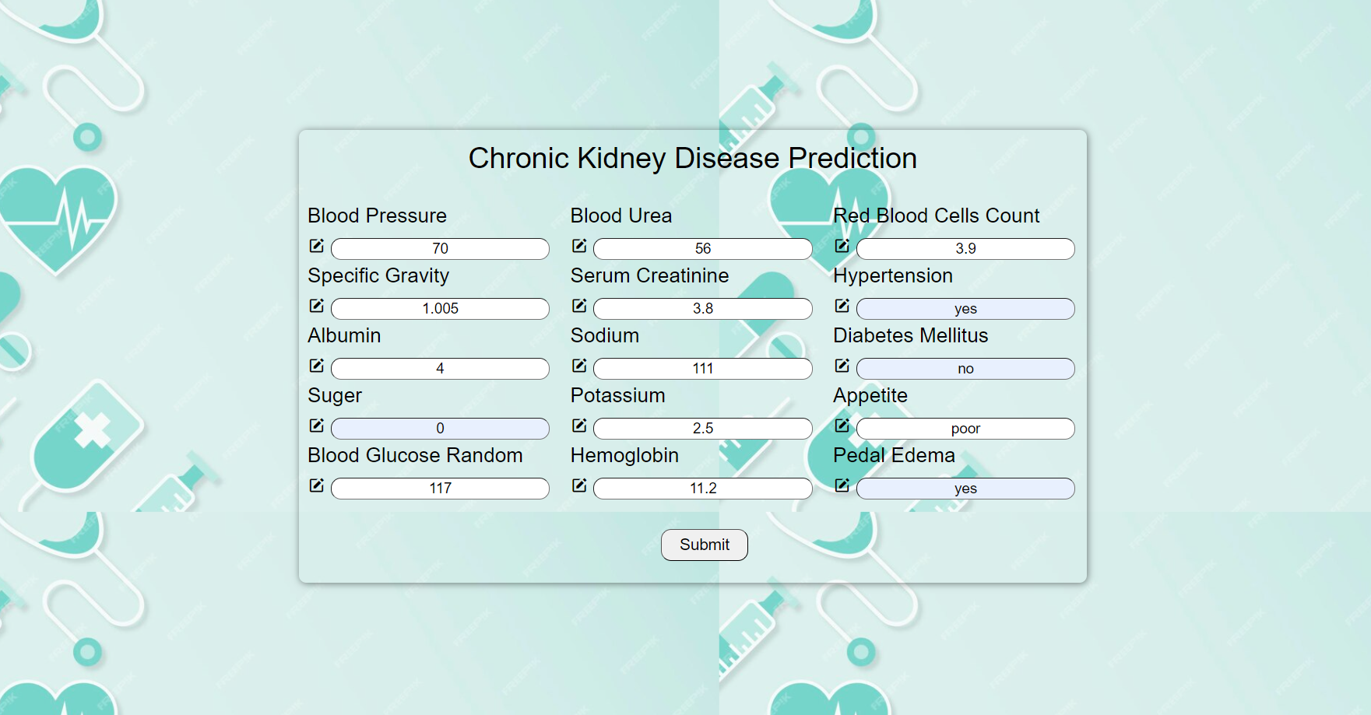
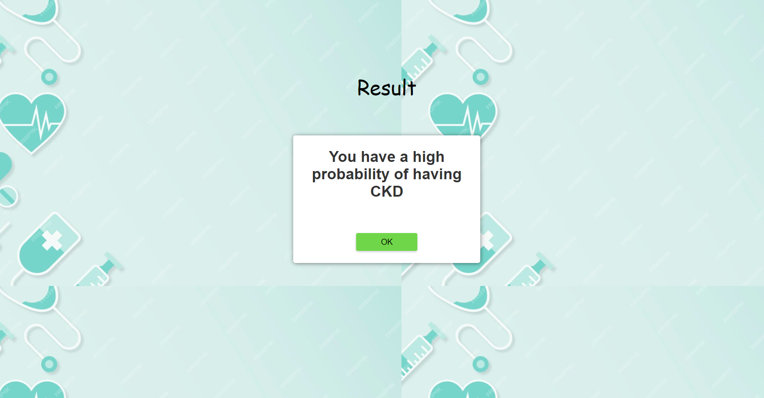
Web Application (CKD)
Four outputs in the confusion matrix assess how well each classifier performs on positive and negative classes independently. False-negative (FN), true negative (TN), false positive (FP), and true positive (TP) are these results. The following formulas assist in determining the ML algorithms' accuracy, precision, recall F-1 score, and sensitivity.
$$AC=\frac{TN+TP}{TN+TP+FN+FP} ×100\%$$
$$P=\frac{TP}{TP+FP} ×100\%$$
$$R=\frac{TP}{TN+TP+FN+FP} ×100\%$$
$$F1 score=2 × \frac{P×R}{P+R} ×100\%$$
A user friendly web application has been created using HTML, CSS and Flask.
Fig. 5. Predicting having CKD
2/19/2024
2/19/2024
2/19/2024
2/19/2024
2/19/2024
2/19/2024
2/19/2024
2/19/2024
26
26
26
26
26
26
26

Slide 27
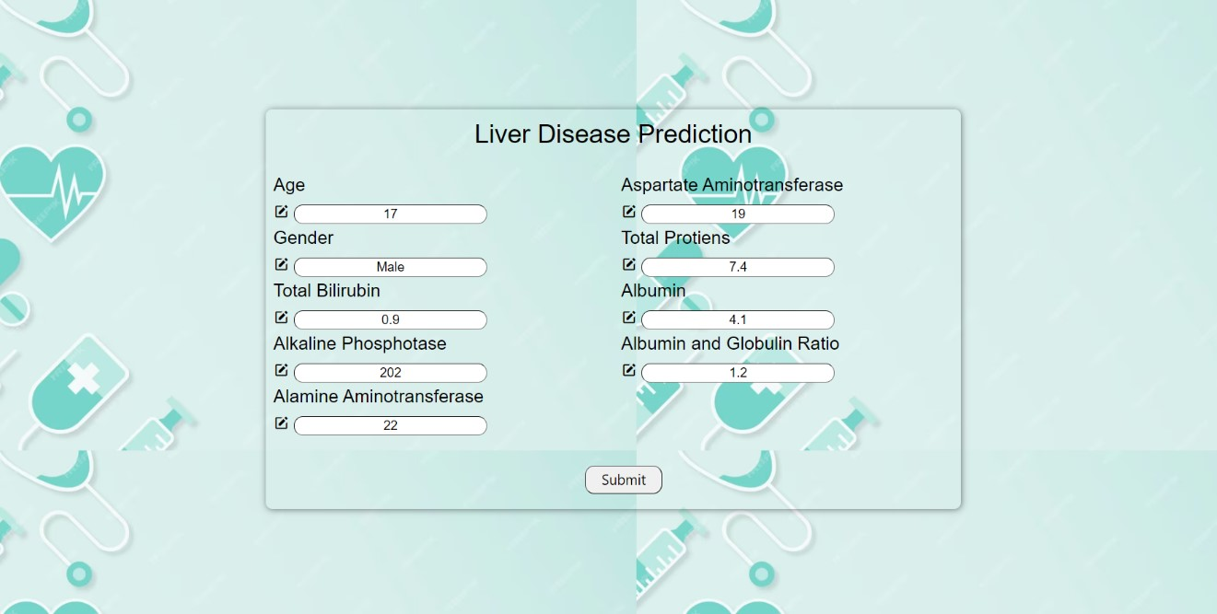
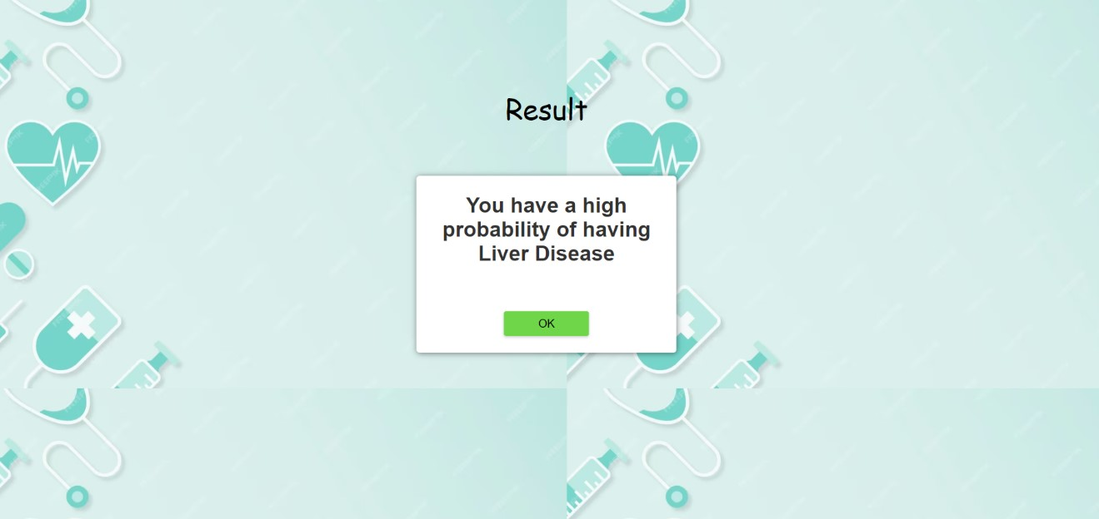
Web Application (LD)
Four outputs in the confusion matrix assess how well each classifier performs on positive and negative classes independently. False-negative (FN), true negative (TN), false positive (FP), and true positive (TP) are these results. The following formulas assist in determining the ML algorithms' accuracy, precision, recall F-1 score, and sensitivity.
$$AC=\frac{TN+TP}{TN+TP+FN+FP} ×100\%$$
$$P=\frac{TP}{TP+FP} ×100\%$$
$$R=\frac{TP}{TN+TP+FN+FP} ×100\%$$
$$F1 score=2 × \frac{P×R}{P+R} ×100\%$$
A user friendly web application has been created using HTML, CSS and Flask.
Fig. 6. Predicting having LD
2/19/2024
2/19/2024
2/19/2024
2/19/2024
2/19/2024
2/19/2024
2/19/2024
2/19/2024
2/19/2024
27
27
27
27
27
27
27
27

Slide 28
Conclusion
Four outputs in the confusion matrix assess how well each classifier performs on positive and negative classes independently. False-negative (FN), true negative (TN), false positive (FP), and true positive (TP) are these results. The following formulas assist in determining the ML algorithms' accuracy, precision, recall F-1 score, and sensitivity.
$$AC=\frac{TN+TP}{TN+TP+FN+FP} ×100\%$$
$$P=\frac{TP}{TP+FP} ×100\%$$
$$R=\frac{TP}{TN+TP+FN+FP} ×100\%$$
$$F1 score=2 × \frac{P×R}{P+R} ×100\%$$
We proposed a hybrid features approach to predict CKD.
Chi2 and MI with Pearson Correlation are used as a hybrid features selection approach for CKD and Pearson Correlation for LD.
10 Distinct Machine Learning Classifier are used.
Obtained highest accuracy of 99.19% with AdaBoost Classifier for CKD and 83.74% with LGBM.
Precision, Recall and F-1 score are for AdaBoost is 100%, 99% and 99% for CKD and for LGBM 78%, 85% and 81% for LD.
2/19/2024
2/19/2024
2/19/2024
2/19/2024
2/19/2024
2/19/2024
2/19/2024
2/19/2024
28
28
28
28
28
28
28

Slide 29
References
Four outputs in the confusion matrix assess how well each classifier performs on positive and negative classes independently. False-negative (FN), true negative (TN), false positive (FP), and true positive (TP) are these results. The following formulas assist in determining the ML algorithms' accuracy, precision, recall F-1 score, and sensitivity.
$$AC=\frac{TN+TP}{TN+TP+FN+FP} ×100\%$$
$$P=\frac{TP}{TP+FP} ×100\%$$
$$R=\frac{TP}{TN+TP+FN+FP} ×100\%$$
$$F1 score=2 × \frac{P×R}{P+R} ×100\%$$
[1] J. Qin, L. Chen, Y. Liu, C. Liu, C. Feng, and B. Chen, ‘‘A machine learning methodology for diagnosing chronic kidney disease,’’ IEEE Access, vol. 8, pp. 20991–21002, 2020. A Machine Learning Methodology for Diagnosing Chronic Kidney Disease | IEEE Journals & Magazine | IEEE Xplore
[2] Silveira, A.C.M.D.; Sobrinho, Á.; Silva, L.D.D.; Costa, E.D.B.; Pinheiro, M.E.; Perkusich, A. Exploring Early Prediction of Chronic Kidney Disease Using Machine Learning Algorithms for Small and Imbalanced Datasets. Appl. Sci. 2022, 12, 3673. https://doi.org/10.3390/app12073673
[3] Ebiaredoh-Mienye, S.A.; Esenogho, E.; Swart, T.G. Integrating Enhanced Sparse Autoencoder-Based Artificial Neural Network Technique and SoftMax Regression for Medical Diagnosis. Electronics 2020, 9, 1963. https://doi.org/10.3390/electronics9111963
[4] S. Y. Yashfi et al., "Risk Prediction Of Chronic Kidney Disease Using Machine Learning Algorithms," 2020 11th International Conference on Computing, Communication and Networking Technologies (ICCCNT), Kharagpur, India, 2020, pp. 1-5. Risk Prediction Of Chronic Kidney Disease Using Machine Learning Algorithms | IEEE Conference Publication | IEEE Xplore
[5] Almansour, N. A.., Syed, H. F., Khayat, N. R., Altheeb, R. K., Juri, R. E., Alhiyafi, J., … Olatunji, S. O. (2019). Neural network and support vector machine for the prediction of chronic kidney disease: A comparative study. Computers in Biology and Medicine, 109, 101–111 https://www.mdpi.com/2075-4418/11/5/864
2/19/2024
2/19/2024
2/19/2024
2/19/2024
2/19/2024
2/19/2024
2/19/2024
2/19/2024
2/19/2024
29
29
29
29
29
29
29
29

Slide 30
References
Four outputs in the confusion matrix assess how well each classifier performs on positive and negative classes independently. False-negative (FN), true negative (TN), false positive (FP), and true positive (TP) are these results. The following formulas assist in determining the ML algorithms' accuracy, precision, recall F-1 score, and sensitivity.
$$AC=\frac{TN+TP}{TN+TP+FN+FP} ×100\%$$
$$P=\frac{TP}{TP+FP} ×100\%$$
$$R=\frac{TP}{TN+TP+FN+FP} ×100\%$$
$$F1 score=2 × \frac{P×R}{P+R} ×100\%$$
[6] Kim, D.-H., & Ye, S.-Y. (2021). Classification of chronic kidney disease in sonography using the GLCM and artificial neural network. Diagnostics, 11, 864. https://doi.org/10.3390/diagnostics11050864
[7] Sara, S. A. B. V. J., & Kalaiselvi, K. (2018). Ensemble swarm behaviour based feature selection and support vector machine classifier for chronic kidney disease prediction. International Journal of Engineering & Technology, 7, 190–195. https://doi.org/ 10.14419/ijet.v7i2.31.13438
[8] Rady, E.-H. A., & Anwar, A. S. (2019). Prediction of kidney disease stages using data mining algorithms. Informatics in Medicine Unlocked, 15, Article 100178. https://doi.org/10.1016/j.imu.2019.100178
[9] Polat H, Danaei Mehr H, Cetin A. Diagnosis of Chronic Kidney Disease Based on Support Vector Machine by Feature Selection Methods. J Med Syst. 2017 Apr;41(4):55. 10.1007/s10916-017-0703-x
[10] Ghosh, P.; Shamrat, F.J.M.; Shultana, S.; Afrin, S.; Anjum, A.A.; Khan, A.A. Optimization of prediction method of chronic kidney disease using machine learning algorithm. In Proceedings of the 2020 15th International Joint Symposium on Artificial Intelligence and Natural Language Processing (iSAI-NLP), Bangkok, Thailand, 18–20 November 2020; pp. 1–6. Optimization of Prediction Method of Chronic Kidney Disease Using Machine Learning Algorithm | IEEE Conference Publication | IEEE Xplore
[11] Sokoliuk, A.; Kondratenko, G.; Sidenko, I.; Kondratenko, Y.; Khomchenko, A.; Atamanyuk, I. Machine learning algorithms for binary classification of liver disease. In Proceedings of the 2020 IEEE International Conference on Problems of Infocommunications. Science and Technology (PIC S&T), Kharkiv, Ukraine, 6–9 October 2020; pp. 417–421. [CrossRef]
[12] Azam, M.S.; Rahman, A.; Iqbal, S.H.S.; Ahmed, M.T. Prediction of liver diseases by using few machine learning based approaches. Aust. J. Eng. Innov. Technol. 2020, 2, 85–90. [CrossRef]
2/19/2024
2/19/2024
2/19/2024
2/19/2024
2/19/2024
2/19/2024
2/19/2024
2/19/2024
2/19/2024
2/19/2024
30
30
30
30
30
30
30
30
30

Slide 31
References
Four outputs in the confusion matrix assess how well each classifier performs on positive and negative classes independently. False-negative (FN), true negative (TN), false positive (FP), and true positive (TP) are these results. The following formulas assist in determining the ML algorithms' accuracy, precision, recall F-1 score, and sensitivity.
$$AC=\frac{TN+TP}{TN+TP+FN+FP} ×100\%$$
$$P=\frac{TP}{TP+FP} ×100\%$$
$$R=\frac{TP}{TN+TP+FN+FP} ×100\%$$
$$F1 score=2 × \frac{P×R}{P+R} ×100\%$$
[13] Srivastava, A.; Kumar, V.V.; Mahesh, T.; Vivek, V. Automated Prediction of Liver Disease using Machine Learning (ML) Algorithms. In Proceedings of the 2022 Second International Conference on Advances in Electrical, Computing, Communication and Sustainable Technologies (ICAECT), Bhilai, India, 21–22 April 2022; pp. 1–4. [CrossRef]
[14] Choudhary, R.; Gopalakrishnan, T.; Ruby, D.; Gayathri, A.; Murthy, V.S.; Shekhar, R. An Efficient Model for Predicting Liver Disease Using Machine Learning. In Data Analytics in Bioinformatics: A Machine Learning Perspective; Wiley Online Library: Hoboken, NJ, USA, 2021; pp. 443–457. [CrossRef]
[15] Geetha, C.; Arunachalam, A. Evaluation based Approaches for Liver Disease Prediction using Machine Learning Algorithms. In Proceedings of the 2021 International Conference on Computer Communication and Informatics (ICCCI), Coimbatore, India, 27–29 January 2021; pp. 1–4. [CrossRef]
[16] Gajendran, G.; Varadharajan, R. Classification of Indian liver patient’s data set using MAMFFN. In Proceedings of the AIP Conference Proceedings, Coimbatore, India, 17–18 July 2020; Volume 2277, p. 120001. [CrossRef]
[17] Elias Dritsas, Supervised Machine Learning Models for Liver Disease Risk Prediction, 13 January 2023 [CrossRef]
[18] Anon, Estimated Glomerular Filtration Rate (eGFR), National Kidney Foundation. (2015). Estimated Glomerular Filtration Rate (eGFR) | National Kidney Foundation (accessed February 4, 2022).
[19] Indian Liver Patient Records. Available online: (accessed on 14 November 2022). [CrossRef]
2/19/2024
2/19/2024
2/19/2024
2/19/2024
2/19/2024
2/19/2024
2/19/2024
2/19/2024
2/19/2024
2/19/2024
2/19/2024
31
31
31
31
31
31
31
31
31
31

Slide 32
Thank You

