Slide 1

Welcome back! Attendance form below
[Link to form]

Slide 2
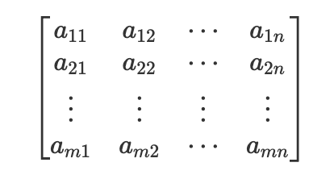
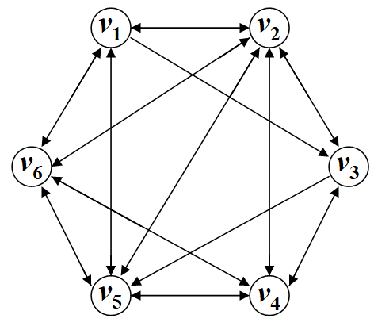


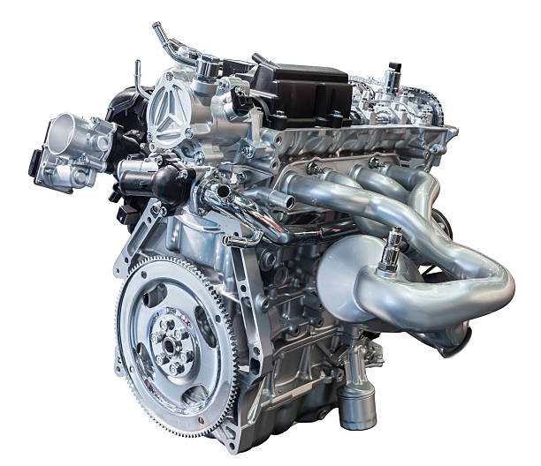

A class as a concept in a program
You can think of classes as a concept in a program
Vectors
Matrices
Graph
Valve
Thermometer
Clock
Engine
std::vector<int>

Slide 3
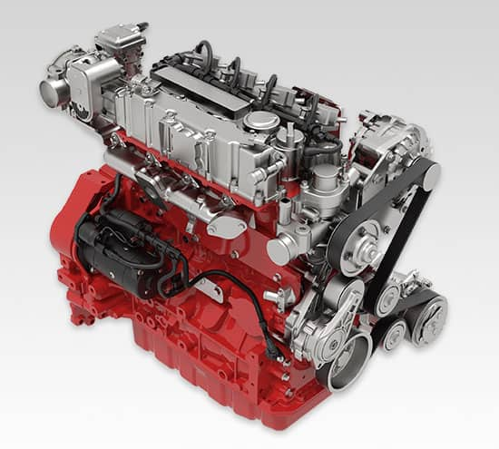

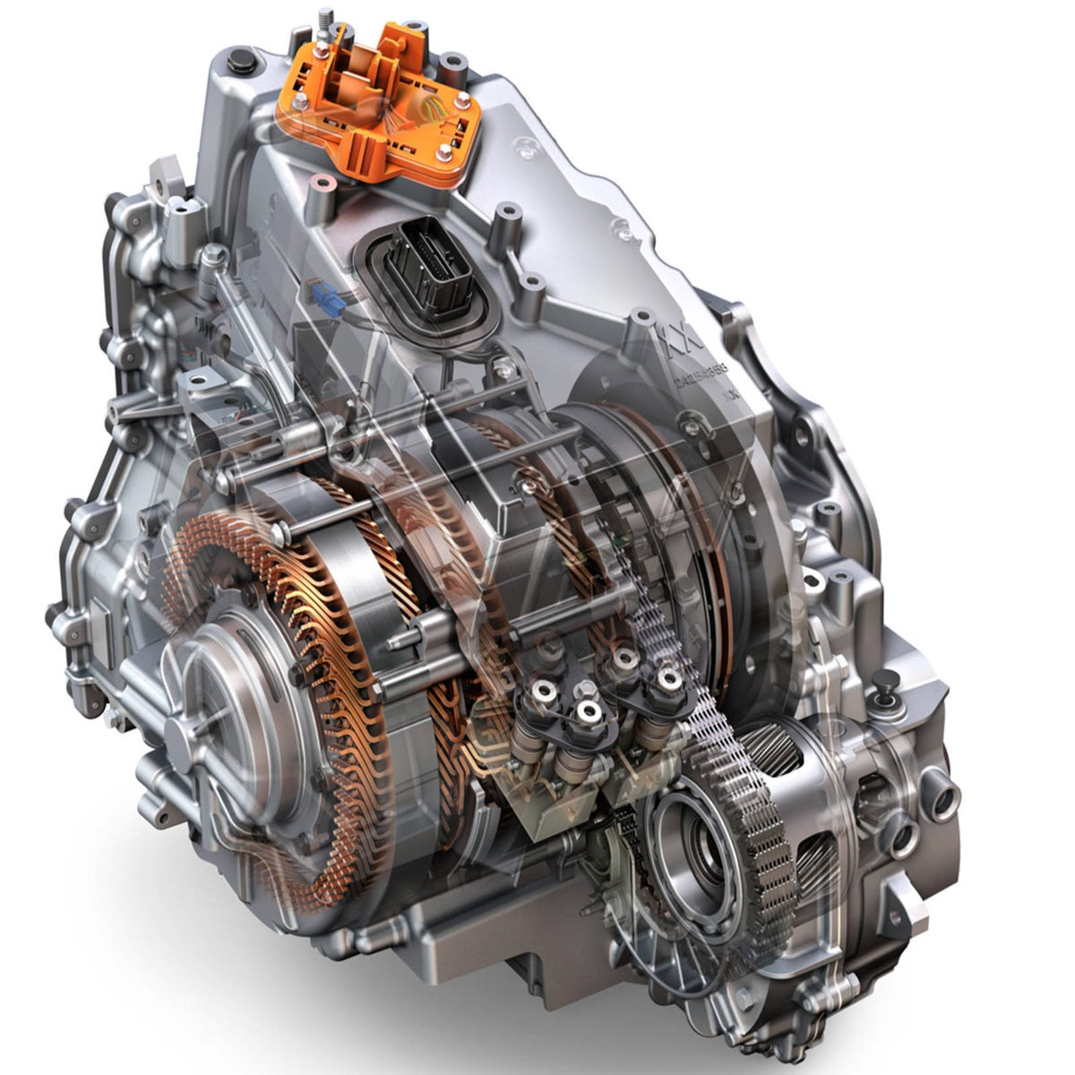
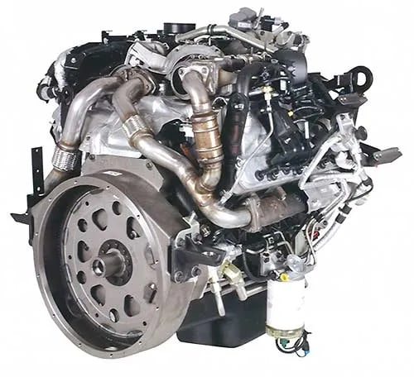
How do we extend classes?
Engine
Gas Engine
Turbine Engine
Electric Engine
Diesel Engine

Slide 4
Lecture 9: Inheritance
CS106L, Spring 2025

Slide 5
Today’s Agenda
A Recap on Classes
And more on how they work behind the scenes
Inheritance
Inheritance allows us to reuse features from a parent class
Virtual Functions
Defining function interfaces that can be overridden in sub-classes
Closing Thoughts
Should you always use inheritance?

Slide 7
A Recap on Classes

Slide 8
Last Time: Classes
What are classes?
Turn to the person next to you and think of one thing you remember from last Thursday’s lecture!
A class bundles data and methods for an object together

Slide 9
A Point on classes
public:
Accessible by everyone!
class Point {
public:
Point(int x, int y);
~Point();
int getX();
int getY();
void setX();
void setY();
private:
int x;
int y;
};
constructor
Initializes this class
destructor
Cleans up this class
Usually don’t need this
private:
Only visible to us! Implementation details

Slide 10
A Point on classes
class Point {
public:
Point(int x, int y);
~Point();
int getX();
int getY();
private:
int x;
int y;
std::string color;
}
#include “Point.h”
Point::Point(int x, int y)
: x(x), y(y) {}
int Point::getX() {
return x;
}
int Point::getY() {
return y;
}
Point.h (header file)
Contains interface, declarations
Point.cpp
Contains implementation, definitions

Slide 11
Classes: Python vs. C++
class Point:
def __init__(self, x, y):
self._x = x
self._y = y
def getX(self):
return self._x
def getY(self):
return self._y
class Point {
private:
int x;
int y;
public:
Point(int x, int y)
: x{x}, y{y} {}
int getX() { return x; }
int getY() { return y; }
};
What does a Point look like in memory?

Slide 12
Classes: Memory Layout (Python)
class Point:
def __init__(self, x, y):
self._x = x
self._y = y
def getX(self):
return self._x
def getY(self):
return self._y
p = Point(1, 2)
p
refcount
type
_x = 1
_y = 2
Python stores extra information about the type of the object in its memory footprint! This enables runtime type checking.

Slide 13
It’s actually much worse than this!
p = Point(1, 2)
refcount = 1 | refcount = 1
type = str | type = str
length = 2 | length = 2
kind = 1 | kind = 1
data = “_x” | data = “_y”
p
Refcount = 1
type = Point
__dict__
refcount
type = dict
size = 2
keys
values
refcount = 1 | refcount = 1
type = int | type = int
size = 1 | size = 1
digits = [1] | digits = [1]
To offer the flexibility of dynamic typing, Python stores a lot of extra info!

Slide 14
Classes: Memory Layout (C++)
Point p {1, 2};
class Point {
private:
int x;
int y;
public:
Point(int x, int y)
: x{x}, y{y} {}
int getX() { return x; }
int getY() { return y; }
};
p
int x = 1
int y = 2
C++ just stores the data in the object! The compiler does all of the type checking at compile time!

Slide 15
Classes: Memory Layout
C++
Python
p = Point(1, 2)
Point p {1, 2};
p = Point(1, 2)
refcount = 1 | refcount = 1
type = str | type = str
length = 2 | length = 2
kind = 1 | kind = 1
data = “_x” | data = “_y”
p
int x = 1
int y = 2
p
refcount
type = dict
size = 2
keys
values
Refcount = 1
type = Point
__dict__
refcount = 1 | refcount = 1
type = int | type = int
size = 1 | size = 1
digits = [1] | digits = [1]
C++ stores less data in classes! This is one reason why C++ is more memory-efficient than Python

Slide 17
Where are the functions?

Slide 18
Where are the functions?
Functions are not stored in the object itself, but separately
class Point:
def __init__(self, x, y):
self._x = x
self._y = y
def getX(self):
return self._x
def getY(self):
return self._y
Your Program’s Memory
OS Shared
Variables (Stack)
Data stored here
Variables (Heap)
Global Variables
Text (Instructions)
Functions stored here

Slide 19
Where are the functions?
Functions are stored separately from the object
class Point:
def __init__(self, x, y):
self._x = x
self._y = y
def getX(self):
return self._x
def getY(self):
return self._y
p = Point(1, 2)
px = p.getX()
# ...is the same as...
p = Point(1, 2)
getX(p)
Passing self as parameter

Slide 20
Q: Do we have a self in C++?
A: Yes! It’s called this

Slide 21
this in C++
this is a pointer to the current class
int Point::getX() {
return this->x;
}
this
int x
int y

Slide 22
The importance of this
Are these two snippets of code the same?
int Point::getX() {
return x;
}
int Point::getX() {
return this->x;
}
✅ These are the same

Slide 23
The importance of this
Are these two snippets of code the same?
void Point::setX(int x)
{
x = x;
}
void Point::setX(int x)
{
this->x = x;
}
❌ Not the same

Slide 24
What is this?
int Point::setX(int x)
{
this->x = x;
}
Point* this
->
Mwahahaha pointer dereference

Slide 25
this in C++
this is passed as a parameter to class function behind the scenes
int Point::getX() {
return this->x;
}
// ...gets turned into...
int Point_getX(Point* this)
{ return this->x; }
Point p {1,2};
int x = p.getX();
// ...gets turned into...
Point p {1,2};
int x = Point_getX(&p);
Passing this as parameter

Slide 27
Inheritance

Slide 28
A mechanism for one class to inherit properties from another

Slide 29



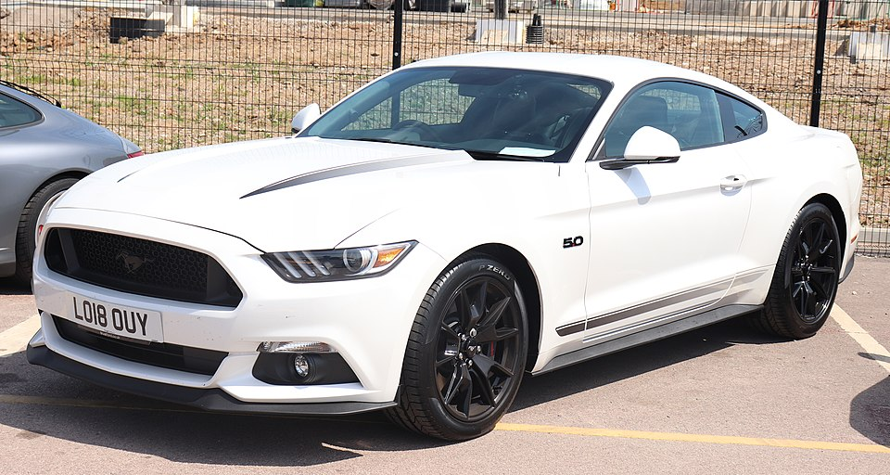
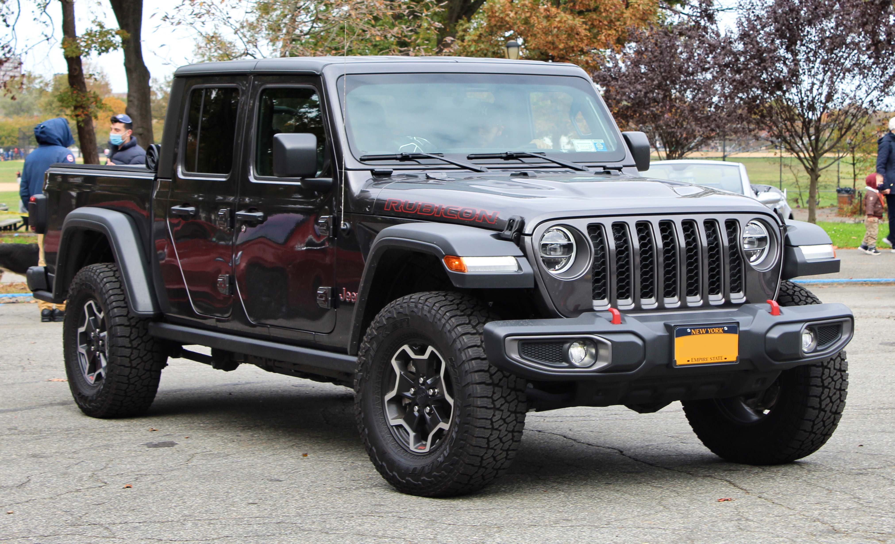
Many kinds of cars
Car
Many kinds of cars, but they all inherit
An engine
Wheels
A steering wheel
Toyota Camry
Honda Civic
Ford Mustang
Jeep Gladiator

Slide 30
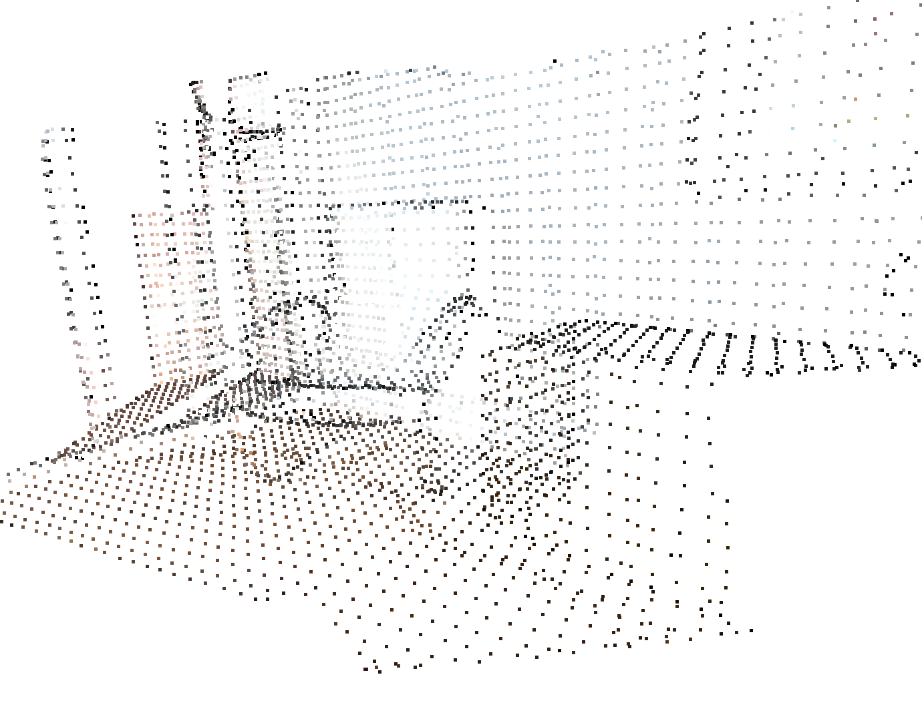
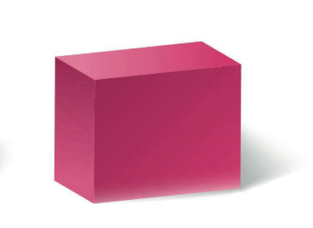

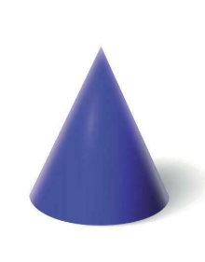

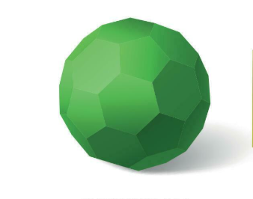
Many kinds of shapes
Shape
Every shape has a
Volume
Surface area
Box
Sphere
Cone
Ring
Buckyball

Slide 31
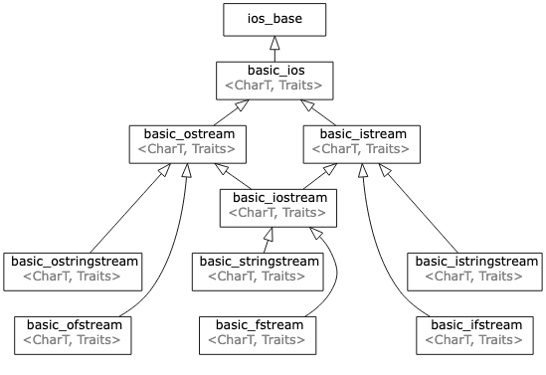
We’ve seen this before: streams!
Is-A relationship: An std::ifstream is a std::istream is a std::ios

Slide 32
How do we model inheritance in C++?

Slide 33

Tree
Projectile
Weapon
NPC
Player

Slide 34



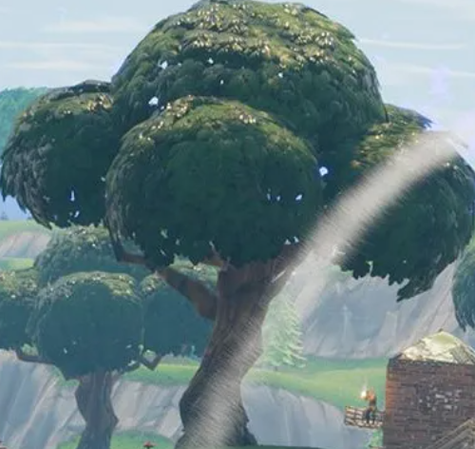

Fortnite as classes
class Player {
double x, y, z;
HitBox hitbox;
double hitpoints;
public:
void damage(double hp);
void update();
void render();
};
class Projectile {
double x, y, z;
HitBox hitbox;
double vx, vy, vz;
public:
void update();
void render();
};
class Weapon {
double x, y, z;
HitBox hitbox;
size_t ammo;
public:
void fire();
void update();
void render();
};
class Tree {
double x, y, z;
HitBox hitbox;
public:
void update();
void render();
};
class NPC {
double x, y, z;
HitBox hitbox;
double hitpoints;
public:
void damage(double hp);
void update();
void render();
};

Slide 35
There’s a lot of redundancy here!
class Player {
double x, y, z;
HitBox hitbox;
double hitpoints;
public:
void damage(double hp);
void update();
void render();
};
class Projectile {
double x, y, z;
HitBox hitbox;
double vx, vy, vz;
public:
void update();
void render();
};
class Weapon {
double x, y, z;
HitBox hitbox;
size_t ammo;
public:
void fire();
void update();
void render();
};
class Tree {
double x, y, z;
HitBox hitbox;
public:
void update();
void render();
};
class NPC {
double x, y, z;
HitBox hitbox;
double hitpoints;
public:
void damage(double hp);
void update();
void render();
};

Slide 36
This model is also a pain to modify
Imagine we wanted to add an overlapsWith method to each object
that checks if it overlaps in space with another object
class Player {
/* ... */
public: bool overlapsWith(const Player& other);
bool overlapsWith(const NPC& other);
bool overlapsWith(const Tree& other);
bool overlapsWith(const Projectile& other);
bool overlapsWith(const Weapon& other);
};
// And we’d do the same for NPC, Tree, Projectile, Weapon!
This doesn’t scale!
What if we add more object types!

Slide 37
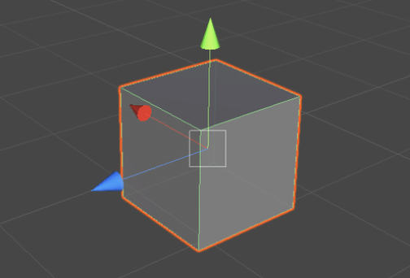
Taking a step back
Many different objects, but they all share:
A position in space
A hitbox
An update and render method!
Entity
Weapon
Player
Tree
Projectile
NPC

Slide 38
Introducing a common base class: Entity
Entity
class Entity {
double x, y, z;
HitBox hitbox;
public:
void update();
void render();
};

Slide 39
Introducing a common base class: Entity
class Player {
double x, y, z;
HitBox hitbox;
double hitpoints;
public:
void damage(double hp);
void update();
void render();
};
class Projectile {
double x, y, z;
HitBox hitbox;
double vx, vy, vz;
public:
void update();
void render();
};
class Weapon {
double x, y, z;
HitBox hitbox;
size_t ammo;
public:
void fire();
void update();
void render();
};
class Tree {
double x, y, z;
HitBox hitbox;
public:
void update();
void render();
};
class Entity {
double x, y, z;
HitBox hitbox;
public:
void update();
void render();
};
class NPC {
double x, y, z;
HitBox hitbox;
double hitpoints;
public:
void damage(double hp);
void update();
void render();
};

Slide 40
Now we inherit!
class Player : Entity {
double hitpoints;
public:
void damage(double hp);
};
class Projectile : Entity
{
double vx, vy, vz;
};
class Weapon : Entity
{
size_t ammo;
public:
void fire();
};
class Tree : Entity
{};
class Entity {
double x, y, z;
HitBox hitbox;
public:
void update();
void render();
};
class NPC : Entity {
double hitpoints;
public:
void damage(double hp);
};

Slide 41
Now we inherit!
class Player : Entity {
double hitpoints;
public:
void damage(double hp);
};
class Projectile : Entity
{
double vx, vy, vz;
};
class Weapon : Entity
{
size_t ammo;
public:
void fire();
};
class Tree : Entity
{};
class Entity {
double x, y, z;
HitBox hitbox;
public:
void update();
void render();
};
class NPC {
double hitpoints;
public:
void damage(double hp);
};
Notice: there is still some redundancy!

Slide 42
More layers of inheritance…
class Player : Actor {};
class Projectile : Entity
{
double vx, vy, vz;
};
class Weapon : Entity
{
size_t ammo;
public:
void fire();
};
class Tree : Entity
{};
class Entity {
double x, y, z;
HitBox hitbox;
public:
void update();
void render();
};
class Actor : Entity
{
double hitpoints;
public:
void damage(double hp);
};
class NPC : Actor {};

Slide 43
An inheritance tree defines is-a relationships
class Entity { /* ... */ };
class Projectile : Entity
{ /* ... */ };
class Actor : Entity
{ /* ... */ };
class Weapon : Entity
{ /* ... */ };
class Tree : Entity
{ /* ... */ };
class Player : Actor
{ /* ... */ };
class NPC : Actor
{ /* ... */ };
“A Weapon is an Entity”
“An NPC is an Actor, and is also an Entity”

Slide 44
Defining common functionality is trivial!
Now we can check if two Entity’s overlap, no matter what kind it is!
class Entity {
double x, y, z;
HitBox hitbox;
public:
void update();
void render();
bool overlapsWith(const Entity& other);
};
Player player { /* ... */ };
Projectile bullet { /* ... */ };
bool isHit = player.overlapsWith(bullet);
To implement, check x,y,z and hitbox to see if there was an overlap

Slide 46
Note: access modifiers
That last line won’t actually work due to access modifiers!
Player player { /* ... */ };
Projectile bullet { /* ... */ };
bool isHit = player.overlapsWith(bullet);
Compiler: overlapsWith is inaccessible

Slide 47
Note: access modifiers
By default, classes are inherited privately.
class Entity {
public:
bool overlapsWith(const Entity& other);
};
class Player : /* private */ Entity {
// Private inheritance:
// - private members of Entity are inaccessible to all
// - public members become private (inaccessible to outside)
};

Slide 48
Note: access modifiers
We can fix this issue by inheriting Entity publicly!
class Entity {
public:
bool overlapsWith(const Entity& other);
};
class Player : public Entity {
// Public inheritance:
// - private members of Entity are still inaccessible
// - public members become public (accessible to outside)
};

Slide 49
Note: access modifiers
private inheritance (default)
class Child : private Parent
private in parent
public in parent
inaccessible in child
private in child
public inheritance
class Child : public Parent
private in parent
public in parent
inaccessible in child
public in child
Note: public inheritance better models is-a relationships! A Player really is an Entity because it exposes all of Entity’s functionality publicly

Slide 50
Note: protected access modifier
Protected members are visible to subclasses, but not the outside!
Remember, class members are private by default
class Entity {
protected:
double x, y, z;
HitBox hitbox;
public:
void update();
void render();
};
class Projectile
: public Entity {
private:
double vx, vy, vz;
public:
void move() {
x += vx;
y += vy;
z += vz;
}
}
private by default
We need to mark them protected inside Entity
In order to access x, y, and z inside Projectile

Slide 52
Let’s build a game!

Slide 53
Let’s build a game!
class Entity {
double x, y, z;
HitBox hitbox;
public:
void update();
void render();
};
We’ll implement the logic for our game by overriding update and render for each kind of Entity.

Slide 54
Let’s build a game!
Let’s override the update and render function for each Entity type!
void Player::update() {
// Handle controller input
}
void Player::render() {
// Draw the player!
}
void Projectile::update() {
// Move the projectile
}
void Projectile::render() {
// Cool particle effects!
}
. . .
. . .
// By default, do nothing!
void Entity::update() {}
// By default, do nothing!
void Entity::render() {}

Slide 55
Let’s build a game!
A game is basically a collection of entities updated and rendered every frame!
int main() {
std::vector<Entity> entities { Player(), Tree(), Projectile() };
while (true) {
for (auto& entity : entities) {
entity.update();
entity.render();
}
}
}
Game event loop (runs every frame)

Slide 56
Let’s try it out!

Slide 57
It didn’t work! What’s going on!?

Slide 58
Behind the scenes
Recall that C++ lays out the fields of an object sequentially
class Entity {
protected:
double x, y, z;
HitBox hitbox;
public:
void update();
void render();
};
Entity
double x
double y
double z
HitBox hitbox

Slide 59
Behind the scenes
C++ stacks the subclass’s members below the inherited ones!
class Projectile
: public Entity {
private:
double vx, vy, vz;
public:
void move();
}
Projectile
double x
double y
double z
HitBox hitbox
double vx
double vy
double vz
Members inherited from Entity

Slide 60
Behind the scenes
Be careful: when you assign a derived class to a base class, it gets sliced!
Projectile
std::vector<Entity>
double x
double y
double z
HitBox hitbox
double vx
double vy
double vz
double x
double y
double z
HitBox hitbox
double x | double x | double x
double y | double y | double y
double z | double z | double z
HitBox hitbox | HitBox hitbox | HitBox hitbox
Issue: every element in the vector is an Entity, so the compiler calls Entity::update() (which does nothing) instead of Player::update(), Tree::update(), Projectile::update, etc.

Slide 61
A Projectile doesn’t “fit” into an Entity

Slide 62
Solution: Use an Entity* instead
Object slicing only happens when a copy is made!
int main() {
Player p; Tree t; Projectile b;
std::vector<Entity*> entities { &p, &t, &b };
while (true) {
for (auto& ent : entities) {
ent->update();
ent->render();
}
}
}
Storing pointers to entities here, not the entities themselves!

Slide 63
Solution: Use an Entity* instead
Pointers retain the details of the subclass by avoiding copies
std::vector<Entity*>
Entity* ptr | Entity* ptr | Entity* ptr
Player
Tree
Projectile
double x
double y
double z
HitBox hitbox
double hitpoints
double x
double y
double z
HitBox hitbox
double x
double y
double z
HitBox hitbox
double vx
double vy
double vz

Slide 65
Let’s try it again!

Slide 66
It still didn’t work… 😭 😭 😭

Slide 67
Announcements
Assignment 2 due this Friday
A note on assignment workload!
We want you guys to spend ~1 hour on each assignment!
If you consistently spend more time than this, come to OH!
OH is 4-5pm Wed, 3-4pm Friday… we are so lonely, please come!!

Slide 68
Virtual Functions

Slide 69
Problem: Which one is called?
We have many different update methods
Given a pointer to an Entity, how does the compiler know which method to call?
void Projectile::update();
void NPC::update();
void Player::update();
void Entity::update();
Entity* entity = entities[0];
entity->update();

Slide 70
Problem: Which one is called?
We should call the update method which matches the type of the object that entity points to
If entity points to a Player, we should call Player::update()
If it points to a Projectile, we should call Projectile::update() and so on
But an Entity* alone doesn’t tell us any information about the type!
Player
Want to call
double x
double y
double z
HitBox hitbox
double hitpoints
void Player::update();
Entity* entity
Actually called
void Entity::update();

Slide 71
Problem: Which one is called?
Given an Entity*, does it point to:
Entity* entity
Player?
Projectile?
Tree?
Entity?
double x
double y
double z
HitBox hitbox
double hitpoints
double x
double y
double z
HitBox hitbox
double vx
double vy
double vz
double x
double y
double z
HitBox hitbox
double x
double y
double z
HitBox hitbox

Slide 72
Problem: Which one is called?
The compiler defaults to assuming entity points to an Entity
This is the only one it can be absolutely sure any entity will support
Entity* entity
Player?
Projectile?
Tree?
Entity?
double x
double y
double z
HitBox hitbox
double hitpoints
double x
double y
double z
HitBox hitbox
double vx
double vy
double vz
double x
double y
double z
HitBox hitbox
double x
double y
double z
HitBox hitbox

Slide 73
Using Entity* comes at a cost:
We “forget” which type the object actually is

Slide 74
This is not what we wanted!
Notice: there is a difference between the compile-time vs. runtime type of the object!
At compile time, it is treated as an Entity
At runtime, it could be an Entity or any subclass, e.g. Projectile, Player, etc.
What we need is dynamic dispatch
Depending on the runtime (dynamic) type of the object, a different method should be called (dispatched)!

Slide 76
Introducing virtual functions

Slide 77
Virtual functions
Marking a function as virtual enables dynamic dispatch
Subclasses can override this method
class Entity {
public:
virtual void update() {}
virtual void render() {}
};
class Projectile : public Entity {
public:
void update() override {};
};
override isn’t required but is good for readability! It will check that you are overriding a virtual method instead of creating a new one.

Slide 78
Does it work?
YES!!! 😄

Slide 80
How does it work?

Slide 81
Behind the Scenes
Adding virtual to a function adds some metadata to each object
Specifically, it adds a pointer (called a vpointer) to a table (called a vtable) that says, for each virtual method, which function should be called for that object
Projectile
Entity* entity
double x
double y
double z
HitBox hitbox
void* vpointer
double vx
double vy
double vz
update | Projectile::update()
render | Entity::render()

Slide 82
Behind the Scenes
Entity* p = new Projectile { /* ... */ };
p->update();
Projectile
Entity* entity
double x
double y
double z
HitBox hitbox
void* vpointer
double vx
double vy
double vz
update | Projectile::update()
render | Entity::render()

Slide 83
Recall: Classes in Python
class Point:
def __init__(self, x, y):
self._x = x
self._y = y
def getX(self):
return self._x
def getY(self):
return self._y
p = Point(1, 2)
p
refcount
type
_x
_y
Python stores extra information about the type of the object in its memory footprint! This enables runtime type checking.

Slide 84
virtual is kind of like Python
Both Python and C++ virtual functions store type-specific information
Entity* p = /* ... */;
p = Point(1, 2)
Projectile
Entity* entity
double x
double y
double z
HitBox hitbox
void* vpointer
double vx
double vy
double vz
p
refcount
type
_x
_y

Slide 85
Quick check: pros/cons of virtual functions?
Turn to a partner and talk about:
When might you want to use a virtual function?
When might you not want to use a virtual function?
In many other languages, class functions are virtual by default
Key idea: In C++, you have to opt in because they are more expensive
Increased size of memory layout of the class
Takes longer to look up vtable and call the method
In quant finance and industries where nanoseconds count, virtual functions are not used!

Slide 87
Pure virtual functions
class Entity {
public:
virtual void update() = 0;
virtual void render() = 0;
};

Slide 88
Pure virtual functions
class Entity {
public:
virtual void update() = 0;
virtual void render() = 0;
};
Mark a virtual function as pure virtual by adding = 0; instead of an implementation!

Slide 89
Pure virtual functions
A class with one or more pure virtual functions is an abstract class, it can’t be instantiated!
Overriding all of the pure virtual functions makes the class concrete!
class Entity {
public:
virtual void update() = 0;
virtual void render() = 0;
};
Entity e;
// ❌ Entity is abstract!
class Projectile
: public Entity {
public:
void update() override {};
void render() override {};
};
Projectile p;
// ✅ Projectile is concrete

Slide 90
Pure virtual functions
Pure virtual functions are useful when there’s no clear default implementation!
class Shape {
public:
virtual double volume() = 0;
};
Shape
Box
Buckyball
Ring
Sphere
Cone
What’s the default volume of a Shape? Let’s mark it pure virtual and let subclass decide!

Slide 92
Closing Thoughts

Slide 93
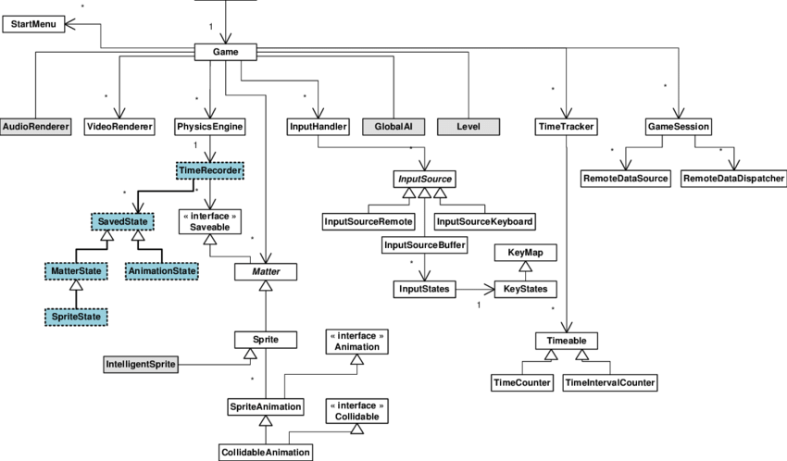
Sometimes inheritance can get out of hand

Slide 94
Sometimes inheritance can get out of hand
Big inheritance trees tend to be slower and harder to reason about
In video games, approach of subclassing for every different object type is uncommon among modern game engines
Composition is often more flexible and just makes sense

Slide 95

“A car is an engine”

Slide 96

“A car is has an engine”

Slide 97
Prefer composition over inheritance
Inheritance is a powerful tool, but sometimes, composition just makes more sense!
class Car
: public Engine
, public SteeringWheel
, public Brakes
{
/* Hmmm... this doesn’t seem quite right */
};
class Car {
Engine engine;
SteeringWheel wheel;
Brakes brakes;
};

Slide 98
Prefer composition and inheritance
Combining both of these ideas can give the best of both worlds!
class Car {
Engine* engine;
SteeringWheel* wheel;
Brakes* brakes;
};
class Engine {};
class CombustionEngine : public Engine {};
class GasEngine : public CombustionEngine {};
class DieselEngine : public CombustionEngine{};
class ElectricEngine : public Engine {};
If you want to see one place this technique is used in C++, look up the PIMPL idiom!

