Slide 1
2021-2022-1
概率统计(经)试卷评讲

Slide 2
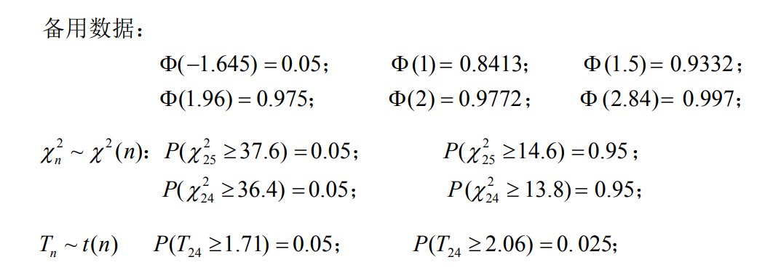

Slide 3
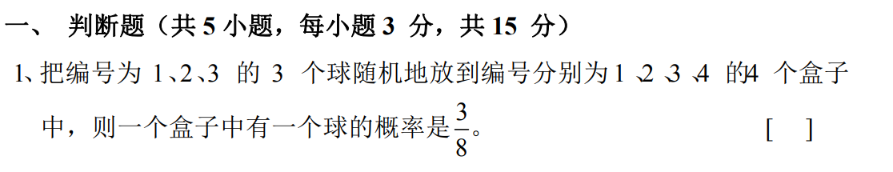
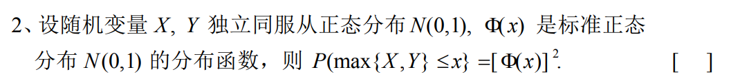

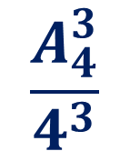


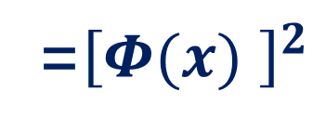

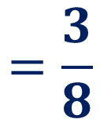

√
$$\frac{A_{4}^{3}}{4^{3}}$$
$$=\frac{3}{8}$$
√
$$P(max\left\{X,Y\right\}≤x)$$
$$=P(X≤x,Y≤x)$$
$$=P\left(X≤x\right)P\left(Y≤x\right)$$
$$=Φ(x)$$
$$Φ(x)$$
=${\left[Φ(x) \right]}^{2}$

Slide 4






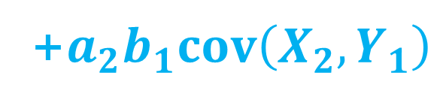








×
$$cov\left(X, X\right)=DX$$
$$cov\left(X, Y\right)=cov\left(Y, X\right)$$
$$cov\left(X,C\right)=0$$
$$cov\left(a_{1}X_{1}+b_{1}Y_{1},a_{2}X_{2}+b_{2}Y_{2}\right)$$
$$=a_{1}a_{2}cov\left(X_{1}, X_{2}\right)$$
$$+a_{1}b_{2}cov\left(X_{1}, Y_{2}\right)$$
+$a_{2}b_{1}cov\left(X_{2}, Y_{1}\right)$
$$+b_{1}b_{2}cov\left(Y_{1}, Y_{2}\right)$$
$$D\left(aX+bY\right)$$
$$=a^{2}DX+b^{2}Y+2abcov(X,Y)$$
$$D\left(X−2Y\right)$$
$$=1^{2}×DX+{(−2)}^{2}×DY+2×1×(−2) cov(X,Y)$$
$$=13$$
$$⇒cov\left(X,Y\right)=0$$
$$cov\left(X−2,X+Y\right)$$
$$=DX+cov\left(X,Y\right)$$
$$=9$$

Slide 5
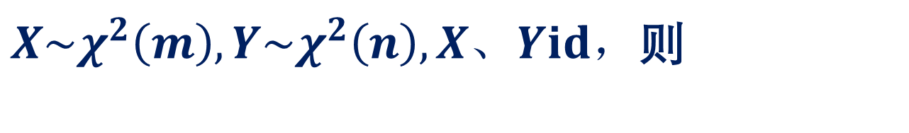
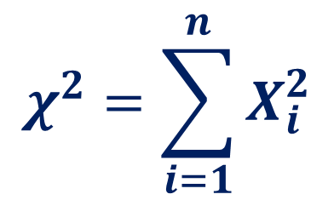

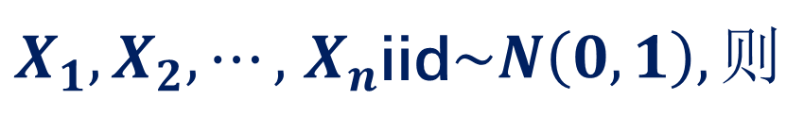

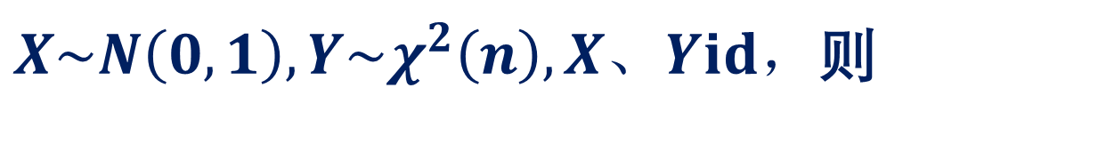



卡方分布：
$X_{1},X_{2},⋯,$ $X_{n}$iid$\sim N\left(0,1\right),则$
$$χ^{2}=\sum_{i=1}^{n}{X_{i}^{2}}$$
$$\sim χ^{2}(n)$$
T分布：
$X\sim N\left(0,1\right),Y\sim χ^{2}\left(n\right),X、Yid，$则
$$\frac{X}{\sqrt{Y/n}}$$
T=
$$\sim t(n)$$
F分布：
$X\sim χ^{2}\left(m\right),Y\sim χ^{2}\left(n\right),X、Yid，$则
$$\frac{X/m}{Y/n}$$
F=
$$\sim F(m−1,n−1)$$

Slide 6
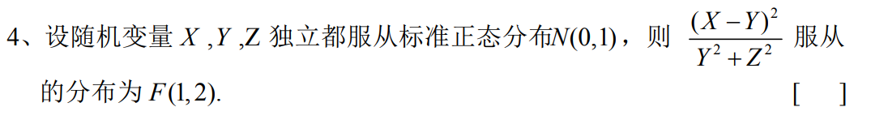


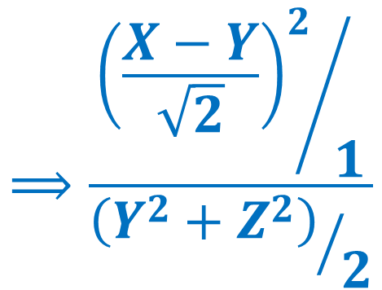
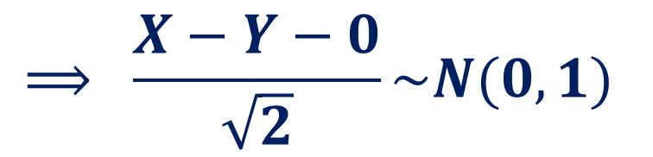



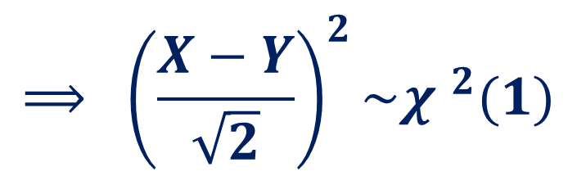

×
$$X、Yiid\sim N(0,1)$$
$$Y、Ziid\sim N(0,1)$$
$$id ？？$$
$$⟹ X−Y\sim N(0,2)$$
$$⟹ Y^{2}+Z^{2}\sim {χ }^{2}(2)$$
$$⟹ \frac{X−Y−0}{\sqrt{2}}\sim N(0,1)$$
$$⟹\frac{{{\left(\frac{X−Y}{\sqrt{2}}\right)}^{2}}/1}{{\left(Y^{2}+Z^{2}\right)}/2}$$
$$⟹ {\left(\frac{X−Y}{\sqrt{2}}\right)}^{2}\sim {χ }^{2}(1)$$
$$\sim F(1,2)$$

Slide 7
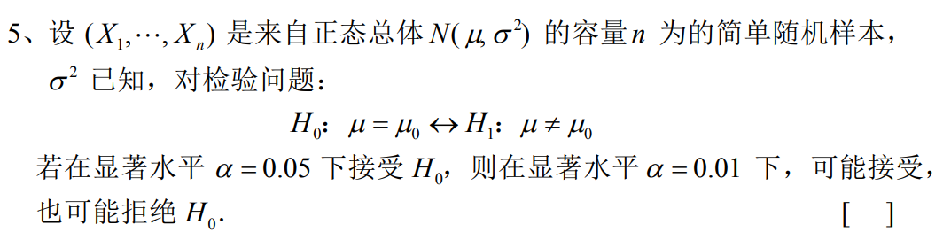



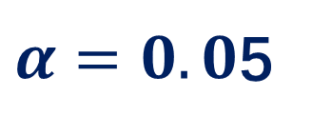




×
$α=0.0$5
$$S$$
$$\overline{S}$$
$$S$$
$$\overline{S}$$
$$α=0.01$$
$$↓$$
$$↑$$

Slide 8
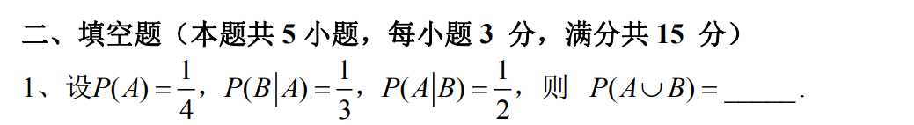
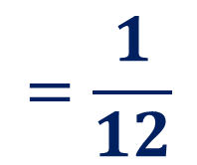

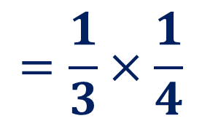
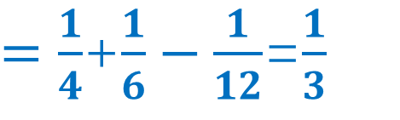

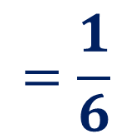

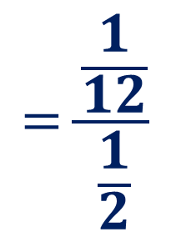

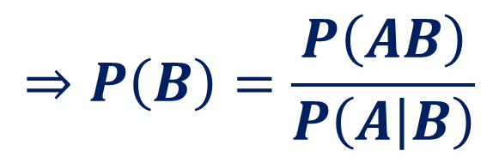
$$\frac{1}{3}$$
$$=\frac{1}{3}×\frac{1}{4}$$
$$=\frac{1}{12}$$
$$P\left(AB\right)$$
$$\text{=}P\left(B | A\right)P\left(A\right)$$
$$=\frac{\frac{1}{12}}{\frac{1}{2}}$$
$$⇒P\left(B\right)=\frac{P\left(AB\right)}{P\left(A | B\right)}$$
$$=\frac{1}{6}$$
$$P\left(AB\right)=P\left(A | B\right)P(B)$$
$$P\left(A∪B\right)=P\left(A\right)+P\left(B\right)−P\left(AB\right)$$
$=\frac{1}{4}$+$\frac{1}{6}−\frac{1}{12}$=$\frac{1}{3}$

Slide 9
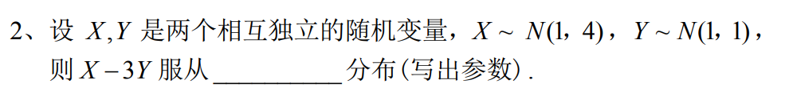
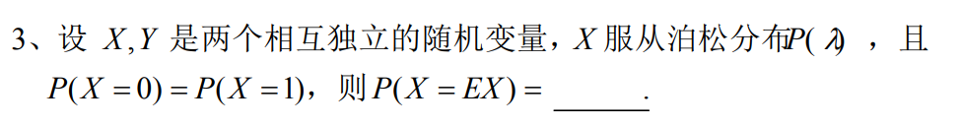
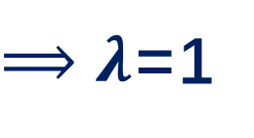
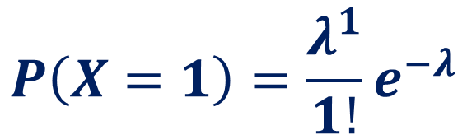

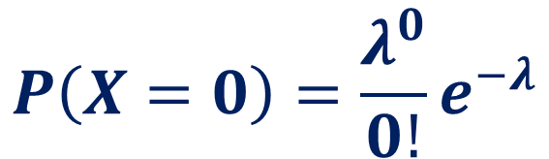




$$N(−2,13)$$
$$X−3Y\sim N(1×1+\left(−3\right)×1,1^{2}×4+{\left(−3\right)}^{2}×1)$$
$$e^{−1}$$
$$P\left(X=0\right)=\frac{λ^{0}}{0!}e^{−λ}$$
$$P\left(X=EX\right)$$
$⟹λ$=1
$$=P\left(X=1\right)$$
$$P\left(X=1\right)=\frac{λ^{1}}{1!}e^{−λ}$$
$$=e^{−1}$$

Slide 10
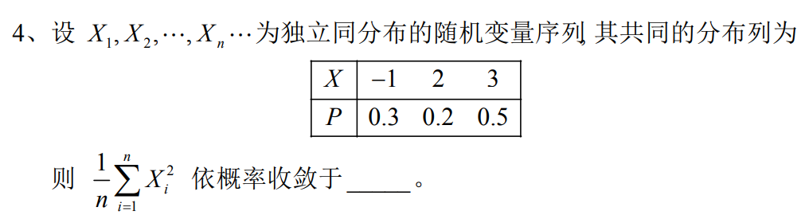
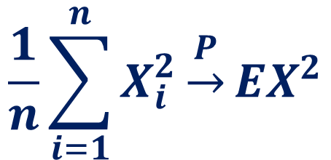

$$5.6$$
$$\frac{1}{n}\sum_{i=1}^{n}{X_{i}^{2}}\underset{→}{P}EX^{2}$$
$$={(−1)}^{2}×0.3+2^{2}×0.2+3^{2}×0.5$$

Slide 11
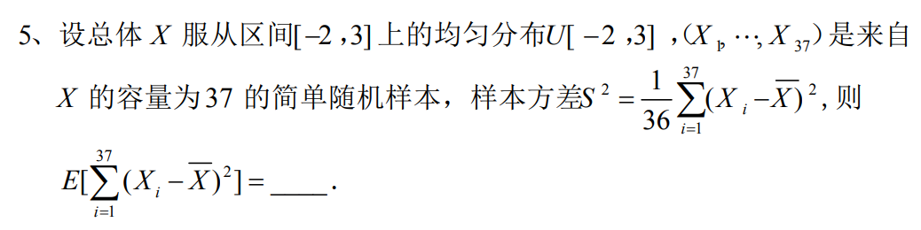
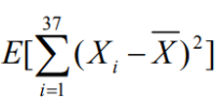

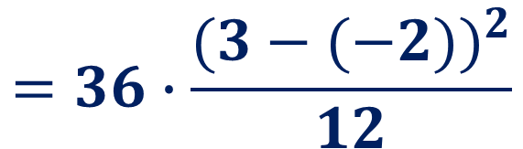




$$75$$
$$=E(36S^{2})$$
$$=36E(S^{2})$$
$$=36σ^{2}$$
$$=36∙\frac{{(3−(−2))}^{2}}{12}$$
$$=75$$

Slide 12
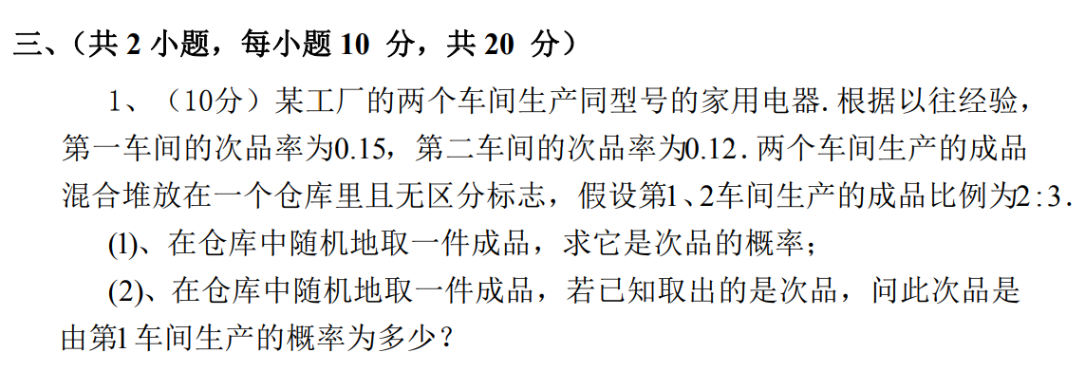
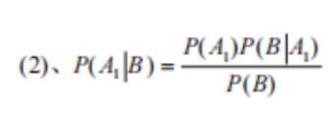
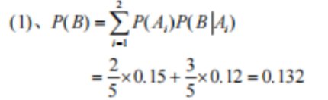
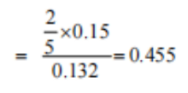

解：设$A_{i}表示产品由第i车间生产，i=1,2。$
$B表示任取一件$产品是次品，则

Slide 13
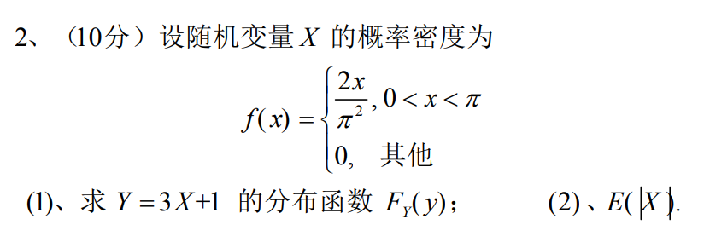

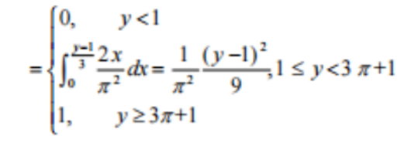


Slide 14
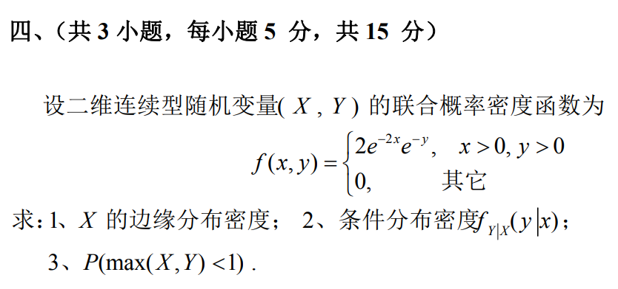

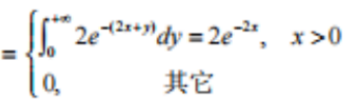

Slide 15

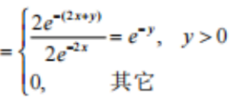

Slide 16

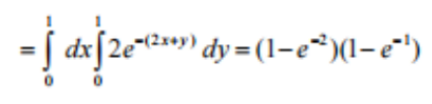

Slide 17
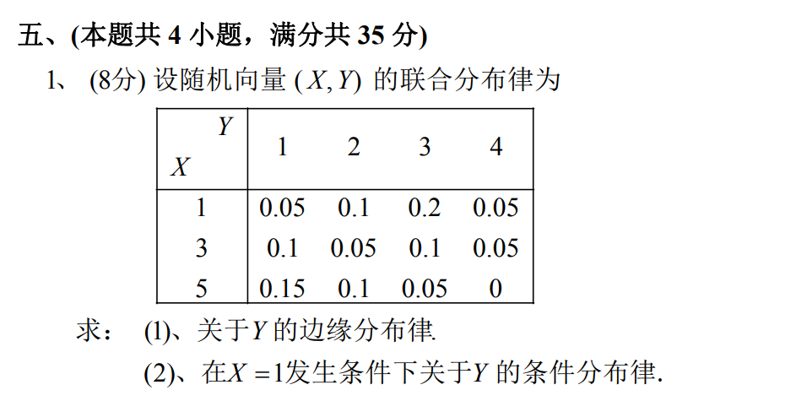



Slide 18
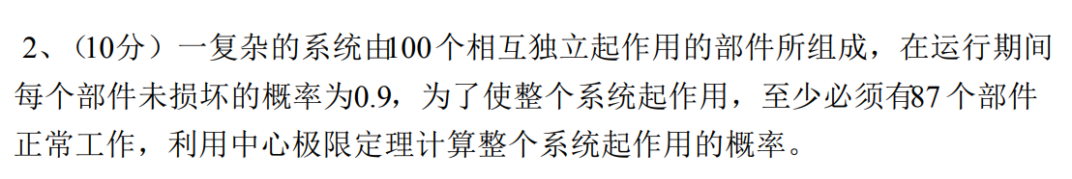




Slide 19
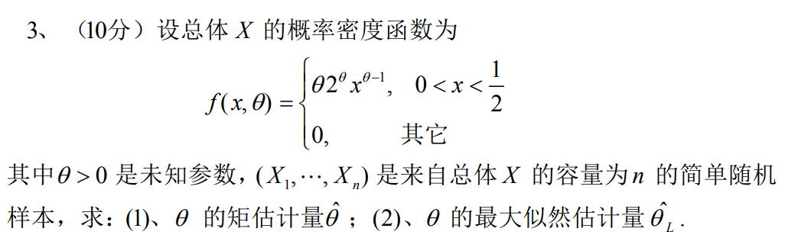
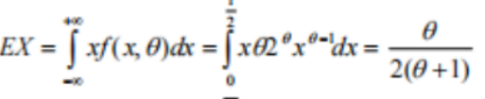



$$EX=\overline{X}$$
$$=\overline{X}$$

Slide 20





Slide 21




