Slide 1
Utilizing Model Checking to Support Constructive Proofs of the MyCHIPs Distributed Digital Currency Protocol

Slide 2
What is MyCHIPs?
Cindy
Digs Well
Fixes Car
Pays
Pays
John
Bob
Bank
Pays
Installs Solar Panels
Notes:
The motivation for this work comes from the need to verify properties in a system that serves as a currency alternative called MyCHIPs. I’m going to break this presentation into two pieces. First we will talk about what MyCHIPs is and what properties we want to verify. Then we will talk about how we will verify those properties.
Talk through this example similar to how it is presented in the proposal paper.

Slide 3
Agents in a credit lift
Originator
Validate
Relay 1
Referee
Relay 2
Validate (Option)
Validate (Option)
Validate (Option)
Notes:
Talk about how the agents in the lift can be modeled as 3 distinct types of agents. Talk about each of their roles. So there are 3 phases to how MyChips handles a lift. Descover the cycle. Promise to pay backwards around the cycle. Commit the lift.
There is a lot of engineering that goes into optimizing this process, but it is the least safety critical portion because there is no transver of value. We will only be modeling and verifying the second two phases.

Slide 4
Messages passed during a credit lift
Referee
Originator
Relay 1
Relay 2
Promise
Promise
Promise
Phase
Promise
Commit
Signature
Signature
Status
Signature
Commit
Phase
Signature
Signature
Notes:
Walk through this example of the messages passed during the lift. We should have a pretty solid understanding of the algorithm we are verifying once we finish this.

Slide 5
Properties we will verify
Termination: Lifts always eventually are committed or nullified for every active node.
Consensus: At the final state of the lift, every active node agrees that the lift was committed, or every active node agrees the lift was nullified.
No Harm: The balance of every active node on the final state of the lift is equal to or greater than its initial balance
Agreement: Every active pair of nodes on the final state of the lift agree on their shared tally
Notes:
Talk about each of these properties and refer to them by their intuitive meaning:
Termination (lifts don’t hang forever)
Consensus (every agent agrees on the status of the lift when it finishes)
Non-Harmful (we would expect balances to be equal after a lift but in cases where some agents fail we may end up with a positive balance)
Agreement (Each nodes final tally matches)
Add assumptions

Slide 6
Assumptions
The referee is always reachable: messages cannot be indefinitely delayed to or from the referee.
All agents behave according to the protocol or fail altogether: no malicious messages
Agents are all independent: An event on one agent does not affect the state of another agent.
Cryptography works as intended: Messages get to the right people. Signatures are only creatable by the signer.

Slide 7
How will we verify these properties?
Model Checking
Handles concurrency elegantly
Can verify liveness properties
Only tractable on small examples
Modeled in Spin
Theorem Proving
Reasons inductively
Can prove that properties hold for any number of agents
Proved in Coq
Notes:
Breaking down what that title means.
Talk about model checking and when it is most useful
Talk about constructive proofs and when they are most useful
Talk about the goal to get the best parts of both by proving model checking results extend to any number of agents

Slide 8
Verification flow
Model Checking
P1: Termination
P2: Consensus
P3: No harm
P4: Agreement
Theorem Proving
Assume Same Traces
Conforms

Slide 9
Model Checking
Model and Implementation in Spin

Slide 10
The mealy machine model
Tigger / Action
Recipient ! Message
Sender ? Message
Originator
Referee
Relay
No Lift
No Lift
No Lift
Node[i] ? Status /
Node[i] ! Pend
True /
Pred ! Promise
True /
Referee ! Status
Referee ? Void /
Succ ! Void
Pend
Successor ? Promise /
Predecessor ! Promise
Node[i] ? Status ⋁
Node[i] ? Commit / Node[i] ! Void
Originator ? Commit /
Originator ! Signature
Succ ? Promise /
Referee ! Commit
True /
Referee ! Status
Call
Pend
Referee ? Void ⋁ Predecessor ? Void /
Successor ! Void
Referee ? Signature ⋁
Predecessor ? Signature /
Successor ! Signature
Referee ? Void /
Succ ! Void
Referee ? Signature /
Succ ! Signature
Void
Good
Void
Good
Void
Good
Node[i] ? Status /
Node[i] ! Void
Node[i] ? Status /
Node[i] ! Signature
Notes:
We can formalize the actions that each type of agent can take using a Mealy machine. The states and transitions impose a partial order on the actions that can be taken by each node. Using this partial order, we can define the set of possible traces by construction. We can use this to prove that the properties that hold on a small system extend to a larger system through conformance. One important feature of this model is it does not explicitly model time, instead it models decisions agents make based on time as non-deterministic choices.

Slide 11
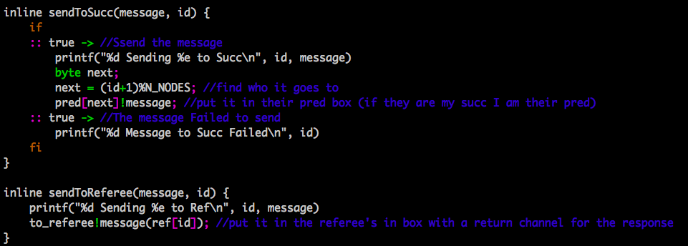
Notes:
Jump to scroll through the results.

Slide 12
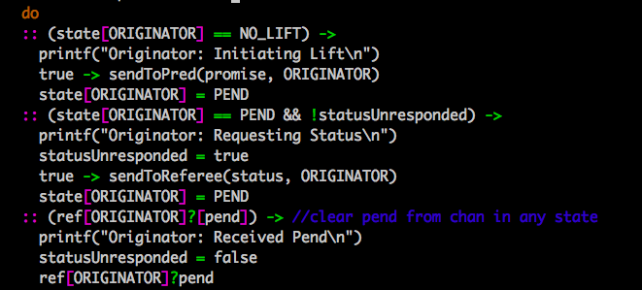

Slide 13
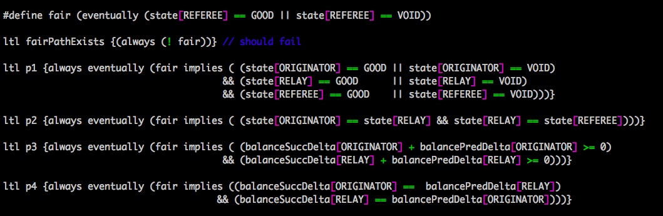

Slide 14
The mealy machine model
Tigger / Action
Recipient ! Message
Sender ? Message
Originator
Referee
Relay
No Lift
No Lift
No Lift
Node[i] ? Status /
Node[i] ! Pend
True /
Pred ! Promise
True /
Referee ! Status
Referee ? Void /
Succ ! Void
Pend
Successor ? Promise /
Predecessor ! Promise
Node[i] ? Status ⋁
Node[i] ? Commit / Node[i] ! Void
Originator ? Commit /
Originator ! Signature
Succ ? Promise /
Referee ! Commit
True /
Referee ! Status
Call
Pend
Referee ? Void ⋁ Predecessor ? Void /
Successor ! Void
Referee ? Signature ⋁
Predecessor ? Signature /
Successor ! Signature
Referee ? Void /
Succ ! Void
Referee ? Signature /
Succ ! Signature
Void
Good
Void
Good
Void
Good
Node[i] ? Status /
Node[i] ! Void
Node[i] ? Status /
Node[i] ! Signature
Notes:
We can formalize the actions that each type of agent can take using a Mealy machine. The states and transitions impose a partial order on the actions that can be taken by each node. Using this partial order, we can define the set of possible traces by construction. We can use this to prove that the properties that hold on a small system extend to a larger system through conformance. One important feature of this model is it does not explicitly model time, instead it models decisions agents make based on time as non-deterministic choices.

Slide 15
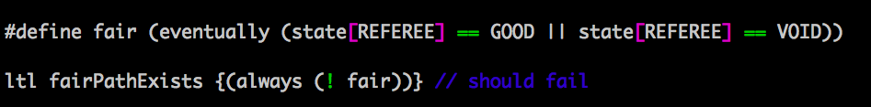

Slide 16
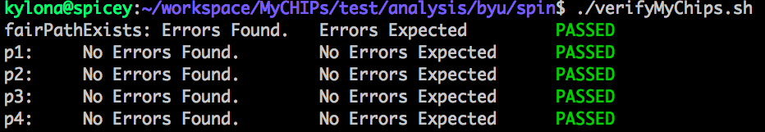

Slide 17
Theorem Proving
Partial Order and Conformance

Slide 18
Defining the partial order using the sequence diagram
Referee
Originator
Relay 1
Relay 2
Promise
Promise
Promise
Commit
Signature
Signature
Status
Signature
Signature
Signature
Notes:
Walk through this example of the messages passed during the lift. We should have a pretty solid understanding of the algorithm we are verifying once we finish this.

Slide 19
Defining the partial order using the mealy machine
Tigger / Action
Recipient ! Message
Sender ? Message
Originator
Referee
Relay
No Lift
No Lift
No Lift
Node[i] ? Status /
Node[i] ! Pend
True /
Pred ! Promise
True /
Referee ! Status
Referee ? Void /
Succ ! Void
Pend
Successor ? Promise /
Predecessor ! Promise
Node[i] ? Status ⋁
Node[i] ? Commit / Node[i] ! Void
Originator ? Commit /
Originator ! Signature
Succ ? Promise /
Referee ! Commit
True /
Referee ! Status
Call
Pend
Referee ? Void ⋁ Predecessor ? Void /
Successor ! Void
Referee ? Signature ⋁
Predecessor ? Signature /
Successor ! Signature
Referee ? Void /
Succ ! Void
Referee ? Signature /
Succ ! Signature
Void
Good
Void
Good
Void
Good
Node[i] ? Status /
Node[i] ! Void
Node[i] ? Status /
Node[i] ! Signature
Notes:
We can formalize the actions that each type of agent can take using a Mealy machine. The states and transitions impose a partial order on the actions that can be taken by each node. Using this partial order, we can define the set of possible traces by construction. We can use this to prove that the properties that hold on a small system extend to a larger system through conformance. One important feature of this model is it does not explicitly model time, instead it models decisions agents make based on time as non-deterministic choices.

Slide 20
Intuition of conformance
Relay 2
Referee
Originator
Relay 1
Relay 3
Promise
Promise
Promise
Promise
Commit
Signature
Signature
Status
Signature
Signature
Signature
Signature
Notes:
Walk through this example of the messages passed during the lift. We should have a pretty solid understanding of the algorithm we are verifying once we finish this.

Slide 21
Conformance
✓
✓
✓
O —Promise➝ Pred
R2 ⟵Promise
O —Promise➝ Pred
R2 ⟵Promise
=
R2 —Promise➝ Pred
R1 ⟵Promise
R2 —Promise➝ Pred
R1 ⟵Promise
R1 —Promise➝ Pred
R1 ⟵Promise
R1 —Promise➝ Pred
O ⟵Promise
R1 —Promise➝ Pred
R1 ⟵Signature
O —Commit➝ Ref
O ⟵Promise
R1 —Signature➝ Succ
Ref ⟵Commit
O —Commit➝ Ref
R2 ⟵Signature
Ref —Signature➝ O
Ref ⟵Commit
R2 —Signature➝ Succ
O ⟵Signature
Ref —Signature➝ O
O —Signature➝ Succ
O ⟵Signature
R1 ⟵Signature
O —Signature➝ Succ
R1 —Signature➝ Succ
R1 ⟵Signatured
O ⟵Signature
R1 —Signature➝ Succ
R2 ⟵Signature
R2 —Signature➝ Succ
O ⟵Signature
Notes:
We say that a system conforms to another system if we can project the events of the first system onto the second system. In other words if we only look at a subset of the agents in the larger system, and the events they see are identical to the events seen in a verified system, we know that the properties we care about hold for those agents. If we can prove that all traces of events possible in the system (as constructed from the partial order imposed by the protocol) can be projected onto the events of one or more verified systems, we can prove that the properties we verified in the smaller system extend to any number of nodes.

Slide 22
✓
✓
✓
R2 ⟵Promise
O —Promise➝ Pred
R2 ⟵Promise
O —Promise➝ Pred
R2 —Promise➝ Pred
R2 —Promise➝ Pred
R1 ⟵Promise
R1 ⟵Promise
R1 ⟵Promise
R1 —Promise➝ Pred
R1 —Promise➝ Pred
R1 —Promise➝ Pred
O ⟵Promise
R1 ⟵Signatured
R1 ⟵Signature
O —Commit➝ Ref
R1 —Signature➝ Succ
O ⟵Promise
R1 —Signature➝ Succ
Ref ⟵Commit
O —Commit➝ Ref
Ref —Signature➝ O
R2 ⟵Signature
R2 ⟵Signature
Ref ⟵Commit
O ⟵Signature
R2 —Signature➝ Succ
R2 —Signature➝ Succ
Ref —Signature➝ O
O —Signature➝ Succ
O ⟵Signature
R1 ⟵Signature
O —Signature➝ Succ
R1 —Signature➝ Succ
O ⟵Signature
O ⟵Signature

Slide 23
✓
✓
✓
O —Promise➝ Pred
O —Promise➝ Pred
R2 ⟵Promise
R2 ⟵Promise
=
R1 ⟵Promise
R2 —Promise➝ Pred
R2 —Promise➝ Pred
R1 —Promise➝ Pred
R1 ⟵Promise
R1 ⟵Promise
O ⟵Promise
R1 —Promise➝ Pred
R1 —Promise➝ Pred
O —Commit➝ Ref
R1 ⟵Signature
O ⟵Promise
Ref ⟵Commit
R1 —Signature➝ Succ
O —Commit➝ Ref
Ref —Signature➝ O
R2 ⟵Signature
Ref ⟵Commit
O ⟵Signature
R2 —Signature➝ Succ
Ref —Signature➝ O
O —Signature➝ Succ
O ⟵Signature
R1 ⟵Signature
O —Signature➝ Succ
R1 —Signature➝ Succ
R1 ⟵Signature
O ⟵Signature
R1 —Signature➝ Succ
R2 ⟵Signature
R2 —Signature➝ Succ
O ⟵Signature

Slide 24
✓
✓
✓
O —Promise➝ Pred
O —Promise➝ Pred
R2 ⟵Promise
R2 ⟵Promise
R1 ⟵Promise
R2 —Promise➝ Pred
R2 —Promise➝ Pred
R1 —Promise➝ Pred
R1 ⟵Promise
R1 ⟵Promise
O ⟵Promise
R1 —Promise➝ Pred
R1 —Promise➝ Pred
O —Commit➝ Ref
R1 ⟵Signature
O ⟵Promise
Ref ⟵Commit
R1 —Signature➝ Succ
O —Commit➝ Ref
Ref —Signature➝ O
R2 ⟵Signature
Ref ⟵Commit
O ⟵Signature
R2 —Signature➝ Succ
Ref —Signature➝ O
O —Signature➝ Succ
O ⟵Signature
R1 ⟵Signature
O —Signature➝ Succ
R1 —Signature➝ Succ
R1 ⟵Signature
O ⟵Signature
R1 —Signature➝ Succ
R2 ⟵Signature
R2 —Signature➝ Succ
O ⟵Signature

Slide 25
Verification flow
Model Checking
P1: Termination
P2: Consensus
P3: No harm
P4: Agreement
Theorem Proving
Assume Same Traces
Conforms

Slide 26
Summary of results and proposed work
Model a system with 1 of each type of agent in Spin
Model a system with 3 sequential relay nodes in Spin
Define the partial order of events imposed by the protocol in Coq
Define the set of all possible traces that satisfy the partial order
Prove that all possible traces conform to at least one verified system
✓

Slide 27
Questions?

