Slide 1
Health Clinic Medicine Management System
PL/SQL Database Development Capstone
Name : Bahati Theoneste ID: 28497 Group: A (Monday)
Adventist University of Central Africa (AUCA) Date: Dec 6, 2025

Slide 2
The Problem: Manual Inventory Risks
Context: The clinic relies on manual paper logs for medicine tracking.
Critical Issues:
Stockouts: Essential drugs run out without warning.
Expired Medication: Batches expire unnoticed, risking patient safety.
Security Gaps: Unrestricted access allows data manipulation at any time
Impact: compromised patient care and financial loss.

Slide 3

The Solution: Automated PL/SQL Database
Objective: Build a secure, automated inventory system using Oracle Database.
Key Capabilities:
Real-time Tracking: Stock decreases automatically upon dispensing.
Predictive Analytics: Calculates exact days of supply remaining.
Strict Security: "Weekend-Only" update rule for administrators.
Scope: Focuses on Medicine, Stock, Usage Logs, and Auditing.

Slide 4
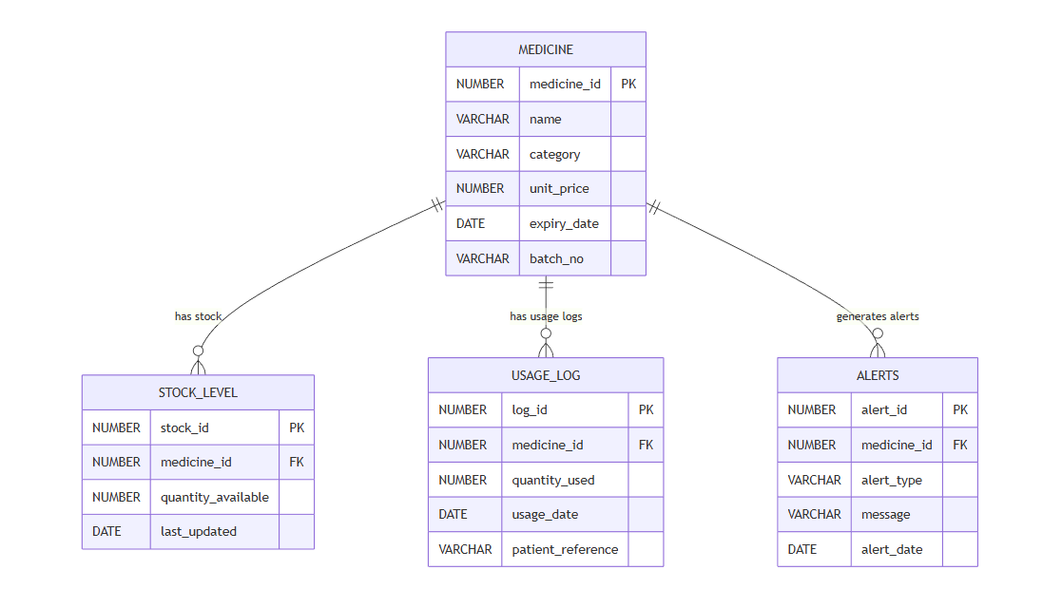
Logical Database Model
Structure: Normalized to 3rd Normal Form (3NF).
Key Entities:
  MEDICINE: Static details (Name, Price, Expiry).
  STOCK_LEVEL: Dynamic quantity (Linked via FK).
  USAGE_LOG: Transactional history.
Visual Model:

Slide 5
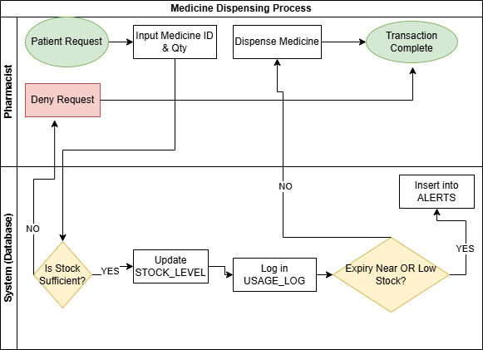
Dispensing Workflow (BPMN)
Process Flow:
Pharmacist requests medicine.
System checks stock status (Function check_stock_status )
Decision: If Stock < Request >> Block Transaction.
Action: If Allowed >> Deduct Stock & Log Usage.

Slide 6
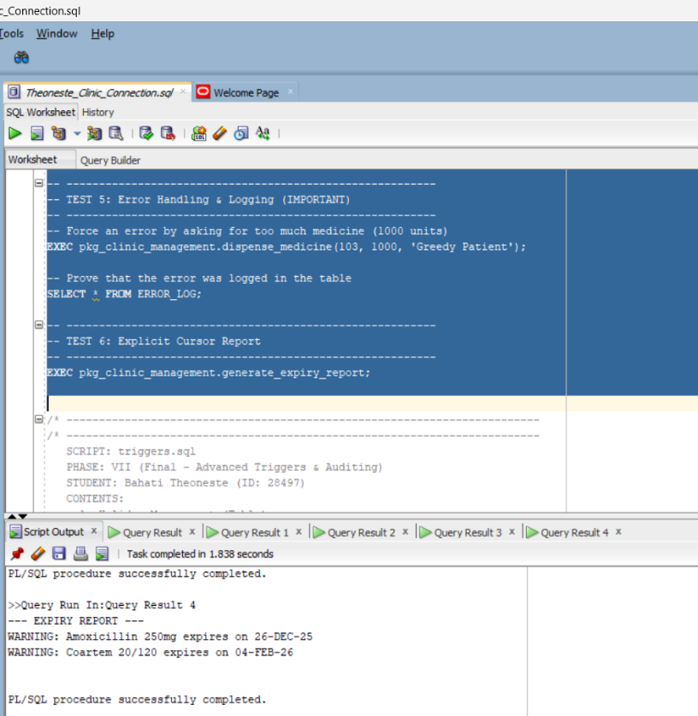
Technical Architecture
Database: Oracle Database 19c / 23ai (PDB Architecture).
Schema Owner: ADMIN_28497.
Storage: Custom Tablespaces (TBS_CLINIC_DATA) for performance.
PL/SQL Logic:
Package: pkg_clinic_management encapsulates all logic.
Procedures: dispense_medicine, restock_medicine.
Functions: predict_days_remaining, validate_batch_no.

Slide 7
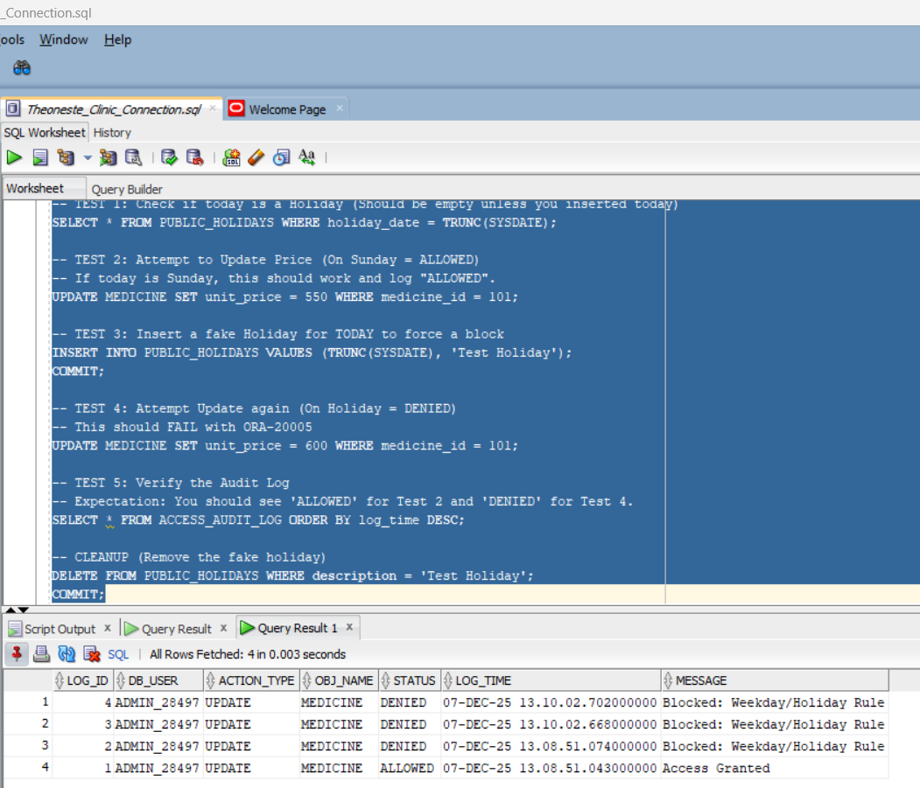
Security & Auditing (Phase VII)
Critical Rule: Updates allowed on Weekends Only (Sat/Sun).
Implementation:
Compound Trigger: trg_medicine_security.
Holiday Management: Blocks updates on Public Holidays.
Auditing:
Autonomous Transactions: Logs every attempt (Denied/Allowed)
to ACCESS_AUDIT_LOG.

Slide 8
Analytics & Innovation
Innovation: System moves beyond storage to Prediction.
Smart Forecasting:
Function predict_days_remaining estimates supply duration based on daily averages.
Trend Analysis:
Uses Window Function LAG() to analyze usage growth (Increasing vs. Declining).
Price Ranking:
Uses RANK() OVER (PARTITION BY category) for financial reporting

Slide 9
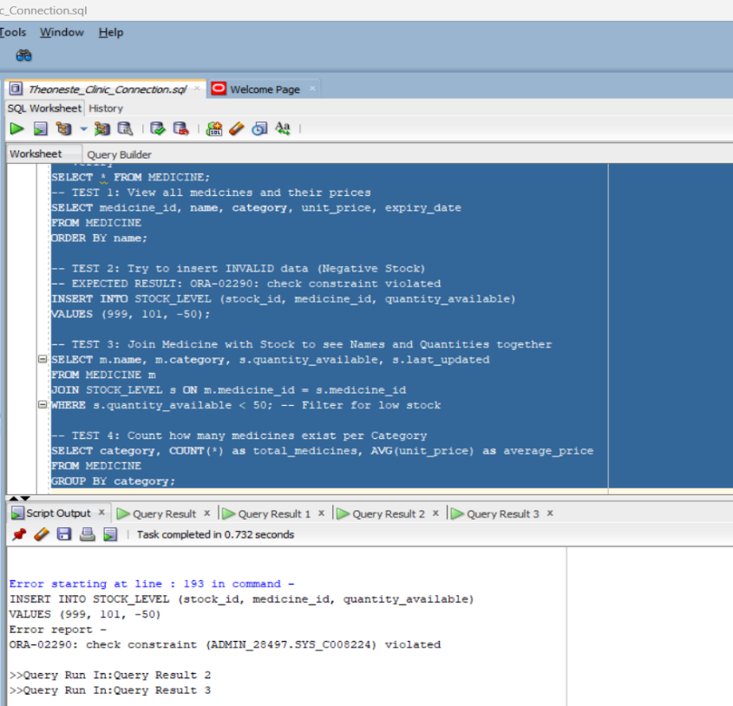
System Validation
Data Integrity: Constraints prevent negative stock (CHECK >= 0).
Transaction Safety: dispense_medicine performs atomic updates (Rollback on error).
Test Evidence: >>>>

Slide 10
Conclusion
Achievements:
Fully functional, secure PL/SQL backend.
Implemented complex logic (Cursors, Triggers, Packages).
Met all security and auditing requirements.
Lessons Learned: Importance of Autonomous Transactions for security logging.

