Slide 1
CSC 480: Artificial Intelligence I Assignment 1: Eight Puzzle (Search)

Slide 2
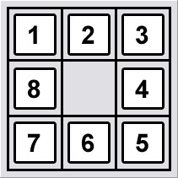
Eight Puzzle
A sliding puzzle that consists of a frame of numbered square tiles in random order with one tile missing.
The puzzle also exists in other sizes. If the size is 4×4 tiles, the puzzle is called the 15-puzzle.
The object of the puzzle is to place the tiles in order (see diagram) by making sliding moves that use the empty space.

Slide 3
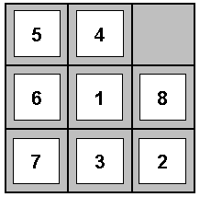
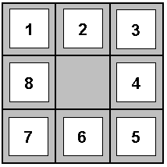
Eight Puzzle
States? integer location of tiles
Operators? move blank left, right, up, down
Goal Test? = goal state (given)
Path Cost? One per move
Note: optimal solution of n-Puzzle problem is NP-hard

Slide 4
Portion of Search Space for an Instance of the 8-Puzzle Problem
8-puzzle → 9! = 362,880 states
15-puzzle → 16! ~ 1.3 x 10¹² states
24-puzzle → 25! ~ 10²⁵ states
. . .
If states are allowed to be revisited, the search tree may be infinite even
when the state space is finite

Slide 5
8-Puzzle: Successor Function
8
2
7
3
4
5
1
6
8
2
8
2
7
8
2
7
3
4
7
3
4
6
3
4
5
1
6
5
1
5
1
6

Slide 6
Heuristics for 8-Puzzle Problem
In total, there are a possible of 9! or 362,880 possible states.
However, with a good heuristic function, it is possible to reduce the number of visited states to less than 50.
Some possible heuristics for 8-Puzzle:
h1(n) = no. of misplaced tiles
may have many plateaus (indistinguishable states)
doesn’t captures the number of moves to get to the right place
h2(n) = sum of Manhattan distances (i.e., no. of squares from desired location of each tile)
doesn’t capture the importance of sequencing tiles (putting them in the right order)

Slide 7
Heuristics for 8-Puzzle Problem
5
4
1
2
3
6
1
8
8
4
7
3
2
7
6
5
s = start state
g = goal state
h1(N) = number of misplaced tiles
h1(s) = 7
h2(N) = sum of the (Manhattan) distances of every tile to its goal position
h2(s) = 4 + 2 + 2 + 3 + 3 + 0 + 2 + 2 = 18

Slide 8
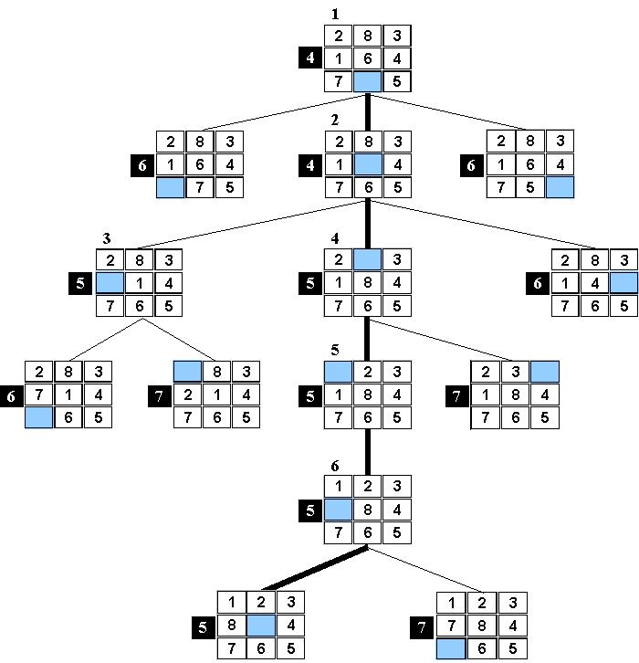
A* search for an instance of 8-puzzle with h1 (sum of misplaced tiles).
g(n) assumes each move has a cost of 1.
Here we assume repeated state checking.
f(n) = g(n) + h(n)

Slide 9
A* search for an instance of 8-puzzle with h1 (sum of misplaced tiles).
g(n) assumes each move has a cost of 1.
Here we assume repeated state checking.
Order of
expansion
f(n) = g(n) + h(n)

Slide 10
A* search for an instance of 8-puzzle with h1 (sum of misplaced tiles).
g(n) assumes each move has a cost of 1.
Here we assume repeated state checking.
f(n) = g(n) + h(n)

Slide 11
A* search for an instance of 8-puzzle with h1 (sum of misplaced tiles).
g(n) assumes each move has a cost of 1.
Here we assume repeated state checking.
f(n) = g(n) + h(n)

Slide 12
A* search for an instance of 8-puzzle with h1 (sum of misplaced tiles).
g(n) assumes each move has a cost of 1.
Here we assume repeated state checking.
f(n) = g(n) + h(n)

Slide 13
A* search for an instance of 8-puzzle with h1 (sum of misplaced tiles).
g(n) assumes each move has a cost of 1.
Here we assume repeated state checking.
f(n) = g(n) + h(n)

Slide 14
A* search for an instance of 8-puzzle with h1 (sum of misplaced tiles).
g(n) assumes each move has a cost of 1.
Here we assume repeated state checking.
f(n) = g(n) + h(n)

Slide 15
A* search for an instance of 8-puzzle with h1 (sum of misplaced tiles).
g(n) assumes each move has a cost of 1.
Here we assume repeated state checking.
A* search for an instance of 8-puzzle with h1 (sum of misplaced tiles).
g(n) assumes each move has a cost of 1.
Here we assume repeated state checking.
f(n) = g(n) + h(n)
Note: at level 2 there are two nodes listed with f(n) = 5. Depending on which node is put in front of the queue, the algorithm will either expand 6 or 7 nodes. Here we have assumed the worse case, and thus the tree shows that 6 nodes were expanded
7

Slide 16
Part of the search tree generated by Best-First search using h2 = sum of Manhattan distances.
18
17
19
16
16
15
15
17
15
14
16
13
14
14

Slide 17
Data Structure of a Node
STATE
PARENT-NODE
In your implementation, you should use a data structure similar to this to store local information for each node.
BOOKKEEPING
CHILDREN
Action
Right
Depth
5
...
Path-Cost
5
Expanded
yes
Depth of a node N = length of path from root to N
(Depth of the root = 0)

Slide 18

Assignment 1: Search
You will solve a MODIFIED version of the eight-puzzle.
The cost of a move is the VALUE OF THE TILE BEING MOVED.
The cost of the move below is 8.

Slide 19
Search
You will implement search algorithms to solve the modified 8-puzzle
Breadth-first
Depth-first
Iterative deepening (Extra Credit)
Uniform-Cost
Best-first, h = number of tiles that are not it correct position
A*1, h = number of tiles that are not it correct position
A*2, h = sum of Manhattan distances between all tiles and their correct positions
A*3, design a better heuristic (Extra Credit)

Slide 20
Inputs / Outputs
Run your program with these configurations (“0” = blank tile)
Goal: 1 2 3 8 0 4 7 6 5
Starting States:
Easy: 1 3 4 8 6 2 7 0 5
Medium: 2 8 1 0 4 3 7 6 5
Hard: 5 6 7 4 0 8 3 2 1
The output should be a solution (a sequence of actions) from start to goal, a sequence of board positions and moves. For example….
…
1 3 4 8 6 2 7 0 5
RIGHT, cost = 7, total cost = 59
1 3 4 8 6 2 0 7 5
…
However, you are welcome to dress up the UI if you so wish
Previous students have turned in some remarkable GUIs

Slide 21
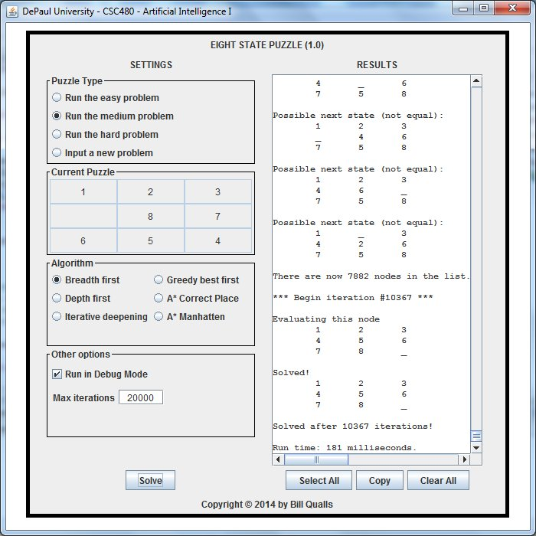
From a former CSC 480 student…

Slide 22
Deliverables
You will deliver
Code
YouTube video (include the link at the top of your write up)
Write up
Submissions that do not include all three deliverables WILL NOT be graded
DO NOT ZIP YOUR CODE OR WRITE UP. SUBMIT EACH FILE SEPERATELY.

Slide 23
Code (60 points)
Function (20 points)
The code works as intended for all inputs and search algorithms
A pleasant user interface (Just a text interface is fine)
Implementation (20 points)
Code demonstrates the author’s understanding of the algorithms
Code should be efficient
No spaghetti code
Code aesthetics (20 points)
Proper use of white space, structure, variable names, etc.
Code is appropriately commented
Every method/function/script should be commented
Assignments will be returned ungraded if your code is not understandable
Code should be well organized and adhere to good programming standards

Slide 24
Video (20 points)
YouTube video
5 minutes. No more! I will stop watching after five minute.
Video capture of your desktop with voice over
Demonstrate your code running (not more than 1 minute)
Present your code
Describe/show how you modeled the 8-puzzle including the successor function
Describe/show how you implemented the search algorithms
In particular highlight the main loop
Describe/show how you inserted and/or removed nodes from the list/queue/heap
How did you modify it for different search algorithms?
Describe/show how you checked for duplicate states
Both on the queue and previously popped off the queue.
Describe the heuristic you designed. (Extra Credit)
Leave the analysis for the written report. The video is about showing that you mastered the concepts needed to write the code.

Slide 25
Write up (20 points)
At the top of the document, include the link for the YouTube video
DOUBLE CHECK THE VIDEO IS PUBLIC
Provide the output of your program for the Easy, Medium, and Hard inputs for BFS and A*2. (If you do the extra credit, also include A*3) .
Does one solution seem better than the other? Explain.
Create a table comparing the length, cost, time and space of the different search methods using the Easy, Medium, and Hard inputs (see the table on the right for the easy case):
Length = length of the solution path
Cost = cost of the solution path
Time = number of nodes popped off the queue
Space = size of the queue at its max
Some search methods may fail to produce a solution, running forever until it crashes
Kill anything that lasts more than 5 min
Identify which approaches failed and explain why
Easy
Alg | Length | Cost | Time | Space
BFS
DFS
IDS
UCS
GBF
A*1
A*2
A*3

Slide 26
Discussion Forums
Post ideas
Post questions
Post helpful answers
Post good humored jokes
!!!!! Do not post code or solutions !!!!!

Slide 27
Warning
A quick Google search of “Eight puzzle code” will give you about millions of hits.
I strongly discourage you from lifting code from the web.
It is plagiarism (and will result in severe sanctions)
As part of the grading, your submissions will go through a nice sophisticated program that will compare your code to all the code on the Web.
The “Modified” part of our “Modified Eight Puzzle” makes most of the code you find on the Web useless anyway.

