Slide 1
自我介紹
緊急
WARNING

Slide 2

1.目標
ATTENTION
Notes:
Make me a picture of a man with white hair wearing a black and white jacket who is a trading card game player

Slide 3
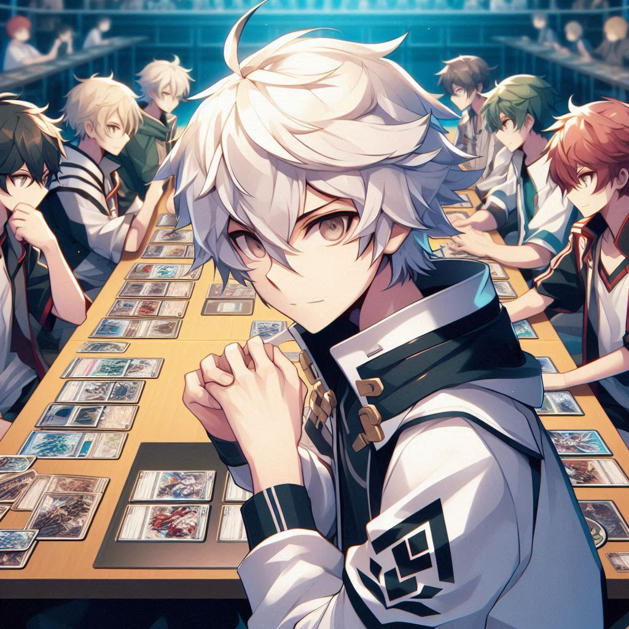
2.阻礙
ATTENTION
Notes:
Make me a picture in anime style of a man with white hair wearing a black and white jacket who is a trading card game player face off with a lot of good player

Slide 4
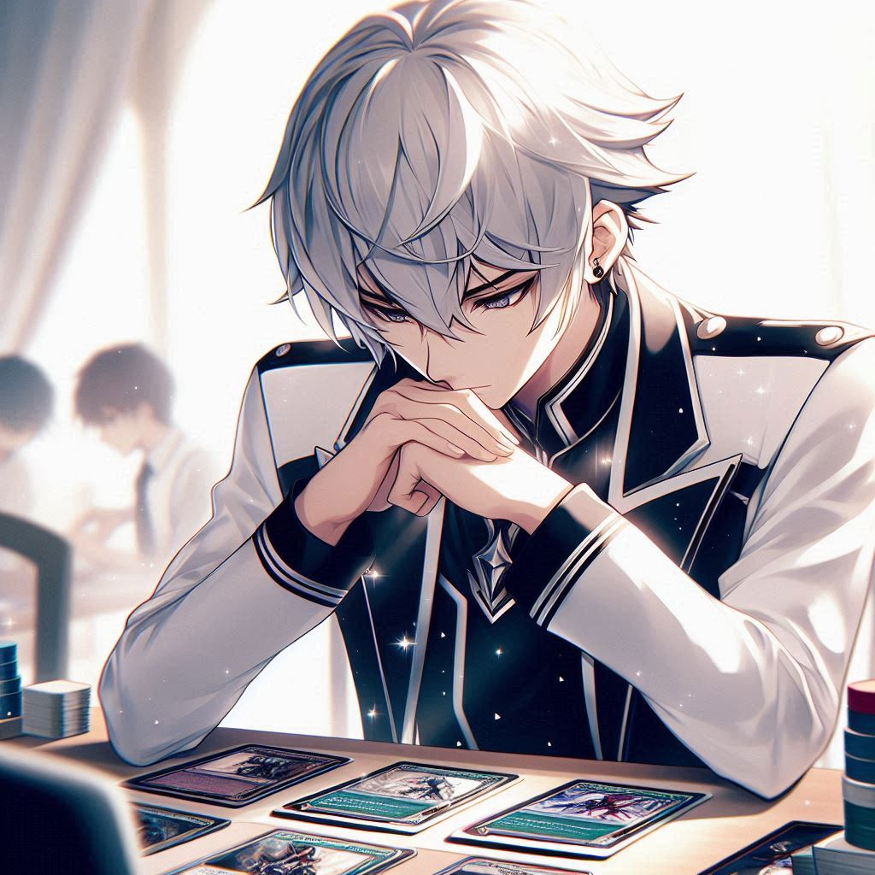
3.努力
ATTENTION
Notes:
Make me a picture in anime style of a man with white hair wearing a black and white jacket who is a trading card game player practice very hard

Slide 5

4.結果
ATTENTION
Notes:
Make me a picture in anime style of a man with white hair wearing a black and white jacket who is a trading card game player got a second place

Slide 6

5.意外
ATTENTION
Notes:
Make me a picture in anime style of a man with white hair wearing a black and white jacket who is a trading card game player is very shock because he had a very bad start card in a competition

Slide 7
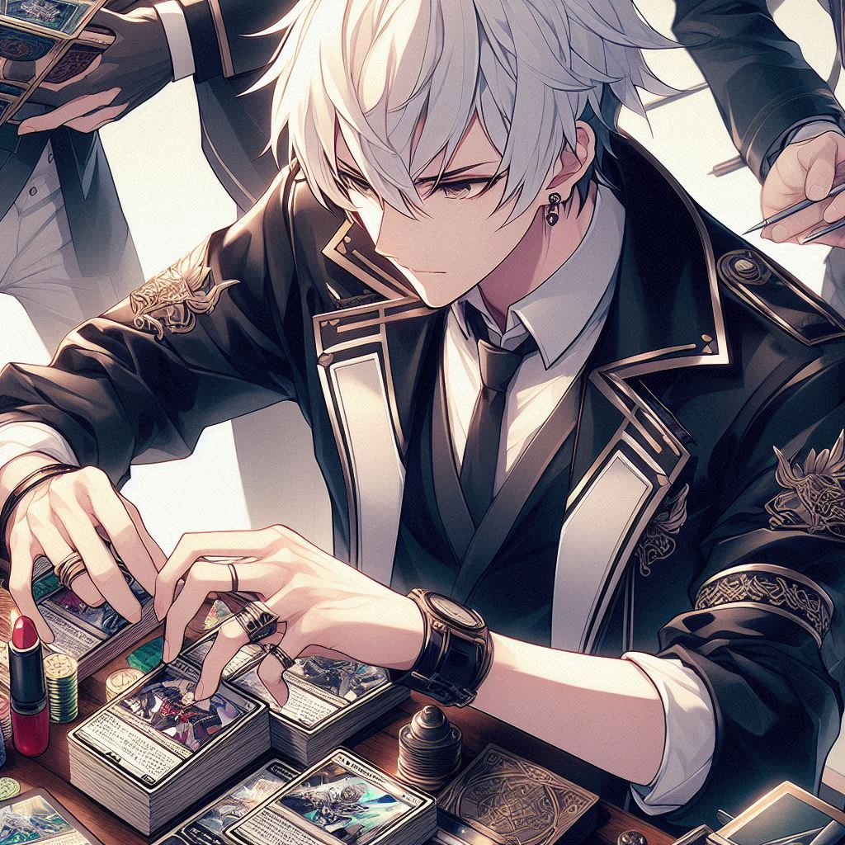
6.轉彎
ATTENTION
Notes:
Make me a picture in anime style of a man with white hair wearing a black and white jacket who is a trading card game player is very shock because he had a very bad start card in a competition

Slide 8
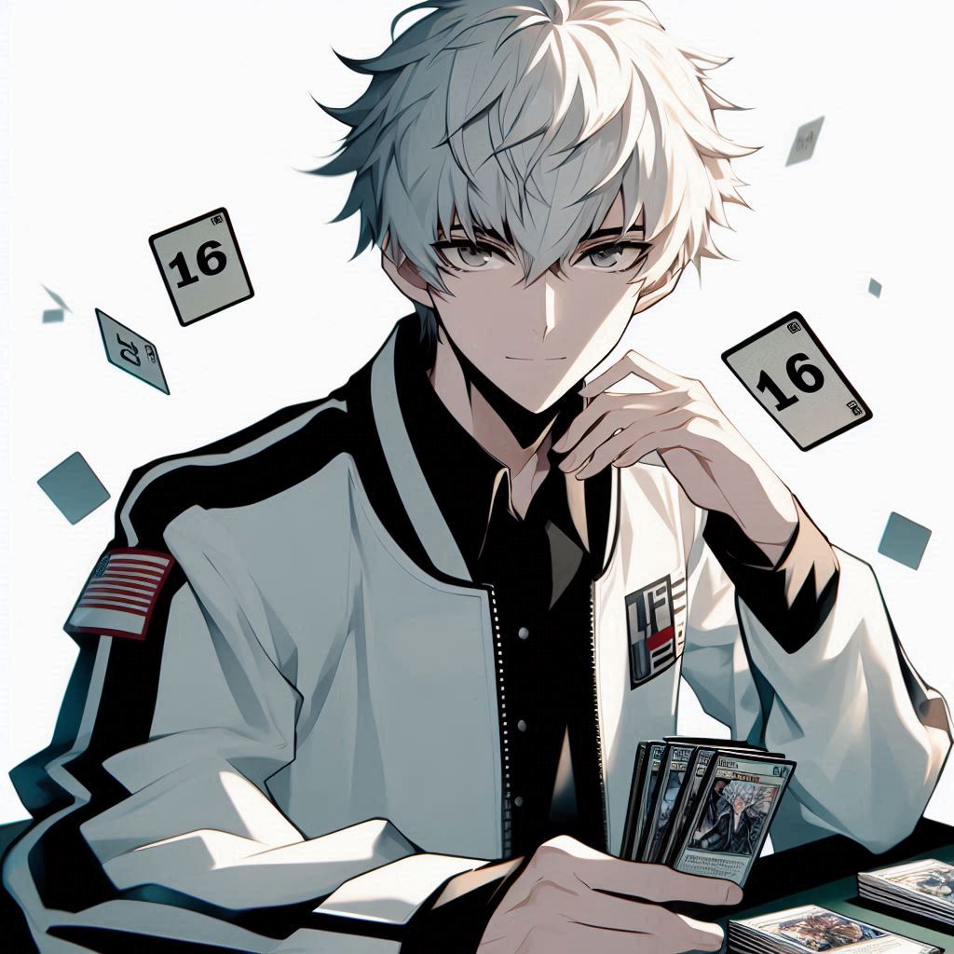
7.結局
ATTENTION
Notes:
Make me a picture in anime style of a man with white hair wearing a black and white jacket who is a trading card game player came back from the down and get a 16th place in a 100 man competition

Slide 9
非常事態
THE END

