Slide 1


C A S E S T U D Y
Software Engineering KISS Sorcar
with KISS Sorcar
Building a self-hosting AI assistant and IDE — and analyzing 3,099 tasks it ran on its own code
Koushik Sen
EECS Department, UC Berkeley · ksen@berkeley.edu

Slide 2
T H E B I G I D E A
We built it with itself
From the second month on, every code change, bug fix, feature, and paper draft was produced by KISS Sorcar operating on its own repository. Self-hosting turns the system into a continuous stress test.
3,099
tasks issued
44
days of development
877
chat sessions
~2,900
lines of agent code
KISS Sorcar · K. Sen, UC Berkeley
03

Slide 3
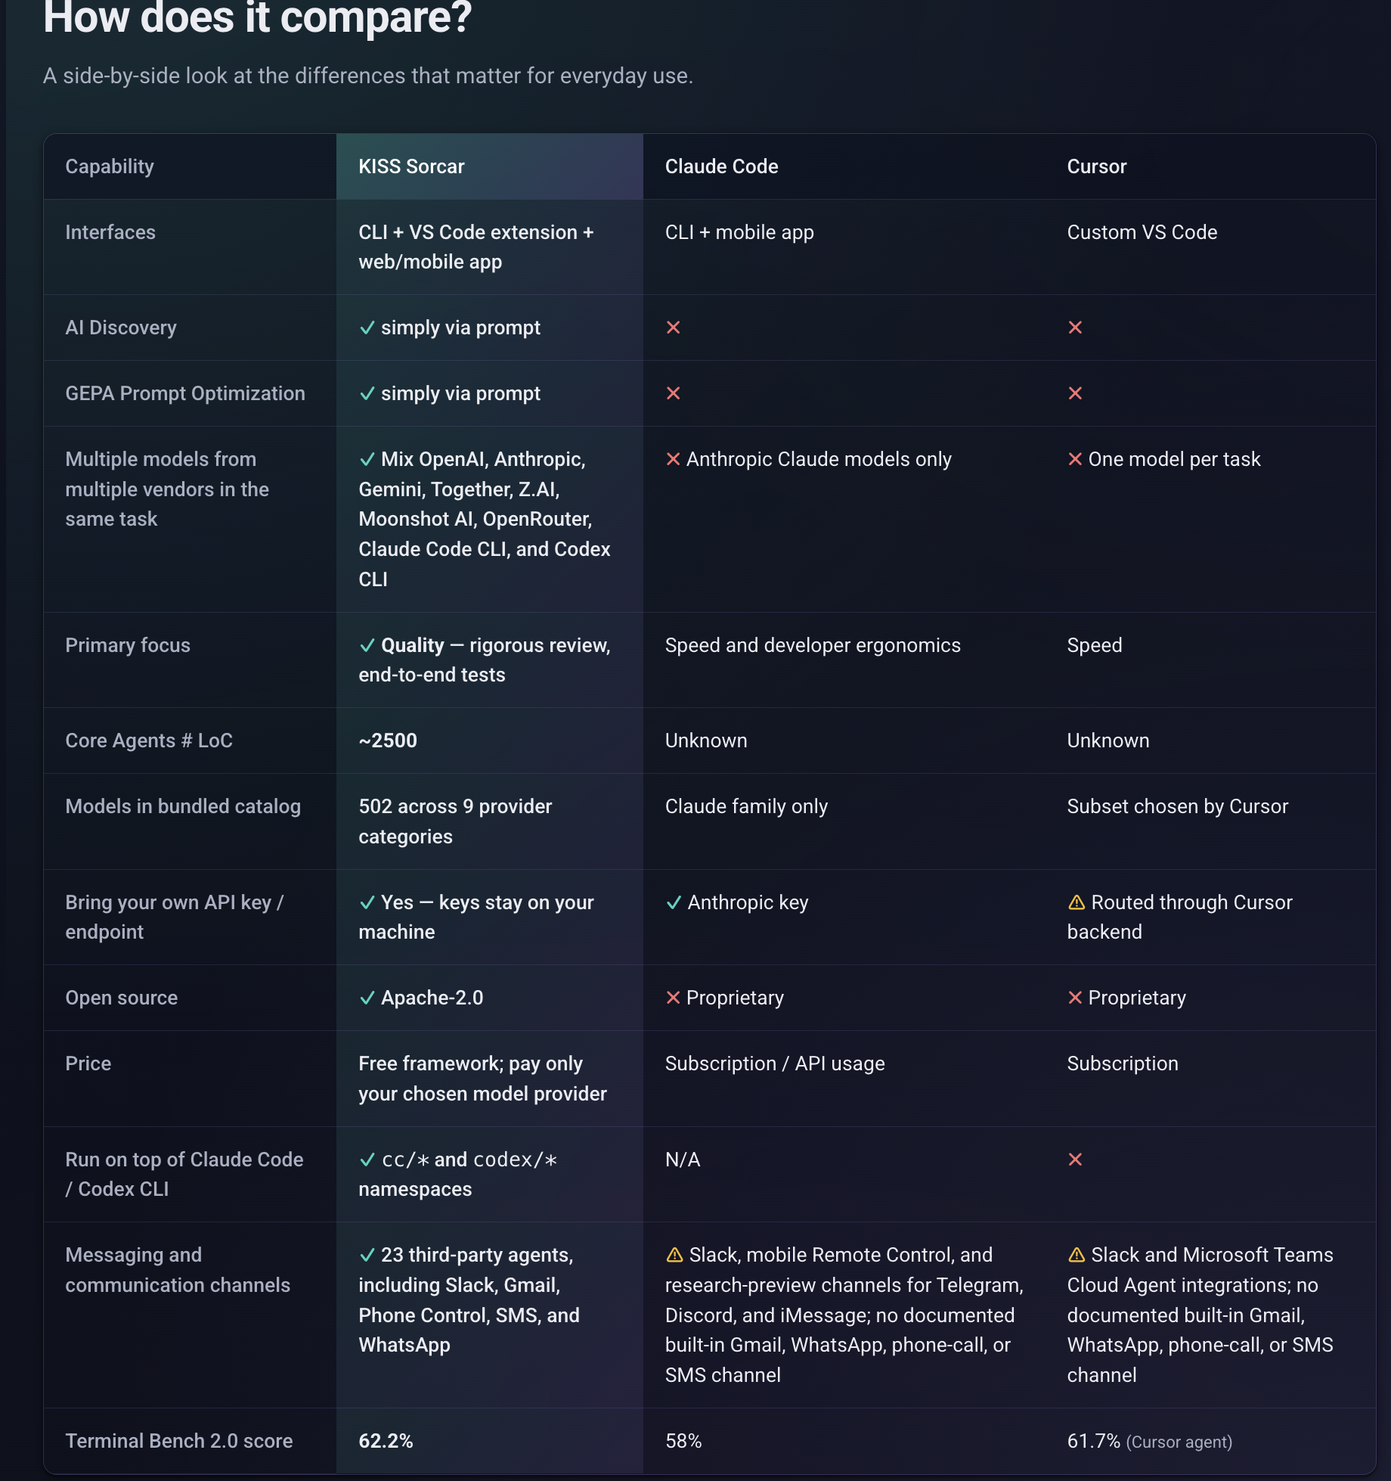

Slide 4
F I N D I N G S
Nine recurring usage patterns
1
Test-first bug fixing
2
Iterative feature construction
3
Periodic code hygiene
4
Paper–code co-evolution
5
Architecture investigation before change
6
System-prompt engineering
7
Multi-channel general assistance
8
Invariant specification and repair
9
Cross-model iterative review
KISS Sorcar · K. Sen, UC Berkeley
07

Slide 5
P A T T E R N 1
Test-first bug fixing
The most common pattern (~20% of tasks): report a bug, write a test that reproduces it, then fix the root cause and verify.
— Three-step protocol: report → reproduce with an integration test → fix root cause and confirm the test passes.
— Evidence, not edits: a test that fails before and passes after proves the bug was real and the fix addressed it.
— Concurrency sub-class: race conditions exposed by running many tabs and a remote server against one repo.
— Defensive revert: “get rid of the last commit” recurs 30+ times — undo first, re-attempt fresh.
From the log
“Can you reproduce the bug by writing an integration test? Then fix it.”

Slide 6
P A T T E R N 2
Iterative feature construction
Features were never built in one task. Describe → observe → refine, often across 5–20 tasks in a single chat session.
— Remote web server: started with one task, hardened over 60+ tasks — TLS, mobile layout, auth, URL discovery, robustness.
— Spec emerges from use: no design document; each refinement was prompted by actually using the feature and hitting a limit.
— Interleaved with fixing: ~half the follow-ups in a feature session are themselves test-first bug reports.
— Demo mode: refined over many days — a feature is never “done” when it first works.
From the log
“…implement a feature where the user can access KISS Sorcar from any device with a browser.”

Slide 7
P A T T E R N 3
Periodic code hygiene
Every 20–30 tasks, the developer ran a dedicated cleanup sweep — decoupled from feature work.
— “uv run check --full and fix”: the 2nd most frequent command in the log (50 verbatim occurrences).
— Directory audits: “find all bugs, redundancies, and inconsistencies” invokes a collect-then-act discipline.
— Honest test oracle: “fix tests only if there is no bug in the code — report the bugs” guards against weakened assertions.
— Garbage collection: lets small inconsistencies accumulate, then clears them in one pass.

Slide 8

P A T T E R N 4
Paper–code co-evolution
The system prompt and the paper describing it evolved together — a self-hosted documentation loop.
— Code-to-paper: “SYSTEM.md has changed — update and build the paper” (Tasks 84, 167, 233, 261, 274, 312, 665, 693, 766…).
— Consistency audits: “check the paper against itself and the latest code” closes the loop — divergence is mechanically detectable.
— Paper-to-code: Task 700 used the paper as source of truth — typo fixes in the paper were propagated back into SYSTEM.md.
— High volume: “build the paper” appears in 73 tasks — one of the highest-volume non-coding activities in the log.

Slide 9
P A T T E R N 5
Architecture investigation before change
Before non-trivial changes, the developer asks the agent to explain the current design — “understand before you change.”
— Explain first: “show me the step-by-step workflow of web_server.py”; “what happens when two tasks run at once?”
— No translation loss: the same agent produces both the explanation and the subsequent edits over the same source.
— Visual variant: “create a graph diagram of how the server-side files are related” before reorganizing them.
— Front-loaded comprehension: turns a vague aspiration into a precise, local edit request.

Slide 10
C A S E S T U D Y
The explain-then-revise loop
Redesigning the git-worktree merge workflow — six consecutive tasks (1 of 3), no file ever opened by hand.
1 Elicit
2 Revise
Can you tell me what happens, step by step, with git in worktree_sorcar_agent.py when a task finishes?
Can you change worktree_sorcar_agent.py and the extension so that after the agent finishes its task, it simply asks "Commit and Merge" or "Discard". When "Commit and Merge" is clicked by the user, the agent must commit the changes with a generated commit message, merge the branch with the original branch, and delete the worktree and the branch associated with the worktree. If the user clicks "discard", it must delete the worktree and the branch, and checkout the original branch.
17

Slide 11
C A S E S T U D Y
The explain-then-revise loop
Redesigning the git-worktree merge workflow — six consecutive tasks (2 of 3), no file ever opened by hand.
3 Diagnose
4 Fix
After the user presses "Commit and Merge", why do the modified files show up as committed in the original branch?
The review is already happening in the worktree branch. You don't need the user to review the modified and new files in the original branch. Fix it.
18

Slide 12
C A S E S T U D Y
The explain-then-revise loop
Redesigning the git-worktree merge workflow — six consecutive tasks (3 of 3), no file ever opened by hand.
5 Audit
6 Audit
What happens to my uncommitted changes if I start a task while the working tree is dirty and then click "Commit and Merge"?
What happens if two tabs both press "Commit and Merge" on the same repo at the same time? Can the checkout/merge steps interleave?
19

Slide 13
P A T T E R N 6
System-prompt engineering
~100 tasks refined the system prompt itself — treated as production code, tested against observed behavior.
— Log as test data: “Look at this week’s tasks and their trajectories; which instructions in the system prompt are not being followed? Write a test with a real task and real LLM call to reproduce each issue. Fix the system prompt. Test.”
— Mutation testing for a spec: write a real-LLM test to confirm an observed deviation, then patch the prompt.

Slide 14
P A T T E R N 7
Multi-channel general assistance
The same prompt and architecture serve non-coding tasks — one agent, one prompt, one architecture, scaling across domains.
— Smart home: Govee lights. Travel: Yosemite trip planning.
— Weather, shopping, finance: current-data queries and ETF analysis.
— Communication: Slack, iMessage, Gmail — uniform third-party agent interface, no special routing.
— Same rigor off-task: Web Research protocol applies; an unethical hacking request was refused with five legitimate alternatives.

Slide 15
P A T T E R N 8
Invariant specification and repair
State a user-visible invariant in one sentence, reproduce any violation with an end-to-end test before touching code, then split implementer and reviewer across two vendors.
— Five-line template: X MUST hold → reproduce with an integration test → fix → model A codes → model B (other vendor) reviews.
— Test before fix: the failing-then-passing end-to-end test is an artifact the reviewer can refute independently and stays as a regression guard.
“The remote web server MUST remain responsive even after the MacBook lid is closed.”

Slide 16
P A T T E R N 8
Invariant specification and repair
State a user-visible invariant in one sentence, reproduce any violation with an end-to-end test before touching code, then split implementer and reviewer across two vendors.
— Five-line template: X MUST hold → reproduce with an integration test → fix → model A codes → model B (other vendor) reviews.
— Test before fix: the failing-then-passing end-to-end test is an artifact the reviewer can refute independently and stays as a regression guard.
“The Sorcar CLI MUST set worktree mode on, parallel mode on, and auto-commit on by default.”

Slide 17
P A T T E R N 8
Invariant specification and repair
State a user-visible invariant in one sentence, reproduce any violation with an end-to-end test before touching code, then split implementer and reviewer across two vendors.
— Five-line template: X MUST hold → reproduce with an integration test → fix → model A codes → model B (other vendor) reviews.
— Test before fix: the failing-then-passing end-to-end test is an artifact the reviewer can refute independently and stays as a regression guard.
“The remote web server MUST remain responsive even after the MacBook lid is closed.”

Slide 18
P A T T E R N 9
Cross-model workflow
set_model lets one agent swap weights mid-task — primary writes code, a different vendor's model audits, repeat until clean.
— set_model tool: copies conversation history and cumulative budget; rebuilds the tools schema in the new vendor's dialect; persists across turns.
— Three idiomatic uses: scout-then-edit (cheap → strong); generate-then-review (vendor swap); cost-aware long-loop (frontier only at decisions).
— Ensemble disagreement: off-by-ones, missed call sites, and stale imports that a single model blesses are caught by a model trained on a different mixture.
— Single continuous task: no second human reviewer; transcript and cumulative budget travel across the switch — the sidebar shows the price of the second opinion.
“Use claude-opus-4-7 for coding, bug fixing, and test creation. Use gpt-5.5 (not codex) for thorough review and debugging of the work done by the other model.”

Slide 19
P A T T E R N 9
Cross-model workflow
set_model lets one agent swap weights mid-task — primary writes code, a different vendor's model audits, repeat until clean.
— set_model tool: copies conversation history and cumulative budget; rebuilds the tools schema in the new vendor's dialect; persists across turns.
— Three idiomatic uses: scout-then-edit (cheap → strong); generate-then-review (vendor swap); cost-aware long-loop (frontier only at decisions).
— Ensemble disagreement: off-by-ones, missed call sites, and stale imports that a single model blesses are caught by a model trained on a different mixture.
— Single continuous task: no second human reviewer; transcript and cumulative budget travel across the switch — the sidebar shows the price of the second opinion.
“Use GLM-5.2 model for all tasks including coding, bug fixing, and test creation. ALWAYS use gpt-5.5-xhigh (not codex) to carefully and thoroughly review and debug the work done by GLM-5.2 for bugs and missing code. Then use claude-opus-4-7 to do the same thing..”

Slide 20
P A T T E R N 9
Cross-model workflow
set_model lets one agent swap weights mid-task — primary writes code, a different vendor's model audits, repeat until clean.
— set_model tool: copies conversation history and cumulative budget; rebuilds the tools schema in the new vendor's dialect; persists across turns.
— Three idiomatic uses: scout-then-edit (cheap → strong); generate-then-review (vendor swap); cost-aware long-loop (frontier only at decisions).
— Ensemble disagreement: off-by-ones, missed call sites, and stale imports that a single model blesses are caught by a model trained on a different mixture.
— Single continuous task: no second human reviewer; transcript and cumulative budget travel across the switch — the sidebar shows the price of the second opinion.
Sakana AI’s Fugu Ultra in 3 sentences
“Use the best model from ~/.kiss/MODEL_INFO.json for various sub tasks. Search the internet extensively to figure out which model is good for each sub-task. Here's what I've found works best in practice: claude-opus-4-7 — best for SWE work , gpt-5.5 — best for reviewing, and GLM-5.2 — for SWE tasks when budget is low.”

Slide 21
AI Discovery and Auto research
Evolutionary search over programs: source code, prompts, or model recipes as the genotype; an LLM mutates/recombines parents and an automated evaluator scores each offspring, with the fittest fed back as parents for the next generation.
FunSearch: island-based population + execution-feedback → cap-set, bin-packing. AlphaEvolve scaled the recipe to math, hardware, Google infrastructure.
OpenEvolve added MAP-Elites quality-diversity; ShinkaEvolve added parent-sampling, code-novelty rejection, and bandit-based LLM-ensemble selection.
ADRS transferred the loop to systems-performance research; GEPA showed the same skeleton optimizes prompts when fitness is trajectory-level reflection.
Common contract — NL objective, code/prompt as mutation unit, automated evaluator, journal, anti-reward-hacking & generalization clauses — is exactly what KISS Sorcar's AI Discovery template inherits.

Slide 22
AI Discovery as a Prompt in KISS Sorcar
Can you discover the lightest and fastest AI model that will give the best accuracy and recall on the data at <</path/to/data>> at the cheapest price? Analyze the data and search the internet extensively to propose the first few models. Implement and experiment with each of your proposals. Note down the ideas you used to optimize the accuracy/recall and speed/cost metrics achieved in a file, so that you can use the file to not repeat ideas that have already been tried and/or failed. You can also use the file to combine ideas that have been successful in the past. Separate 20% of the data for evals, and your discovery strategy must not look at the evals data. Use 'lambda' CLI to train your models on GPUs and evaluate if needed. Total budget for Lambda Labs is $1000. Experiment with a smaller subset of data and fewer parameters in a model to do experiments quickly and then extrapolate. Use internet search extensively at every step. MAKE SURE THAT YOU DO NOT DO REWARD HACKING OR CHEATING IN THE MODELS OR AGENTS YOU ARE IMPLEMENTING TO FIT DATA. YOUR SOLUTION MUST GENERALIZE BEYOND THE DATA PROVIDED. Do not STOP until accuracy/recall reaches 95% on evals and you can process each query in less than 600 seconds and under 50 USD per query amortized over all queries. Create an html report with diagrams and illustrations in ./reports and open it in the user's default browser?

Slide 23
Advantages: AI Discovery as Prompt
Rapidly prototype and change discovery algorithms
No need to use a specialized AI discovery software such as AlphaEvolve, OpenEvolve, ShinkaEvolve, GEPA, SkyDiscover
Even optimize the AI discovery prompt for each domain using AI discovery

Slide 24
Code Optimization as a Prompt in KISS Sorcar
Can you run the command <<command>> in the background and monitor its output in real time to optimize the code at <<folder_name_or_url>> with respect to the following metrics: <<speed, accuracy, recall, cost>>. You can add diagnostic code which will print the metrics, such as running time at a finer level of granularity. Check for opportunities to optimize the code on the basis of the metrics information. If you discover any opportunities to optimize the metric based on the code, logs, events, and the command output, optimize the code and run the command again. Note down the ideas you used to optimize the code and the metric you achieved in a file, so that you can use the file to not repeat ideas that have already been tried and failed. You can also use the file to combine ideas that have been successful in the past. Repeat the process. Do not forget to remove the diagnostic code after the optimization is complete. You MUST NOT STOP until the metrics achieve the following values: <<give_concrete_values_for_metrics>>. Use the internet extensively to get new ideas for optimization. Create an html report with diagrams and illustrations in ./reports and open it in the user's default browser?

Slide 25
F R O M T H E L O G
Verbatim user tasks — engineering
Real, unedited requests recorded in sorcar.db — short natural language, one task at a time.
TEST-FIRST BUG FIX
“Can you reproduce the bug by writing an integration test? Then fix it.”
BUG REPORT
“ask_user_question is not showing its window in the web/mobile app.”
CODE HYGIENE
“uv run check --full and fix” — the 2nd most frequent command (50×).
DIRECTORY AUDIT
“Find all bugs, redundancies, and inconsistencies in agents/vscode/.”
DEFENSIVE REVERT
“Can you get rid of the last commit to main?” — recurs 30+ times.
ITERATIVE FEATURE
“Let the user access KISS Sorcar from any device with a browser.”
INVESTIGATE FIRST
“Show me the detailed step-by-step workflow of web_server.py.”
PROMPT ENGINEERING
“Which SYSTEM.md instructions were not followed yesterday? Fix them.”
KISS Sorcar · K. Sen, UC Berkeley
15

Slide 26
F R O M T H E L O G
Verbatim user tasks — general assistance
The same agent, prompt, and architecture handle everything beyond code.
SMART HOME
“Turn off the living room and family room lights.” (Govee API)
TRAVEL
“Plan me a trip to Yosemite” — with hotel availability checks.
WEATHER
“How is the weather today?” — answered from live sources, never stale data.
SHOPPING
“Where can I find Darjeeling tea in the Bay Area?”
FINANCE
“Will Microsoft stock increase by August 2026?” — plus ETF analysis.
COMMUNICATION
Slack, iMessage, and Gmail messages — sent through third-party agents.
SELF-SETUP
“Authenticate with govee.com so you can control the lights.”
ETHICAL REFUSAL
An unethical hacking request — refused, with five legitimate alternatives.
KISS Sorcar · K. Sen, UC Berkeley
16

Slide 27
T H E S P E C
The system prompt as engineering specification
A structured, human-readable spec — XML-tagged sections, each encoding one principle.
<identity>
<visibility_constraint>
<tool_rules>
<web_research>
<code_style>
<workflow>
<testing>
<pre_finish_verification>
<sorcar_specific>
— Prompt as test oracle: audit compliance from the log, write a real-LLM test, then patch the prompt.
— Evolved voice: from aggressive imperatives to calm, explanatory framing — the agent performed better.
— Every rule names a failure mode: a specific action and a specific verification, refined iteratively.
KISS Sorcar · K. Sen, UC Berkeley
22

Slide 28
L E S S O N S
What the patterns reveal
— The role shifts: from writing code to directing and verifying an agent that writes code — discipline lives in task phrasing.
— Natural language is precise enough: when explanation and edit come from the same agent over the same source, vague instructions land.
— The self-hosting paradox: the tool must be good enough to build itself; resolved by bootstrapping, version by version.
— Cost of the approach: ~1 in 90 tasks needed a defensive revert — but every surviving change is validated by its own maintainer.
— A general-purpose companion: because it is used all day, it becomes the interface for everything, not just coding.
KISS Sorcar · K. Sen, UC Berkeley
23

Slide 29
Web Research & File Browsing Protocols
Two-Phase Approach: COLLECT first → SYNTHESIZE second (skipped for pure code edits with sufficient context)
Web Research
File Browsing
• Visit AT LEAST 10 websites (HARD requirement)
• Read files into PWD/tmp/file-information-{id}.md
• Use go_to_url() only — NOT curl/wget (loophole closed)
• Collect WITHOUT much thinking first
• Collect into PWD/tmp/information-{id}.md (your proof of work)
• Extract facts: signatures, hierarchies, call sites
• Real-time data: look it up — never answer from training memory
• Summary is smaller than raw files — saves context
• Don’t fabricate source counts; skip for code edits with context
• Prevents premature commitment to a plan
KISS Sorcar — Koushik Sen, UC Berkeley

Slide 30
T A K E A W A Y S
Conclusion
— Nine patterns emerged from 44 days of building KISS Sorcar with itself.
— Each maps to a decades-old software engineering principle.
— One 2,900-line framework and a single structured prompt wrote code in five languages, controlled lights, planned trips, and refused an unethical request.
The surprise is not the principles — they are decades old. The surprise is that encoding them in a prompt and a simple layered architecture produces an assistant that works well enough to build itself.
KISS Sorcar · K. Sen, UC Berkeley
25

Slide 31
Thank you
Keep it simple — and let the system build itself.
Koushik Sen · ksen@berkeley.edu
github.com/ksenxx/kiss_ai

