Slide 1

William Stallings, Computer Organization and Architecture. 9th Edition
Chapter 1: Introduction
Notes:
Lecture slides prepared for “Computer Organization and Architecture”, 9/e, by William Stallings, Chapter 1 “Introduction”.
Modified by Thân Văn Sử

Slide 2
Objectives
Why should we study this chapter?
Distinguishing architecture and organization
What is a hierachical system?
What are basic computer functions?
What are main structural components of the computer?
System: an assemblage of related parts in which there exists an operating mechanism.
Hierarchical system: a system in which each part have a level but without a like or equal
Notes:
Phân biệt kiến ​​trúc và tổ chức
Hệ thống điều khiển phân cấp là gì?
Các chức năng cơ bản của máy tính là gì?
Các thành phần cấu trúc chính của máy tính là gì?

Slide 3
Contents
1.1- Organization and Architecture.
1.2- Structure and functions
Notes:
Tổ chức và Kiến trúc.
Cấu trúc và chức năng

Slide 4
1.1- Computer Organization and Architecture
Computer Architecture
Attributes of a system visible to the programmer
Have a direct impact(affect) on the logical execution of a program
Architectural attributes include:
Instruction set, number of bits used to represent various data types, I/O mechanisms, techniques for addressing memory
Computer Organization
The operational units and their interconnections that realize the architectural specifications
Organizational attributes include:
Hardware details transparent to the programmer, control signals, interfaces between the computer and peripherals, memory technology used
Differences:
Notes:
Khi mô tả máy tính, người ta thường phân biệt giữa kiến ​​trúc máy tính và tổ chức máy tính. Mặc dù rất khó để đưa ra định nghĩa chính xác đối với các điều khoản này, tồn tại sự đồng thuận về các lĩnh vực chung được đề cập trong mỗi (ví dụ: xem [VRAN80], [SIEW82] và [BELL78a]); một chế độ xem thay thế thú vị được trình bày trong [REDD76]. Kiến trúc máy tính đề cập đến các thuộc tính đó của một hệ thống mà lập trình viên hay nói cách khác là những thuộc tính có tác động trực tiếp đến thực thi logic của một chương trình. Tổ chức máy tính đề cập đến hoạt động các đơn vị và sự kết nối của chúng để thực hiện các đặc điểm kiến ​​trúc. Ví dụ về các thuộc tính kiến ​​trúc bao gồm tập lệnh, số lượng bit được sử dụng để đại diện cho các kiểu dữ liệu khác nhau (ví dụ: số, ký tự), cơ chế I / O, và các kỹ thuật định địa chỉ bộ nhớ. Các thuộc tính của tổ chức bao gồm những thông tin chi tiết phần cứng đối với lập trình viên, chẳng hạn như tín hiệu điều khiển; giao diện giữa máy tính và thiết bị ngoại vi; và công nghệ bộ nhớ được sử dụng. Ví dụ, đó là một vấn đề thiết kế kiến ​​trúc liệu một máy tính có một lệnh nhân. Đó là một vấn đề tổ chức liệu hướng dẫn đó sẽ được thực hiện bởi một đơn vị nhân đặc biệt hoặc bởi một cơ chế làm cho sử dụng đơn vị thêm của hệ thống. Quyết định của tổ chức có thể dựa trên tần suất dự kiến ​​của việc sử dụng lệnh nhân, tốc độ tương đối của hai phương pháp tiếp cận, và chi phí và kích thước vật lý của một đơn vị nhân đặc biệt. Trong lịch sử và cho đến ngày nay, sự khác biệt giữa kiến ​​trúc và tổ chức đã là một trong những quan trọng. Nhiều nhà sản xuất máy tính cung cấp một nhóm các mô hình máy tính, tất cả đều có kiến ​​trúc giống nhau nhưng có sự khác biệt về tổ chức. Do đó, các mô hình khác nhau trong gia đình có giá cả và hiệu suất khác nhau nét đặc trưng. Hơn nữa, một kiến ​​trúc cụ thể có thể kéo dài nhiều năm và bao gồm một số kiểu máy tính khác nhau, tổ chức của nó thay đổi theo thay đổi công nghệ.
In describing computers, a distinction is often made between computer architecture
and computer organization. Although it is difficult to give precise definitions
for these terms, a consensus exists about the general areas covered by each
(e.g., see [VRAN80], [SIEW82], and [BELL78a]); an interesting alternative view
is presented in [REDD76].
Computer architecture refers to those attributes of a system visible to a
programmer or, put another way, those attributes that have a direct impact on
the logical execution of a program. Computer organization refers to the operational
units and their interconnections that realize the architectural specifications.
Examples of architectural attributes include the instruction set, the number of bits
used to represent various data types (e.g., numbers, characters), I/O mechanisms,
and techniques for addressing memory. Organizational attributes include those
hardware details transparent to the programmer, such as control signals; interfaces
between the computer and peripherals; and the memory technology used.
For example, it is an architectural design issue whether a computer will have
a multiply instruction. It is an organizational issue whether that instruction will
be implemented by a special multiply unit or by a mechanism that makes repeated
use of the add unit of the system. The organizational decision may be based on the
anticipated frequency of use of the multiply instruction, the relative speed of the two
approaches, and the cost and physical size of a special multiply unit.
Historically, and still today, the distinction between architecture and organization
has been an important one. Many computer manufacturers offer a family of
computer models, all with the same architecture but with differences in organization.
Consequently, the different models in the family have different price and performance
characteristics. Furthermore, a particular architecture may span many years and
encompass a number of different computer models, its organization changing with
changing technology.

Slide 5
Building Block
Who are interested in computers with architectural look?
Who are interested in computers with organizational look?
Notes:
Ai quan tâm đến máy tính với giao diện kiến trúc?
Ai quan tâm đến máy tính với giao diện tổ chức?

Slide 6
1.2- Structure and Function
Hierarchical system
Set of interrelated subsystems (modules)
Hierarchical nature of complex systems is essential to both their design and their description
Designer need only deal with a particular level of the system at a time
Concerned with structure and function at each level
Structure
The way in which components relate to each other
Function
The operation of individual components as part of the structure
Modularity is the degree to which system's components may be separated and recombined
Module is a specific discrete thing/named code/circuit which has it’s own function to use
Notes:
A computer is a complex system; contemporary computers contain millions of
Elementary electronic components. How, then, can one clearly describe them?
The key is to recognize the hierarchical nature of most complex systems, including
the computer [SIMO96]. A hierarchical system is a set of interrelated subsystems,
each of the latter, in turn, hierarchical in structure until we reach some lowest level
of elementary subsystem.
The hierarchical nature of complex systems is essential to both their design
and their description. The designer need only deal with a particular level of the
system at a time. At each level, the system consists of a set of components and
their interrelationships. The behavior at each level depends only on a simplified,
abstracted characterization of the system at the next lower level. At each level, the
designer is concerned with structure and function:
• Structure: The way in which the components are interrelated.
• Function: The operation of each individual component as part of the structure.
In terms of description, we have two choices: starting at the bottom and building
up to a complete description, or beginning with a top view and decomposing the
system into its subparts. Evidence from a number of fields suggests that the top-down
approach is the clearest and most effective [WEIN75].
The approach taken in this book follows from this viewpoint. The computer
system will be described from the top down. We begin with the major components
of a computer, describing their structure and function, and proceed to successively
lower layers of the hierarchy. The remainder of this section provides a very brief
overview of this plan of attack.

Slide 7
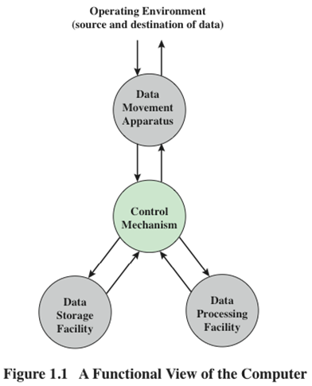
Functions
Apparatus: Things provided as means to some end (peripherals )
A computer can perform four basic functions:
Data processing
Data storage
Data movement
Control
Notes:
Both the structure and functioning of a computer are, in essence, simple. Figure 1.1
depicts the basic functions that a computer can perform. In general terms, there are
only four:
• Data processing
• Data storage
• Data movement
• Control
The computer, of course, must be able to process data. The data may take a wide
variety of forms, and the range of processing requirements is broad. However, we
shall see that there are only a few fundamental methods or types of data processing.
It is also essential that a computer store data. Even if the computer is processing
data on the fly (i.e., data come in and get processed, and the results go out
immediately), the computer must temporarily store at least those pieces of data
that are being worked on at any given moment. Thus, there is at least a short-term
data storage function. Equally important, the computer performs a long-term data
storage function. Files of data are stored on the computer for subsequent retrieval
and update.
The computer must be able to move data between itself and the outside
world. The computer’s operating environment consists of devices that serve as
either sources or destinations of data. When data are received from or delivered to
a device that is directly connected to the computer, the process is known as input–
output (I/O), and the device is referred to as a peripheral. When data are moved
over longer distances, to or from a remote device, the process is known as data
communications.
Finally, there must be control of these three functions. Ultimately, this control
is exercised by the individual(s) who provides the computer with instructions. Within
the computer, a control unit manages the computer’s resources and orchestrates the
performance of its functional parts in response to those instructions.

Slide 8
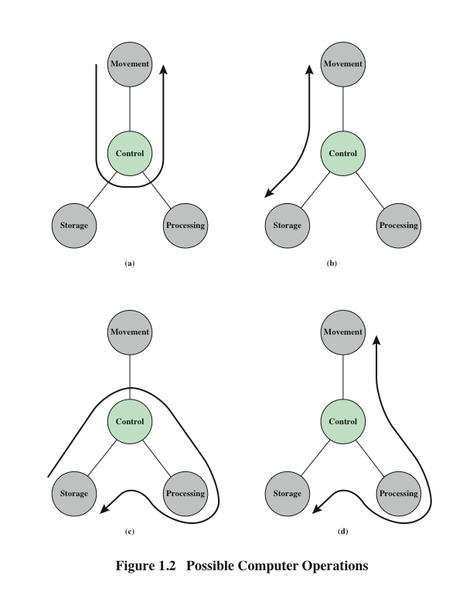
Operations (a) Data movement
Peripheral 1
Peripheral 2
Notes:
At this general level of discussion, the number of possible operations that
can be performed is few. Figure 1.2 depicts the four possible types of operations.
The computer can function as a data movement device (Figure 1.2a), simply
transferring data from one peripheral or communication line to another.

Slide 9
Operations (b) Data storage
External
environment
read
write
Building block:
Why data from an external device can not move to storage automatically?
Notes:
It can also function as a data storage device (Figure 1.2b), with data transferred from
the external environment to computer storage (read) and vice versa (write).

Slide 10
Operations (c) Data movement
Building block:
Open the Calculator to compute some numeric operations. Give your explanation
read
write
compute
Notes:
The final two diagrams show operations involving data processing, on data either in
storage (Figure 1.2c)

Slide 11
Operations (d) Control
Notes:
En route between storage and the external environment
(Figure 1.2d).

Slide 12
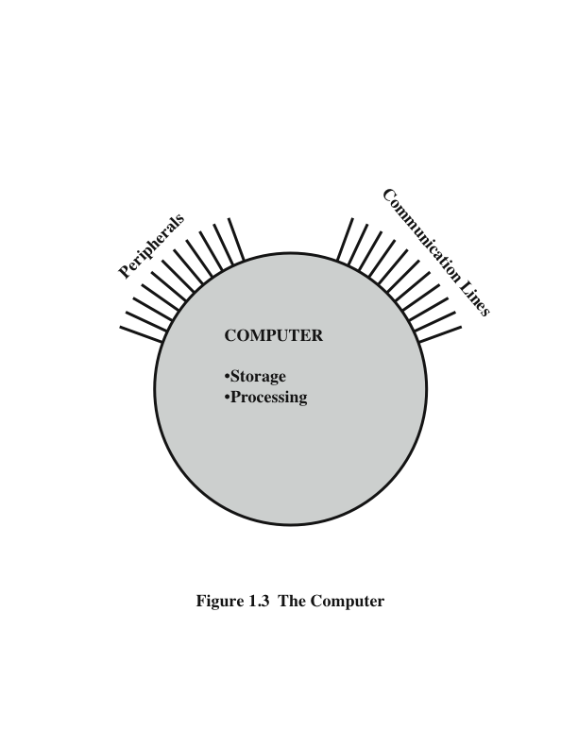
The Computer
linkages
Notes:
Figure 1.3 is the simplest possible depiction of a computer. The computer interacts
in some fashion with its external environment. In general, all of its linkages to
the external environment can be classified as peripheral devices or communication
lines. We will have something to say about both types of linkages.

Slide 13
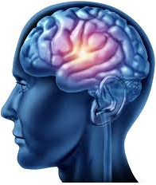
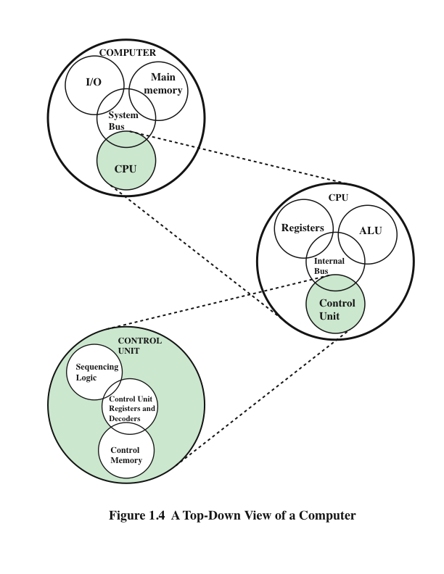
Structure
1+2
1
+
2
3
Try to verify
Notes:
But of greater concern in this book is the internal structure of the computer
itself, which is shown in Figure 1.4. There are four main structural components:
Central Processing Unit (CPU)
Main Memory
I/O
System Interconnection

Slide 14
CPU – controls the operation of the computer and performs its data processing functions
Main Memory – stores data
I/O – moves data between the computer and its external environment
System Interconnection – some mechanism that provides for communication among CPU, main memory, and I/O
There are four main structural components
of the computer:
Notes:
There are four main structural components:
• Central processing unit (CPU): Controls the operation of the computer and
performs its data processing functions; often simply referred to as processor.
• Main memory: Stores data.
• I/O: Moves data between the computer and its external environment.
• System interconnection: Some mechanism that provides for communication
among CPU, main memory, and I/O. A common example of system interconnection
is by means of a system bus, consisting of a number of conducting
wires to which all the other components attach.

Slide 15
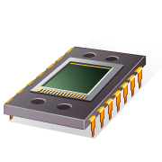
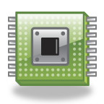
CPU
Control Unit
Controls the operation of the CPU and hence the computer
Arithmetic and Logic Unit (ALU)
Performs the computer’s data processing function
Registers
Provide storage internal to the CPU
CPU Interconnection
Some mechanism that provides for communication among the control unit, ALU, and registers
Major structural components:
Notes:
There may be one or more of each of the aforementioned components.
Traditionally, there has been just a single processor. In recent years, there has been
increasing use of multiple processors in a single computer. Some design issues relating
to multiple processors crop up and are discussed as the text proceeds; Part Five
focuses on such computers.
Each of these components will be examined in some detail in Part Two.
However, for our purposes, the most interesting and in some ways the most complex
component is the CPU. Its major structural components are as follows:
• Control unit: Controls the operation of the CPU and hence the computer.
• Arithmetic and logic unit (ALU):Performs the computer’s data processing
functions.
• Registers: Provides storage internal to the CPU.
• CPU interconnection: Some mechanism that provides for communication
among the control unit, ALU, and registers.

Slide 16
Exercises (Write your answers to your notebook)
1.1 What, in general terms, is the distinction between computer organization and computer architecture?
1.2 What, in general terms, is the distinction between computer structure and computer function?
1.3 What are the four main functions of a computer?
1.4 List and briefly define the main structural components of a computer.
1.5 List and briefly define the main structural components of a processor.
Notes:
Terminologies
In general terms: diễn đạt ngắn gọn
Briefly define: Định nghĩa ngắn gọn

Slide 17
Summary
Introduction
Chapter 1
Computer Organization
Computer Architecture
Function
Data processing
Data storage
Data movement
Control
Structure
CPU
Main memory
I/O
System interconnection
CPU structural components
Control unit
ALU
Registers
CPU interconnection
Notes:
Chapter 1 summary.

Slide 18
Internet Resources - Web site for book
http://WilliamStallings.com/COA/COA9e.html
Links to sites of interest
Links to sites for courses that use the book
Errata list for book
Information on other books by W. Stallings
http://WilliamStallings.com/StudentSupport.html
Math
How-to
Research resources
Misc
Notes:
Internet resources.

