Slide 1

CHAPTER 4
Operation on Data
Notes:
1.#

Slide 2
Objectives
After studying this chapter, the student should be able to:
List the three categories of operations performed on data.
Perform unary and binary logic operations on bit patterns.
Distinguish between logic shift operations and arithmetic
shift operations.
Perform logic shift operations on bit patterns.
Understand some applications of logic and shift operations such
as setting, unsetting, and flipping bits.
Perform arithmetic shift operation on integers whey they are
stored in two’ complement format.
Perform addition and subtraction operations on reals when they
are stored in sign and magnitude format.

Slide 3
4-1 LOGIC OPERATIONS
In Chapter 3 we discussed the fact that data inside a computer is stored as patterns of bits. Logic operations refer to those operations that apply the same basic operation on individual bits of a pattern, or on two corresponding bits in two patterns. This means that we can define logic operations at the bit level and at the pattern level. A logic operation at the pattern level is n
logic operations, of the same type, at the bit level where n is the number of bits in the pattern.

Slide 4

4.1.1 Logic operations at bit level
A bit can take one of the two values: 0 or 1. If we interpret 0 as the value false and 1 as the value true, we can apply the operations defined in Boolean algebra to manipulate bits. Boolean algebra, named in honor of George Boole, belongs to a special field of mathematics called logic. Boolean algebra and its application to building logic circuits in computers are briefly discussed in Appendix E. In this section, we show briefly four bit-level operations that are used to manipulate bits: NOT, AND, OR, and XOR.
Boolean algebra and logic circuits are discussed in Appendix E.

Slide 5
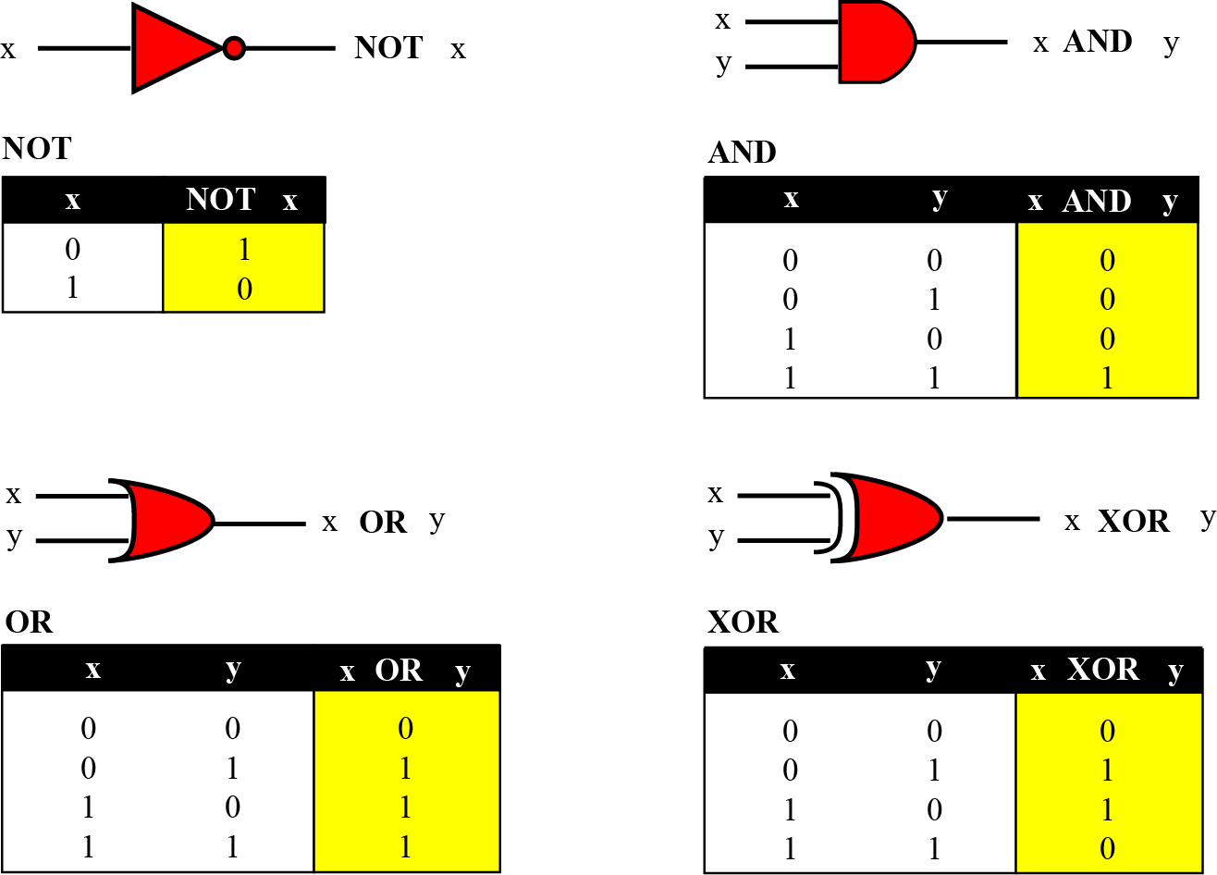
Figure 4.1 Logic operations at the bit level

Slide 6
NOT
The NOT operator is a unary operator: it takes only one input. The output bit is the complement of the input.
AND
The AND operator is a binary operator: it takes two inputs. The output bit is 1 if both inputs are 1s and the output is 0 in the other three cases.
For x = 0 or 1 x AND 0 → 0 0 AND x → 0

Slide 7
OR
The OR operator is a binary operator: it takes two inputs. The output bit is 0 if both inputs are 0s and the output is 1 in other three cases.
For x = 0 or 1 x OR 1 → 1 1 OR x → 1
XOR
The XOR operator is a binary operator like the OR operator, with only one difference: the output is 0 if both inputs are 1s.
For x = 0 or 1 1 XOR x → NOTx 1 XOR x → 1

Slide 8

Example 4.1
In English we use the conjunction “or” sometimes to means an inclusive-or, and sometimes to means an exclusive-or.
The sentence “I wish to have a car or a house” uses “or” in the inclusive sense—I wish a car, a house, or both.
The sentence “Today is either Monday or Tuesday” uses “or” in the exclusive sense—today is either Monday or Tuesday, but it cannot be both.

Slide 9

Example 4.2
The XOR operator is not actually a new operator. We can always simulate it using the other three operators. The following two expressions are equivalent
x XOR y ↔ [x AND (NOT y)] OR [(NOT x) AND y]
The equivalence can be proved if we make the truth table for both.
4.<number>

Slide 10
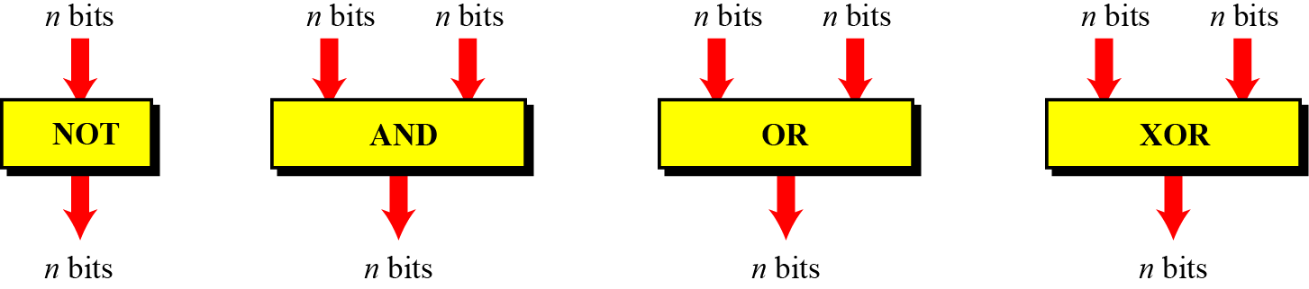
4.1.2 Logic operations at pattern level
The same four operators (NOT, AND, OR, and XOR) can be applied to an n-bit pattern. The effect is the same as applying each operator to each individual bit for NOT and to each corresponding pair of bits for other three operators. Figure 4.2 shows these four operators with input and output patterns.
Figure 4.2 Logic operators applied to bit patterns

Slide 11
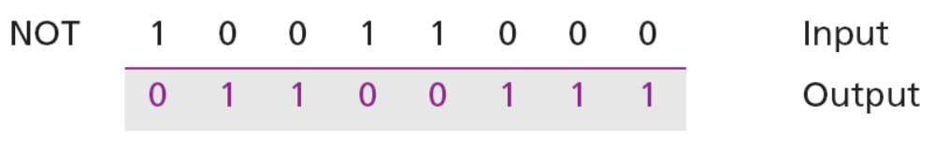
Example 4.3
Use the NOT operator on the bit pattern 10011000.
Solution
The solution is shown below. Note that the NOT operator changes every 0 to 1 and every 1 to 0.
4.<number>

Slide 12
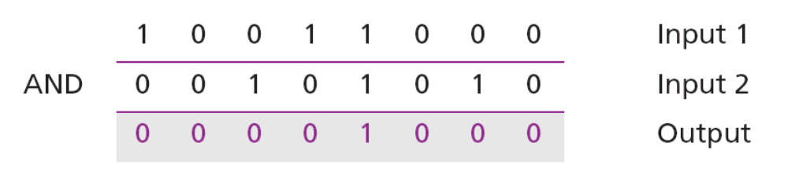
Example 4.4
Use the AND operator on the bit patterns 10011000 and 00101010.
Solution
The solution is shown below. Note that only one bit in the output is 1, where both corresponding inputs are 1s.
4.<number>

Slide 13
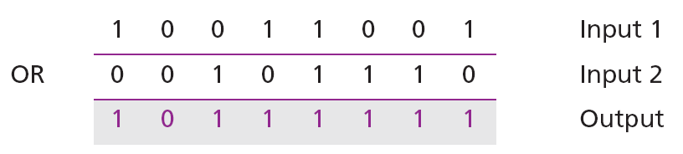
Example 4.5
Use the OR operator on the bit patterns 10011001 and 00101110.
Solution
The solution is shown below. Note that only one bit in the output is 0, where both corresponding inputs are 0s.
4.<number>

Slide 14
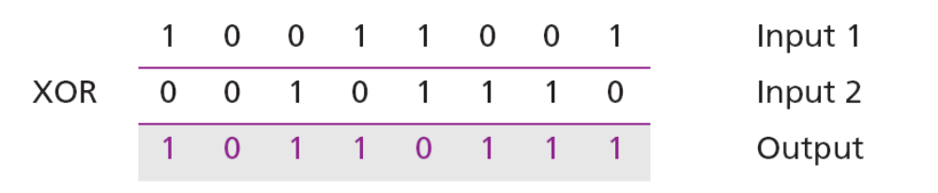
Example 4.6
Use the XOR operator on the bit patterns 10011001 and 00101110.
Solution
The solution is shown below. Compare the output in this example with the one in Example 4.5. The only difference is that when the two inputs are 1s, the result is 0 (the effect of exclusion).
4.<number>

Slide 15
Applications
The four logic operations can be used to modify a bit pattern.
Complementing (NOT)
Unsetting (AND)
Setting (OR)
Flipping (XOR)
4.<number>

Slide 16

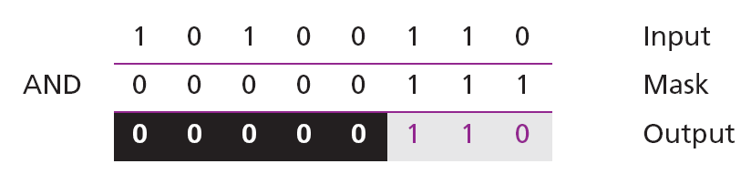
Example 4.7
Use a mask to unset (clear) the five leftmost bits of a pattern. Test the mask with the pattern 10100110.
Solution
The mask is 00000111. The result of applying the mask is:
4.<number>

Slide 17
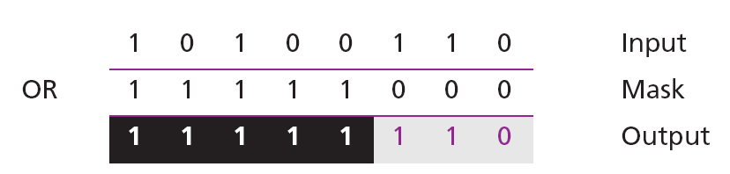
Example 4.8
Use a mask to set the five leftmost bits of a pattern. Test the mask with the pattern 10100110.
Solution
The mask is 11111000. The result of applying the mask is:
4.<number>

Slide 18
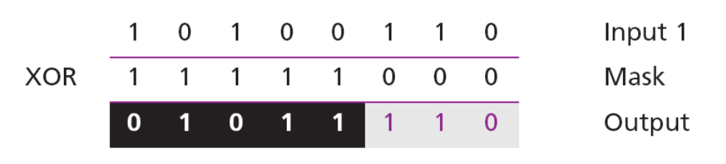
Example 4.9
Use a mask to flip the five leftmost bits of a pattern. Test the mask with the pattern 10100110.
Solution
The mask is 11111000. The result of applying the mask is:
4.<number>

Slide 19
4-2 SHIFT OPERATIONS
Shift operations move the bits in a pattern, changing the positions of the bits. They can move bits to the left or to the right. We can divide shift operations into two categories: logical shift operations and arithmetic shift operations.
4.<number>

Slide 20
4.2.1 Logical shift operations
A logical shift operation is applied to a pattern that does not represent a signed number. The reason is that these shift operation may change the sign of the number that is defined by the leftmost bit in the pattern. We distinguishes two types of logical shift operations, as described below:
Logical shift
Logical circular shift (Rotate)
4.<number>

Slide 21
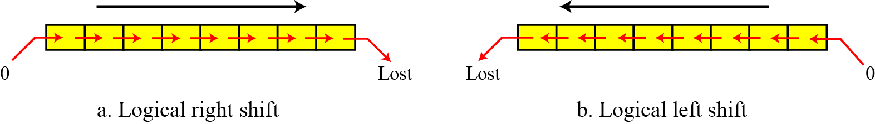
Figure 4.3 Logical shift operations
4.<number>

Slide 22

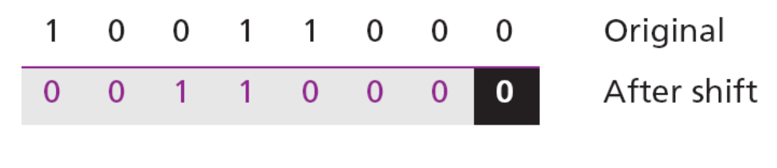
Example 4.10
Use a logical left shift operation on the bit pattern 10011000.
Solution
The solution is shown below. The leftmost bit is lost and a 0 is inserted as the rightmost bit.
Discarded
Added
4.<number>

Slide 23
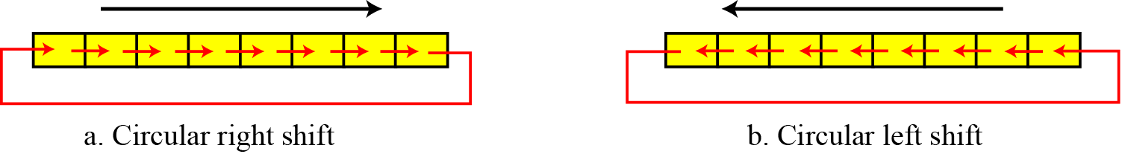
Figure 4.4 Circular shift operations
4.<number>

Slide 24

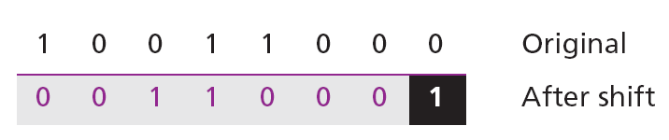
Example 4.11
Use a circular left shift operation on the bit pattern 10011000.
Solution
The solution is shown below. The leftmost bit is circulated and becomes the rightmost bit.

Slide 25
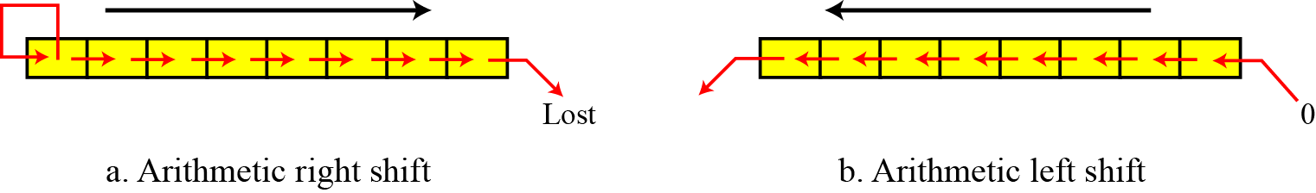
4.2.2 Arithmetic shift operations
Arithmetic shift operations assume that the bit pattern is a signed integer in two’s complement format. Arithmetic right shift is used to divide an integer by two, while arithmetic left shift is used to multiply an integer by two.
Figure 4.5 Arithmetic shift operations
4.<number>

Slide 26
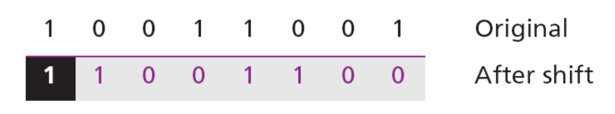
Example 4.12
Use an arithmetic right shift operation on the bit pattern 10011001. The pattern is an integer in two’s complement format.
Solution
The solution is shown below. The leftmost bit is retained and also copied to its right neighbor bit.
The original number was −103 and the new number is −52, which is the result of dividing −103 by 2 truncated to the smaller integer.
4.<number>

Slide 27
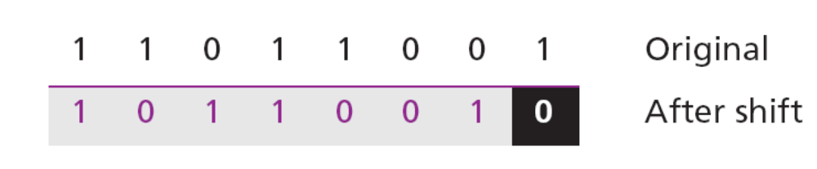
Example 4.13
Use an arithmetic left shift operation on the bit pattern 11011001. The pattern is an integer in two’s complement format.
Solution
The solution is shown below. The leftmost bit is lost and a 0 is inserted as the rightmost bit.
The original number was −39 and the new number is −78. The original number is multiplied by two. The operation is valid because no underflow occurred.
4.<number>

Slide 28
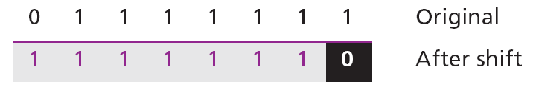
Example 4.14
Use an arithmetic left shift operation on the bit pattern 01111111. The pattern is an integer in two’s complement format.
Solution
The solution is shown below. The leftmost bit is lost and a 0 is inserted as the rightmost bit.
The original number was 127 and the new number is −2. Here the result is not valid because an overflow has occurred. The expected answer 127 × 2 = 254 cannot be represented by an 8-bit pattern.
4.<number>

Slide 29
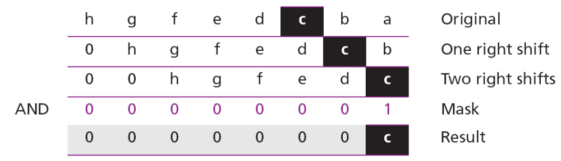
Example 4.15
Combining logic operations and logical shift operations give us some tools for manipulating bit patterns. Assume that we have a pattern and we need to use the third bit (from the right) of this pattern in a decision-making process. We want to know if this particular bit is 0 or 1. The following shows how we can find out.
We can then test the result: if it is an unsigned integer 1, the target bit was 1, whereas if the result is an unsigned integer 0, the target bit was 0.
4.<number>

Slide 30
4-3 ARITHMETIC OPERATIONS
Arithmetic operations involve adding, subtracting, multiplying, and dividing. We can apply these operations to integers and floating-point numbers.
4.<number>

Slide 31
4.3.1 Arithmetic operations on integers
All arithmetic operations such as addition, subtraction, multiplication, and division can be applied to integers. Although multiplication (division) of integers can be implemented using repeated addition (subtraction), the procedure is not efficient. There are more efficient procedures for multiplication and division, such as Booth procedures, but these are beyond the scope of this book. For this reason, we only discuss addition and subtraction of integers here.
4.<number>

Slide 32
Two’s complement integers
When the subtraction operation is encountered, the computer simply changes it to an addition operation, but makes two’s complement of the second number. In other words:
A − B ↔ A + (B + 1)
Where B is the one’s complement of B and
(B + 1) means the two’s complement of B
4.<number>

Slide 33
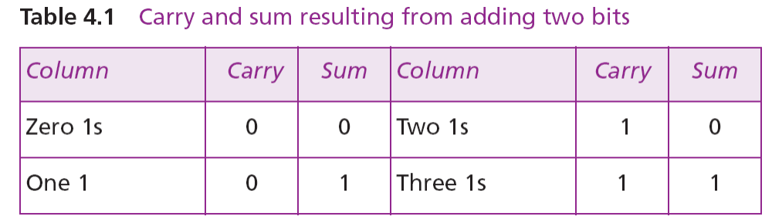
We should remember that we add integers column by column. The following table shows the sum and carry (C).
4.<number>

Slide 34
Figure 4.6 Addition and subtraction of integers in two’s complement

Slide 35
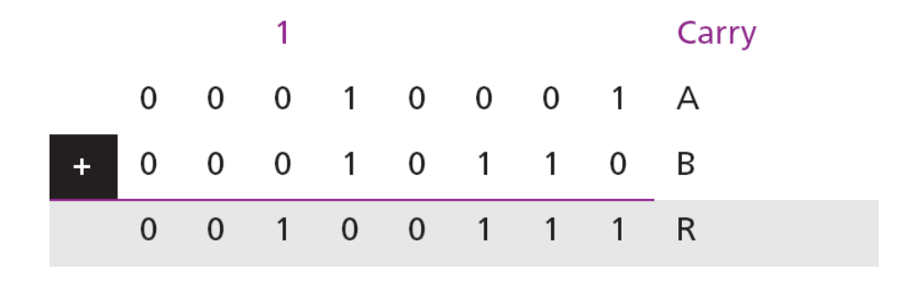
Example 4.16
Two integers A and B are stored in two’s complement format. Show how B is added to A.
A = (00010001)₂ B = (00010110)₂
Solution
The operation is adding. A is added to B and the result is stored in R. (+17) + (+22) = (+39).
4.<number>

Slide 36
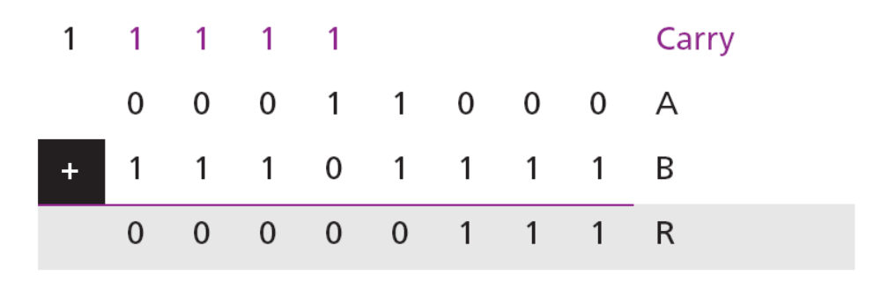
Example 4.17
Two integers A and B are stored in two’s complement format. Show how B is added to A.
A = (00011000)₂ B = (11101111)₂
Solution
The operation is adding. A is added to B and the result is stored in R. (+24) + (−17) = (+7).
4.<number>

Slide 37
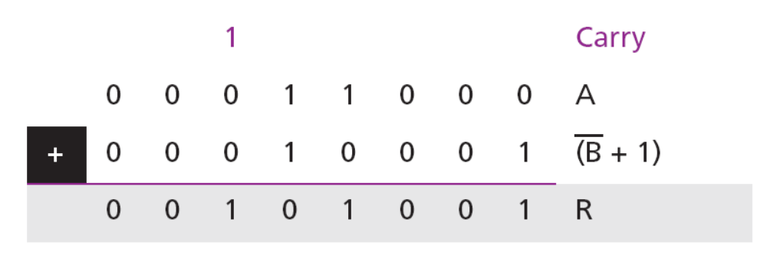
Example 4.18
Two integers A and B are stored in two’s complement format. Show how B is subtracted from A.
A = (00011000)₂ B = (11101111)₂
Solution
The operation is subtracting. A is added to (B + 1) and the result is stored in R. (+24) − (−17) = (+41).
4.<number>

Slide 38
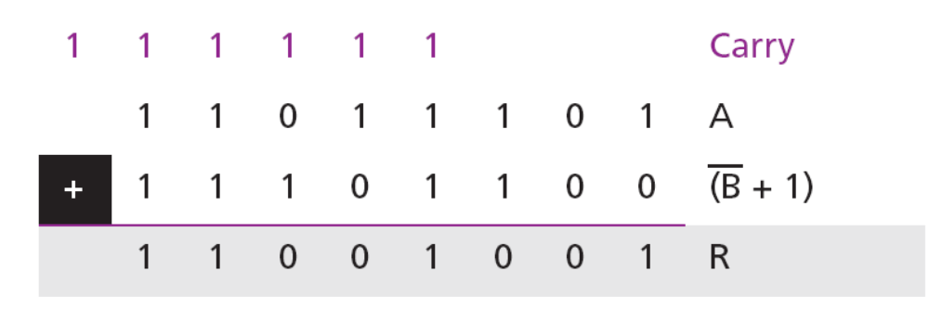
Example 4.19
Two integers A and B are stored in two’s complement format. Show how B is subtracted from A.
A = (11011101)₂ B = (00010100)₂
Solution
The operation is subtracting. A is added to (B + 1) and the result is stored in R. (−35) − (+20) = (−55).
4.<number>

Slide 39
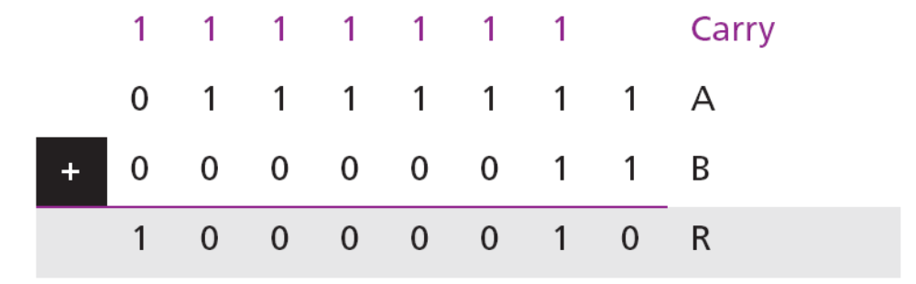
Example 4.20
Two integers A and B are stored in two’s complement format. Show how B is added to A.
A = (01111111)₂ B = (00000011)₂
Solution
The operation is adding. A is added to B and the result is stored in R.
We expect the result to be 127 + 3 = 130, but the answer is −126. The error is due to overflow, because the expected answer (+130) is not in the range −128 to +127.
4.<number>

Slide 40

When we do arithmetic operations on numbers in a computer, we should remember that each number and the result should be in the range defined by
the bit allocation.

Slide 41
sign-and-magnitude integers
Addition and subtraction for integers in sign-and-magnitude representation looks very complex. We have four different combination of signs (two signs, each of two values) for addition, and four different conditions for subtraction. This means that we need to consider eight different situations. However, if we first check the signs, we can reduce these cases, as shown in Figure 4.7.
4.<number>

Slide 42
4.<number>

Slide 43

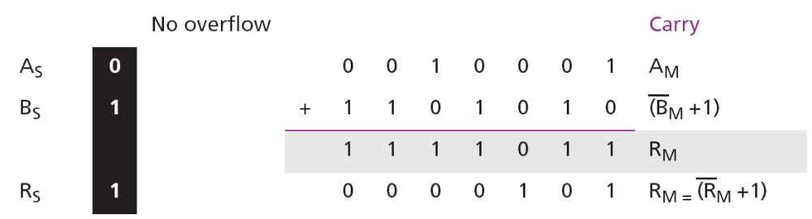
Example 4.22
Two integers A and B are stored in sign-and-magnitude format. Show how B is added to A.
A = (0 0010001)₂ B = (1 0010110)₂
Solution
The operation is adding: the sign of B is not changed. S = A_{S} XOR B_{S} = 1; R_{M} = A_{M} + (B_{M} +1). Since there is no overflow, we need to take the two’s complement of R_{M}. The sign of R is the sign of B. (+17) + ( −22) = (−5).
4.<number>

Slide 44
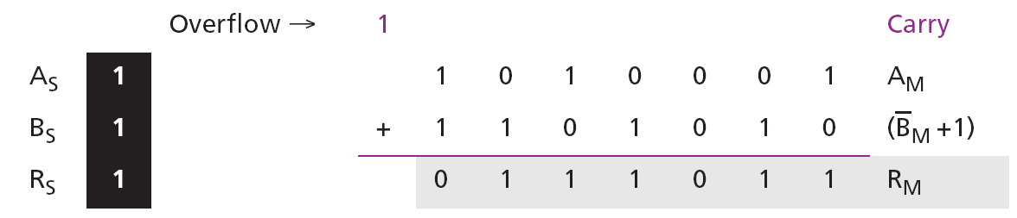
Example 4.23
Two integers A and B are stored in sign-and-magnitude format. Show how B is subtracted from A.
A = (1 1010001)₂ B = (1 0010110)₂
Solution
The operation is subtracting: S_{B} = S_{B}. S = A_{S} XOR B_{S} = 1, R_{M} = A_{M} + (B_{M} +1). Since there is an overflow, the value of R_{M} is final. The sign of R is the sign of A. (−81) − (−22) = (−59).
4.<number>

Slide 45
4.3.2 Arithmetic operations on reals
All arithmetic operations such as addition, subtraction, multiplication, and division can be applied to reals stored in floating-point format. Multiplication of two reals involves multiplication of two integers in sign-and-magnitude representation. Division of two reals involves division of two integers in sign-and-magnitude representations. Since we did not discuss the multiplication or division of integers in sign-and magnitude representation, we will not discuss the multiplication and division of reals, and only show addition and subtractions for reals.
4.<number>

Slide 46
Addition and subtraction of reals
Addition and subtraction of real numbers stored in floating-point numbers is reduced to addition and subtraction of two integers stored in sign-and-magnitude (combination of sign and mantissa) after the alignment of decimal points. Figure 4.8 shows a simplified version of the procedure (there are some special cases that we have ignored).
4.<number>

Slide 47
4.<number>

Slide 48
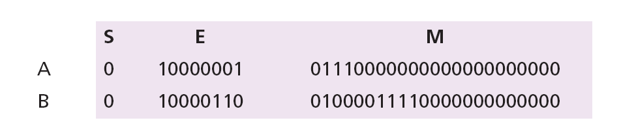
Example 4.23
Show how the computer finds the result of (+5.75) + (+161.875) = (+167.625).
Solution
As we saw in Chapter 3, these two numbers are stored in floating-point format, as shown below, but we need to remember that each number has a hidden 1 (which is not stored, but assumed).
4.<number>

Slide 49
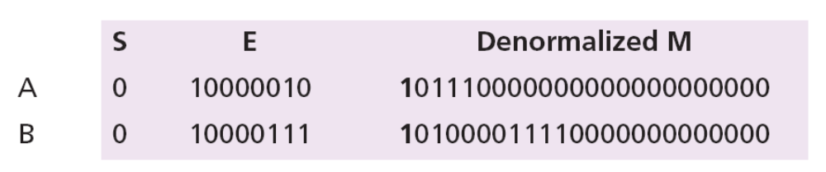
The first few steps in the UML diagram (Figure 4.8) are not needed. We de-normalize the numbers by adding the hidden 1s to the mantissa and incrementing the exponent. Now both de-normalized mantissas are 24 bits and include the hidden 1s. They should be stored in a location that can hold all 24 bits. Each exponent is incremented.
4.<number>

Slide 50
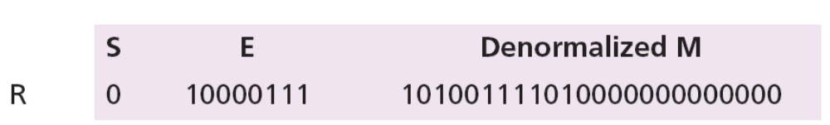

Now we do sign-and-magnitude addition, treating the sign and the mantissa of each number as one integer stored in sign-and-magnitude representation.
There is no overflow in the mantissa, so we normalize.
The mantissa is only 23 bits, no rounding is needed. E = (10000110)₂ = 134 M = 0100111101. In other words, the result is (1.0100111101)₂ × 2¹³⁴⁻¹²⁷ = (10100111.101)₂ = 167.625.
4.<number>

Slide 51
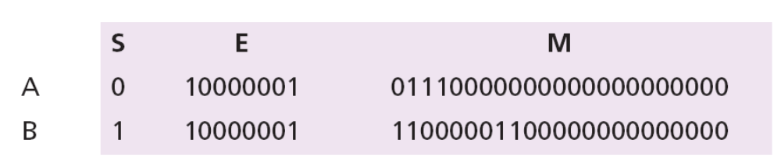
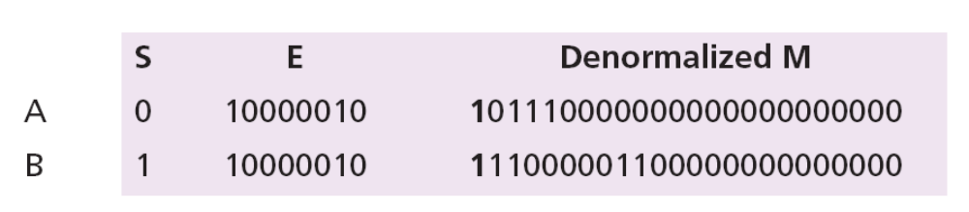
Example 4.24
Show how the computer finds the result of (+5.75) + (−7.0234375) = − 1.2734375.
Solution
These two numbers can be stored in floating-point format, as shown below:
De-normalization results in:
4.<number>

Slide 52
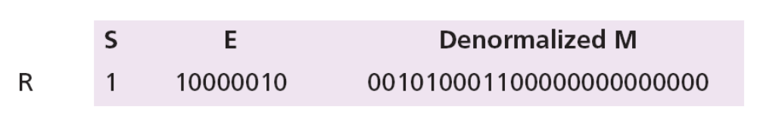
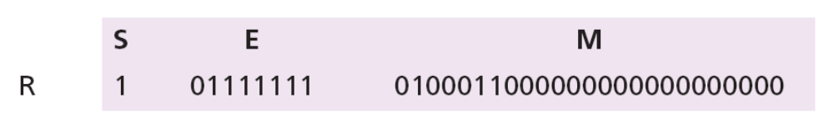
Alignment is not needed (both exponents are the same), so we apply addition operation on the combinations of sign and mantissa. The result is shown below, in which the sign of the result is negative:
Now we need to normalize. We decrement the exponent three times and shift the de-normalized mantissa to the left three positions:
4.<number>

Slide 53
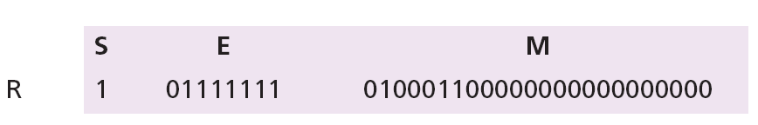
The mantissa is now 24 bits, so we round it to 23 bits.
The result is R = − 2¹²⁷⁻¹²⁷ × 1.0100011 = − 1.2734375, as expected.
4.<number>

