Slide 1
CHAPTER 12
Abstract Data Type

Slide 2
Objectives
After studying this chapter, the student should be able to:
Define the concept of an abstract data type (ADT).
Define a stack, the basic operations on stacks, their applications, and how they can be implemented.
Define a queue, the basic operations on queues, their applications, and how they can be implemented.
Define a general tree and its application.
Define a general linear list, the basic operations on lists, their application and how they can be implemented.
Define a binary tree—a special kind of tree—and its applications.
Define a binary search tree (BST) and its applications.
Define a graph and its applications.

Slide 3
12-1 BACKGROUND
Problem solving with a computer means processing data. To process data, we need to define the data type and the operation to be performed on the data. The definition of the data type and the definition of the operation to be applied to the data is part of the idea behind an abstract data type (ADT)—to hide how the operation is performed on the data. In other word, the user of an ADT needs only to know that a set of operations are available for the data type, but does not need to know how they are applied.

Slide 4
12.1.1 Simple ADTs
Many programming languages already define some simple ADTs as integral parts of the language. For example, the C language defines a simple ADT called an integer. The type of this ADT is integer with predefined ranges. C also defines several operation that can be applied on this data type (addition, subtraction, multiplication, division, and so on). C explicitly defines these operations on integers and what we expect as the results. A programmer who writes a C program to add two integers should know about the integer ADT and the operations that can be applied to it.

Slide 5
12.1.2 Complex ADTs: Kiểu dữ liệu trìu tượng phức tạp
Although several simple ADTs, such as integer, real, character, pointer, and so on, have been implemented and are available for use in most language, many useful complex ADTs are not. As we will see in this chapter, we need a list ADT, a stack ADT, a queue ADT, and so on. To be efficient, these ADTs should be created and stored in the library of the computer to be used.
The concept of abstraction means:
1. We know what a data type can do.
2. How it is done is hidden.

Slide 6
12.1.3 Definition
Let us now define an ADT. An abstract data type is a data type packaged with the operations that are meaningful for the data type. We then encapsulate the data and the operations on the data and hide them from the user.
Abstract data type:
1. Definition of data
2. Definition of operations
3. Encapsulation of data and operation

Slide 7
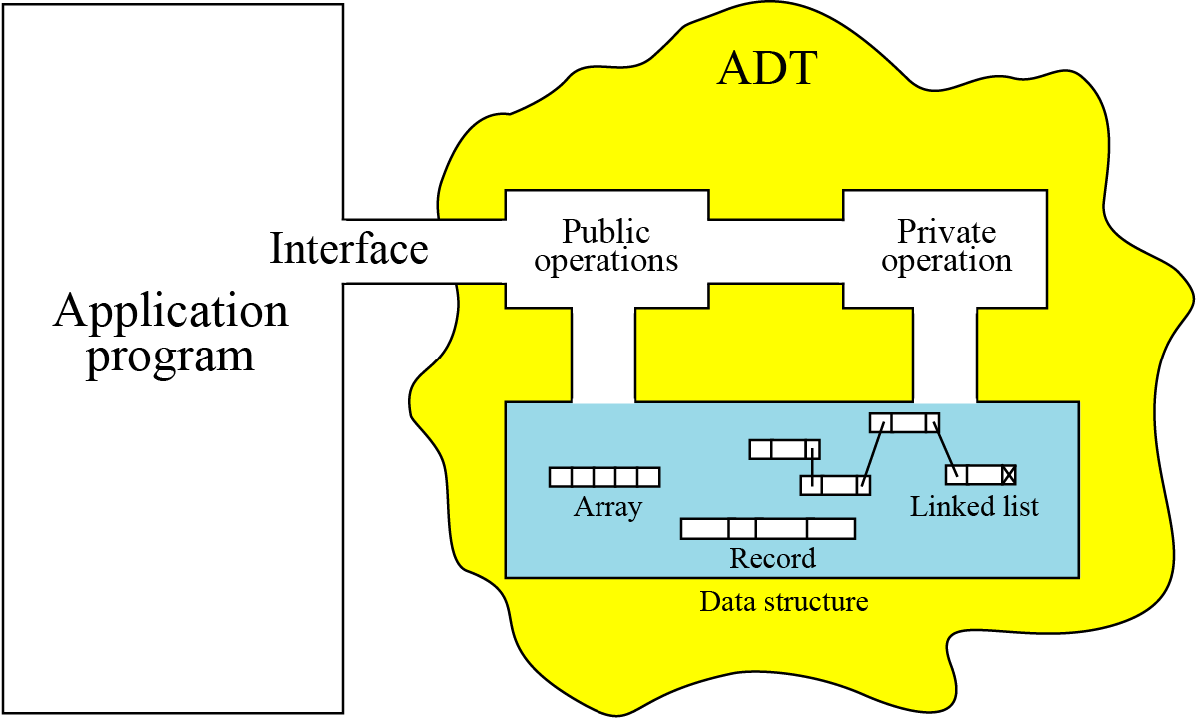
12.1.4 Model for an abstract data type
The ADT model is shown in Figure 12.1. Inside the ADT are two different parts of the model: data structure and operations (public and private).
Figure 12.1 The model for an ADT

Slide 8
12.1.5 Implementation
Computer languages do not provide complex ADT packages. To create a complex ADT, it is first implemented and kept in a library. The main purpose of this chapter is to introduce some common user-defined ADTs and their applications. However, we also give a brief discussion of each ADT implementation for the interested reader. We leave the pseudocode algorithms of the implementations as challenging exercises.

Slide 9
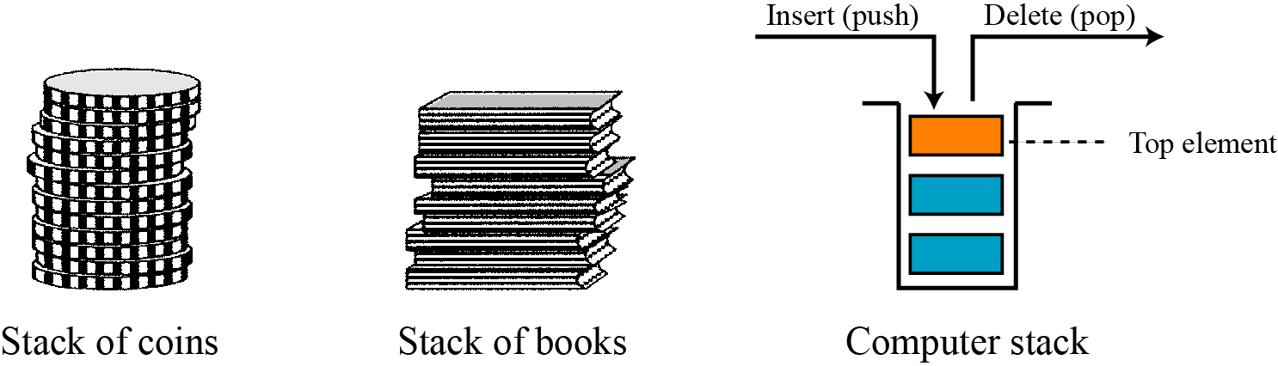
12-2 STACKS
A stack is a restricted linear list in which all additions and deletions are made at one end, the top. If we insert a series of data items into a stack and then remove them, the order of the data is reversed. This reversing attribute is why stacks are known as last in, first out (LIFO) data structures.
Figure 12.2 Three representations of stacks

Slide 10
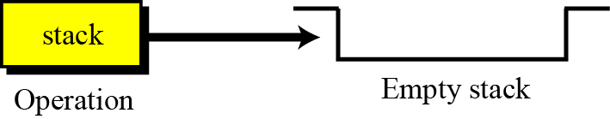
12.2.1 Operations on stacks
There are four basic operations, stack, push, pop, and empty, that we define in this chapter.
The stack operation
The stack operation creates an empty stack. The following shows the format.
Figure 12.3 Stack operation

Slide 11
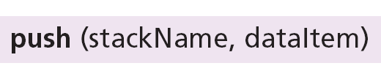
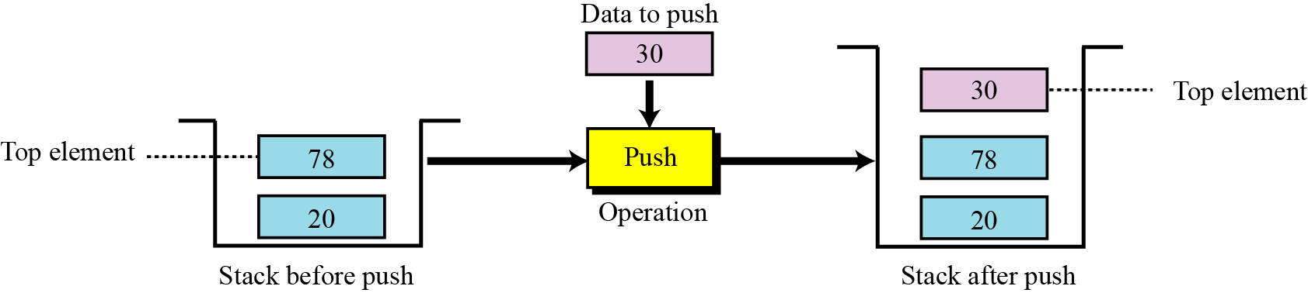
The push operation
The push operation inserts an item at the top of the stack. The following shows the format.
Figure 12.4 Push operation

Slide 12
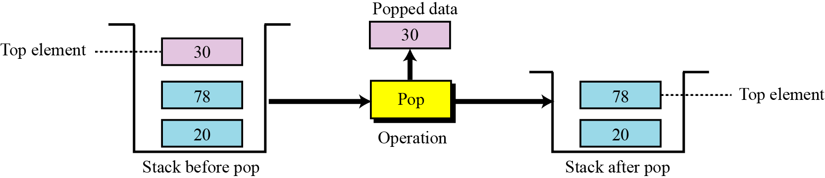
The pop operation
The pop operation deletes the item at the top of the stack. The following shows the format.
Figure 12.5 Pop operation

Slide 13
The empty operation
The empty operation checks the status of the stack. The following shows the format.
This operation returns true if the stack is empty and false if the stack is not empty.

Slide 14
12.2.2 Stack ADT
We define a stack as an ADT as shown below:

Slide 15
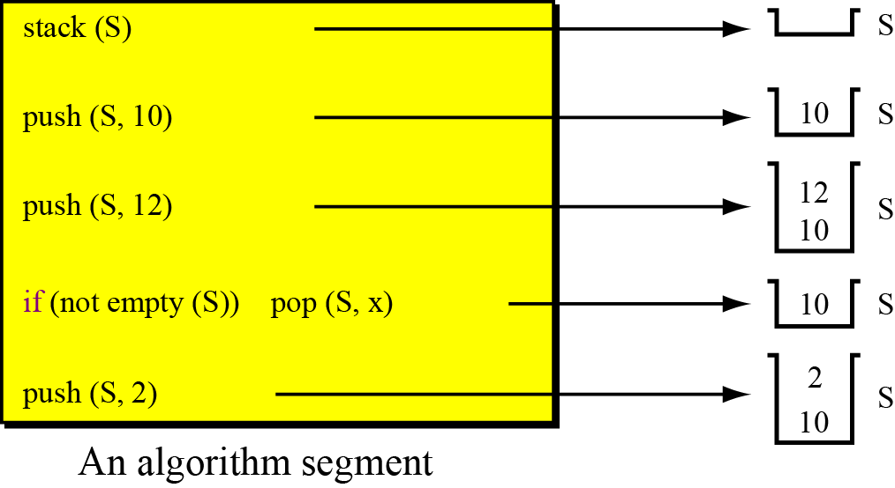
Example 12.1
Figure 12.6 shows a segment of an algorithm that applies the previously defined operations on a stack S.
Figure 12.6 Example 12.1

Slide 16
12.2.3 Stack applications
Stack applications can be classified into four broad categories: reversing data, pairing data, postponing data usage, and backtracking steps. We discuss the first two in
the sections that follow.
Reversing data items
Reversing data items requires that a given set of data items be reordered so that the first and last items are exchanged, with all of the positions between the first and last being relatively exchanged also. For example, the list (2, 4, 7, 1, 6, 8) becomes (8, 6, 1, 7, 4, 2).

Slide 17
Example 12.2
In Chapter 2 (Figure 2.6 on page 27) we gave a simple UML diagram to convert an integer from decimal to any base. Although the algorithm is very simple, if we print the digits of the converted integer as they are created, we will get the digits in reverse order. The print instruction in any computer language prints characters from left to right, but the algorithm creates the digits from right to left. We can use the reversing characteristic of a stack (LIFO structure) to solve the problem.
Algorithm 12.1 shows the pseudocode to convert a decimal integer to binary and print the result.

Slide 20
Pairing data items: Ghép nối dữ liệu
We often need to pair some characters in an expression. For example, when we write a mathematical expression in a computer language, we often need to use parentheses to change the precedence of operators. The following two expressions are evaluated differently because of the parentheses in the second expression:
When we type an expression with a lot of parentheses, we often forget to pair the parentheses. One of the duties of a compiler is to do the checking for us. The compiler uses a stack to check that all opening parentheses are paired with a closing parentheses.

Slide 21
Example 12.3
Algorithm 12.2 shows how we can check if all opening parentheses are paired with a closing parenthesis.

Slide 22
Algorithm 12.2 Continued

Slide 23
12.2.4 Stack implementation: Thực hiện ngăn xếp
At the ADT level, we use the stack and its four operations; at the implementation level, we need to choose a data structure to implement it. Stack ADTs can be implemented using either an array or a linked list. Figure 12.7 shows an example of a stack ADT with five items. The figure also shows how we can implement the stack.
In our array implementation, we have a record that has two fields. The first field can be used to store information about the array. The linked list implementation is similar: we have an extra node that has the name of the stack. This node also has two fields: a counter and a pointer that points to the top element.

Slide 24
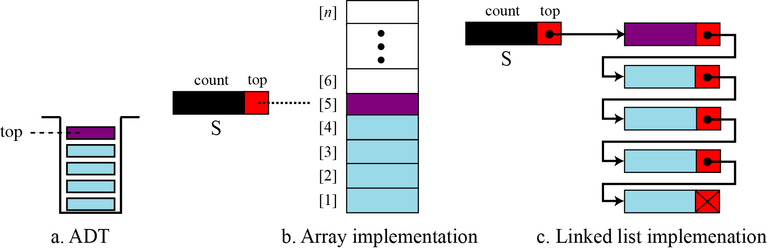
Figure 12.7 Stack implementations

Slide 25
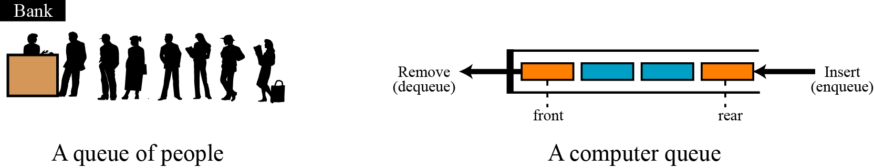
12-3 QUEUES: Hàng đợi
A queue is a linear list in which data can only be inserted at one end, called the rear, and deleted from the other end, called the front. These restrictions ensure that the data is processed through the queue in the order in which it is received. In other words, a queue is a first in, first out (FIFO) structure.
Figure 12.8 Two representation of queues

Slide 26
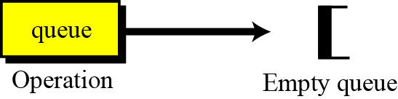
12.3.1 Operations on queues
Although we can define many operations for a queue, four are basic: queue, enqueue, dequeue, and empty, as defined below.
The queue operation
The queue operation creates an empty queue. The following shows the format.
Figure 12.9 The queue operation

Slide 27

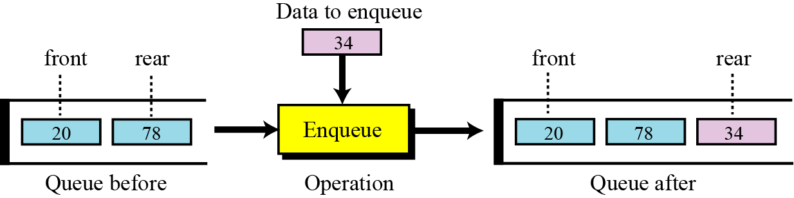
The enqueue operation
The enqueue operation inserts an item at the rear of the queue. The following
shows the format.
Figure 12.10 The enqueue operation

Slide 28
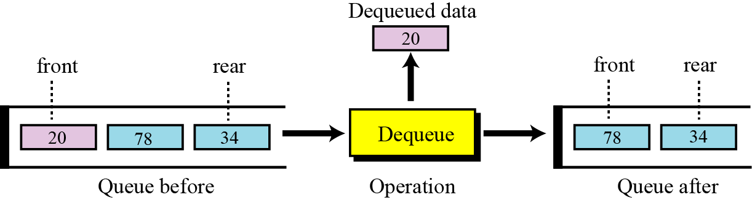
The dequeue operation
The dequeue operation deletes the item at the front of the queue. The following shows the format.
Figure 12.11 The dequeue operation

Slide 29
The empty operation
The empty operation checks the status of the queue. The following shows the format.
This operation returns true if the queue is empty and false if the queue is not empty.

Slide 30
12.3.2 Queue ADT
We define a queue as an ADT as shown below:

Slide 31
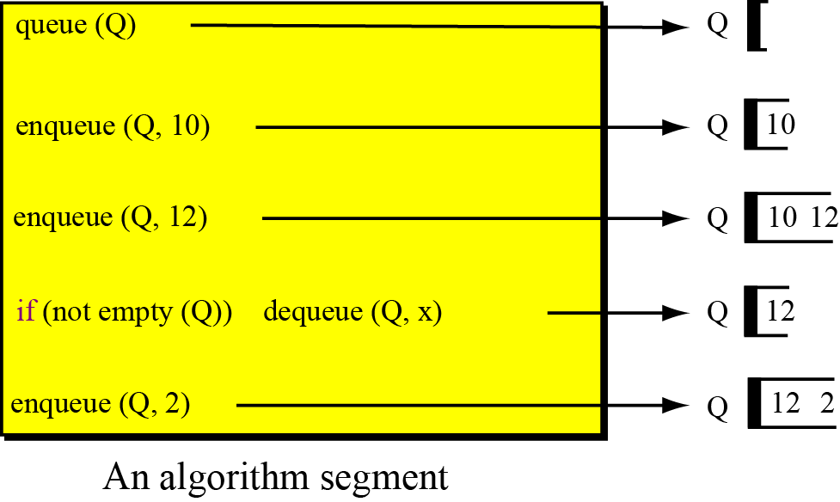
Example 12.4
Figure 12.12 shows a segment of an algorithm that applies the previously defined operations on a queue Q.
Figure 12.12 Example 12.4

Slide 32
12.3.3 Queue applications
Queues are one of the most common of all data processing structures. They are found in virtually every operating system and network and in countless other areas. For example, queues are used in online business applications such as processing customer requests, jobs, and orders. In a computer system, a queue is needed to process jobs and for system services such as print spools.

Slide 33
Example 12.5
Queues can be used to organize databases by some characteristic of the data. For example, imagine we have a list of sorted data stored in the computer belonging to two categories: less than 1000, and greater than 1000. We can use two queues to separate the categories and at the same time maintain the order of data in their own category. Algorithm 12.3 shows the pseudocode for this operation.

Slide 35
Algorithm 12.3 Continued

Slide 36
Example 12.6
Another common application of a queue is to adjust and create a balance between a fast producer of data and a slow consumer of data. For example, assume that a CPU is connected to a printer. The speed of a printer is not comparable with the speed of a CPU. If the CPU waits for the printer to print some data created by the CPU, the CPU would be idle for a long time. The solution is a queue. The CPU creates as many chunks of data as the queue can hold and sends them to the queue. The CPU is now free to do other jobs. The chunks are dequeued slowly and printed by the printer. The queue used for this purpose is normally referred to as a spool queue.

Slide 37
12.3.4 Queue implementation
At the ADT level, we use the queue and its four operations at the implementation level, we need to choose a data structure to implement it. A queue ADT can be implemented using either an array or a linked list. Figure 12.13 on page 329 shows an example of a queue ADT with five items. The figure also shows how we can implement it. In the array implementation we have a record with three fields. The first field can be used to store information about the queue.
The linked list implementation is similar: we have an extra node that has the name of the queue. This node also has three fields: a count, a pointer that points to the front element, and a pointer that points to the rear element.

Slide 38
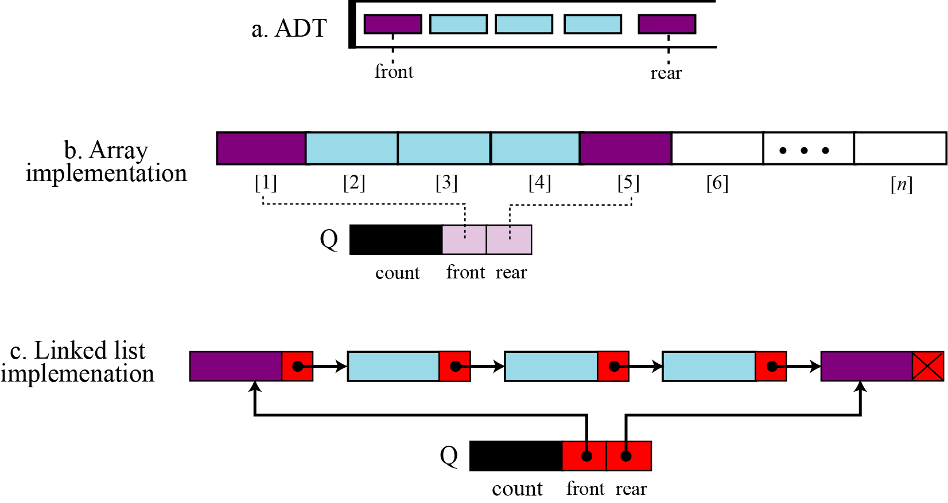
Figure 12.13 Queue implementation

Slide 39
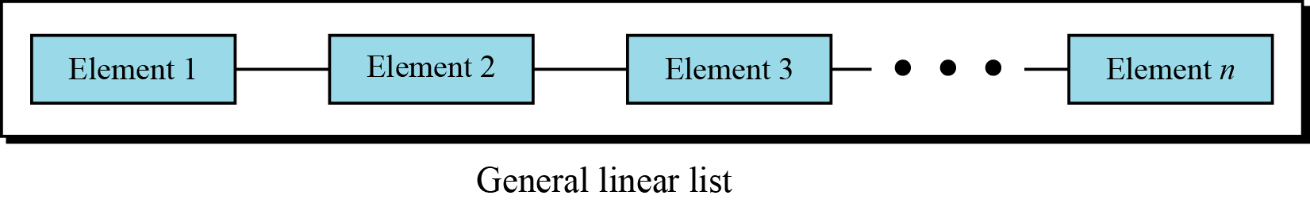
12-4 GENERAL LINEAR LISTS
Stacks and queues defined in the two previous sections are restricted linear lists. A general linear list is a list in which operations, such as insertion and deletion, can be done anywhere in the list—at the beginning, in the middle, or at the end. Figure 12.14 shows a general linear list.
Figure 12.14 General linear list

Slide 40
12.4.1 Operations on general linear lists
Although we can define many operations on a general linear list, we discuss only six common operations in this chapter: list, insert, delete, retrieve, traverse, and empty.
The list operation
The list operation creates an empty list. The following shows the format:

Slide 41
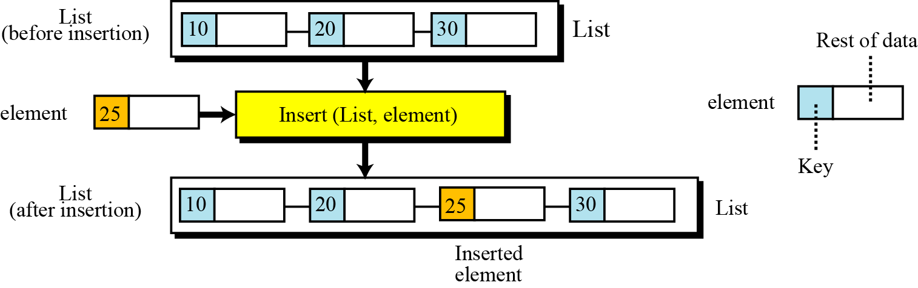
The insert operation
Since we assume that data in a general linear list is sorted, insertion must be done in such a way that the ordering of the elements is maintained. To determine where the element is to be placed, searching is needed. However, searching is done at the implementation level, not at the ADT level.
Figure 12.15 The insert operation

Slide 42
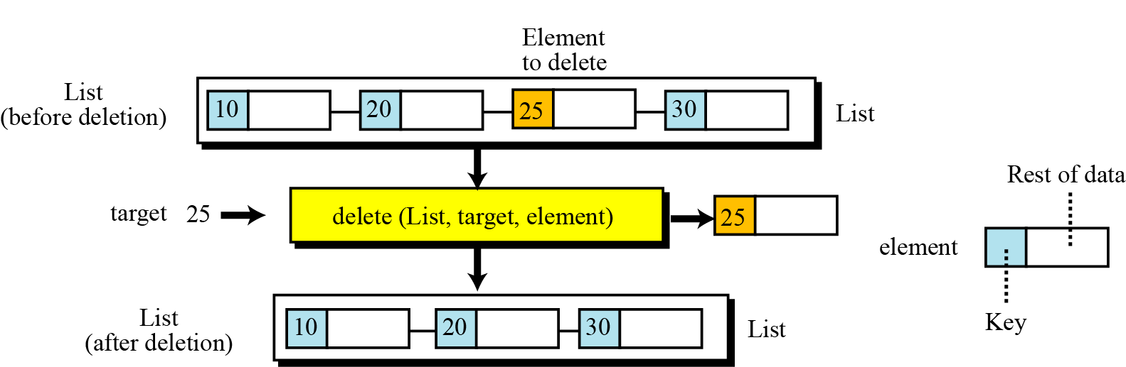
The delete operation
Deletion from a general list (Figure 12.16) also requires that the list be searched to locate the data to be deleted. After the location of the data is found, deletion can be done. The following shows the format:
Figure 12.16 The delete operation

Slide 43
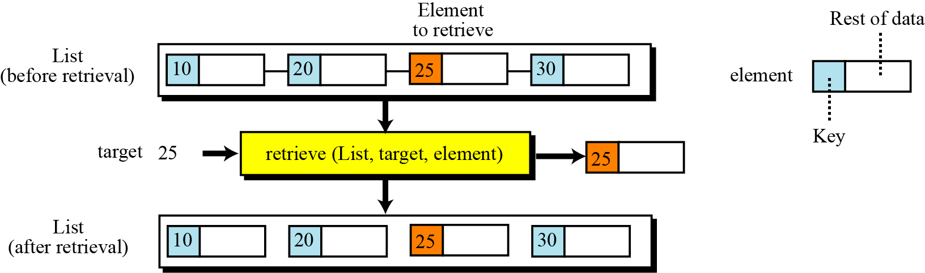
The retrieve operation: truy xuất dữ liệu
By retrieval, we mean access of a single element. Like insertion and deletion, the general list should be first searched, and if the data is found, it can be retrieved. The format of the retrieve operation is:
Figure 12.17 The retrieve operation

Slide 44


The traverse operation: truy xuất ngẫu nhiên
Each of the previous operations involves a single element in the list, randomly accessing the list. List traversal, on the other hand, involves sequential access. It is an operation in which all elements in the list are processed one by one. The following shows the format:
The empty operation
The empty operation checks the status of the list. The following shows the format:

Slide 45
The empty operation
The empty operation checks the status of the list. The following shows the format:
This operation returns true if the list is empty, or false if the list is not empty.

Slide 46
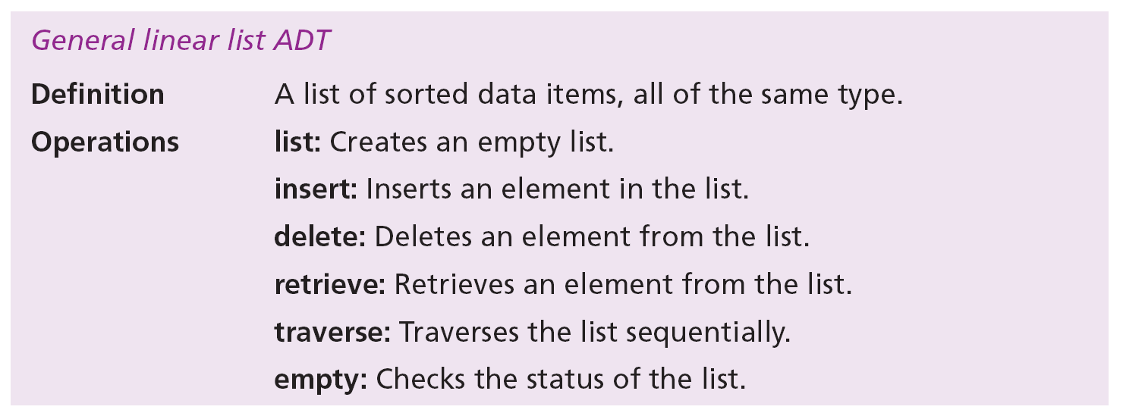
12.4.2 General linear list ADT
We define a general linear list as an ADT as shown below:

Slide 47
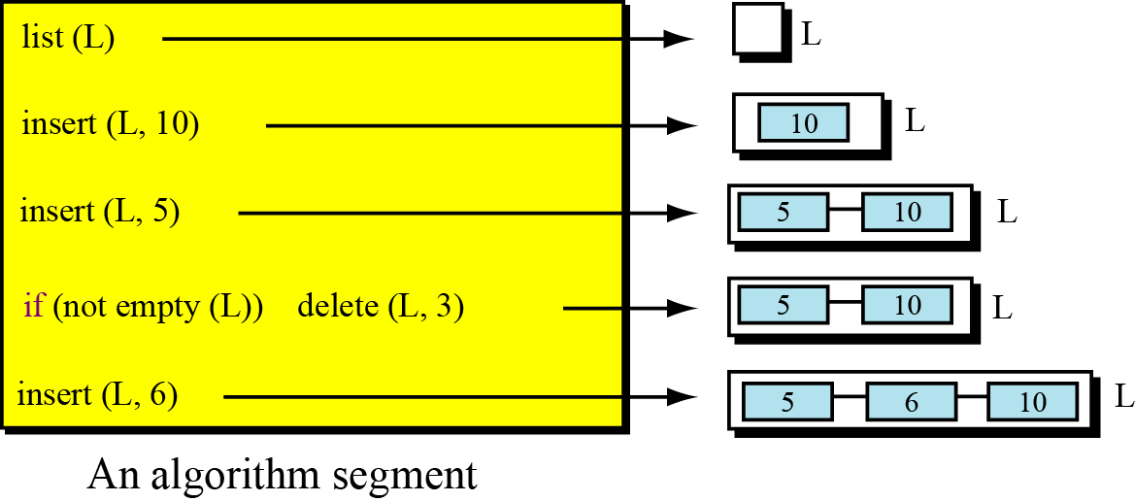
Example 12.7
Figure 12.18 shows a segment of an algorithm that applies the previously defined operations on a list L. Note that the third and fifth operation inserts the new data at the correct position because the insert operation calls the search algorithm at the implementation level to find where the new data should be inserted. The fourth operation does not delete the item with value 3 because it is not in the list.
Figure 12. 18 Example 12.7

Slide 48
12.4.3 General linear list applications
General linear lists are used in situations in which the elements are accessed randomly or sequentially. For example, in a college a linear list can be used to store information about students who are enrolled in each semester.

Slide 49
Example 12.8
Assume that a college has a general linear list that holds information about the students and that each data element is a record with three fields: ID, Name, and Grade. Algorithm 12.4 shows an algorithm that helps a professor to change the grade for a student. The delete operation removes an element from the list, but makes it available to the program to allow the grade to be changed. The insert operation inserts the changed element back into the list. The element holds the whole record for the student, and the target is the ID used to search the list.

Slide 51
Example 12.9
Continuing with Example 12.8, assume that the tutor wants to print the record of all students at the end of the semester. Algorithm 12.5 can do this job. We assume that there is an algorithm called Print that prints the contents of the record. For each node, the list traverse calls the Print algorithm and passes the data to be printed to it.

Slide 53
12.4.4 General linear list implementation
At the ADT level, we use the list and its six operations but at the implementation level we need to choose a data structure to implement it. A general list ADT can be implemented using either an array or a linked list. Figure 12.19 shows an example of a list ADT with five items. The figure also shows how we can implement it.

Slide 54
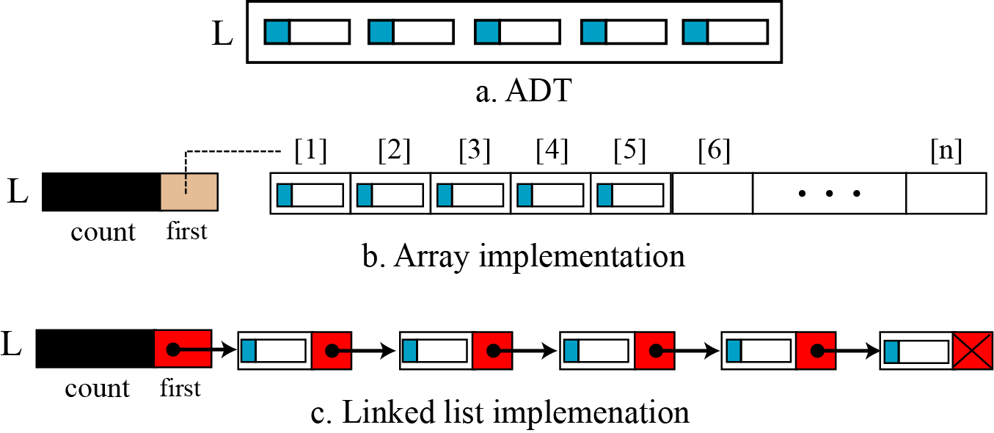
Figure 12.19 General linear list implementation

Slide 55
Algorithm
We can write six algorithms in pseudocode for the six operations we defined for a list in each implementation. We showed algorithms to handle arrays and linked lists in Chapter 11: these algorithms can be slightly modified to create the algorithms we need for a list. We leave these as an exercise.

Slide 56
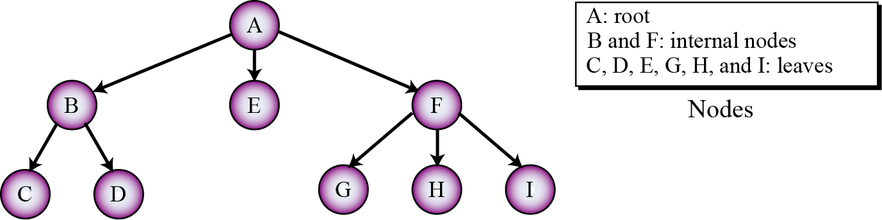
12-5 TREES
A tree consists of a finite set of elements, called nodes (or vertices), and a finite set of directed lines, called arcs, that connect pairs of the nodes.
Figure 12.20 Tree representation

Slide 57
We can divided the vertices in a tree into three categories: the root, leaves, and the internal nodes. Table 12.1 shows the number of outgoing and incoming arcs allowed for each
type of node.

Slide 58
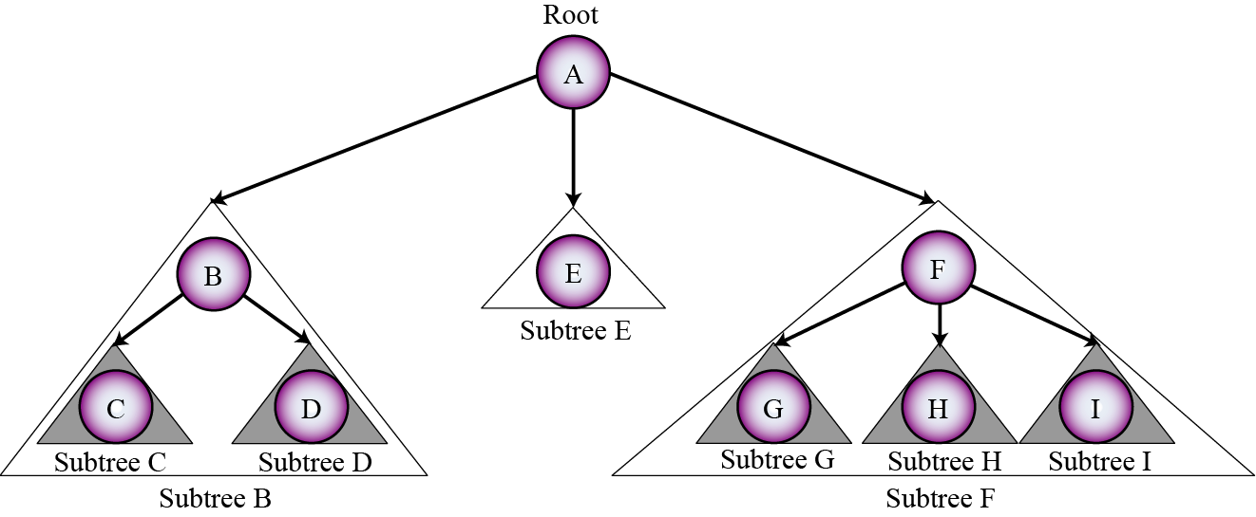
Each node in a tree may have a subtree. The subtree of each node includes one of its children and all descendents of that child. Figure 12.21 shows all subtrees for the tree in Figure 12.20.
Figure 12.21 Subtrees

Slide 59
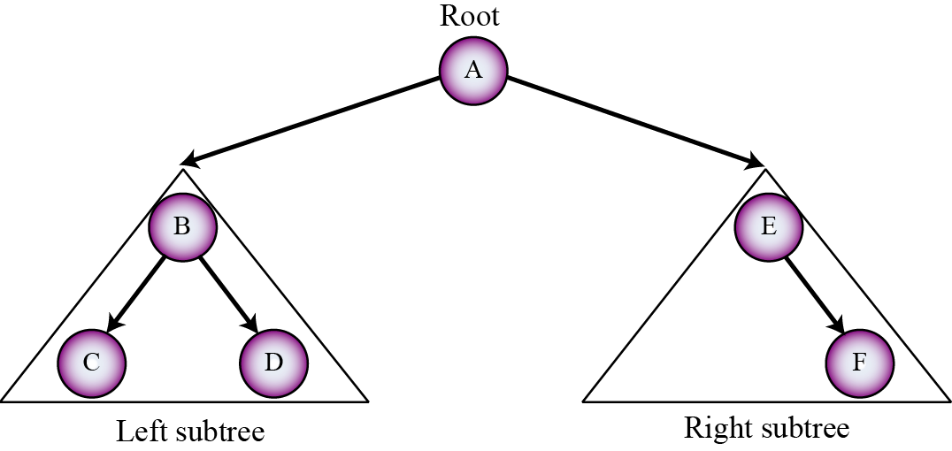
12-5.1 BINARY TREES
A binary tree is a tree in which no node can have more than two subtrees. In other words, a node can have zero, one, or two subtrees.
Figure 12.22 A binary tree

Slide 60
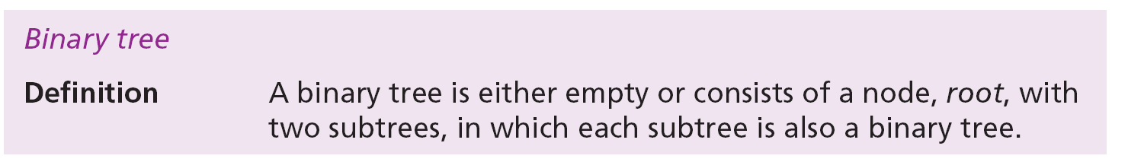
Recursive definition of binary trees
In Chapter 8 we introduced the recursive definition of an algorithm. We can also define a structure or an ADT recursively. The following gives the recursive definition of a binary tree. Note that, based on this definition, a binary tree can have a root, but each subtree can also have a root.

Slide 61
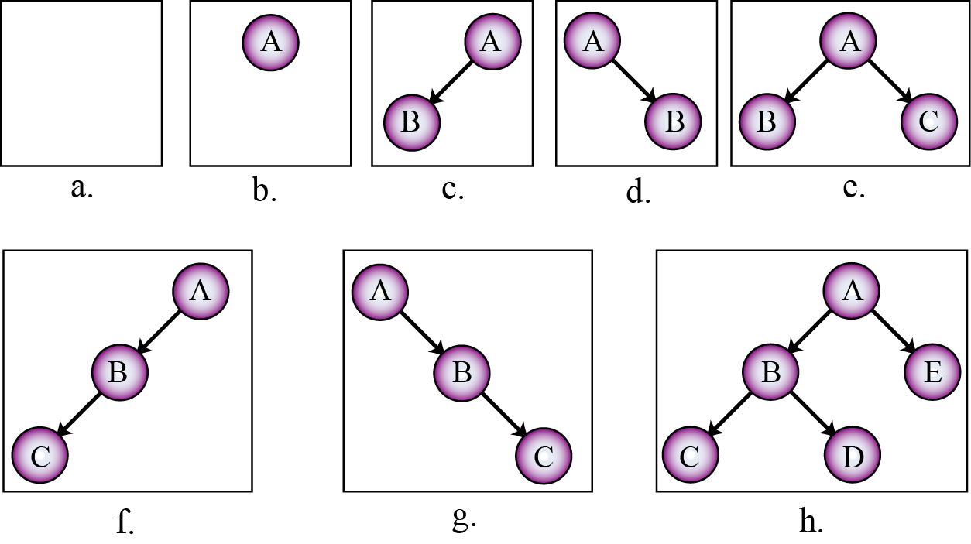
Figure 12.23 shows eight trees, the first of which is an empty binary tree (sometimes called a null binary tree).
Figure 12.23 Examples of binary trees

Slide 62
12.5.2 Operations on binary trees
The six most common operations defined for a binary tree are tree (creates an empty tree), insert, delete, retrieve, empty and traversal. The first five are complex and beyond the scope of this book. We discuss binary tree traversal in this section.

Slide 63
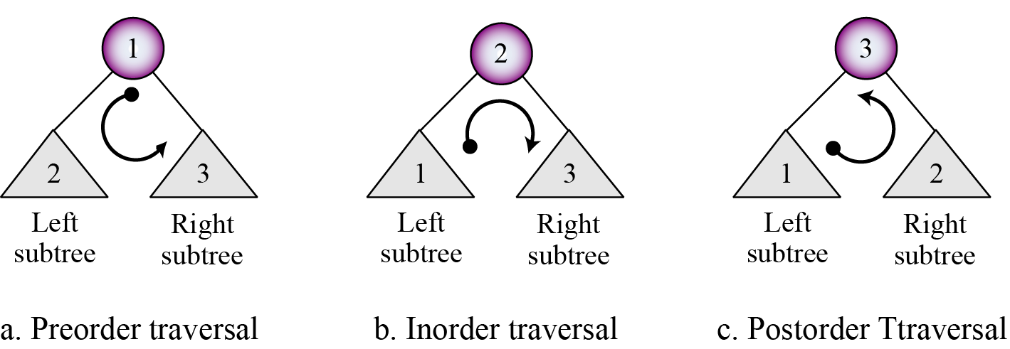
Binary tree traversals
A binary tree traversal requires that each node of the tree be processed once and only once in a predetermined sequence. The two general approaches to the traversal sequence are depth-first and breadth-first traversal.
Figure 12.24 Depth-first traversal of a binary tree

Slide 64
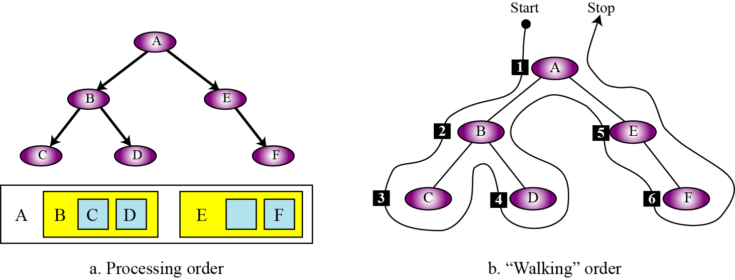
Example 12.10
Figure 12.25 shows how we visit each node in a tree using preorder traversal. The figure also shows the walking order. In preorder traversal we visit a node when we pass from its left side. The nodes are visited in this order: A, B, C, D, E, F.
Figure 12.25 Example 12.10

Slide 65
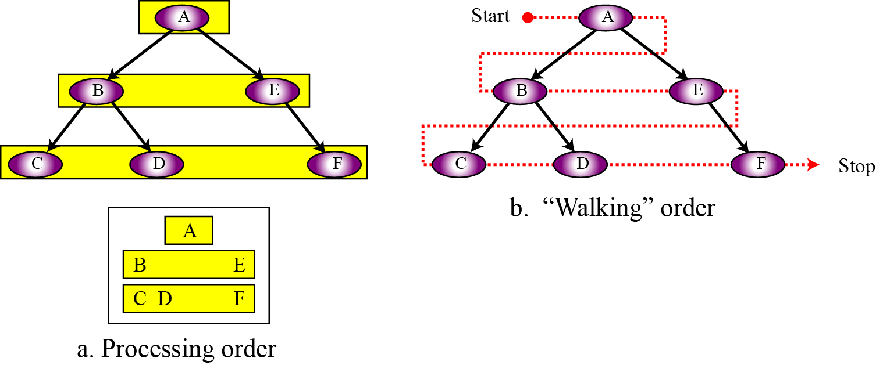
Example 12.11
Figure 12.26 shows how we visit each node in a tree using breadth-first traversal. The figure also shows the walking order. The traversal order is A, B, E, C, D, F.
Figure 12.26 Example 12.11

Slide 66
12.5.3 Binary tree applications
Binary trees have many applications in computer science. In this section we mention only two of them: Huffman coding and expression trees.
Huffman coding
Huffman coding is a compression technique that uses binary trees to generate a variable length binary code from a string of symbols. We discuss Huffman coding in detail in Chapter 15.

Slide 67
Expression trees
An arithmetic expression can be represented in three different formats: infix, postfix, and prefix. In an infix notation, the operator comes between the two operands. In postfix notation, the operator comes after its two operands, and in prefix notation it comes before the two operands. These formats are shown below for addition of two operands A and B.

Slide 68
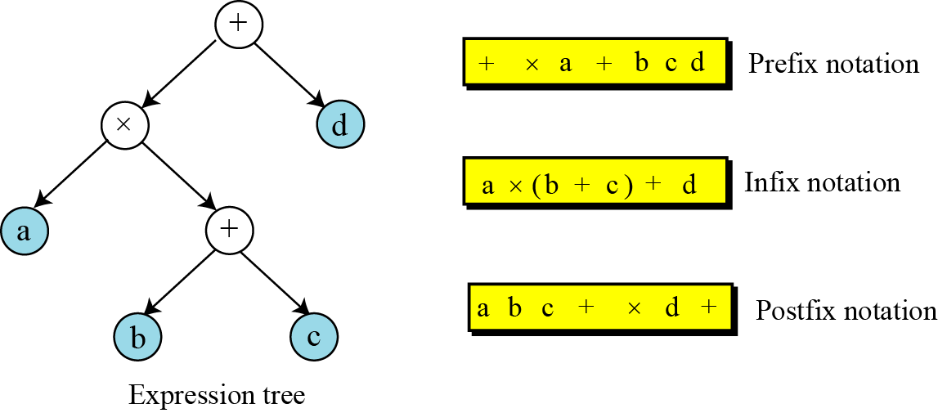
Figure 12.27 Expression tree

Slide 69
12.5.4 Binary tree implementation
Binary trees can be implemented using array or linked lists. Linked list implementation is more efficient for insertion and deletion and more prevalent.

Slide 70
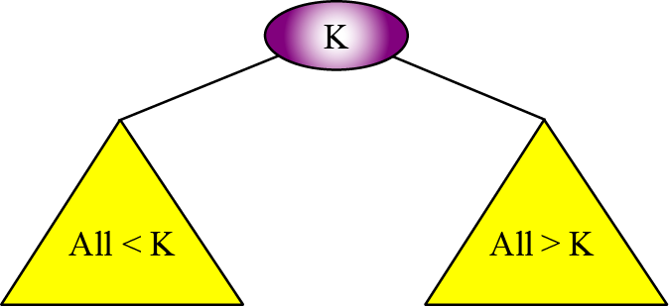
12-5.5 BINARY SEARCH TREES
A binary search tree (BST) is a binary tree with one extra property: the key value of each node is greater than the key values of all nodes in each left subtree and
smaller than the value of all nodes in each right subtree. Figure 12.28 shows the idea.
Figure 12.28 Binary search tree (BST)

Slide 71
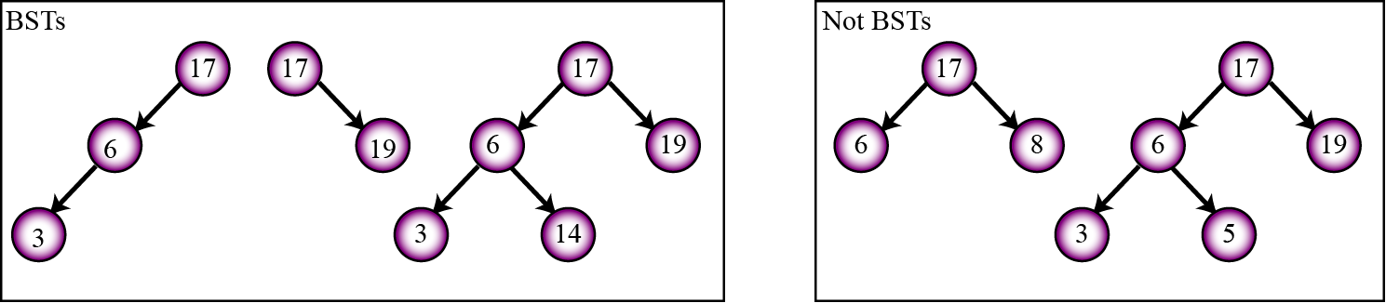
Example 12.12
Figure 12.29 shows some binary trees that are BSTs and some that are not. Note that a tree is a BST if all its subtrees are BSTs and the whole tree is also a BST.
Figure 12.29 Example 12.12

Slide 72
A very interesting property of a BST is that if we apply the inorder traversal of a binary tree, the elements that are visited are sorted in ascending order. For example, the three BSTs in Figure 12.29, when traversed in order, gives the list (3, 6, 17), (17, 19), and (3, 6, 14, 17, 19).
An inorder traversal of a BST creates a list that is sorted in ascending order.

Slide 73
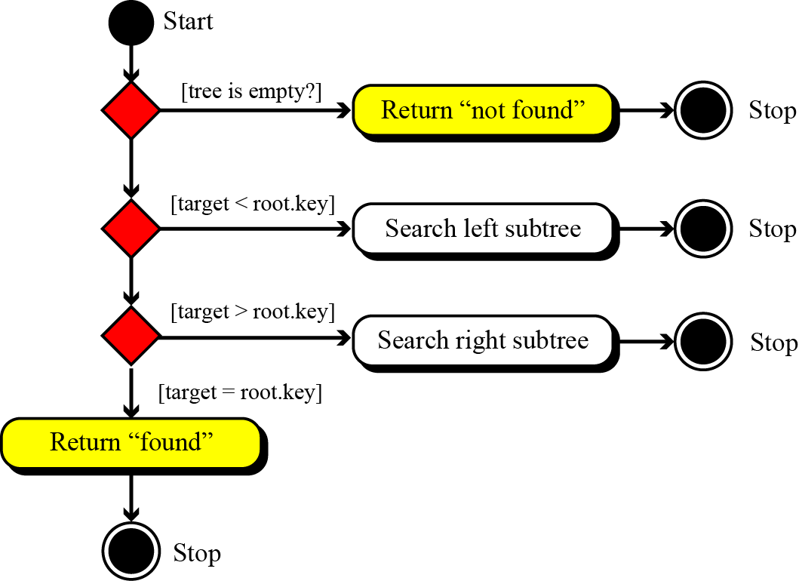
Another feature that makes a BST interesting is that we can use a version of the binary search we used in Chapter 8 for a binary search tree. Figure 12.30 shows the UML for a BST search.
Figure 12.30 Inorder traversal of a binary search tree

Slide 74
Binary search tree ADTs
The ADT for a binary search tree is similar to the one we defined for a general linear list with the same operation. As a matter of fact, we see more BST lists than general linear lists today. The reason is that searching a BST is more efficient that searching a linear list: a general linear list uses sequential searching, but BSTs use a version of binary search.

Slide 75
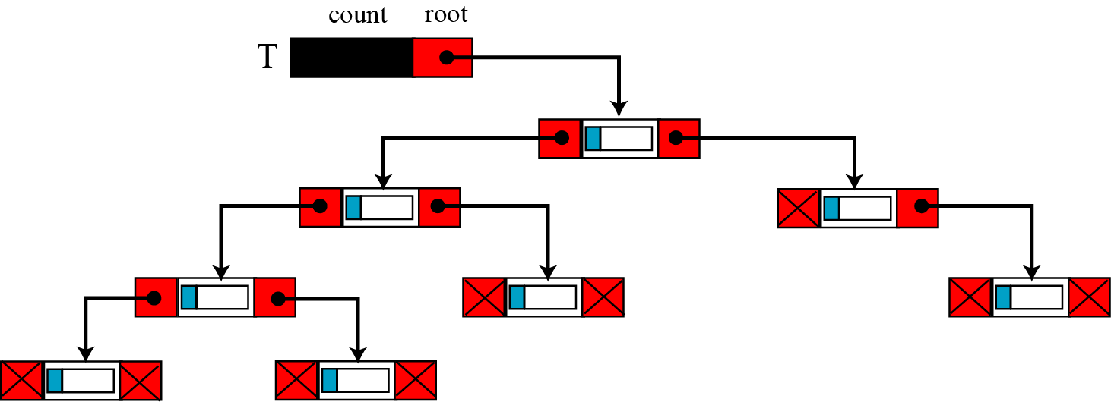
BST implementation
BSTs can be implemented using either arrays or linked lists. However, linked list structures are more common and more efficient. The implementation uses nodes with two pointers, left and right.
Figure 12.31 A BST implementation

Slide 76
12-8 GRAPHS
A graph is an ADT made of a set of nodes, called vertices, and set of lines connecting the vertices, called edges or arcs. Whereas a tree defines a hierarchical structure in which a node can have only one single parent, each node in a graph can have one or more parents. Graphs may be either directed or undirected. In a directed graph, or digraph, each edge, which connects two vertices, has a direction from one vertex to the other. In an undirected graph, there is no direction. Figure 12.32 shows an example of both a directed graph (a) and an undirected graph (b).

Slide 77
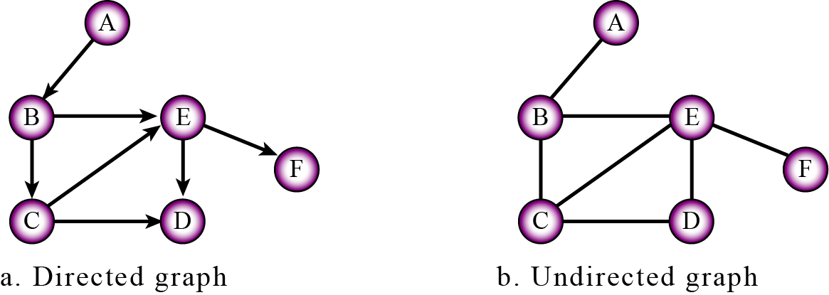
Figure 12.32 Graphs

Slide 78
Example 12.13
A map of cities and the roads connecting the cities can be represented in a computer using an undirected graph. The cities are vertices and the undirected edges are the roads that connect them. If we want to show the distances between the cities, we can use weighted graphs, in which each edge has a weight that represent the distance between two cities connected by that edge.
Example 12.14
Another application of graphs is in computer networks (Chapter 6). The vertices can represent the nodes or hubs, the edges can represent the route. Each edge can have a weight that defines the cost of reaching from one hub to an adjacent hub. A router can use graph algorithms to find the shortest path between itself and the final destination of a packet.

