Slide 1

4
Vector geometry

Slide 2
Chapter Outline
4.1. Vectors and Lines
4.2. Projections and Planes
4.3. More on the Cross Product
4.4. Linear Operations on ○³
4.5. An application to Computer Graphics

Slide 3
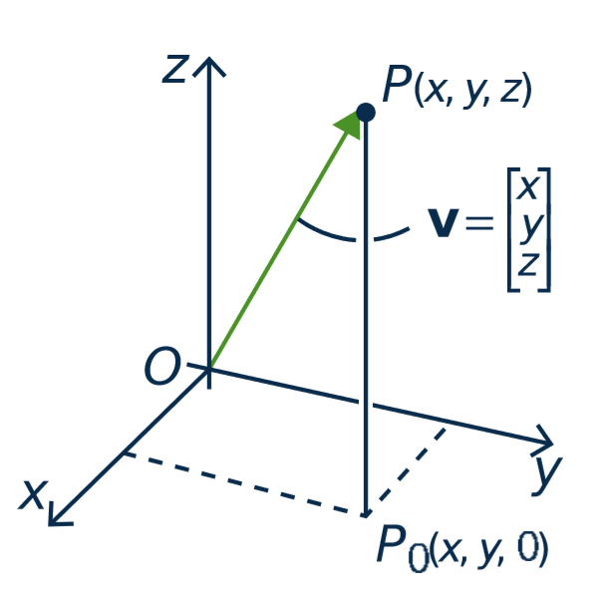
4.1. Vectors and Lines
point P(x, y, z)
Vectors in ○³
The terms vector and point
are interchangeable.
vector v

Slide 4
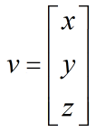

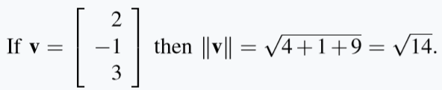
Vectors in ○³
Length.
If then
Ex.

Slide 5

True or false?
If $\left\|v\right\|$ = 3, then $\left\|−2v\right\|$ = -6.
If $\left\|v\right\|$ = 0, then $v$ is zero vector.
-2v
v

Slide 6
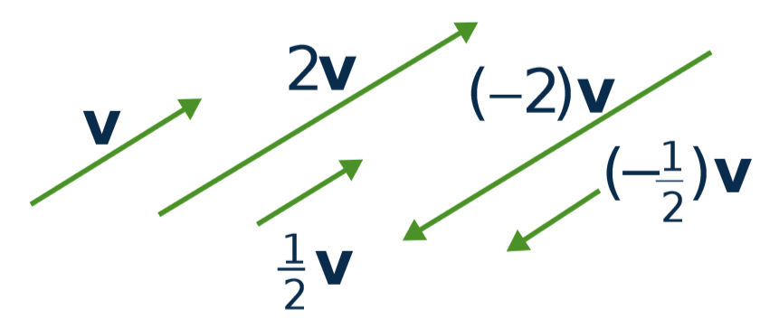
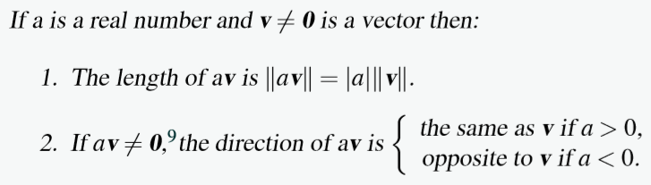
Scalar Multiple Law

Slide 7
Equality
Let v ≠ 0 and w ≠ 0 be vectors in R³.
Then v = w if and only if v and w have the same direction and the same length.
➔ The same geometric vector can be positioned anywhere in space.
•
•
v
w
•
•

Slide 8
Parallel vectors
Two nonzero vectors are called parallel if they have the same or opposite direction.
v and w are parallel ⇔ v = kw for some scalar k
v
-2v

Slide 9
The Parallelogram Law
v
v + w ⬅ first v then w
w
v + w = w + v

Slide 10
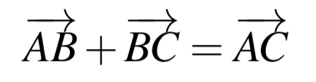
Tip-to-tail rule
B
C
A

Slide 11
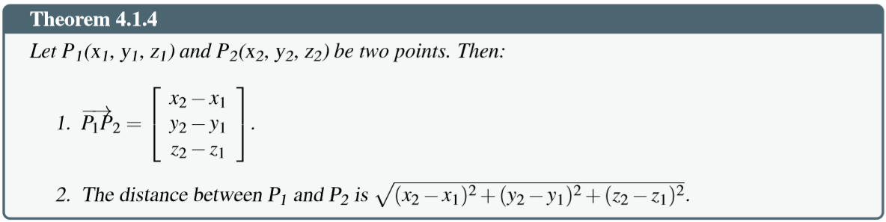
Distance between two points

Slide 12
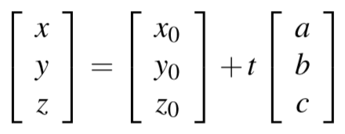
Lines in Space
Given the point P₀ (with vector p₀) and the direction vector d ≠ 0.
Then line parallel to d through the point P₀ is given by:
p = p₀ + td,
(t is any number)

Slide 13
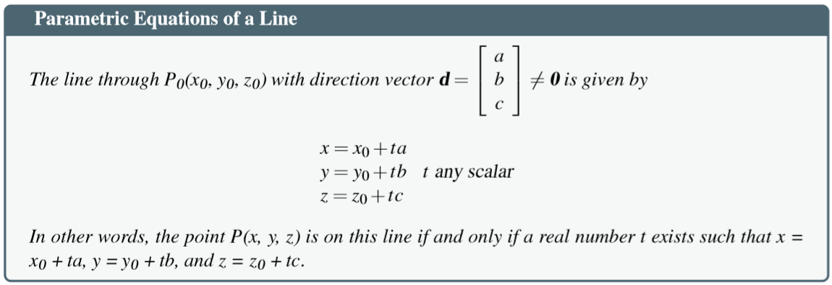
Lines in Space

Slide 14
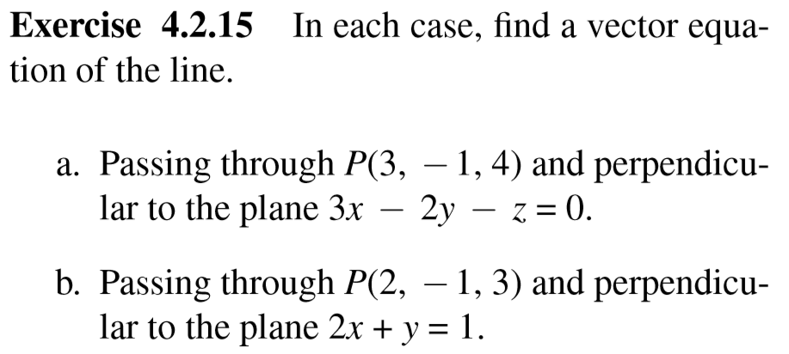

Slide 15
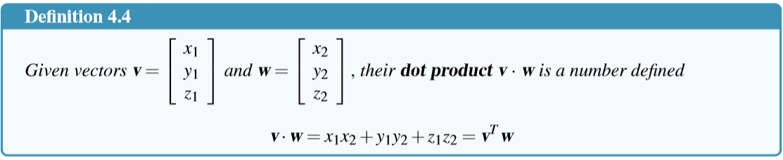
4.2 Projections and Planes
The Dot Product

Slide 16
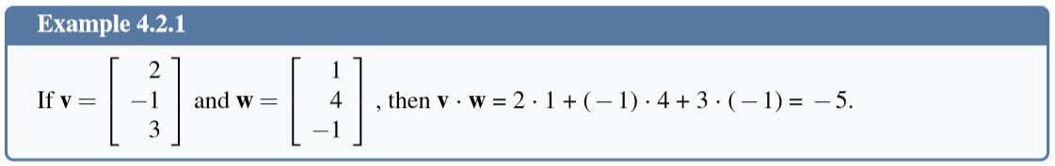
The Dot Product

Slide 17
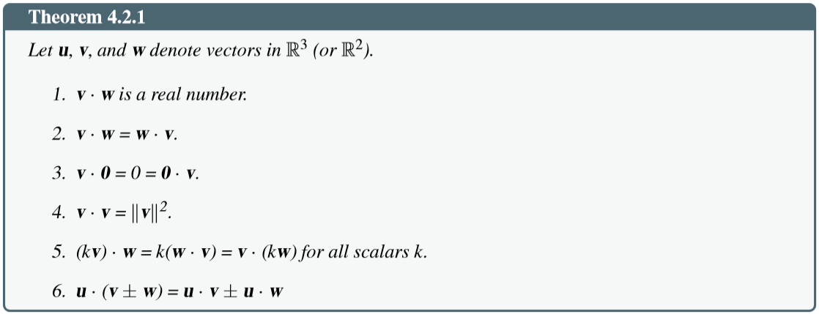
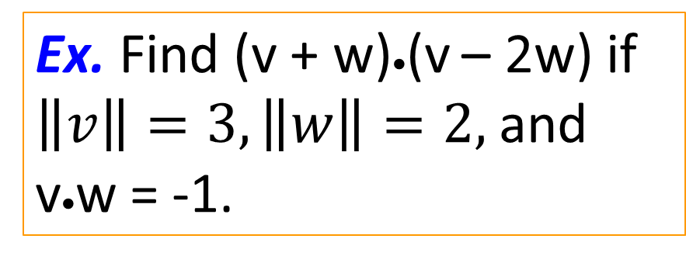
Properties of dot product
Ex. Find (v + w)•(v – 2w) if $\left\|v\right\|=3, \left\|w\right\|=2,$and v•w = -1.

Slide 18
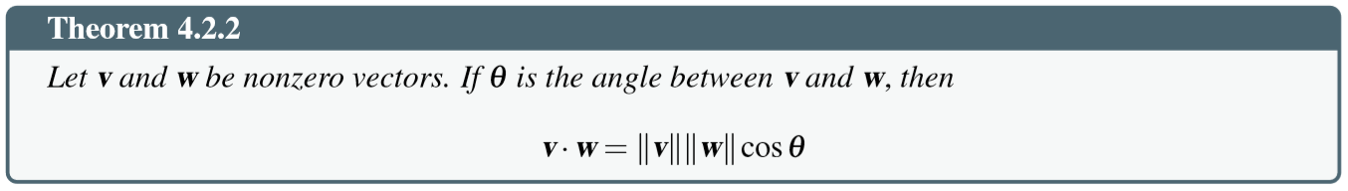
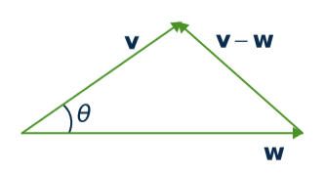
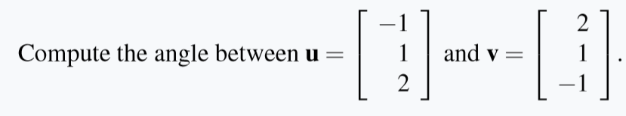
Angles between vectors
Example.

Slide 19
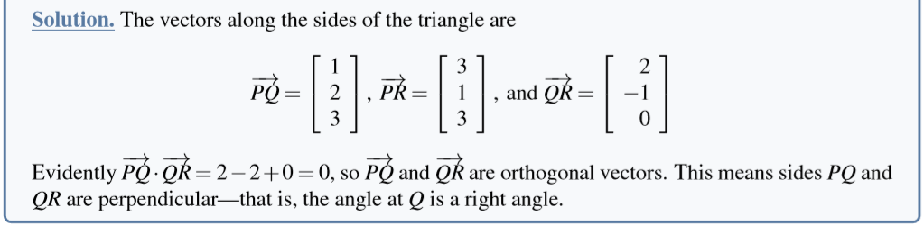
Orthogonality
Two vectors v and w are said to be orthogonal if
v • w = 0

Slide 20
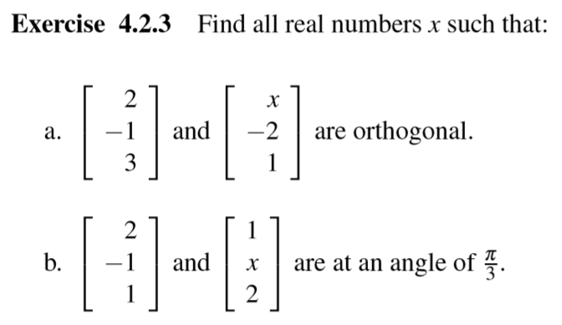

Slide 21
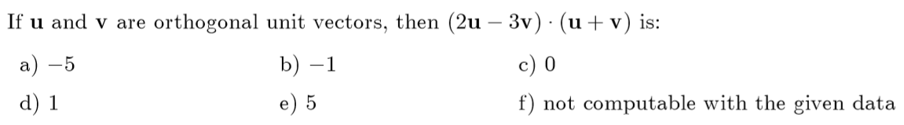

Slide 22
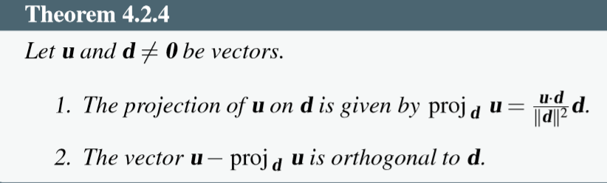
Projection
u
u – v
1. v ⁄ d
2. u – v ⊥ d
•
d
v

Slide 23
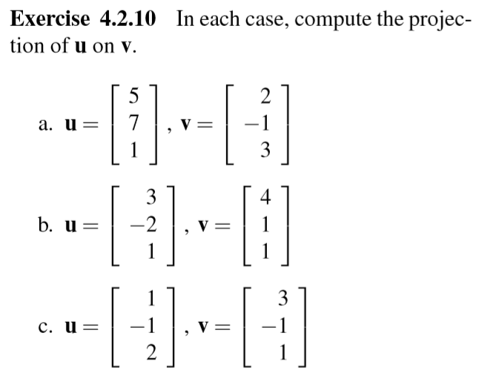

Slide 24
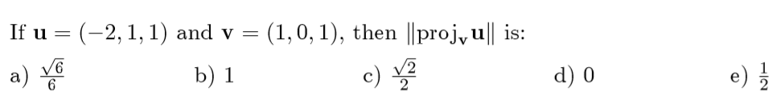

Slide 25
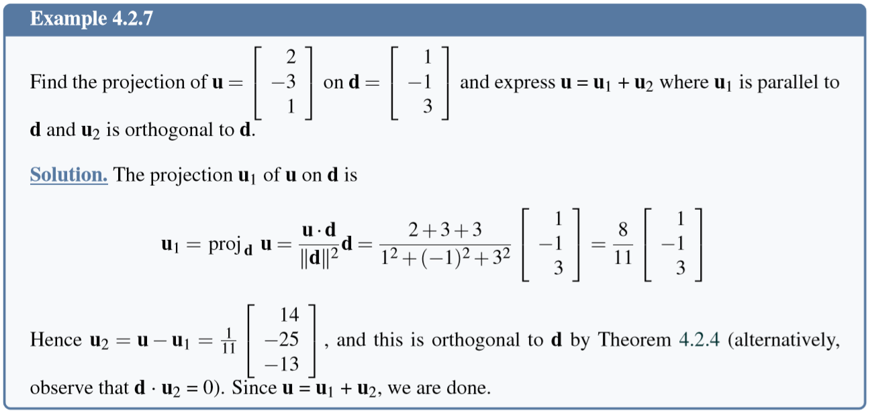
Projection

Slide 26
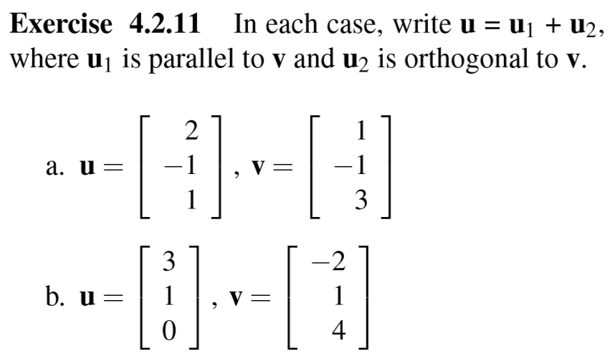

Slide 28
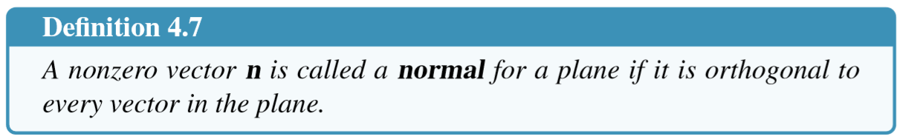
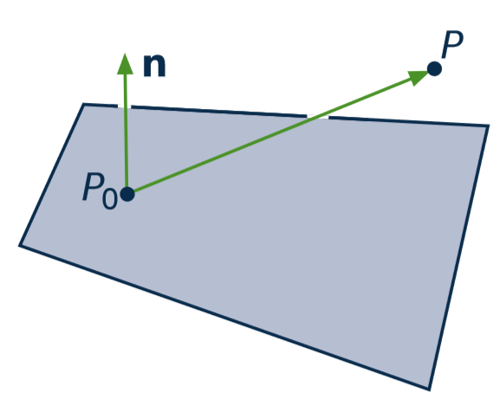


Planes

Slide 29
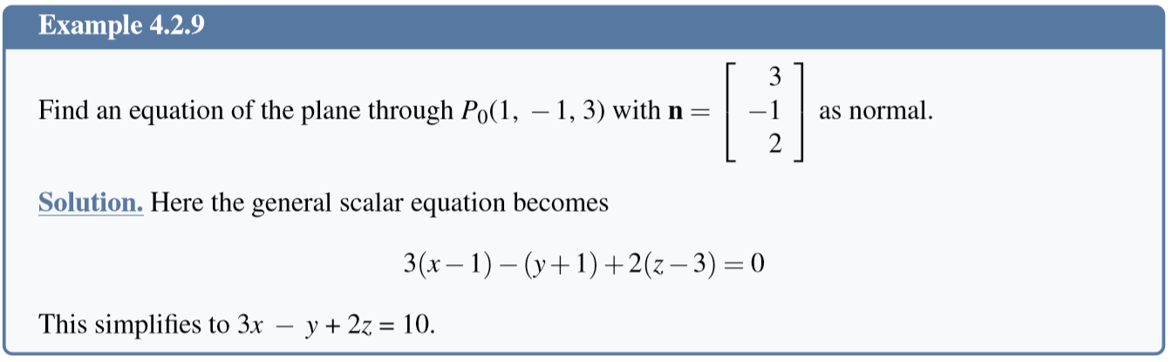
Equation of a Plane

Slide 30
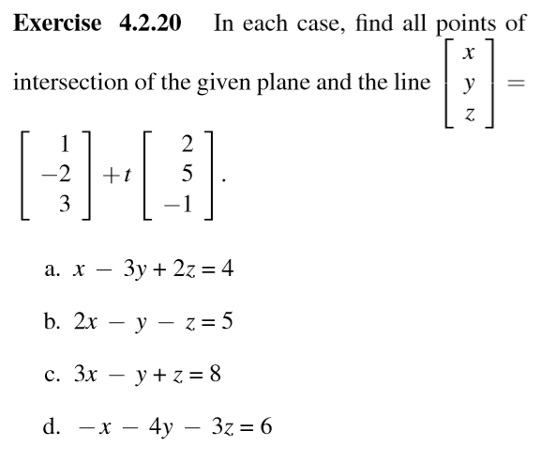

Slide 31
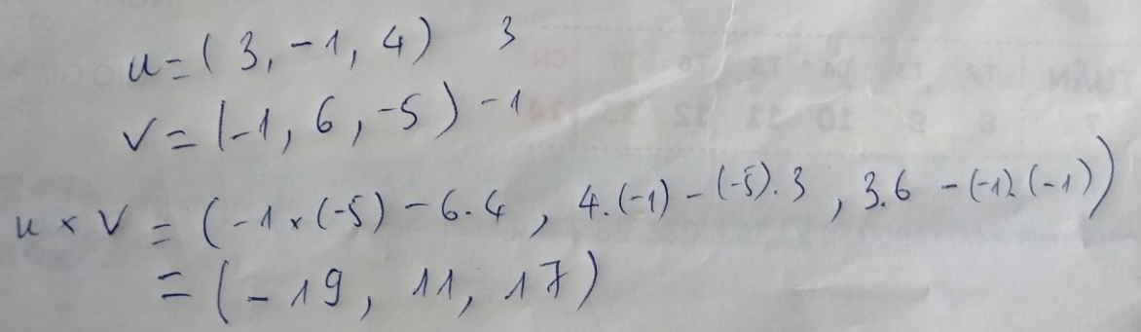
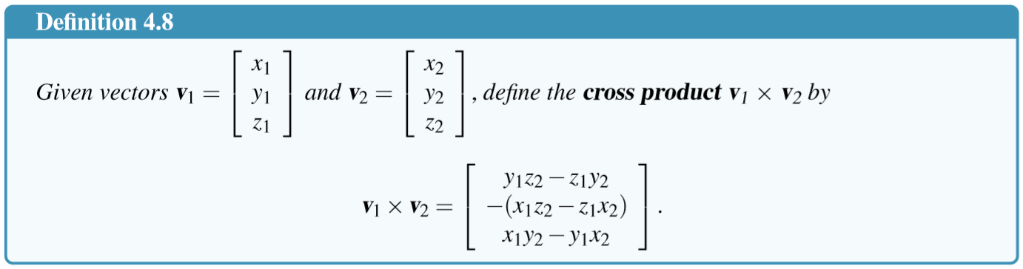
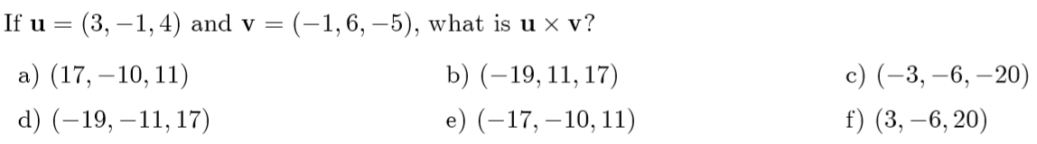
The Cross Product

Slide 32
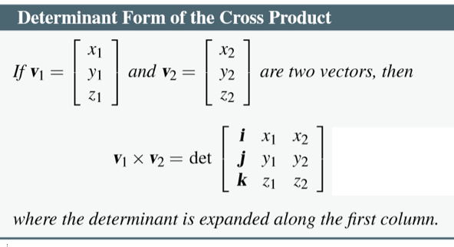

Slide 33
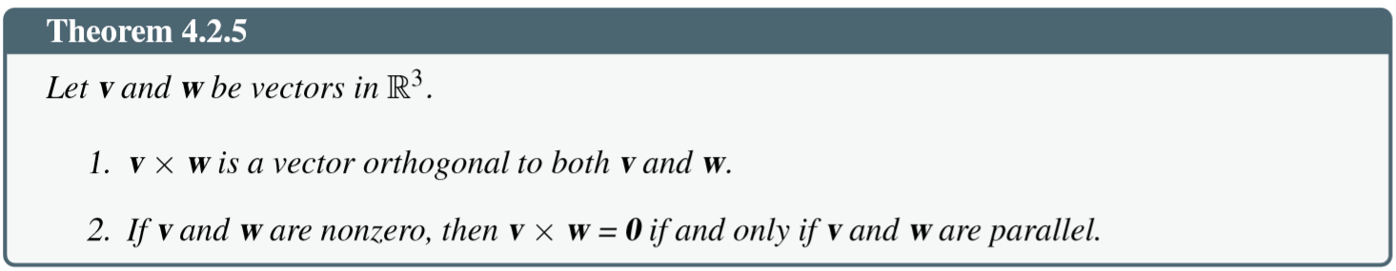
Properties of cross product

Slide 34
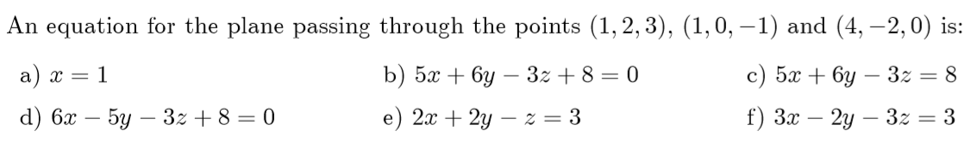

Slide 35
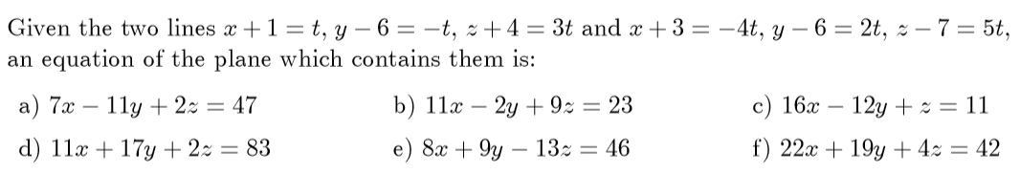

Slide 36
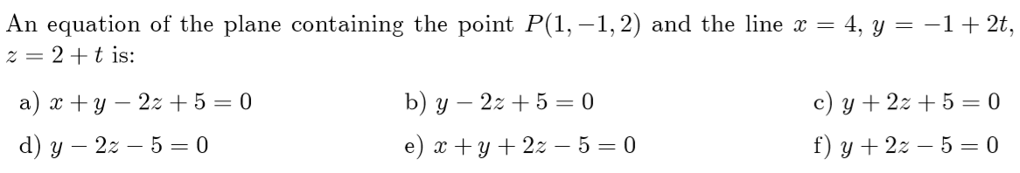

Slide 37
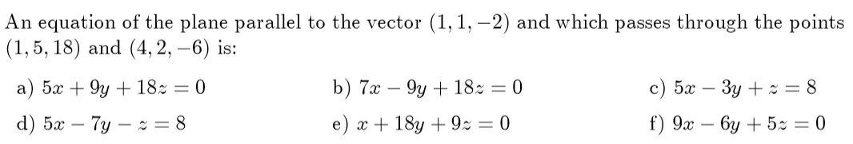

Slide 38
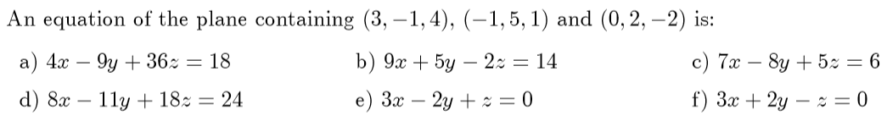

Slide 39
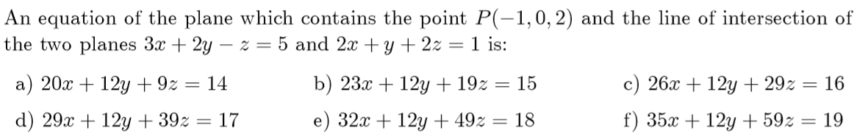

Slide 40
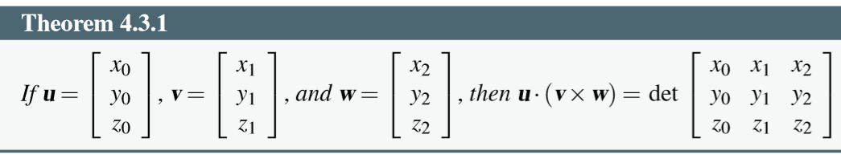
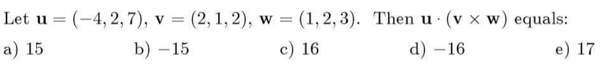
4.3 More on Cross Product

Slide 42
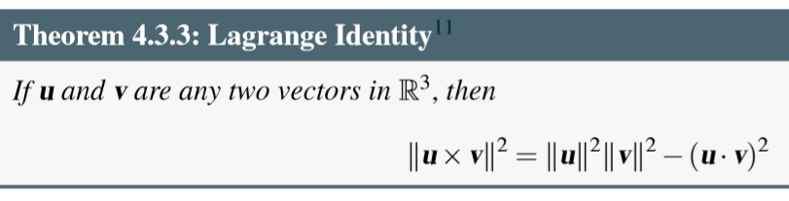
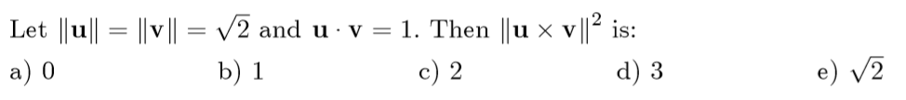

Slide 43
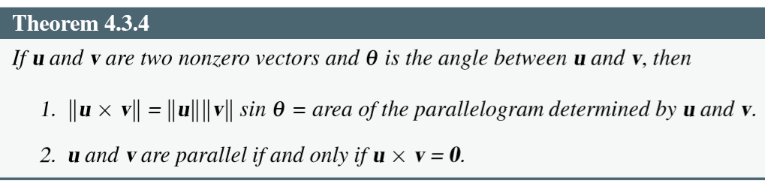

Slide 45
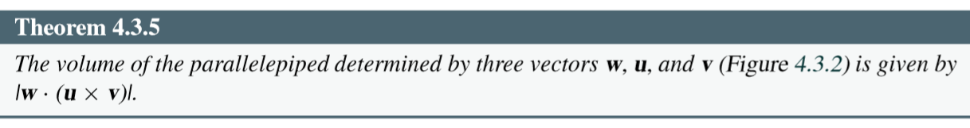
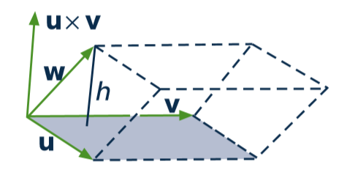
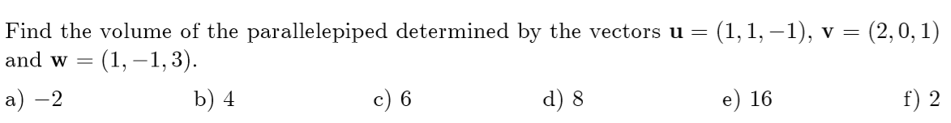

Slide 47
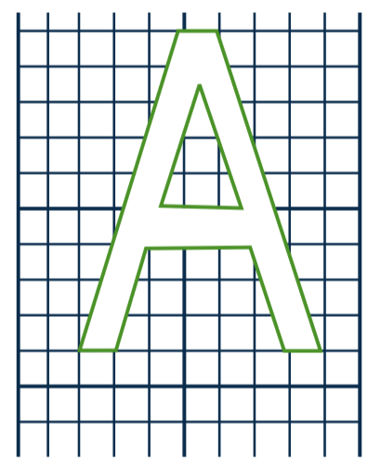


4.5 An application in Computer Graphics
Data matrix D

Slide 48







How to change image?
C
D
C

Slide 49
Computer graphics
Image ➔ matrix D
Matrices of transformations A₁, A₂, ..., A_{n}
Compute A_{n}...A₃A₂A₁D
3rd transformation
1st transformation
Data matrix
n^{th} transformation
2nd transformation

Slide 50
Some common transformations and their matrices
Reﬂections and Projections
Rotations
Translations

Slide 51


Slide 52

Matrices of Reﬂections and Projections
Reﬂections and Projections

Slide 53
Matrices of Translations
Need a clever way to give these matrices (Read yourself in the text book)

Slide 54



Slide 56
Summary
4.1. Vectors and Lines
4.2. Projections and Planes
4.3. More on the Cross Product
4.4. Linear Operations on ○³
4.5. An application to Computer Graphics

