Slide 1
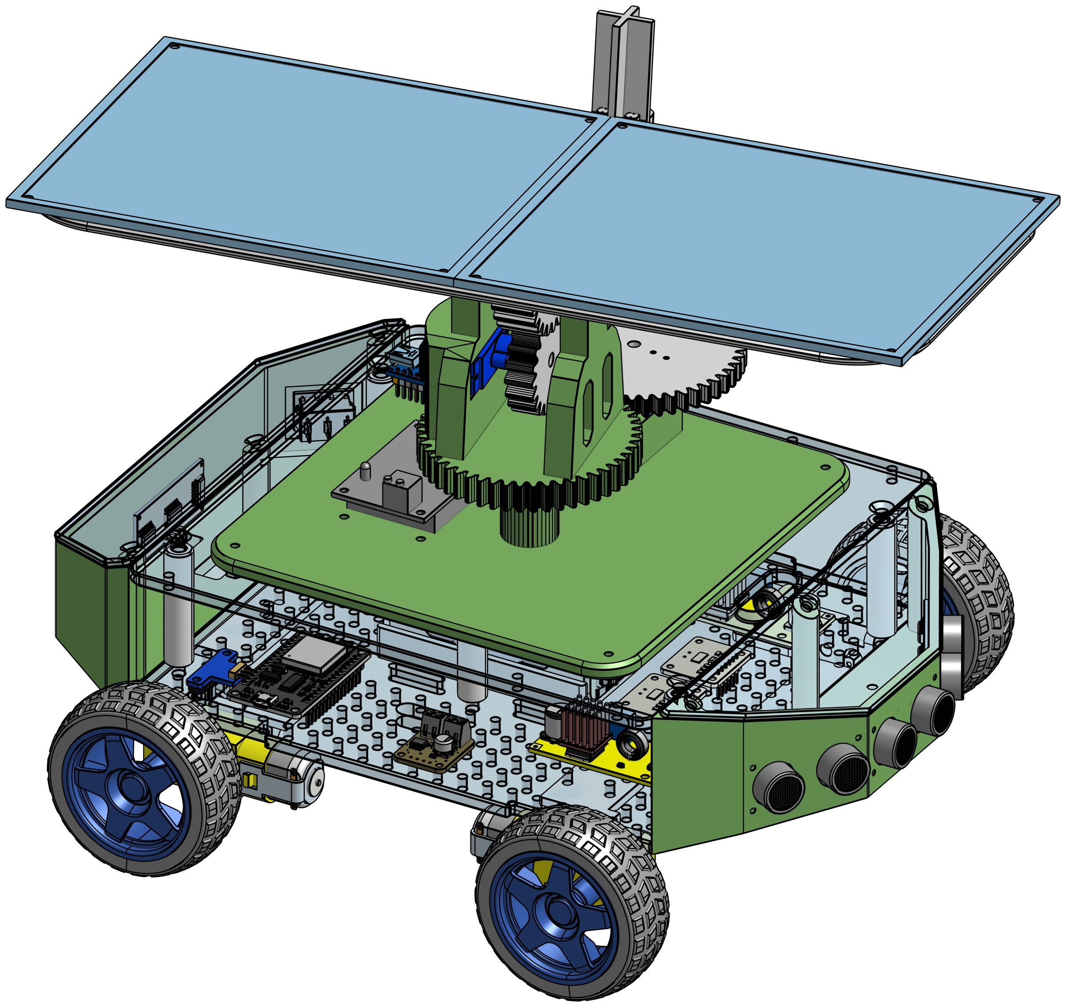
Engineering a Solar Car
Jonathan Tirkaso · Mechatronics Engineering, University of Cape Town
Notes:
Hi everyone, my name is Jonathan. I'm a final-year Mechatronics Engineering student at UCT. Today I'll show you the solar-powered car I built for my final-year project, and how one project like this brings together several kinds of engineering. At the end, you'll get to drive it yourselves through a maze. (Check first: everyone has filled in Side 1 of their sheet and is keeping it for later.)

Slide 2
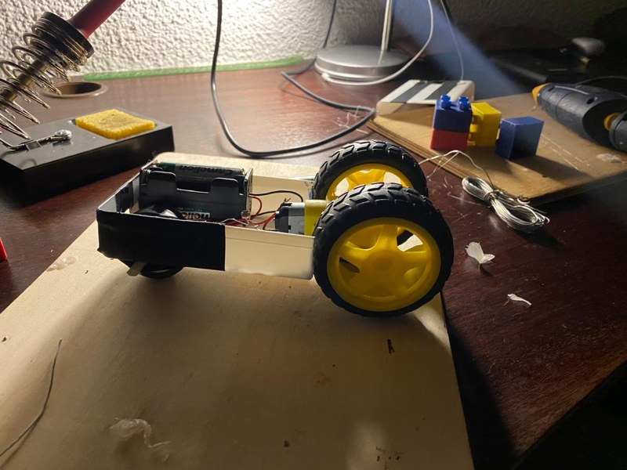
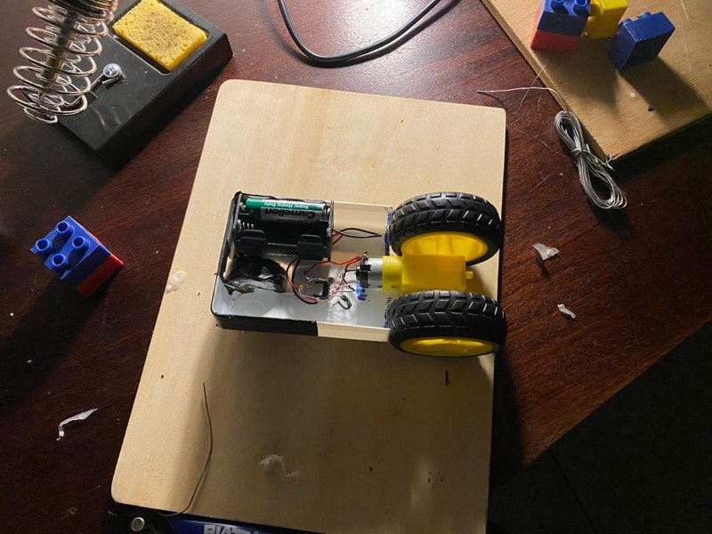

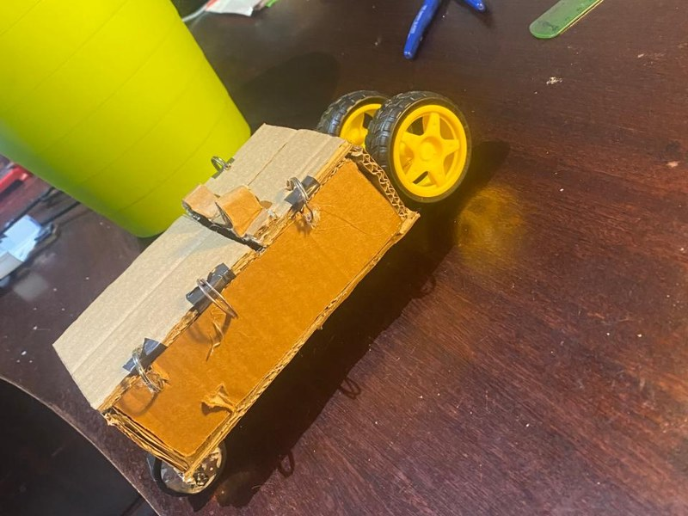
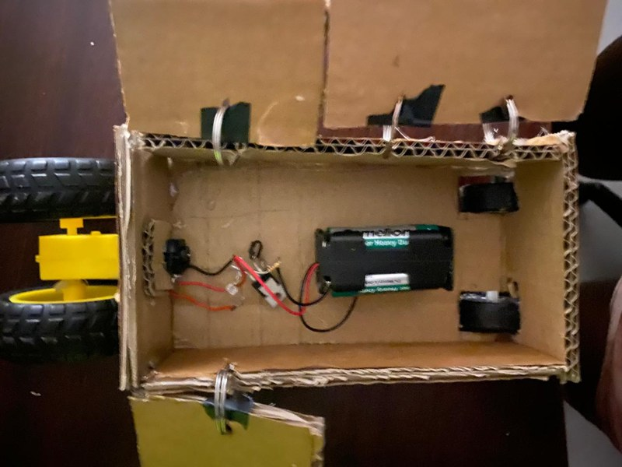



Where it started: Grade 11
A careers advisor said I might suit electronics engineering, so I built a car that moved when light shone on it.
Battery and one motor
Light sensor (LDR): resistance drops in light
Transistor: an electronic switch
Front wheel made from a candle
Version 1 in a plastic tray (top), version 2 in cardboard (bottom)
Engineering is learning what you need to know to get things done.
Notes:
My engineering journey started where you are now, in Grade 11. A careers advisor told me I had an aptitude for electronics engineering, a field I'd never heard of. To find out if it was for me, I built a little car that moved when you shone light on it. It had one motor, a battery, a transistor, which is an electronic switch, and an LDR, a resistor whose resistance drops when light hits it. Light on the LDR switched the transistor on, and the motor turned. I even made the front wheel from a candle. It was simple, but seeing how my siblings reacted showed me how much there is to learn and achieve in engineering.

Slide 3



Scientist, engineer or technician?
Scientist
Engineer
Technician
Discovers how the world works. Builds knowledge, often without a use in mind yet.
Applies that knowledge to design new solutions to real problems.
Builds, maintains and repairs specific systems with deep hands-on skill.
Example: an electrician wires your house; an electrical engineer designs the system and the appliances in it.
Notes:
What do engineers actually do? Picture three people. A scientist discovers how the world works, often just to understand it better. A technician is a specialist who builds, maintains and repairs a particular system. The engineer sits in the middle: they understand the science well enough to apply it in new ways to solve real problems. For example, an electrician knows how to wire a house, while an electrical engineer designs the electrical system and the appliances, and can suggest how to make them better. Engineers design; technicians build and maintain; both are valuable.

Slide 4
What is Mechatronics?
Engineers are problem solvers. "Mechanical" or "electrical" just names the kind of problem they are trained for.
Mechanical
Electrical
Mechatronics
Mechatronics engineers solve problems that join mechanical, electrical and computer engineering together, like robots, drones and cars.
Computer
Notes:
I study Mechatronics, in UCT's Electrical Engineering department. Few universities in South Africa offer it. Engineers are problem solvers, and names like mechanical, chemical or electrical just describe the kind of problem they are trained to solve. Mechatronics sits where mechanical, electrical and computer engineering overlap, so we specialise in integration: making those parts work together in one system, like a robot, a drone or a car. My course leans towards the electrical and computer side, with some mechanical.

Slide 5
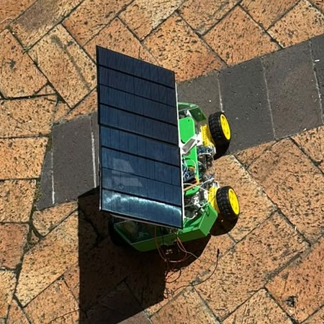
Meet the solar car
Mechanical
Electrical
Computer
Solar energy
One project, every discipline, built for you to drive.
Designed on a computer (left), built for real (right)
Notes:
So how do you show all of that in one project? This is my final-year thesis: a small solar-powered car, built to show how useful renewable energy is, and to be something you can interact with. On the left is the computer design; on the right is the real thing. I'll walk you through each part and the kind of engineering behind it: electrical, mechanical, renewable energy and computer.

Slide 6
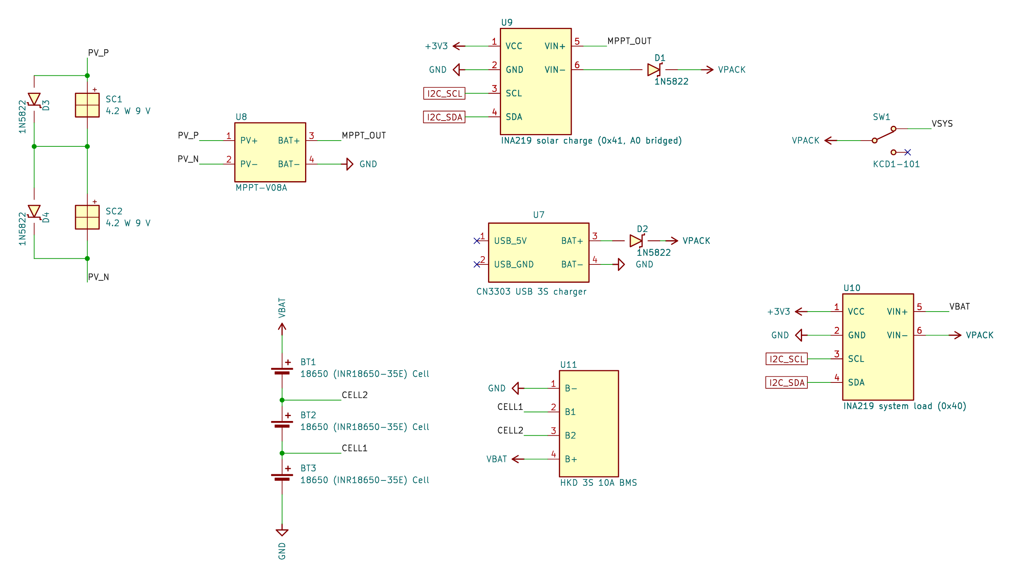



Electrical: managing power
Three circuits on the car
Power: solar, battery and charging
Drive: motors, steering and sensors
Tracker: turns the panel to the light
The same ideas in your home
Phone charger: controls the power into a battery
The car's power circuit
Solar garden light: stores the day's sun
TV remote: a sensor and a tiny chip
Notes:
First, the electrical side, my strongest area. The car has three circuits: the power system, the drive system that controls the motors and steering, and the solar tracker on top. Engineers don't reinvent the wheel: we buy proven parts where they exist and design circuits ourselves where they don't, and this car uses both. The biggest job is managing power. You need enough energy for everything, but it must be controlled, because power is a double-edged sword: necessary, but dangerous if it isn't managed. The same ideas are in devices you use every day: your phone charger controls the power going into a battery, a solar garden light stores the day's sun, and a TV remote uses a sensor and a tiny chip.

Slide 7
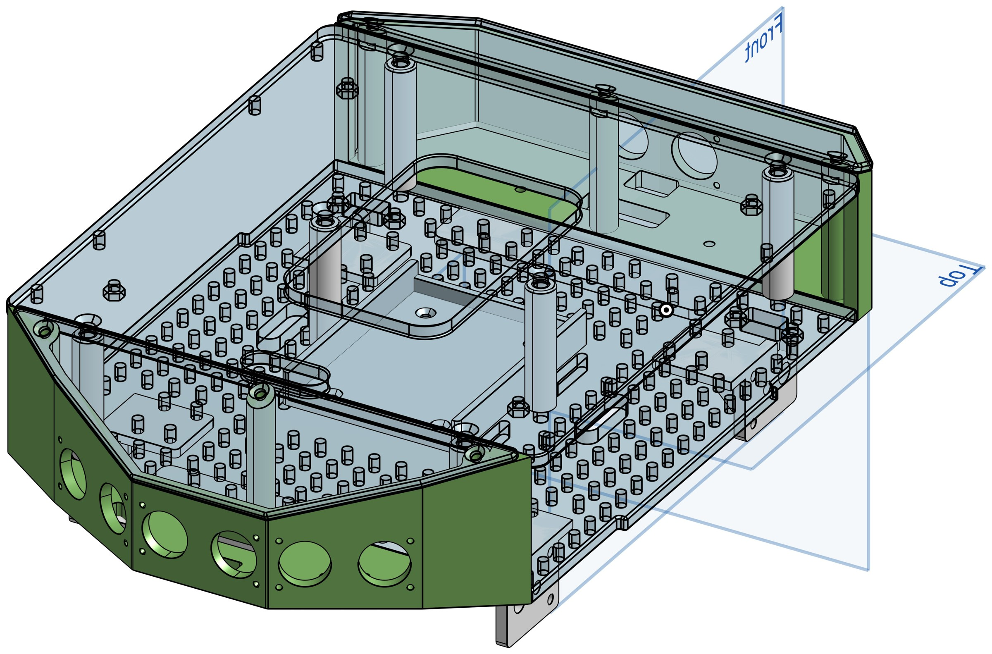
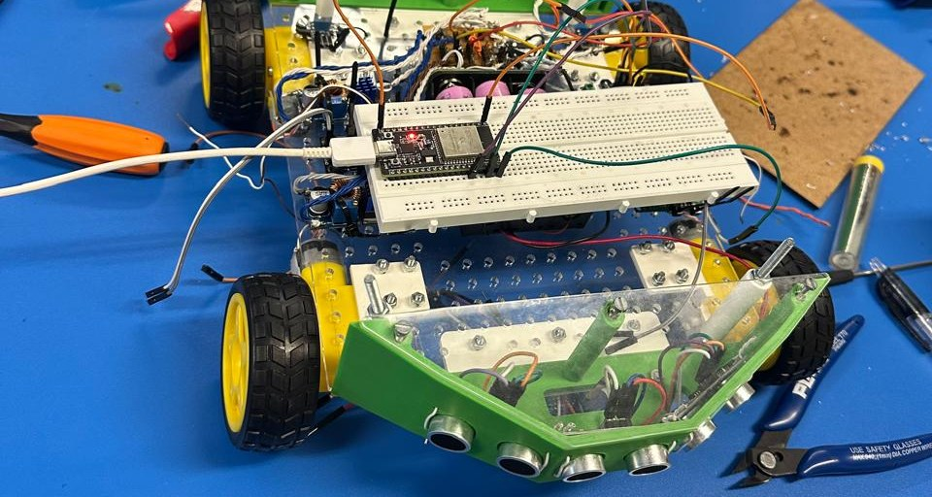

Mechanical: designing the body
Designed in CAD
Every part modelled on a computer, then 3D-printed or laser-cut from clear acrylic so you can see inside.
Shaped like real cars
The angled nose and tail cut through air. Air drag only matters at high speed, so here the shape is for show.
Kept light
F = m × a: a lighter car needs less force, and so less energy, to get moving.
Notes:
Now the mechanical side. Every part was designed in CAD software, then 3D-printed in plastic or laser-cut from clear acrylic, so you can see the electronics inside. The angled nose and tail copy the shapes real cars use to slip through the air. If you've run into the wind in Cape Town, you know air pushes back, and at highway speeds that becomes a big energy cost. But air drag only matters at high speed, and my car is slow, so here the shape is mostly for show. Knowing when a design choice really matters is part of engineering. What did matter was weight: force equals mass times acceleration, so a lighter car needs less force, and less energy, to move. In a real car, engineers also calculate the stresses each part carries to choose the right materials and shapes.

Slide 8
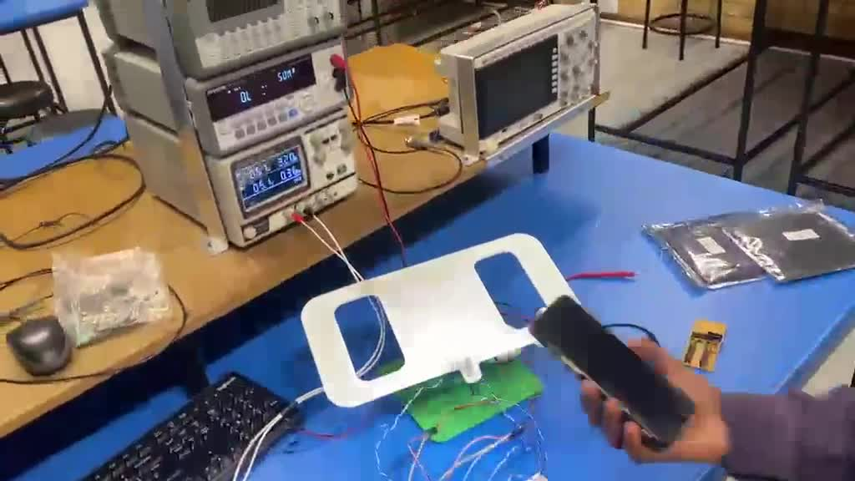
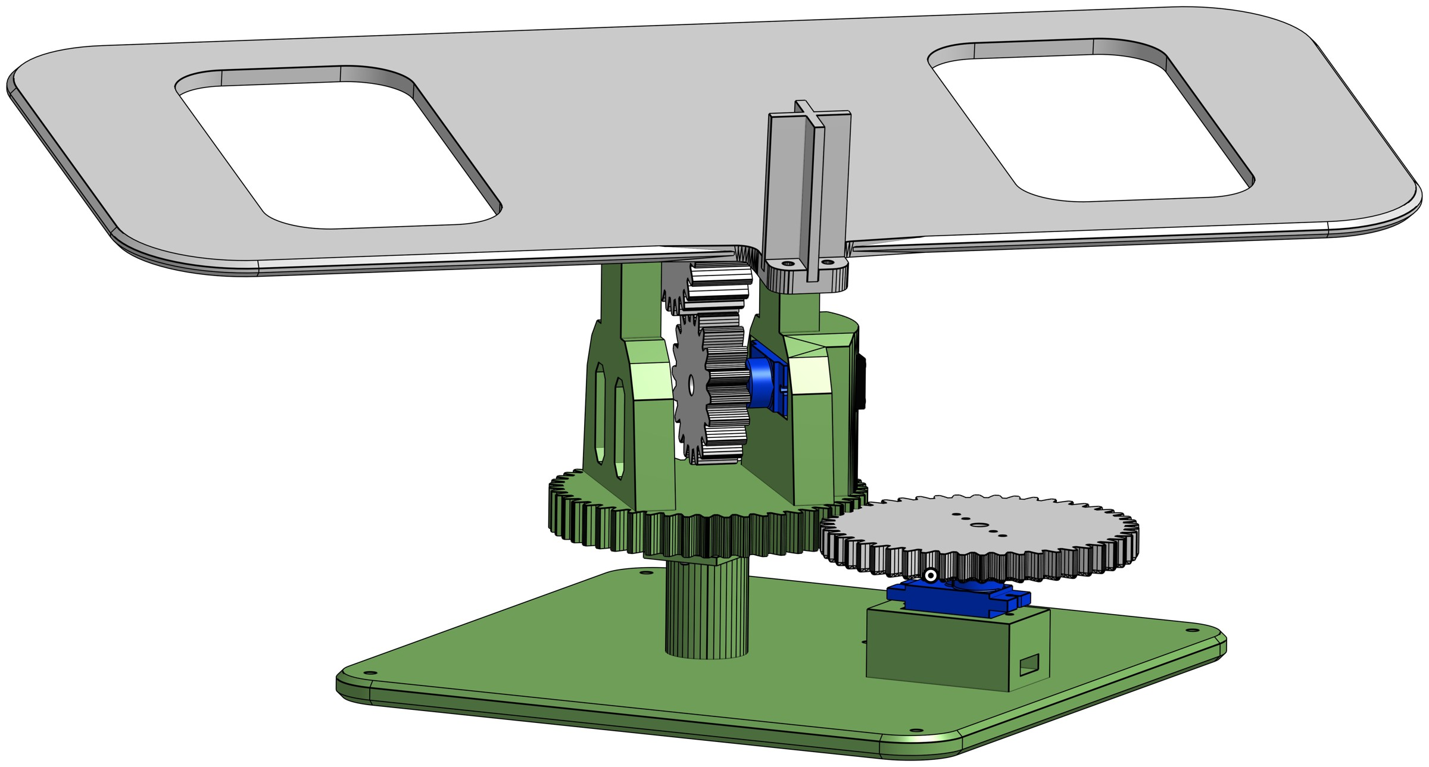
Mechanical: gears that follow the sun
Gears change speed, force (torque) and direction of turning
Tooth counts and sizes follow exact ratios
Two motors tilt and turn the panel towards the brightest light
The tracker following a light in the lab
Notes:
The solar tracker on top is the other mechanical feature. It uses gears, which change speed, turning force (called torque) and direction. Gears look simple, but you can't just put teeth on a circle: the number of teeth and the sizes of two meshing gears must follow exact ratios. The tracker uses two small motors, one to turn the panel and one to tilt it, so the panel faces the brightest light. This video shows it working in the lab: as the light moves, the panel follows it. (Play video.)

Slide 9


Renewables: how a solar panel works
photons (light energy)
Solar
Wind
Hydro
Renewables turn natural energy into electricity, the easiest form of energy to move and use.
solar cell (semiconductor)
Careers: designing solar farms, battery systems and electric vehicles.
electrons flow = electricity
Bigger panels catch more light, so they make more power.
Notes:
Next, renewable energy: solar, wind and hydro are the big three. Electricity is just the easiest way to move and use energy, and most power stations, even coal ones, convert one kind of energy into electricity. Solar panels are made from a special material called a semiconductor. Light is made of tiny packets of energy called photons; you feel their energy as warmth on your face. When photons hit the panel, they give that energy to electrons in the material and free them to flow through a circuit. That flow is electricity. Bigger panels catch more light, so they make more power. This is a growing career area: engineers design solar farms, battery systems and electric vehicles.

Slide 10





Why the sun charges a battery
Sun
Panel
Solar controller
Battery
Car
Sunlight changes all the time
Sun makes the battery last longer
Clouds and angle change the power, so the panel charges a battery, and the battery runs the car. Solar garden lights work the same way.
In the sun, the panel shares the load, so the battery does less work. Watch the solar power on the live dashboard.
Notes:
Sunlight isn't steady: clouds and the panel's angle change the power all the time, and electronics need steady, controlled power. So the panel doesn't drive the car directly. A solar controller conditions the power and charges the battery, and the battery runs the car. Solar garden lights and many home solar systems work the same way: capture energy, store it, use it later. Solar also extends how long the battery lasts: in the sun, the panel supplies part of the power the car needs, so the battery does less work. (Show the live dashboard on the projector: point out the solar power reading.) This panel is small and not very efficient, but real panels are much bigger.

Slide 11
Computer: the car's two brains
ESP32: drives the car
Arduino Nano: runs the tracker
Reads 4 distance sensors and 2 speed sensors
Controls the 4 motors
Runs the Wi-Fi and the dashboard
Reads 4 light sensors
Moves the 2 tracker motors
Turns the panel to the brightest light
A microcontroller is a small computer on a chip: it reads sensors, makes decisions and drives motors.
Notes:
The third discipline is computer engineering, which shows up in embedded systems. At the centre of almost every modern device is a microcontroller, a small computer on a chip. It reads sensors, makes decisions and sends commands to motors. My car has two: an ESP32, which drives the car, reads the distance and speed sensors and runs the Wi-Fi, and an Arduino Nano, which reads four light sensors and moves the tracker. Engineers must both design the circuits around these chips and program them to do exactly what's needed.

Slide 12
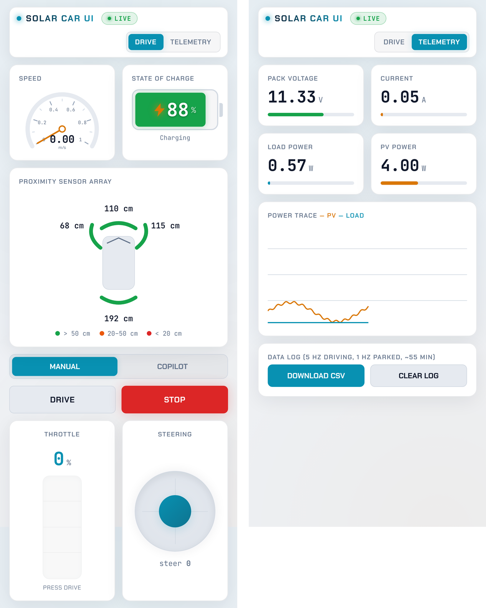


Drive it from your phone
The car makes its own Wi-Fi network
Your phone connects straight to the car: an Internet of Things (IoT) link.
The dashboard is a web page
HTML builds it, CSS styles it and JavaScript makes it work.
Live data, 10 times a second
Speed, battery, solar power and distance sensors.
Notes:
You'll drive the car from a phone. The car creates its own Wi-Fi network, and your phone connects directly to it. Connecting devices wirelessly like this is called the Internet of Things, or IoT. The controls are a web page I wrote: HTML lays out the page, CSS styles it, and JavaScript makes the buttons and live readings work, just like any website. The dashboard updates about ten times a second with the speed, battery level, solar power and distance sensors, so you can see exactly what the car is doing.

Slide 13
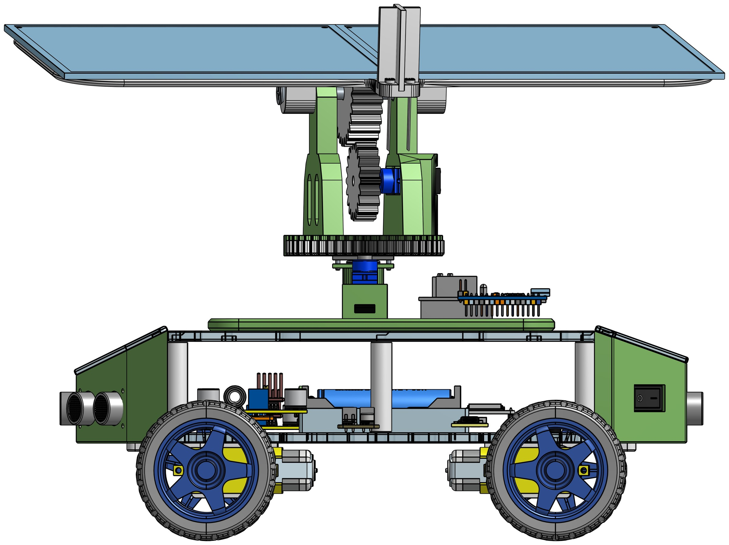
One car, every kind of engineering
Mechanical
Electrical
Body, gears and the sun tracker
Power circuits, motors and sensors
Computer
Renewable energy
Two microcontrollers and the dashboard
Solar panel charging the battery
Notes:
So, to bring it together: mechanical engineering gives us the body, the gears and the tracker; electrical engineering gives us the power circuits, motors and sensors; computer engineering gives us the two microcontrollers and the dashboard; and renewable energy keeps the battery topped up. None of these parts works without the others. That's what real engineering projects look like: different disciplines working together on one product.

Slide 14


How to get here
Grades 11–12
University
Explore
Take Mathematics (not Maths Literacy) and Physical Sciences, and aim high in both.
A 4-year engineering degree, such as a BSc in Engineering.
Mechatronics, Electrical, Mechanical, Civil, Chemical and Computer engineering, and renewable energy.
I started exactly where you are now, in Grade 11.
Notes:
If any of this interests you, here's how to get here. In Grades 11 and 12, take Mathematics, not Maths Literacy, and Physical Sciences, and aim high in both, because engineering faculties require them. Then comes a four-year engineering degree. Look up the different kinds of engineering, such as Mechatronics, Electrical, Mechanical, Civil, Chemical and Computer, and the growing renewable-energy field, and see which problems excite you. Remember, I started exactly where you are now, in Grade 11.

Slide 15
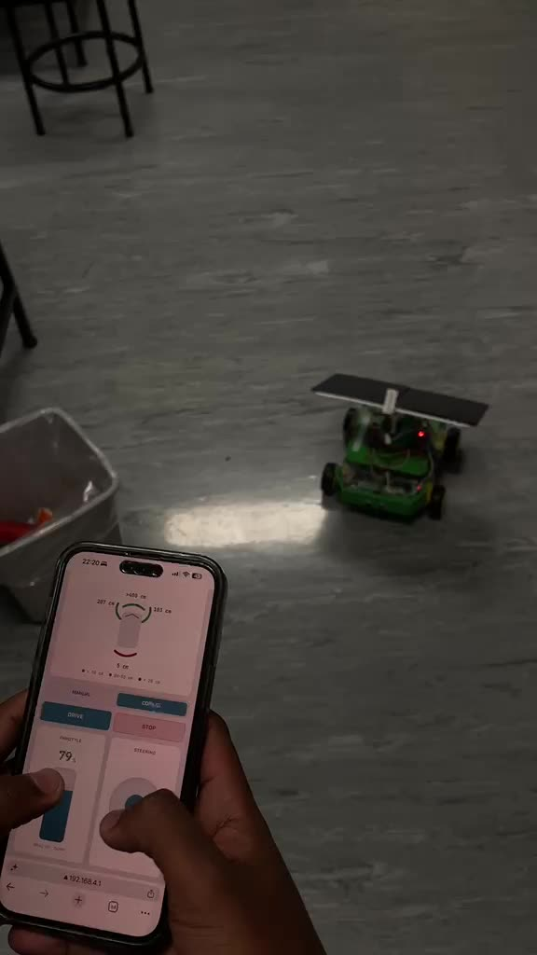

Your turn: the maze challenge
Drive in pairs: one run each
One run in manual, one with co-pilot on
Co-pilot helps steer around walls and stops before a crash
Everyone: watch the live dashboard on the screen
Try both modes and decide for yourself: does co-pilot make a difference?
Notes:
Now it's your turn. I've set up a small maze. In pairs, each of you drives the car through it, from one end to the other, using the phone. One run is in manual mode, where you do all the steering, and one is with co-pilot on, a mode I designed where the car helps steer away from walls and stops before it crashes. Some of you will start with co-pilot and some with manual. Try both and decide for yourself whether co-pilot makes a difference; there's no right answer, so be honest. Everyone else, watch the live dashboard on the screen. (Play video as an example.)

Slide 16

Questions?
Then: the maze challenge, then Side 2 of your sheet
Notes:
Thank you. Does anyone have a question before we start the demo? (After the demo: hand out the reminder to complete Side 2 straight away, before the next presenter starts. Collect the sheets.)

