Slide 1
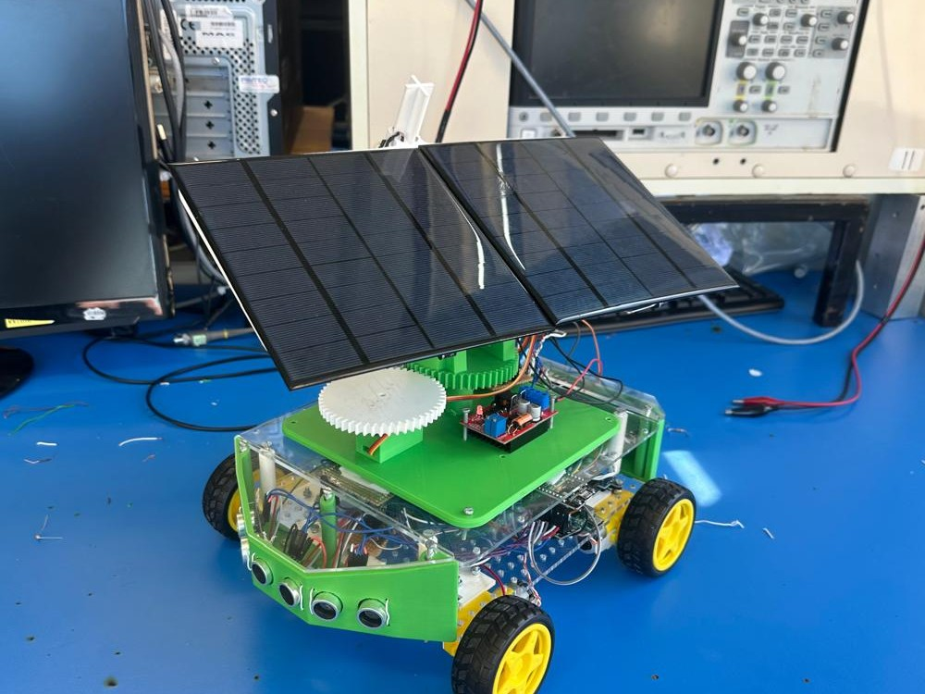
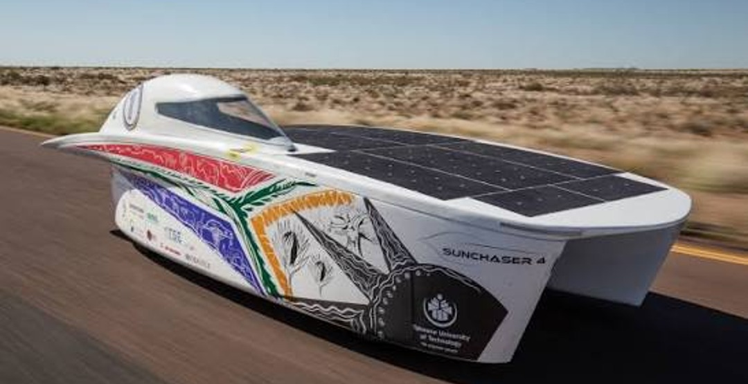
Engineering a Solar Car
Jonathan Tirkaso · Mechatronics Engineering, University of Cape Town
Sunchaser 4, Tshwane University of Technology
Notes:
Hi everyone, my name is Jonathan. I'm a final-year Mechatronics Engineering student at UCT. Today I'll show you the solar-powered car I built for my final-year project. Real solar race cars, like Sunchaser 4 from Tshwane University of Technology here in South Africa, race thousands of kilometres on sunlight alone. Mine is a small version you can drive, and how one project like this brings together several kinds of engineering. At the end, you'll get to drive it yourselves. (Check first: everyone has filled in Side 1 of their sheet and is keeping it for later.)

Slide 2
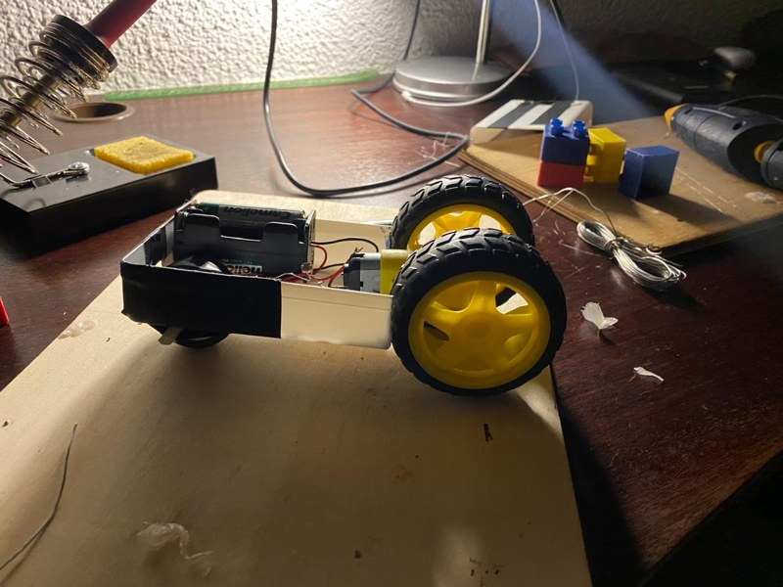
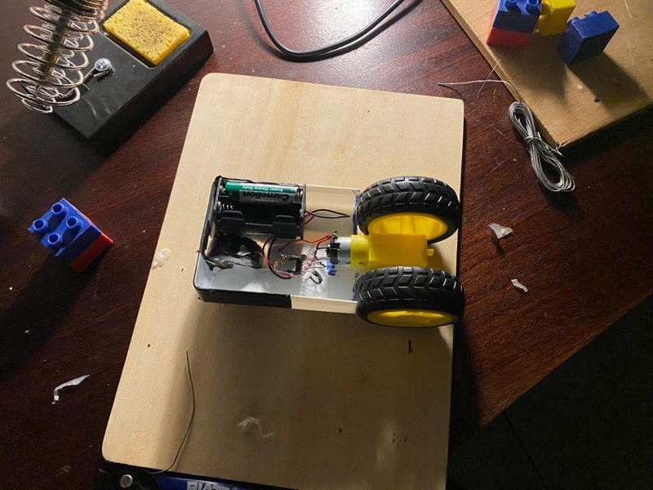

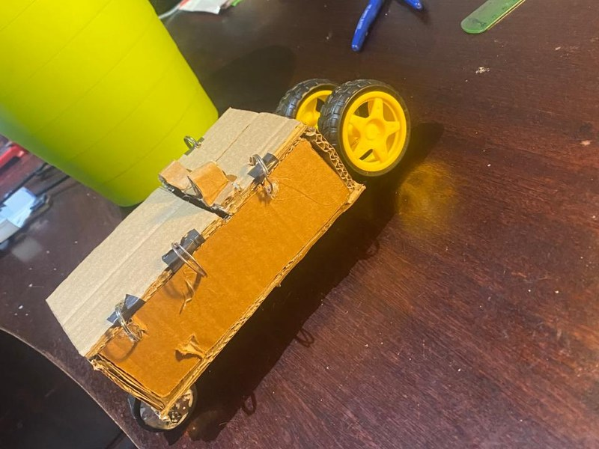
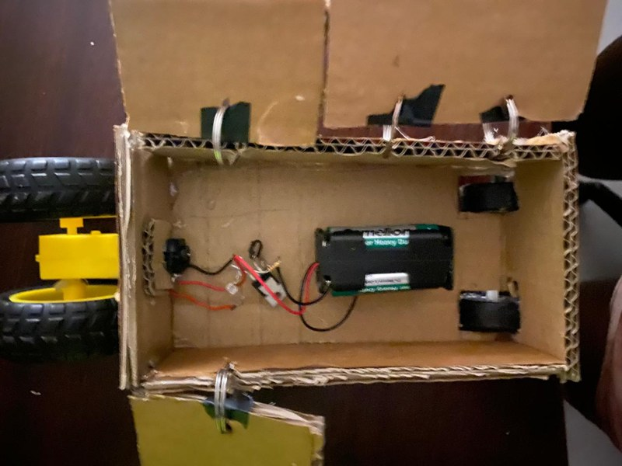



Where it started: Grade 11
A careers advisor said I might suit Mechatronics engineering, so I built a car that moved when light shone on it.
Battery and one motor
Light sensor (LDR): resistance drops in light
Transistor: an electronic switch
Front wheel made from a candle
Version 1 in a plastic tray (top), version 2 in cardboard (bottom)
Engineering is learning what you need to know to get things done.
Notes:
My engineering journey started where you are now, in Grade 11. A careers advisor told me I might be suited to Mechatronics engineering, a field I'd never heard of. To find out if it was for me, I built a little car that moved when you shone light on it. It had one motor, a battery, a transistor, which is an electronic switch, and an LDR, a resistor whose resistance drops when light hits it. Light on the LDR switched the transistor on, and the motor turned. I even made the front wheel from a candle. It was simple, but seeing how my siblings reacted showed me how much there is to learn and achieve in engineering.

Slide 3
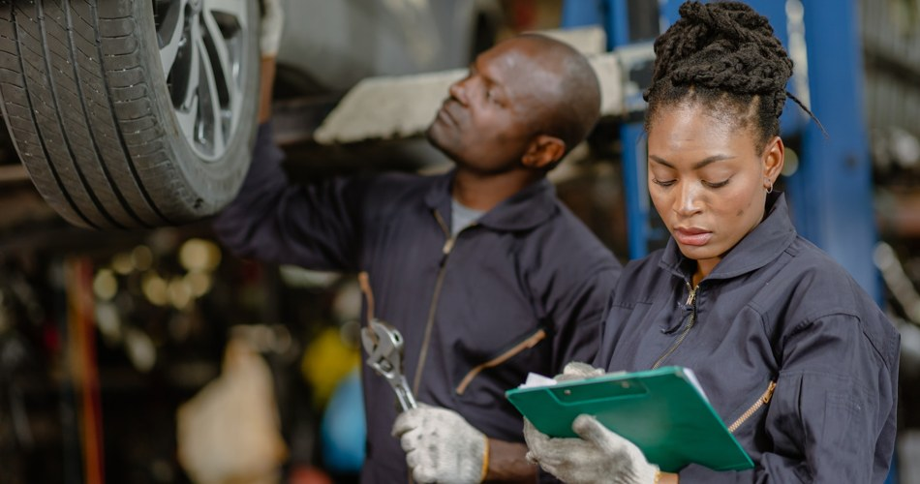
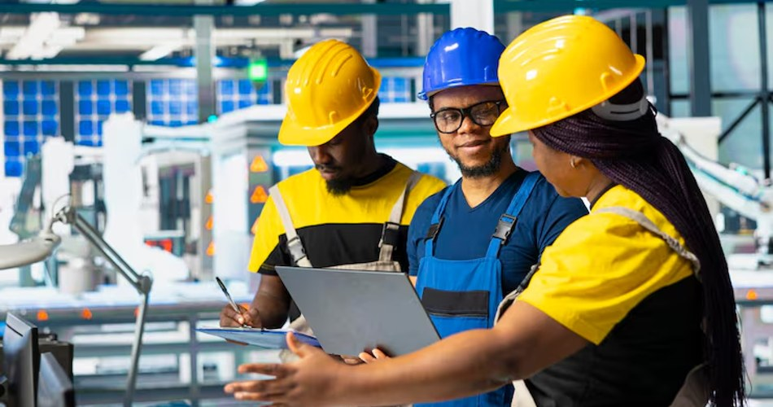
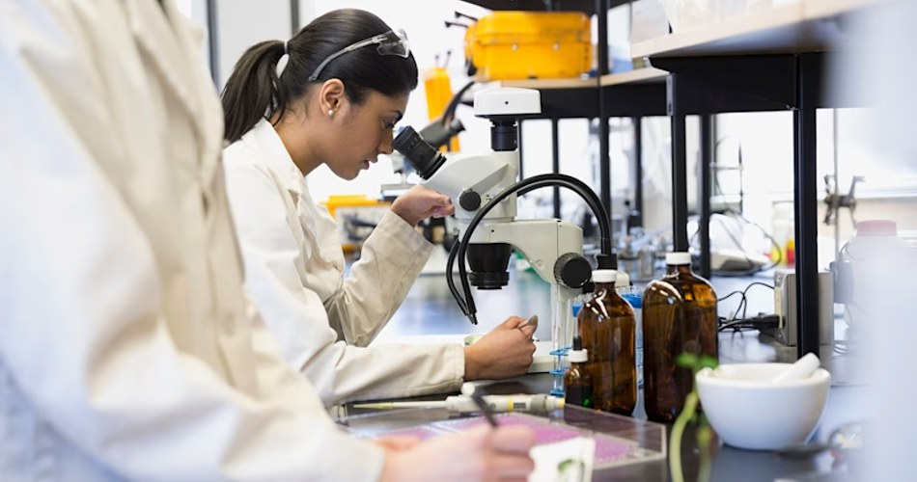
Technician, engineer or scientist?
Technician
Engineer
Scientist
A skilled hands-on worker who builds, fixes and maintains using tools (e.g. mechanic, electrician).
Understands science, maths and technology well enough to solve real problems in new ways, and invent new solutions.
Studies and researches the natural world to build knowledge (e.g. biologist, chemist, physicist).
Technicians build and maintain. Scientists discover. Engineers design and invent.
Notes:
So what do engineers do? The easiest way to understand it is to look at the two professions engineers sit between. On one side is the technician: a skilled worker who does practical, hands-on work with mechanical, electrical or industrial tools, like a mechanic or an electrician. On the other side is the scientist: someone who studies and researches the natural world to build knowledge, like a biologist, chemist or physicist. Engineers sit right in the middle. They understand the science, maths and technology well enough to apply it in new ways to solve real problems, and sometimes to create brand-new solutions. So: technicians build and maintain, scientists discover, and engineers design and invent.

Slide 4





What is Mechatronics?
Engineers are problem solvers
"Mechanical" or "electrical" just names the kind of problem an engineer is trained to solve.
Mechanical
Electrical
Mechatronics
Mechatronics joins them together
Making mechanical, electrical and computer parts work as one system.
Computer
Robots
Drones
Cars
Notes:
I study Mechatronics, in UCT's Electrical Engineering department. Few universities in South Africa offer it. Engineers are problem solvers, and names like mechanical, chemical or electrical just describe the kind of problem they are trained to solve. Mechatronics sits where mechanical, electrical and computer engineering overlap, so we specialise in integration: making those parts work together in one system, like a robot, a drone or a car. My course leans towards the electrical and computer side, with some mechanical.

Slide 5
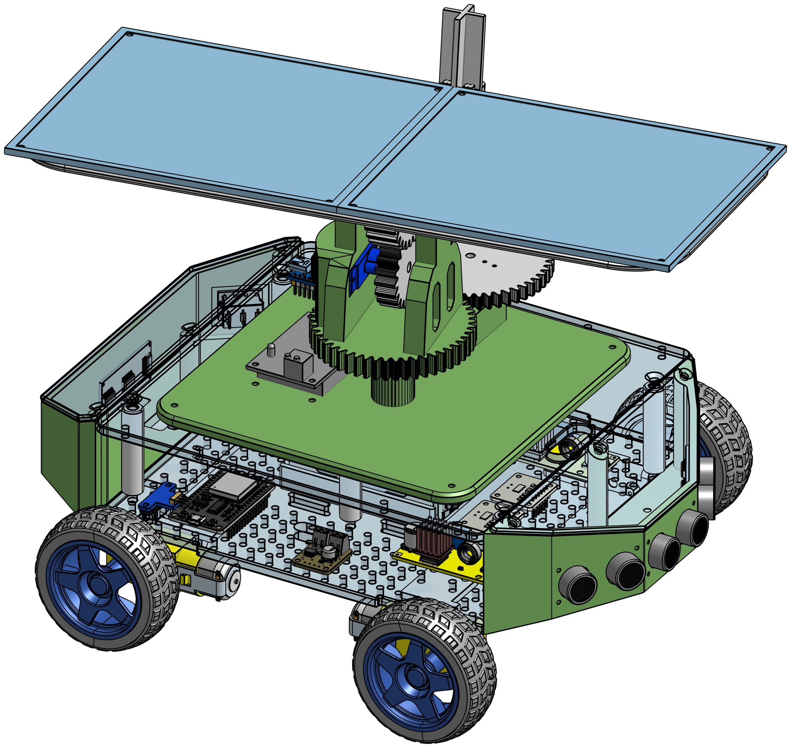
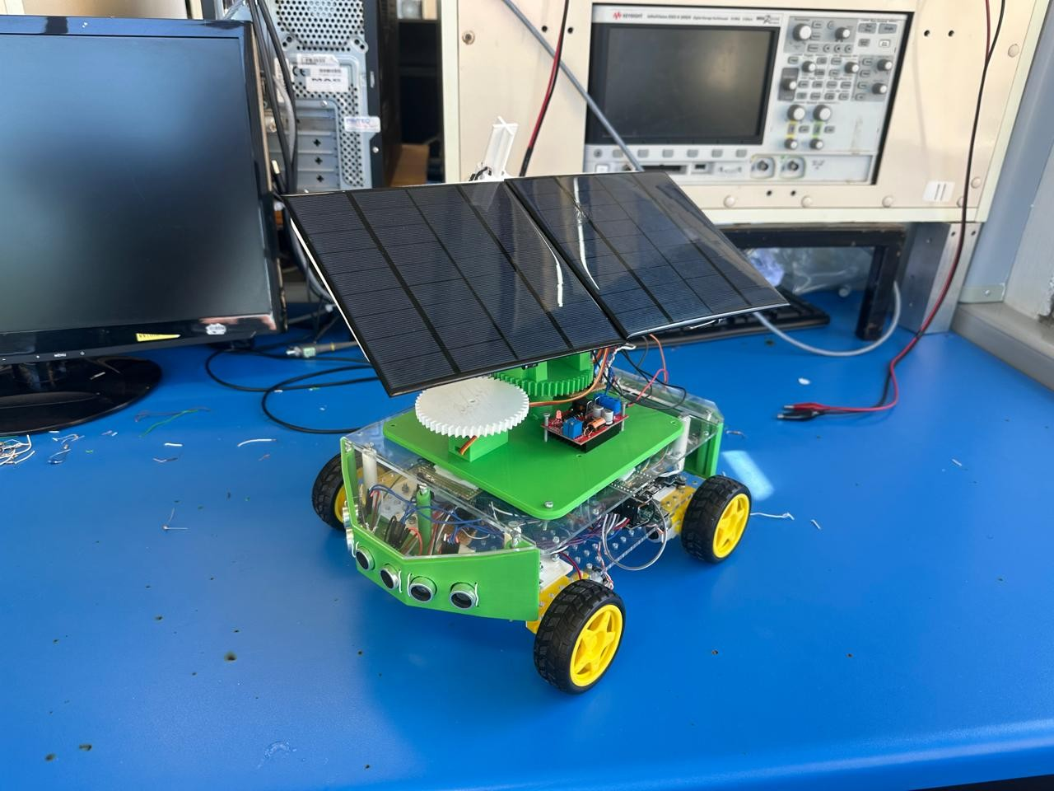
Meet the solar car
Mechanical
Electrical
Computer
Solar energy
One project, every discipline, built for you to drive.
Designed on a computer (left), built for real (right)
Notes:
So how do you show all of that in one project? This is my final-year thesis: a small solar-powered car, built to show how useful renewable energy is, and to be something you can interact with. On the left is the computer design; on the right is the real thing. I'll walk you through each part and the kind of engineering behind it: electrical, mechanical, renewable energy and computer.

Slide 6
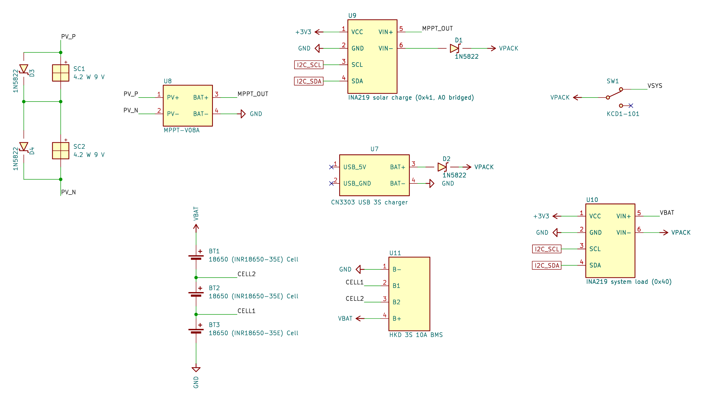
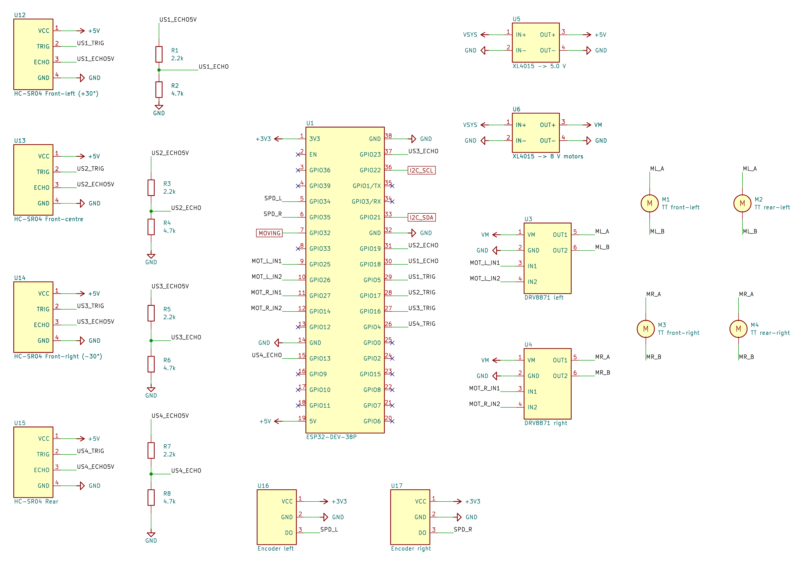
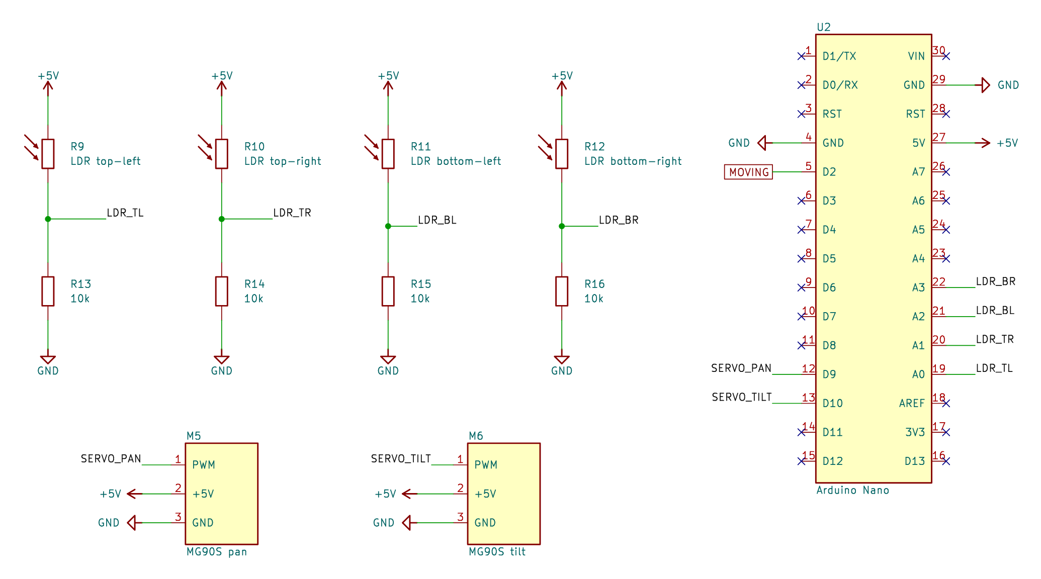



Electrical: three circuits, one car
Power
Drive and control
Solar tracker
Solar panel, battery, charging and power rails
ESP32, motor drivers, distance and speed sensors
Arduino Nano, 4 light sensors and 2 servo motors
The same ideas at home:
phone charger
solar garden light
TV remote
Notes:
First, the electrical side, my strongest area. These are the three circuit diagrams I designed for the car. Don't worry about reading them; they show how much goes on inside. The power circuit takes energy from the solar panel and the battery and controls it. The drive circuit runs the motors and the sensors. The tracker circuit turns the panel towards the light. Engineers don't try to reinvent the wheel. We look for parts and ideas that already exist, then adapt them or build them into our own design. Much of this car is off-the-shelf parts that manufacturers designed for one specific job; only where nothing suitable exists do we build it from scratch. The biggest job is managing power: you need enough energy for everything, but it must be controlled, because power is a double-edged sword, necessary but dangerous if it isn't managed. The same ideas are in devices you use every day: your phone charger controls the power going into a battery, a solar garden light stores the day's sun, and a TV remote uses a sensor and a tiny chip.

Slide 7
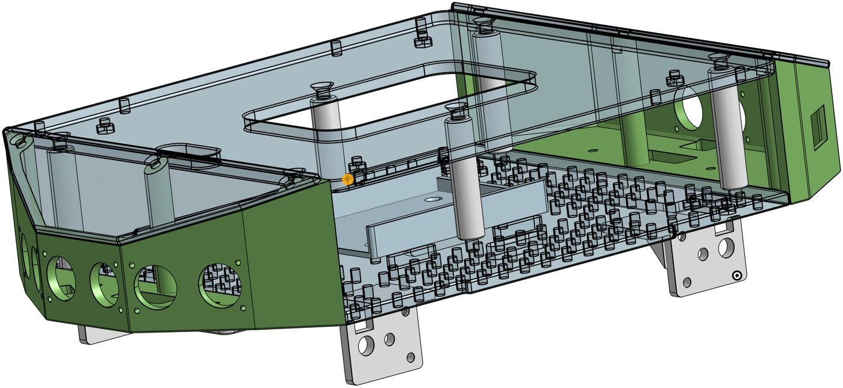
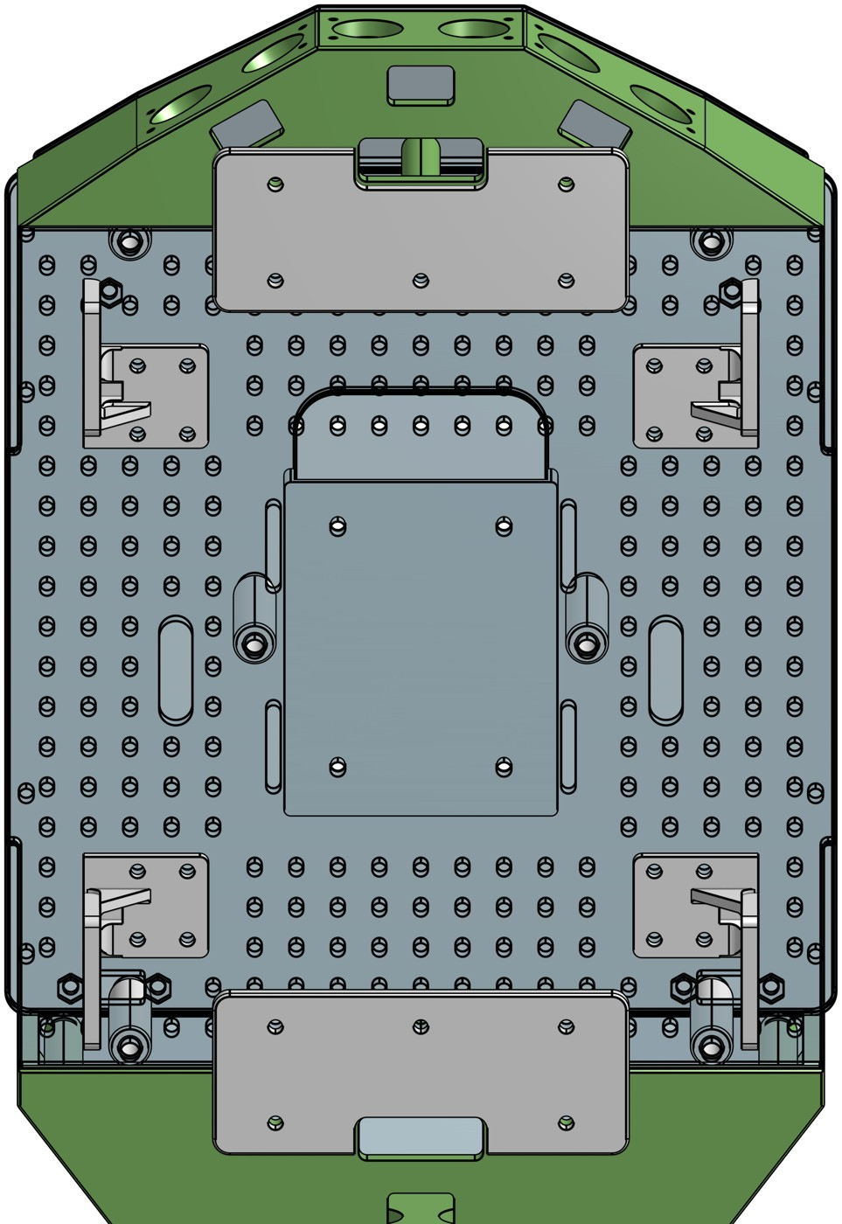
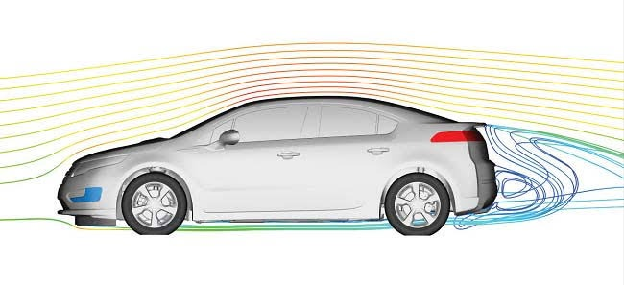
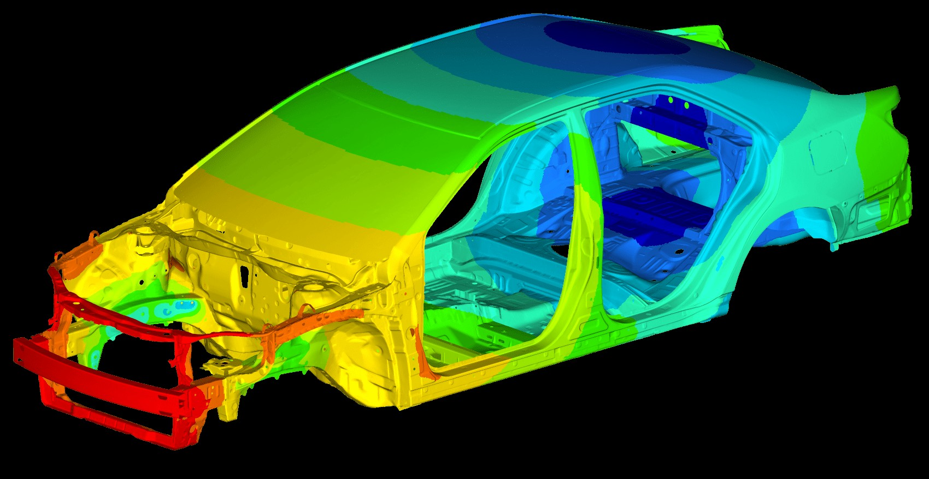
Mechanical: designing the body
Designed in CAD, built in parts
Modelled on a computer, then made as separate 3D-printed and laser-cut parts that bolt together. Clear acrylic lets you see inside.
Shaped like real cars
Angled noses and tails help air flow smoothly around a car. Air drag only matters at high speed, so on this slow car the shape is for show.
Light but strong
F = m × a: a lighter car needs less energy to move. Stress analysis shows where a car body carries the most load.
Notes:
Now the mechanical side. Every part was designed in CAD software, then 3D-printed in plastic or laser-cut from clear acrylic, so you can see the electronics inside. The car was made as separate parts that bolt together, so if one part needs changing, I only reprint that part, not the whole car. The angled nose and tail copy the shapes real cars use to slip through the air. If you've run into the wind in Cape Town, you know air pushes back, and at highway speeds that becomes a big energy cost. But air drag only matters at high speed, and my car is slow, so here the shape is mostly for show. Knowing when a design choice really matters is part of engineering. What did matter was weight: force equals mass times acceleration, so a lighter car needs less force, and less energy, to move. In a real car, engineers also calculate the stresses each part carries to choose the right materials and shapes.

Slide 8
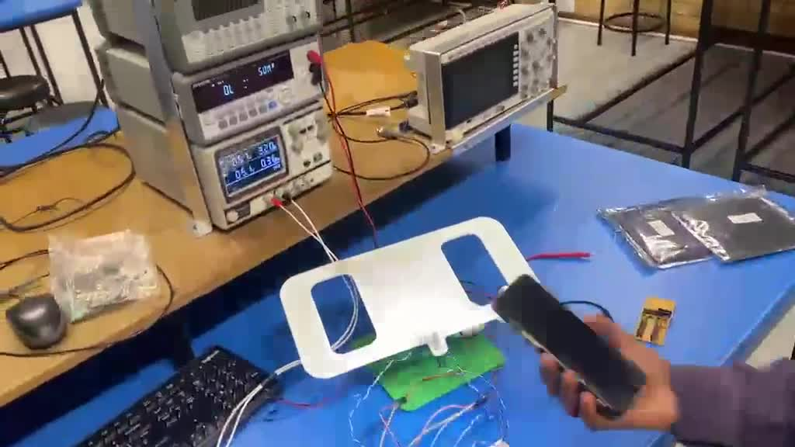
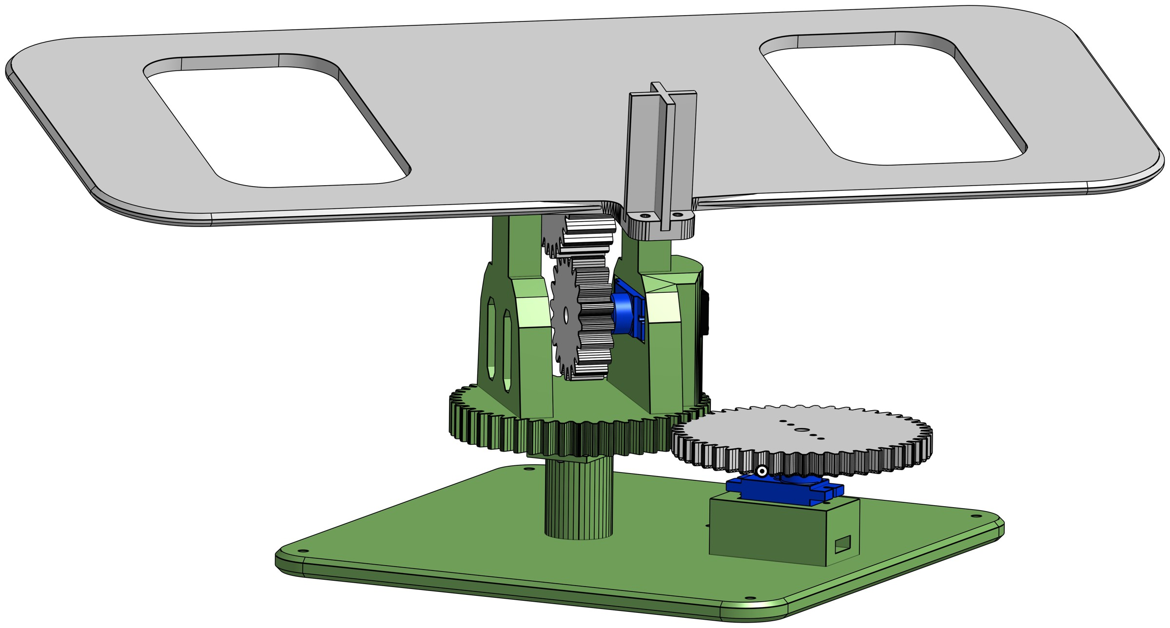
Mechanical: gears that follow the sun
Dual-axis: two geared motors pan (turn) and tilt the panel
4 light sensors (LDRs), the same part as my Grade 11 car, find the brightest light
Gears change speed, torque and direction; tooth counts follow exact ratios
The tracker following a light in the lab
Notes:
The solar tracker on top is another mechanical feature. It has two sets of gears, which makes it a dual-axis tracker: one motor pans the panel left and right, and the other tilts it up and down. Gears change speed, turning force (called torque) and direction, and you can't just put teeth on a circle: tooth counts and gear sizes must follow exact ratios. To know where to point, it uses four LDRs, the same light sensor from my Grade 11 car. They detect changes in light, and the difference between them tells the controller which way to turn each motor until the panel faces the brightest light. Here it is following a light in the lab. (Video plays and loops automatically.)

Slide 9


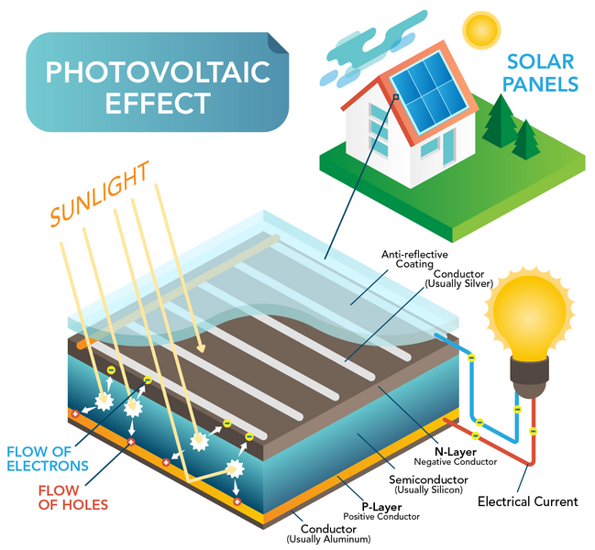
Renewables: how a solar panel works
Solar
Wind
Hydro
Renewables turn natural energy into electricity. In a solar panel, light frees electrons in a semiconductor so they flow as current.
Careers in renewable energy
Solar and wind farm design engineer
Power grid (power systems) engineer
Battery and energy storage engineer
Electric vehicle engineer
Notes:
Next, renewable energy: solar, wind and hydro are the big three. Electricity is just the easiest way to move and use energy, and most power stations, even coal ones, convert one kind of energy into electricity. Solar panels are made from a special material called a semiconductor. Light is made of tiny packets of energy called photons; you feel their energy as warmth on your face. When photons hit the panel, they give that energy to electrons in the material and free them to flow through a circuit, as this diagram shows. That flow is electricity. Bigger panels catch more light, so they make more power. This is a growing career area in South Africa: engineers design solar and wind farms, connect them to the power grid, build battery storage systems and develop electric vehicles.

Slide 10




Why the sun charges a battery
Sun
Panel
Solar controller
Battery
Car
Sunlight changes all the time
Sun makes the battery last longer
Clouds and angle change the power, so the panel charges a battery, and the battery runs the car. Solar garden lights work the same way.
In the sun, the panel shares the load, so the battery does less work. Watch the solar power on the live dashboard.
Notes:
Sunlight isn't steady: clouds and the panel's angle change the power all the time, and electronics need steady, controlled power. So the panel doesn't drive the car directly. A solar controller conditions the power and charges the battery, and the battery runs the car. Solar garden lights and many home solar systems work the same way: capture energy, store it, use it later. Solar also extends how long the battery lasts: in the sun, the panel supplies part of the power the car needs, so the battery does less work. (Show the live dashboard on the projector: point out the solar power reading.) This panel is small and not very efficient, but real panels are much bigger.

Slide 11
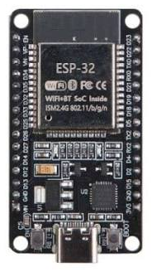
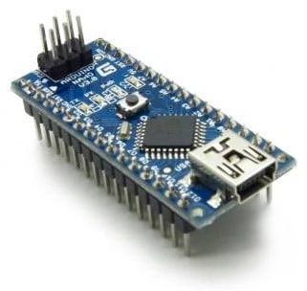
Computer: the car's two brains
ESP32: drives the car
Arduino Nano: runs the tracker
Reads 4 distance sensors and 2 speed sensors
Controls the 4 motors
Runs the Wi-Fi and the dashboard
Reads 4 light sensors
Moves the 2 tracker motors
Turns the panel to the brightest light
A microcontroller is a small computer on a chip: it reads sensors, makes decisions and drives motors.
Notes:
The third discipline is computer engineering, which shows up in embedded systems. At the centre of almost every modern device is a microcontroller, a small computer on a chip. It reads sensors, makes decisions and sends commands to motors. My car has two: an ESP32, which drives the car, reads the distance and speed sensors and runs the Wi-Fi, and an Arduino Nano, which reads four light sensors and moves the tracker. Engineers must both design the circuits around these chips and program them to do exactly what's needed.

Slide 12
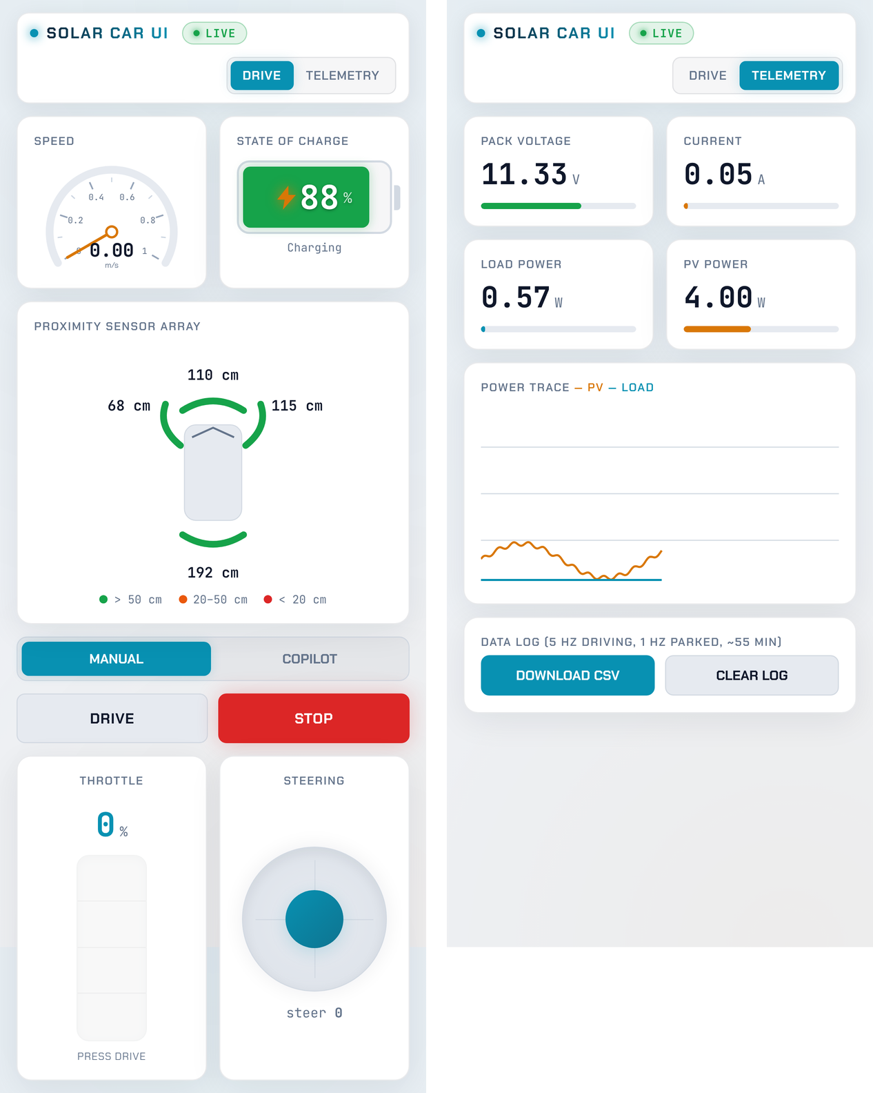


Drive it from your phone
The car makes its own Wi-Fi network
Your phone connects straight to the car: an Internet of Things (IoT) link.
The dashboard is a web page
HTML builds it, CSS styles it and JavaScript makes it work.
Live data, 10 times a second
Speed, battery, solar power and distance sensors.
Notes:
You'll drive the car from a phone. The car creates its own Wi-Fi network, and your phone connects directly to it. Connecting devices wirelessly like this is called the Internet of Things, or IoT. The controls are a web page I wrote: HTML lays out the page, CSS styles it, and JavaScript makes the buttons and live readings work, just like any website. The dashboard updates about ten times a second with the speed, battery level, solar power and distance sensors, so you can see exactly what the car is doing.

Slide 13
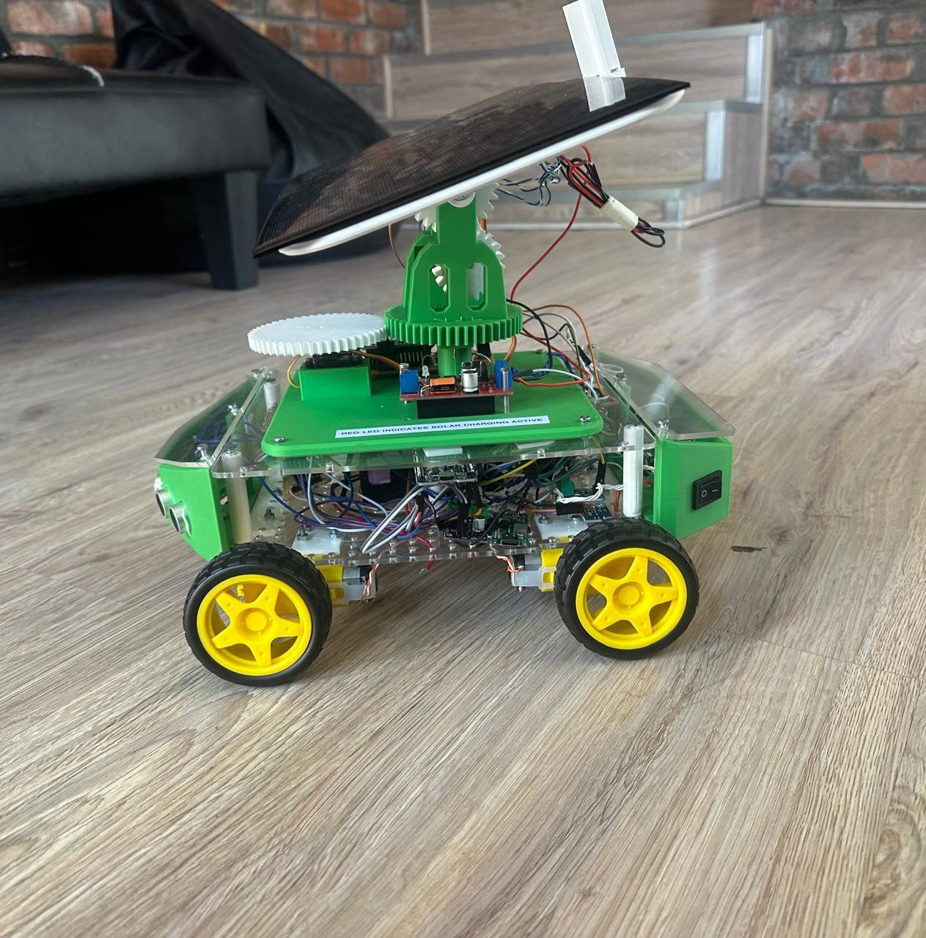
One car, every kind of engineering
Renewable energy
Electrical
Solar panel charging the battery
Power circuits, motors and sensors
Mechanical
Computer
Body, gears and the sun tracker
Two microcontrollers and the dashboard
Notes:
So, to bring it together: mechanical engineering gives us the body, the gears and the tracker; electrical engineering gives us the power circuits, motors and sensors; computer engineering gives us the two microcontrollers and the dashboard; and renewable energy keeps the battery topped up. None of these parts works without the others. That's what real engineering projects look like: different disciplines working together on one product.

Slide 14



How to get here
Grades 11–12
University
Explore
Take Mathematics (not Maths Literacy) and Physical Sciences, and aim high in both.
A 4-year engineering degree, such as a BSc in Engineering.
Mechatronics, Electrical, Mechanical, Civil, Chemical and Computer engineering, and renewable energy.
I started exactly where you are now, in Grade 11.
Notes:
If any of this interests you, here's how to get here. In Grades 11 and 12, take Mathematics, not Maths Literacy, and Physical Sciences, and aim high in both, because engineering faculties require them. Then comes a four-year engineering degree. Look up the different kinds of engineering, such as Mechatronics, Electrical, Mechanical, Civil, Chemical and Computer, and the growing renewable-energy field, and see which problems excite you. Remember, I started exactly where you are now, in Grade 11.

Slide 15
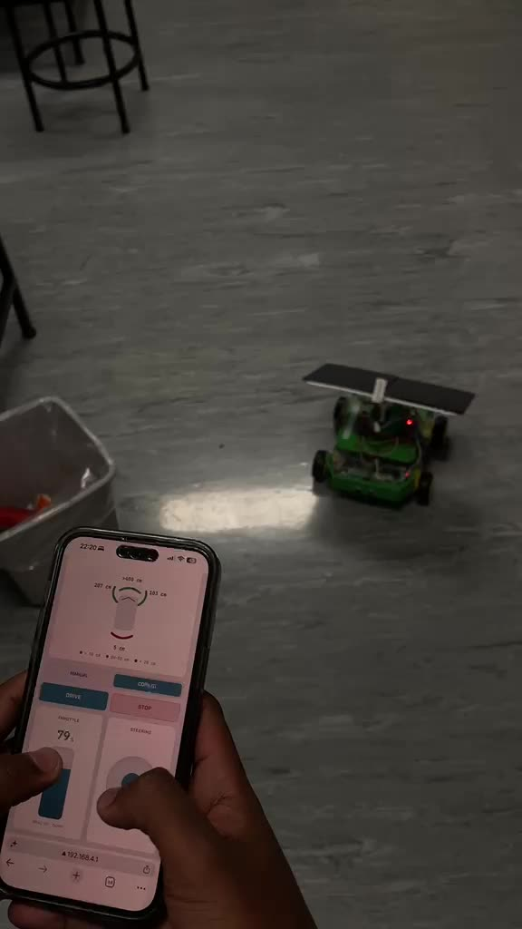

Your turn: drive the route
Watch me drive the route first
Drive in pairs: one run each
One run in manual, one with co-pilot on
Co-pilot helps steer around walls and stops before a crash
Everyone: watch the live dashboard on the screen
Try both modes and decide for yourself: does co-pilot make a difference?
Notes:
Now it's your turn. I've set out a short route, and I'll drive it first so you can see how the controls work. Then, in pairs, each of you drives the car along the route using the phone. One run is in manual mode, where you do all the steering, and one is with co-pilot on, a mode I designed where the car helps steer away from walls and obstacles and stops before it crashes. Some of you will start with co-pilot and some with manual. Try both and decide for yourself whether co-pilot makes a difference; there's no right answer, so be honest. Everyone else, watch the live dashboard on the screen. (Video plays and loops automatically.)

Slide 16

Questions?
Then: driving the route, then Side 2 of your sheet
Notes:
Thank you. Does anyone have a question before we start the demo? (After the demo: hand out the reminder to complete Side 2 straight away, before the next presenter starts. Collect the sheets.)

