Slide 1
Economy & Mental Health
Does economy affect people’s need for mental health support
Golden Huang

Slide 2
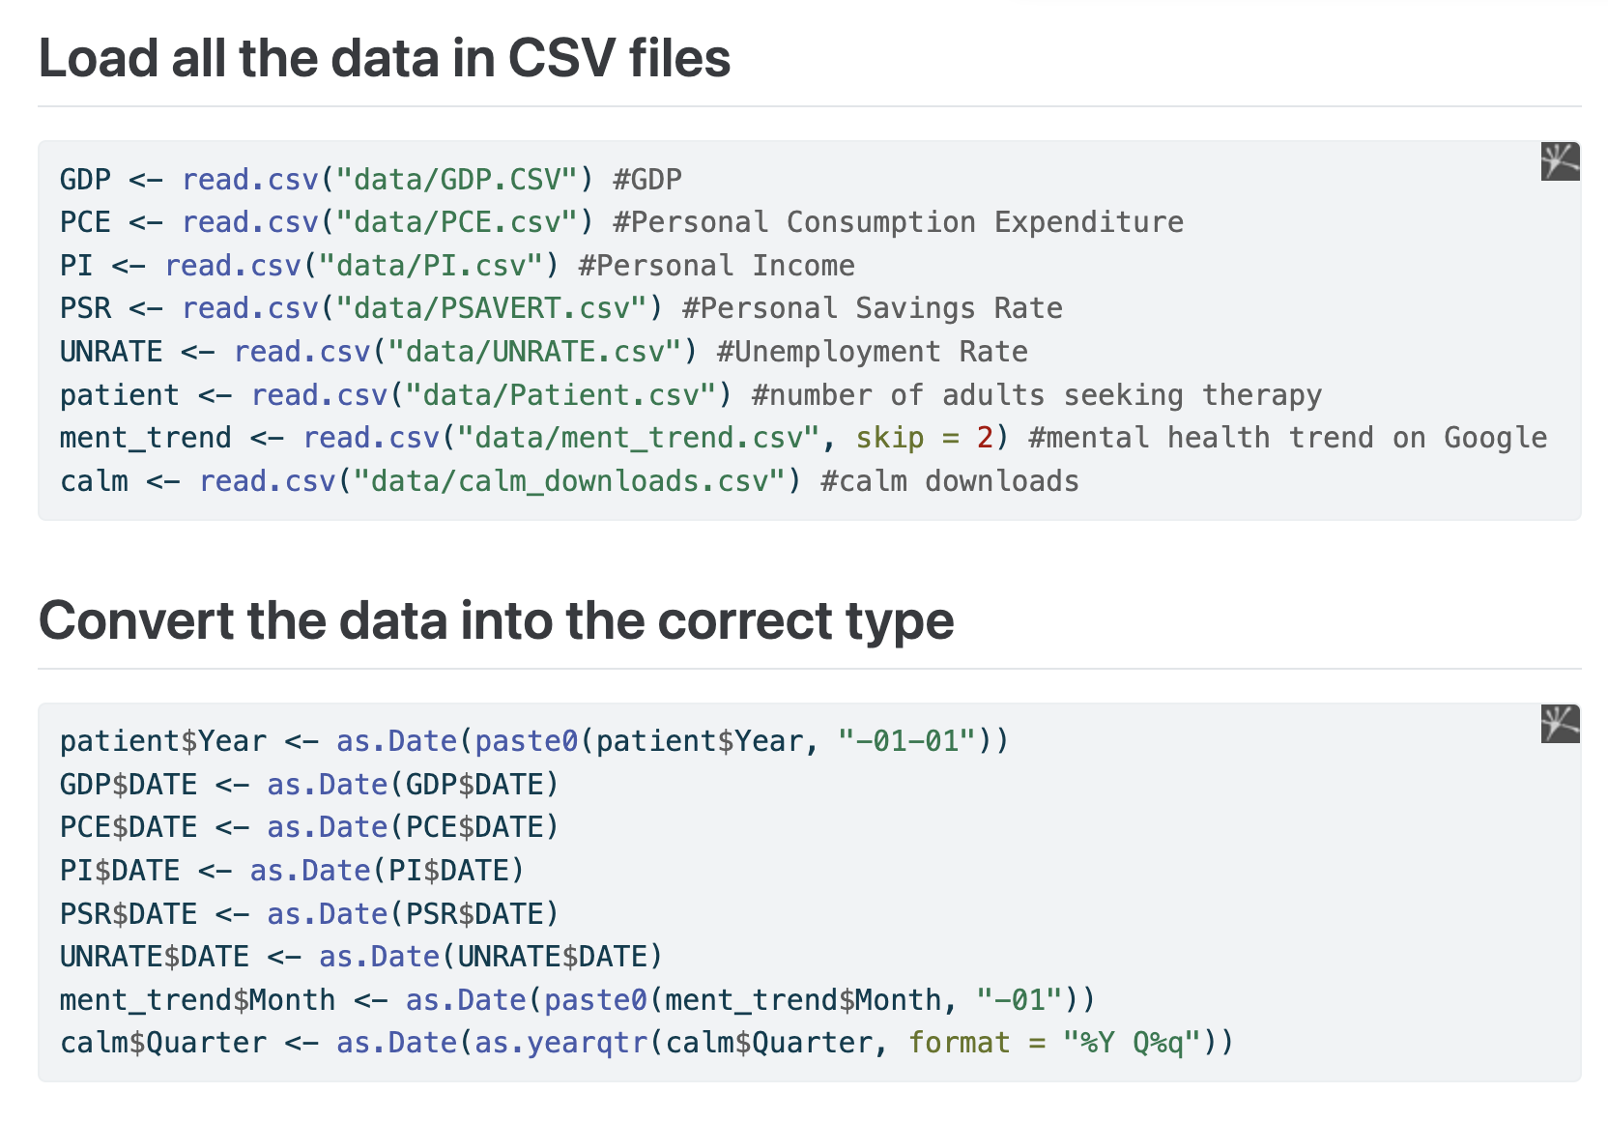
Data Collection/Tidying
Simple part
FRED
Google Trends
Statista

Slide 3
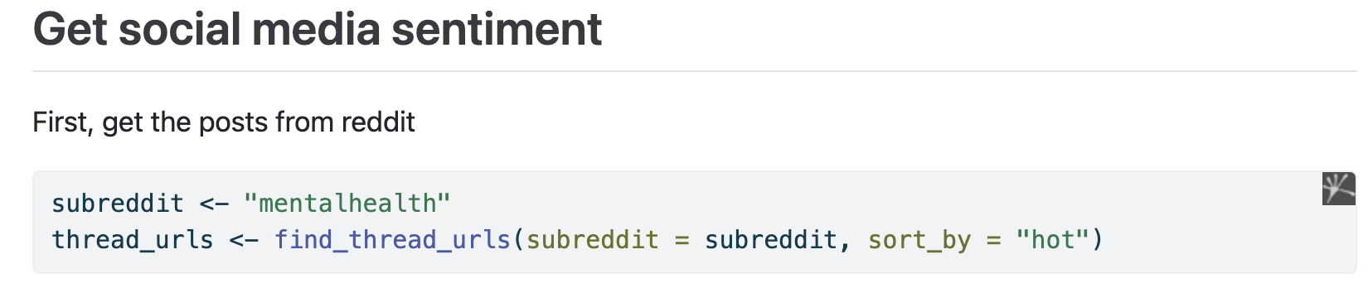
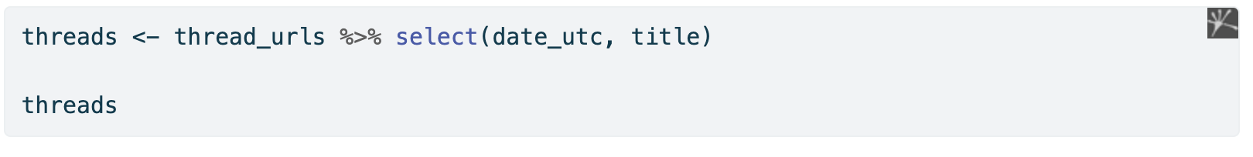
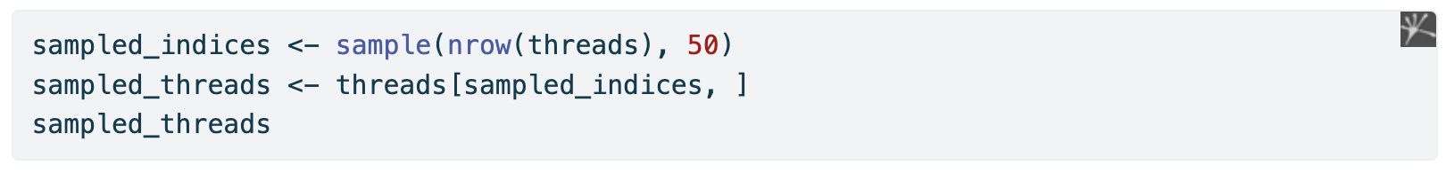
Data Collection/Tidying
Hard part (Social media sentiment)
RedditExtractoR
OpenAI API
Took 50 random samples because of limited funding and efficiency

Slide 4
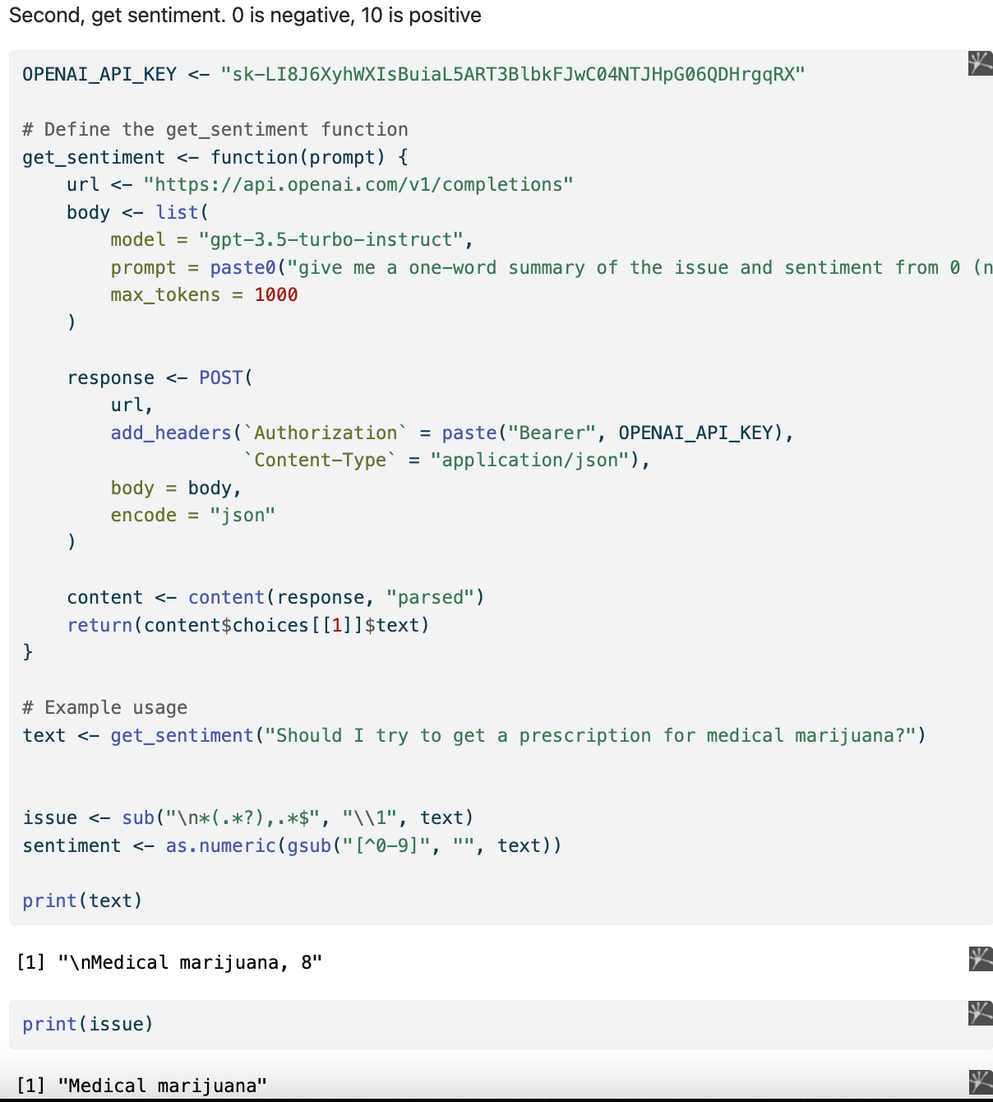
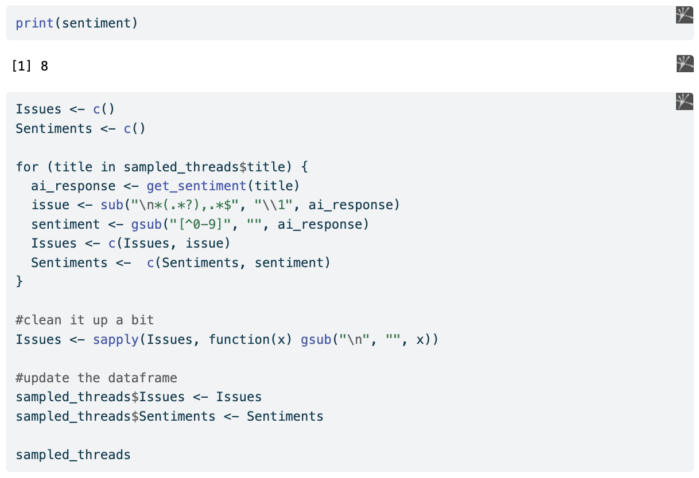

Slide 5
Findings
PSR is not a good indicator, it doesn’t have significant correlations with the mental health data
Number of downloads of Calm (a meditation/mental health app) does not seem to be affected by economic indicators
Generally, as the economy grows, more people seek help with mental health (some linear models had 0.9+ r²⁾
Sentiment Findings:
Most positive issues: Accuracy, Gaslighting, Mental Health Advice, Question, Self-worth
Most negative issues: Family, Attention, Friendship, Self-harm, Improvement

Slide 6
Future Improvements
Larger sample size for Calm downloads
Use a natural language processing tool to convert similar issues into the same one/merge into the same category

