Slide 1
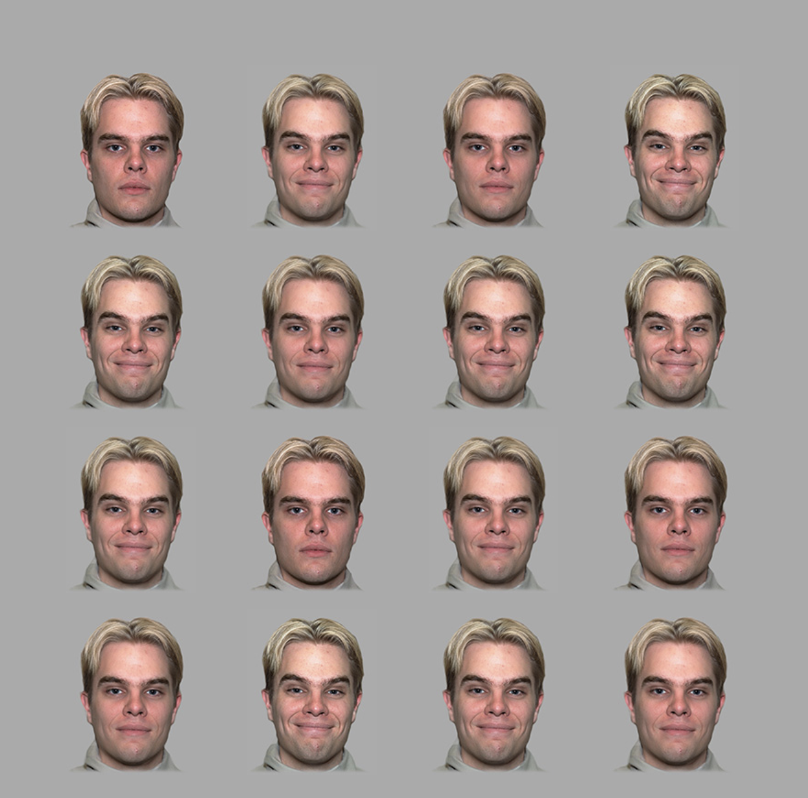
The goal of this study is to examine whether people can estimate the average emotional expression of multiple faces. In each trial, 12 faces expressing various degrees of emotions will appear on the screen. The faces may either be expressing positive or negative emotions. The faces will on the screen for a brief moment. In order to take all the ratings in, try to expand your attention to all the faces on the screen at the same time.

