Slide 1
After the face group is displayed, one face will appear in the center of the screen. As you move your mouse, the face's expression will change gradually, from neutral to emotional. You must move the mouse until the face expresses the emotion that you think matches the average emotion in the face group you just saw.

Slide 2

After the face group is displayed, one face will appear in the center of the screen. As you move your mouse, the face's expression will change gradually, from neutral to emotional. You must move the mouse until the face expresses the emotion that you think matches the average emotion in the face group you just saw.

Slide 3
Remember, the goal here is provide
YOUR ESTIMATION OF THE AVERAGE EMOTIONAL RESPONSE
of the faces you just saw.

Slide 4
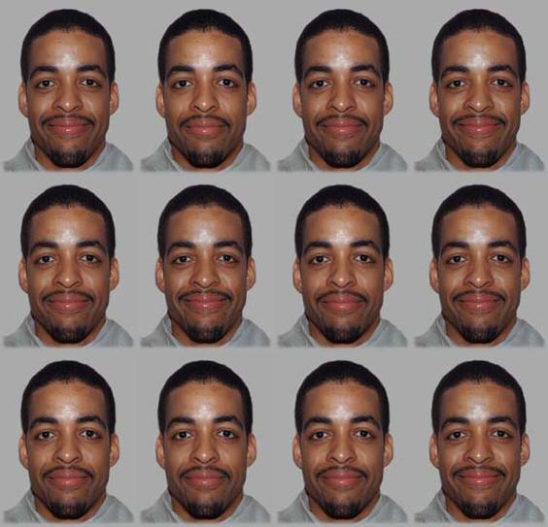
Once you make the choice, the page will switch to the next trial.

Slide 5
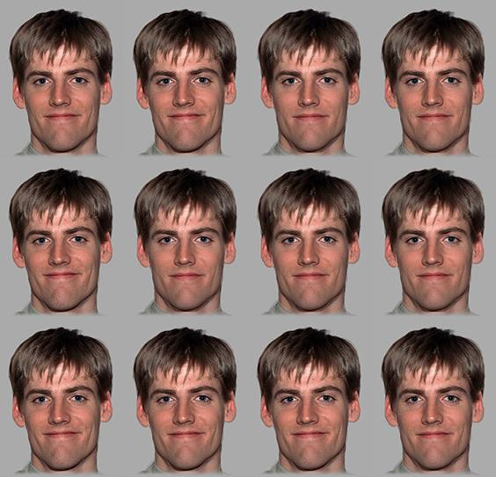
Once you make the choice, the page will switch to the next trial.

