Slide 1
The goal of this study is to test how well you can identify whether a face was taken from a sample of similar faces or not.

Slide 2
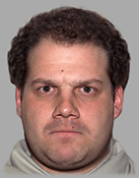
In the first screen of each trial you will see a face. The face will express a certain emotion, from neutral to angry.

Slide 3
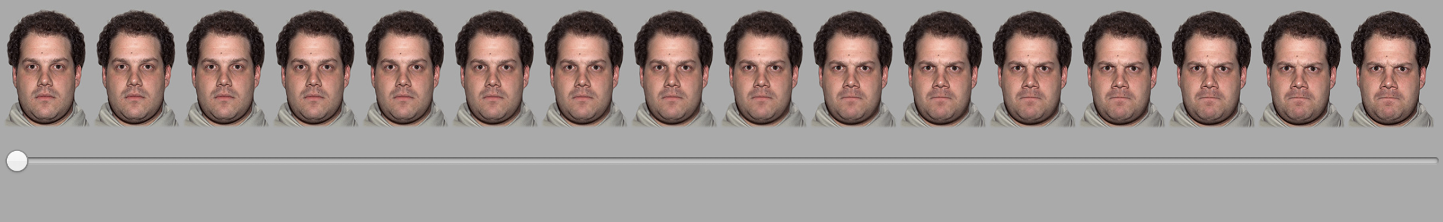
​Following the picture, a scale will appear in the middle of the screen. By moving the indicator, you are asked to estimate the emotion expressed by the face you just saw. This step is designed to validate that you indeed saw the face. In order to estimate the emotion you just saw, you need to move the scale and click on it. Once you click on the scale, it will move to the next page.

Slide 4
Remember, the goal here is to click on the point of the scale that is identical to the EMOTION YOU JUST SAW.

Slide 5
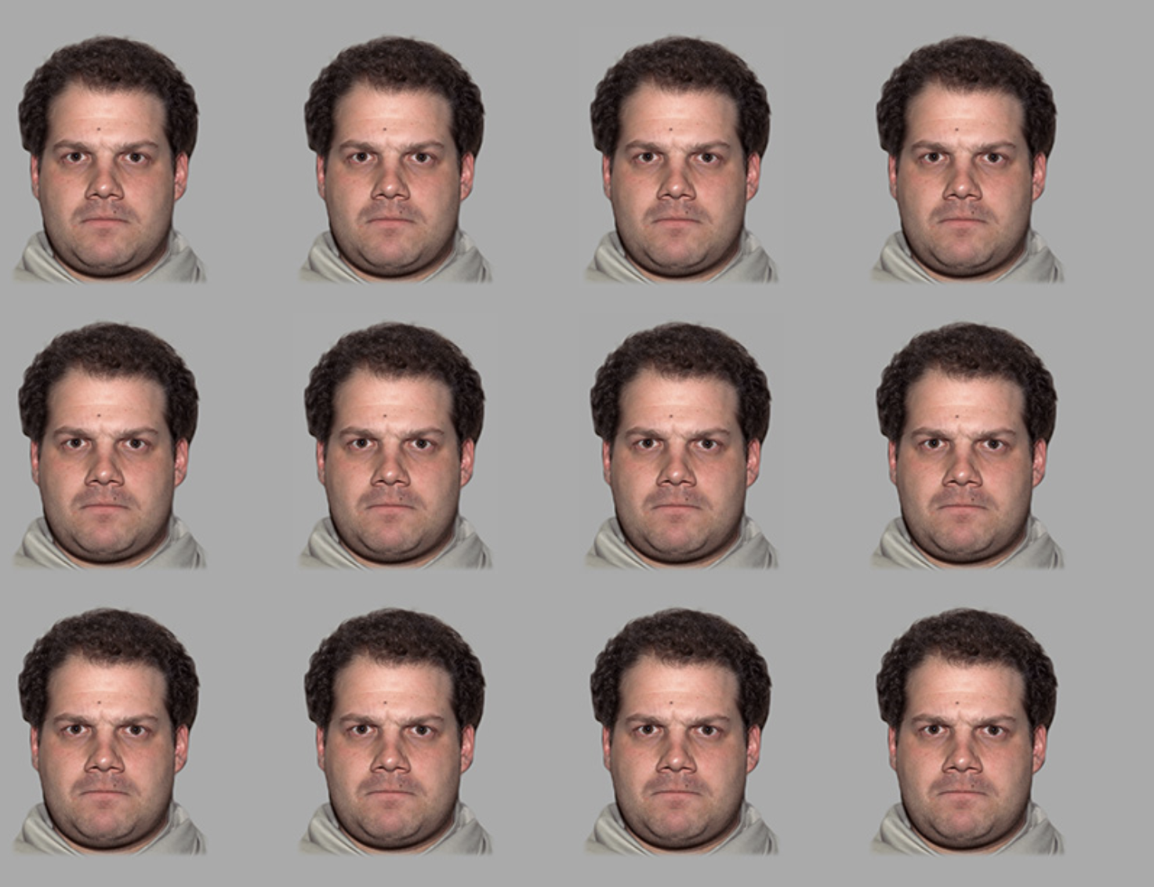
Following your rating, you will see 12 other faces. These faces will appear only for 1 second. In order to take all the ratings in, try to expand your attention to the four corners of the screen.

Slide 6
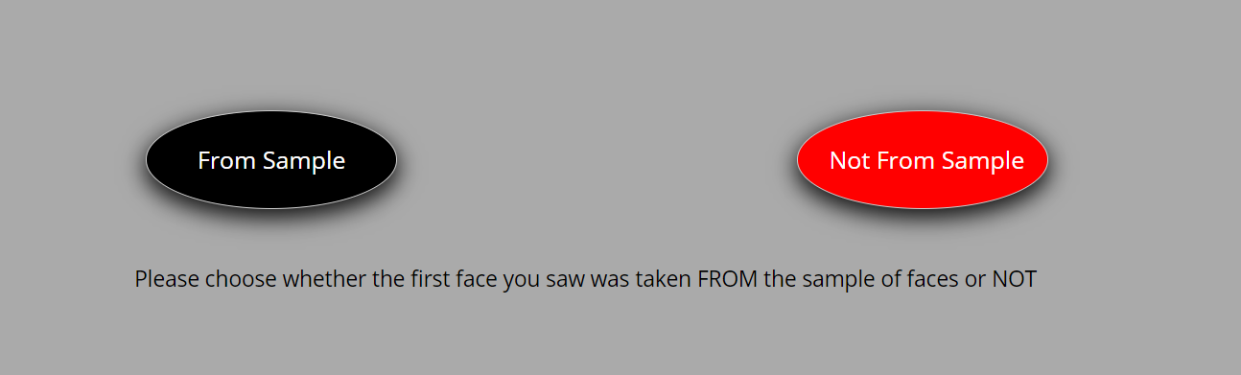
Following these pictures you will then asked to choose whether the initial face you saw was taken from the group of 12 faces you saw or not.

Slide 7
Next you will conduct a short practice run for the task.

Slide 8
Thank you for completing the practice stage.
Remember – the goal was to estimate whether the face you saw first was taken from the sample of 12 faces or not.
In the following section you will complete the actual study, which consists of 50 trials. The task should take 5 minutes, more or less.
Click ‘Continue’ to begin the actual task.

Slide 9
You've completed the task.
Thank you for your participation.
The next section is a short survey
(up to 5 min).

