Slide 1
Dear participant,
You are about to participate in a study that was designed to examine emotional responses to pictures.
You will first go through a short instructions session, and then go participate in the actual experiment.
The total length of this study is approximately 10-15 minutes.
Please follow the instructions carefully.

Slide 2
The goal of this study is to examine your emotional responses to pictures. You will see a picture on the screen and will be asked to answer a few questions.

Slide 3

First you will see a picture that will stay on the screen for 5 seconds
For instruction purposes

Slide 4
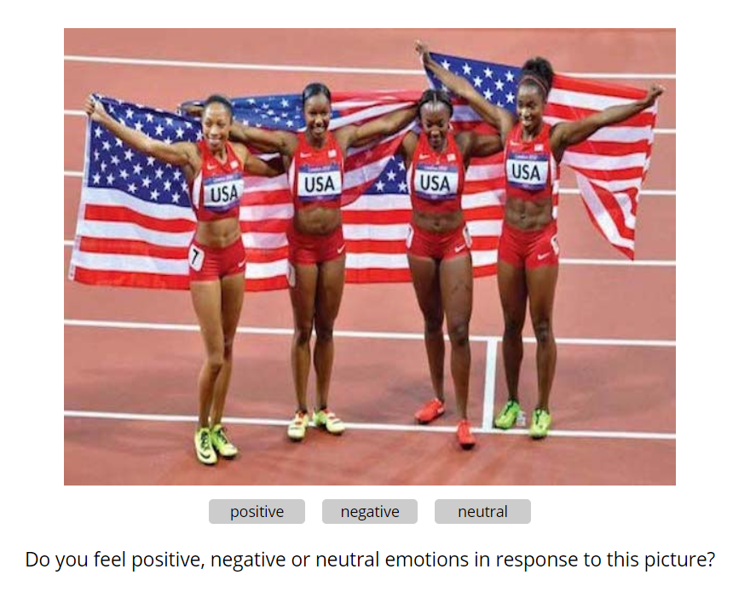
Following this stage you will be asked whether the picture elicits positive or negative emotions.
For instruction purposes

Slide 5
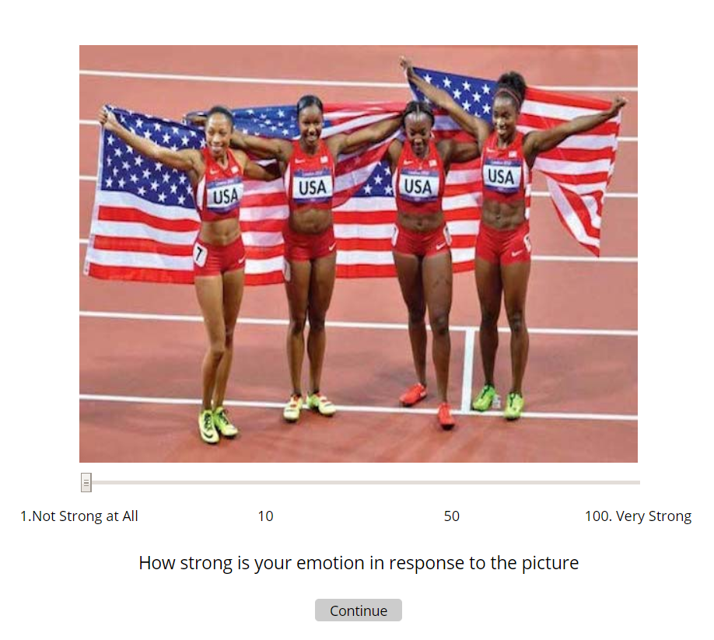

You will then be asked to rate the intensity of your emotional response.
For instruction purposes

Slide 6
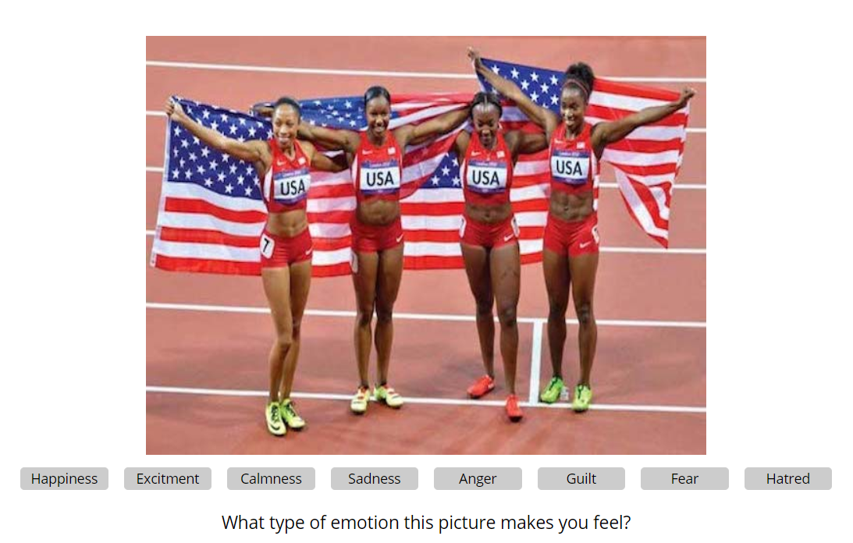
Finally, you will be asked to indicate the specific emotion you experienced.
For instruction purposes

Slide 7
Click ‘Continue’ when you are ready to start.

Slide 8
You've completed the task.
Thank you for your participation.
The next section is a short survey (up to 5 min).

