Slide 1
Dear participant,
You are about to participate in a study that was designed to examine your ability to evaluate the average emotional response of groups.
You will first go through a short instructions session, then complete a short practice round, and then go participate in the actual experiment.
The total length of this study is approximately 10-15 minutes.
Please follow the instructions carefully.

Slide 2
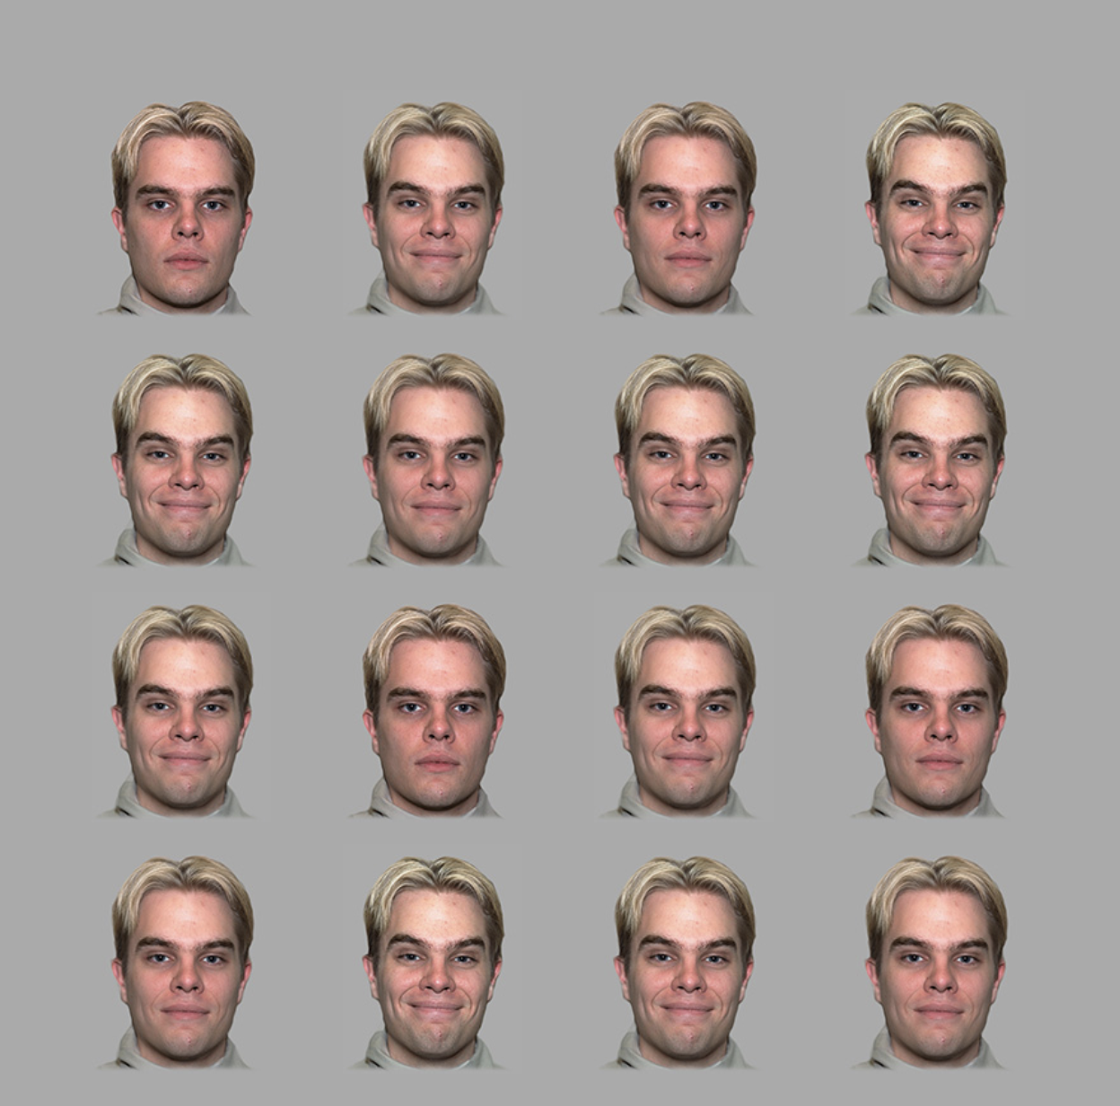
The goal of this study is to examine whether people can estimate the average emotional expression of multiple faces. In each trial, 16 faces expressing various degrees of emotions will appear on the screen. The faces may either be expressing positive or negative emotions. The faces will on the screen for a brief moment. In order to take all the ratings in, try to expand your attention to all the faces on the screen at the same time.

Slide 3
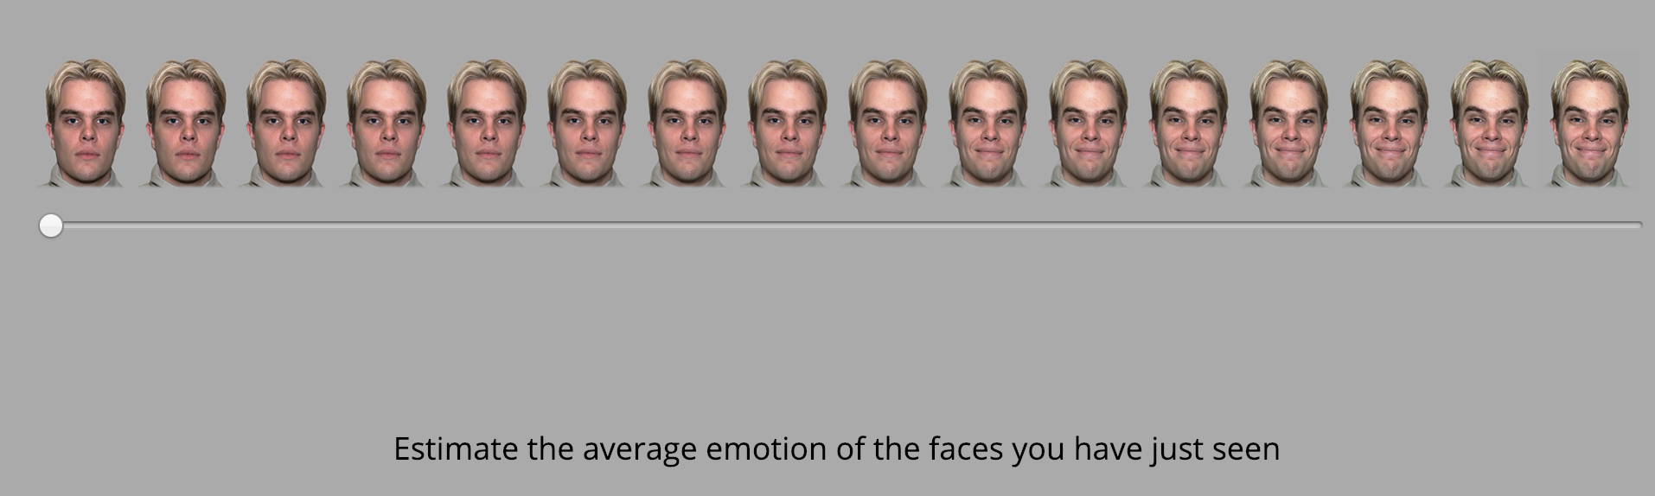
​Following the 16 emotional faces, a scale will appear in the middle of the screen. By moving the scale, you are asked to estimate the average emotional response of the faces you just saw. You have to move the scale and click on it in order to move to the next page. Once you click the scale, it will move to the next page.

Slide 4
Remember, the goal here is to click one point on the scale that reflects
YOUR ESTIMATION OF THE AVERAGE EMOTIONAL RESPONSES
of the faces you just saw.

Slide 5
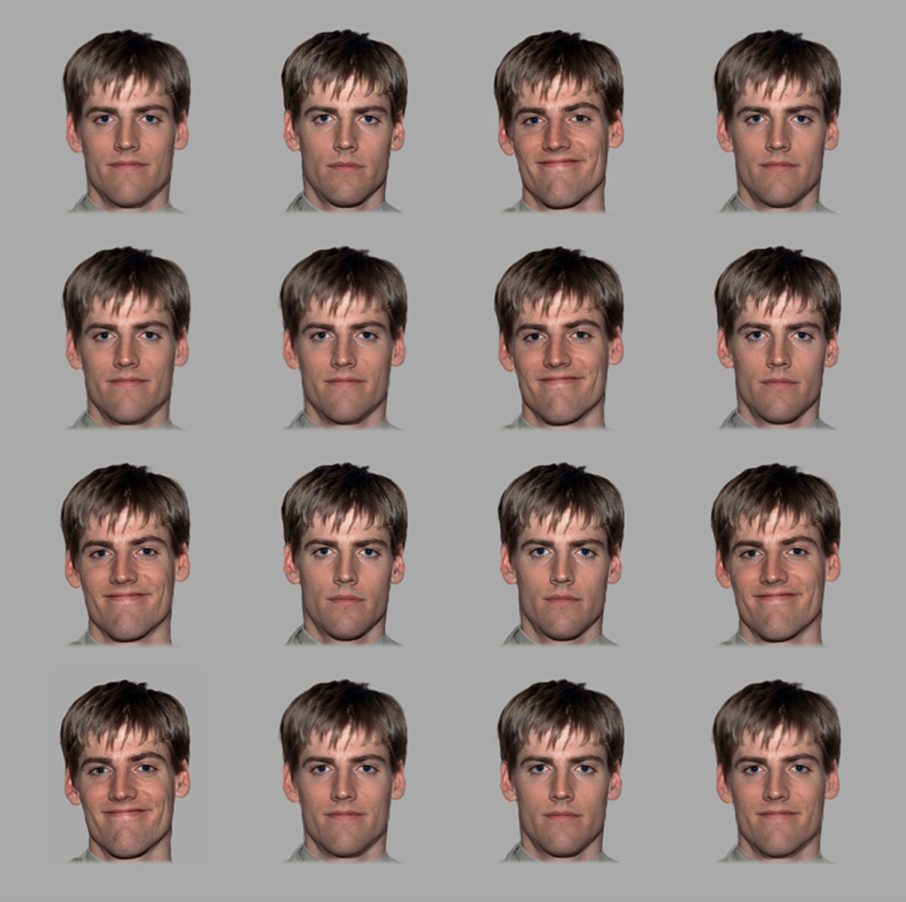

Once you make the choice, the page will switch to the next trial.

Slide 6
At the next stage, you will conduct a short practice run to make sure that the task is clear.
Remember – the goal is for your to ESTIMATE THE AVERAGE EMOTIONAL RESPONSES of the faces you just saw.

Slide 7
Thank you for completing the practice stage.
Remember – the goal was to ESTIMATE THE AVERAGE EMOTIONAL RESPONSES of the faces you just saw.
In the following section you will complete the actual study, which consists of 50 trials. The task should take 5 minutes, more or less.
Click ‘Continue’ to begin the actual task.

Slide 8
You've completed the task.
Thank you for your participation.
The next section is a short survey (up to 5 min).

