Slide 1
The face sequence will be on the screen for a brief moment. In order to take all the ratings in, try to focus your attention on it as much as possible.
You completed the first session! The goal of this session is to examine whether people can remember the emotional facial expressions of a face in the sequence. As in the previous session, a series of faces expressing various degrees of emotions will appear on the screen. The face sequence may either be expressing positive or negative emotions.

Slide 2
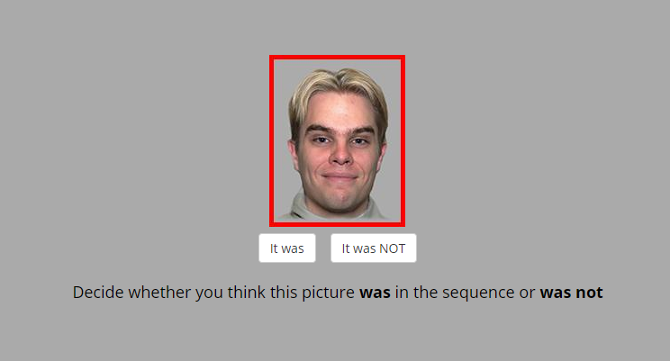
After the sequence a target face will be presented to you.
We ask you to recall, if the the presented face was in the sequence
that you just have seen.
If you think that the target face DID appear in the sequence press
If you think that the target face DID NOT appear
in the sequence you just saw press

Slide 3
Remember, the goal here is to provide
YOUR JUDGEMENT WHETHER
THE PRESENTED PICTURE WAS OR WAS NOT
one of the faces in the sequence you just saw.

Slide 4
Once you make the choice, the page will switch to the next trial.

Slide 5
At the next stage, you will conduct a short practice run to make sure that the task is clear.
Remember – the goal here is to provide YOUR JUDGEMENT WHETHER THE PRESENTED PICTURE WAS OR WAS NOT of the of the face sequence you just saw.

Slide 6
Thank you for completing the practice stage.
Remember – the goal here is to provide YOUR JUDGEMENT WHETHER THE PRESENTED PICTURE WAS OR WAS NOT of the face sequence you just saw.
In the following section you will complete the actual session, which consists of 15 trials. This part of the study should take 7 minutes, more or less.
Click ‘Continue’ to begin the actual task.

