Slide 1
Dear participant,
You are about to participate in a study that was designed to test the process in which people evaluate emotional expressions that are presented in a sequence.
You will go through two sessions in which you will be asked to do slightly different things. Before each session you will go through a short instruction session, a practice round to make sure you understand what you need to do and complete the actual task.
Please follow the instructions carefully.

Slide 2
The goal of this session is to examine whether people can estimate the average emotional expression of face sequences. In each trial, a series of faces expressing various degrees of emotions will appear on the screen. The face sequence may either be expressing positive or negative emotions. The face sequence will be on the screen for a brief moment. In order to take all the ratings in, try to focus your attention on it as much as possible.

Slide 3
​Following the face sequence, you will be asked to move the mouse left of the line to begin the rating phase
Move mouse left of the line to begin

Slide 4
​A face will then appear on the screen. When you move your mouse, the face will change from being neutral to expressing emotion By adjusting your mouse, you are asked to estimate the average emotional response of the face sequence you just saw.

Slide 5
Remember, the goal here is provide
YOUR ESTIMATION OF THE
AVERAGE EMOTIONAL RESPONSE
of the face sequence you just saw.

Slide 6
Once you make the choice, the page will switch to the next trial.

Slide 7
At the next stage, you will conduct a short practice run to make sure that the task is clear.
Remember – the goal is to ESTIMATE THE AVERAGE EMOTIONAL RESPONSE of the of the face sequence you just saw.

Slide 8
Thank you for completing the practice stage.
Remember – the goal was to ESTIMATE THE AVERAGE EMOTIONAL RESPONSE of the face sequence you just saw.
In the following section you will complete the actual session, which consists of 15 trials. This part of the study should take 7 minutes, more or less.
Click ‘Continue’ to begin the actual task.

Slide 9
The face sequence will be on the screen for a brief moment. In order to take all the ratings in, try to focus your attention on it as much as possible.
You completed the first session! The goal of this session is to examine whether people can remember the emotional facial expressions of a face in the sequence. As in the previous session, a series of faces expressing various degrees of emotions will appear on the screen. The face sequence may either be expressing positive or negative emotions.

Slide 10
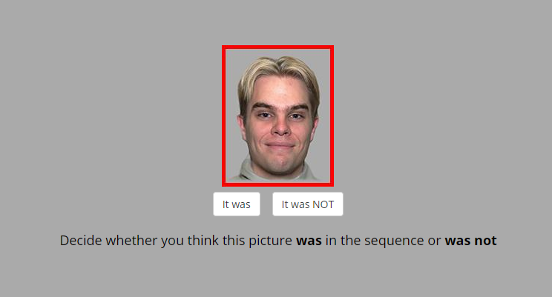
After the sequence a target face will be presented to you.
We ask you to recall, if the the presented face was in the sequence
that you just have seen.
If you think that the target face DID appear in the sequence press
If you think that the target face DID NOT appear
in the sequence you just saw press

Slide 11
Remember, the goal here is to provide
YOUR JUDGEMENT WHETHER
THE PRESENTED PICTURE WAS OR WAS NOT
one of the faces in the sequence you just saw.

Slide 12
Once you make the choice, the page will switch to the next trial.

Slide 13
At the next stage, you will conduct a short practice run to make sure that the task is clear.
Remember – the goal here is to provide YOUR JUDGEMENT WHETHER THE PRESENTED PICTURE WAS OR WAS NOT of the of the face sequence you just saw.

Slide 14
Thank you for completing the practice stage.
Remember – the goal here is to provide YOUR JUDGEMENT WHETHER THE PRESENTED PICTURE WAS OR WAS NOT of the face sequence you just saw.
In the following section you will complete the actual session, which consists of 15 trials. This part of the study should take 7 minutes, more or less.
Click ‘Continue’ to begin the actual task.

Slide 15
You've completed the task.
Thank you for your participation.
The next section is a short survey (up to 5 min).

