Slide 1
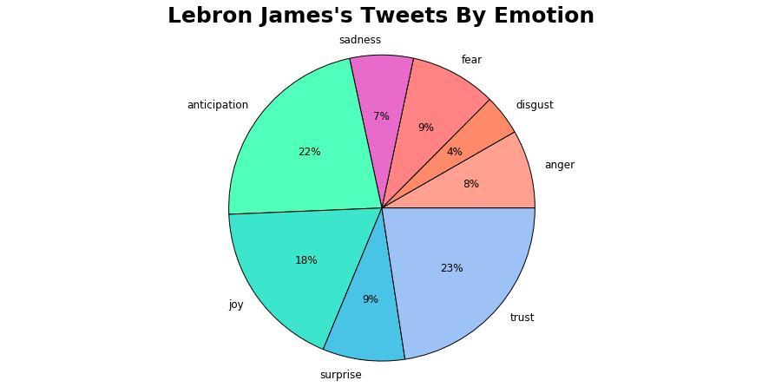
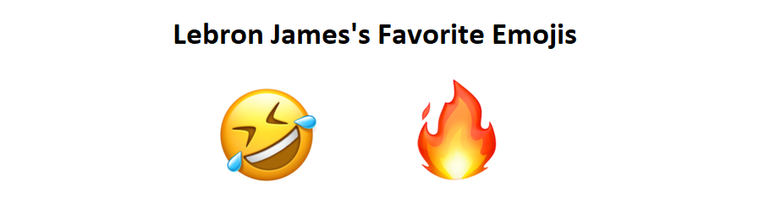
Lebron James’s Tweets By Emotion
LeBron James’s Favorite Emojis

Slide 2
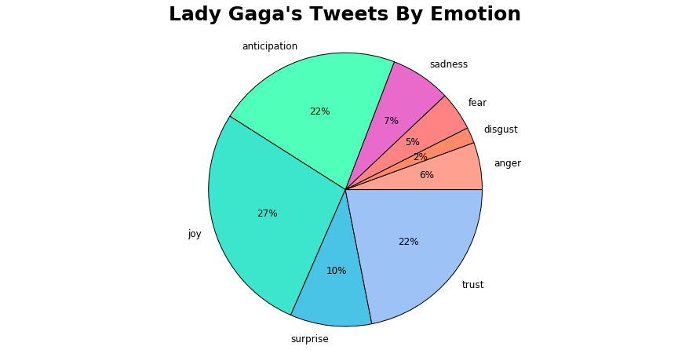
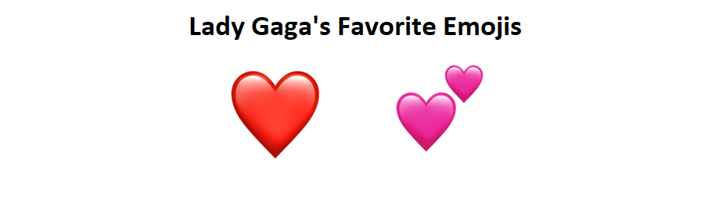
Lady Gaga’s Tweets By Emotion
Lady Gaga’s Favorite Emojis

Slide 3
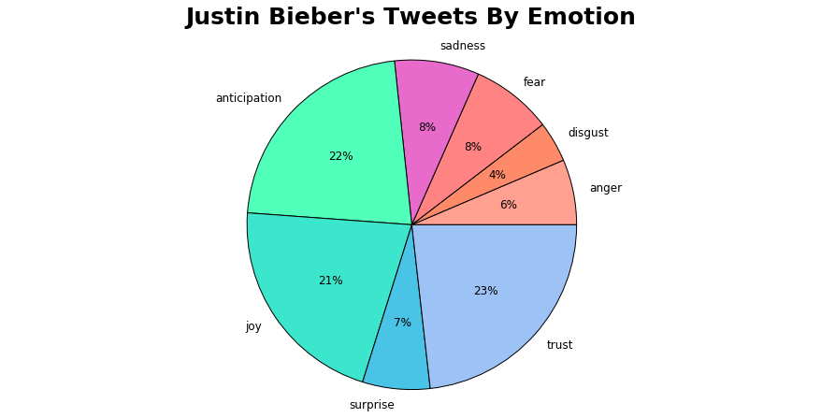
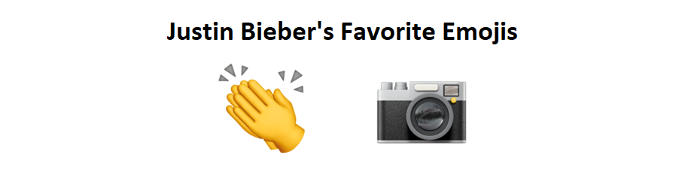
Justin Bieber’s Tweets By Emotion
Justin Bieber’s Favorite Emojis

Slide 4
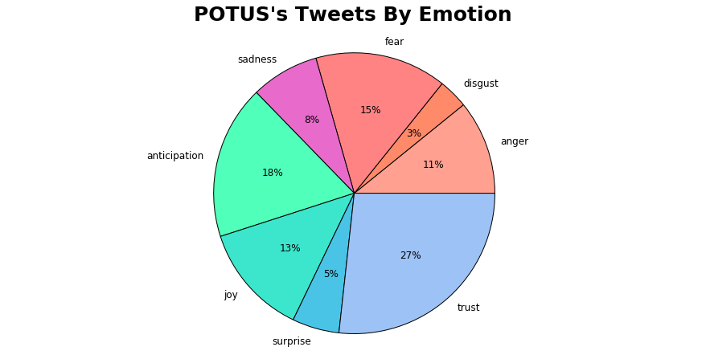
POTUS’s Tweets By Emotion
POTUS does not use any emojis!

