Slide 1
COEN 510 Network Security and Cryptography
Lecture 2

Slide 2
Outline
Definitions
Threats and Threat Models
Attacks
Malware
Vulnerabilities

Slide 3
Definitions
Threats are people who are able to take advantage of security vulnerabilities to attack systems.
Criminals, hacktivists, spies, disgruntled employees.
Attacks are tools, programs, and methods used by threats to obtain assets from systems in violation of the security policy.
Stuxnet, Dark Comet, AirCrack, John the Ripper
Vulnerabilities are weaknesses in a system that allow a threat to obtain access to information assets in violation of a system’s security policy.

Slide 4
How are Digital Threats Different?
Automation
Use of Botnets to carryout attacks.
Action at a Distance
Volodya Levin, from St. Petersburg, Russia, stole over $10million from US Citibank. Arrested in London.
Technique Propagation
Criminals share attacks rapidly and globally.

Slide 5
Who are the threats?
Hackers and Crackers: Hacker is the generic term applies to computer enthusiasts who take pleasure in gaining access to other people’s computer networks. Hackers program or hacks to check the integrity and vulnerability strength of a network. While crackers are hackers that are more malicious, crashing entire computer systems, stealing or damaging confidential data, defacing web pages, and ultimately disrupting business.
Unaware Staff: employees that have no knowledge of security breaches and therefore handle the network carelessly.
Disgruntled Staff: employees that have access to security policy and have reprimanded or laid off.
Snoops: employees that partake in corporate espionage, gaining unauthorized access to confidential data in order to provide competitors with inaccessible information.

Slide 6
Insider Problem
Insiders are threats who are members of the organization that they are attacking.
Insiders are dangerous because they
Are inside the security perimeter, so cannot be blocked by perimeter defenses like firewalls and locked doors.
Have some level of legitimate access to systems.
May have physical access to systems and information.

Slide 7
Threat Model
A threat model describes which threats exist to a system, their capabilities, history, intentions, and likely targets.
Are you worried about broad or targeted threats?
Are your threats able to develop their own tools or just use off the shelf tools?
Do you keep enough data about historical incidents to know what your threats are?

Slide 8
Threat Model Examples
Example 1: Disgruntled Insider
Targeted attack on organization
Knows systems and information assets already
Sophistication level varies, but may have access without carrying out sophisticated attacks.
Example 2: Botnet recruitment
Broad attack, looking for any vulnerable system.
Automated tools to scan for specific set of vulnerabilities or to deliver malware to employees

Slide 9
Attacks and Exploits
An attack is an action taken by a threat to gain unauthorized access or to create unauthorized modification of assets.
Spam
Phishing
Malware
An exploit is a piece of software or a scripted set of actions that carry out an attack. Threats often turn attacks into exploits to automate compromising of systems.

Slide 10

Spam
Spam is the use of electronic messaging systems to send unsolicited bulk messages, especially advertising, indiscriminately.
Mostly e-mail, but also
Blog and webforum comment spam,
Wiki spam,
IM spam, etc.

Slide 11
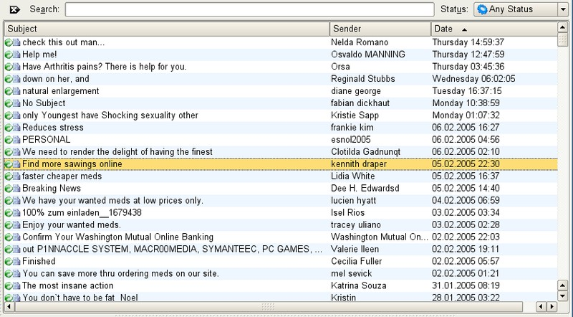
Over 90% of e-mail is spam!

Slide 12
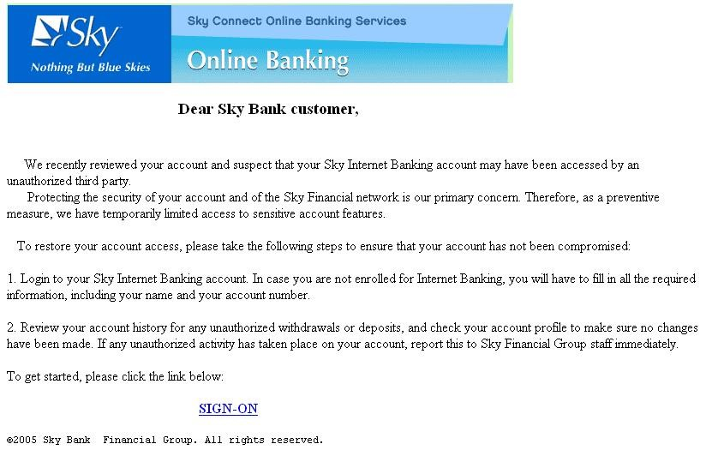
Phishing E-mail
Phishing is the act of sending an email to a user falsely claiming to be an established legitimate enterprise in an attempt to scam the user into surrendering private information that will be used for identity theft. Attempt to obtain sensitive information like username, password, account details etc. by masquerading

Slide 13
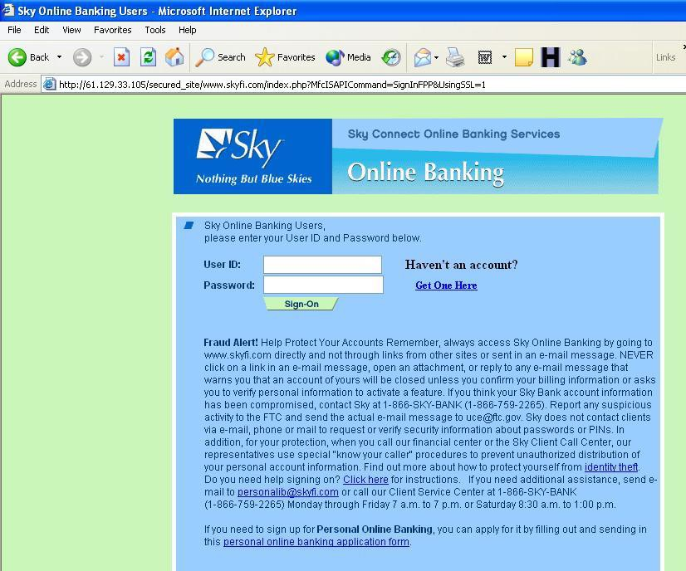
Phishing Site

Slide 14
Spoofing
A spoofing attack is when a threat masquerades as another entity on a telecommunications network.
Examples of spoofing include:
E-mail spoofing
ARP spoofing (MAC to IP address map spoofing)
IP address spoofing
Caller ID spoofing
GPS spoofing

Slide 15
Sniffing
Packet sniffing is when a program records wired or wireless network packets destined for other hosts.
Wireless traffic is available to everyone nearby.
Antennas can extend range to miles.
Wired traffic is accessible depending on network location.
If network location unsatisfactory, ARP spoofing can
redirect traffic to sniffing machine.
Sniffing used to
Obtain passwords (ftp, imap, etc.)
Obtain other confidential information

Slide 16
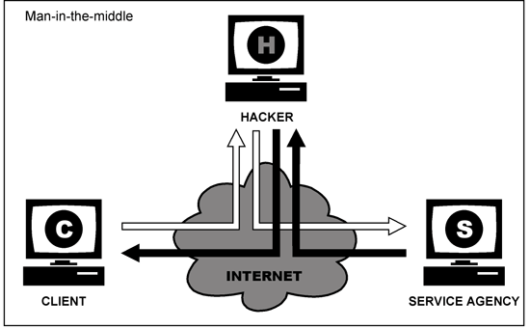
Man in the Middle
A man-in-the-middle attack is an active eavesdropping attack, in which the attacker connects to both parties and relays messages between them.

Slide 17
Injection Attacks
Injection attacks send code to a program instead of the data it was expected, then exploit a vulnerability in the software to execute the code.
Buffer overflows inject machine code into a process.
Cross-site scripting injects JavaScript code into a web page seen by another user.
SQL injection injects SQL code into a database query run by an application.

Slide 18
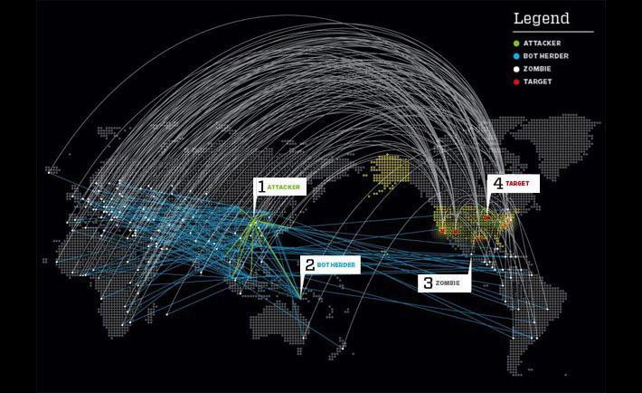
Denial of Service
A denial of service (DoS) attack attempts to make computer or network resources unavailable to its intended users.

Slide 19
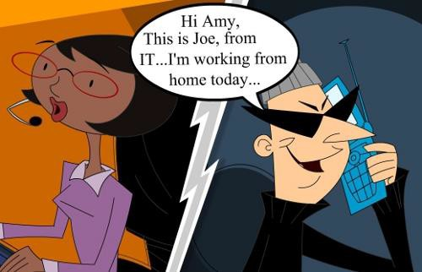
Social Engineering
Social engineering is the psychological manipulation of people to reveal confidential information or perform actions to violate security policy.

Slide 20
Attack Surface
Attack surface: the set of ways an application can be attacked.
Used to measure attackability of app.
The larger the attack surface of a system, the more likely an attacker is to exploit its vulnerabilities and the more damage is likely to result from attack.
Compare to measuring vulnerability by counting
number of reported security bugs.
Both are useful measures of security, but have very different meanings.

Slide 21
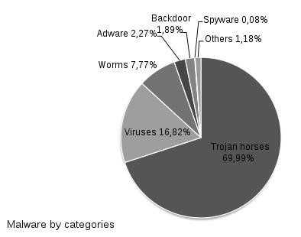
Malware
Malware, short for malicious software, is software designed to gain access to confidential information, disrupt computer operations, and/or gain access to private computer systems. Malware can be classified by how it infects systems:
Trojan Horses
Viruses
Worms
Or by what assets it targets:
Ransomware
Spyware and adware
Backdoors
Rootkits
Botnets

Slide 22
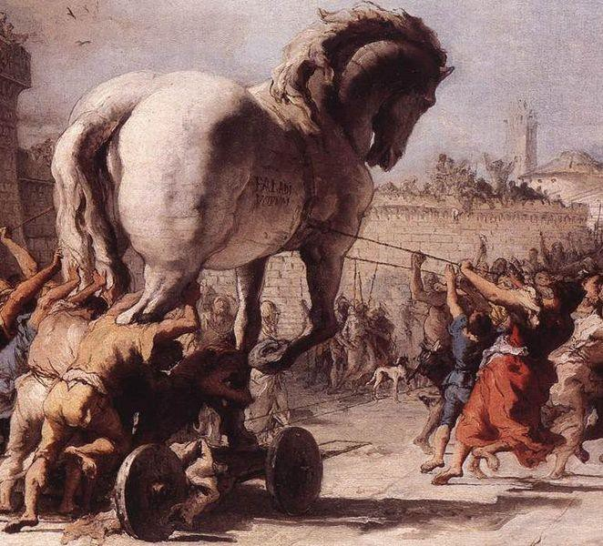
Trojan Horses
Trojan horse, or Trojan, is any malicious computer program which is used to hack into a computer by misleading users of its true intent. The term is derived from the Ancient Greek story of the wooden horse that was used to help Greek troops invade the city of Troy by stealth.
trojan horses do not replicate themselves but they can be just as destructive. One of the most insidious types of Trojan horse is a program that claims to rid your computer of viruses but instead introduces viruses onto your computer

Slide 23
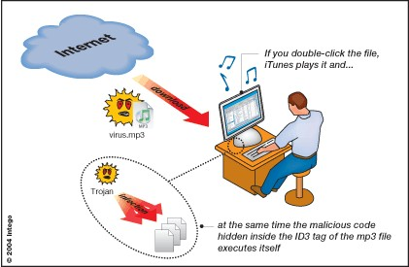
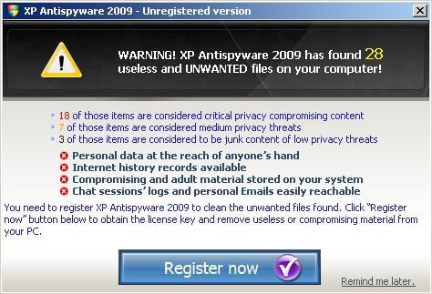
Trojan Horse Examples

Slide 24
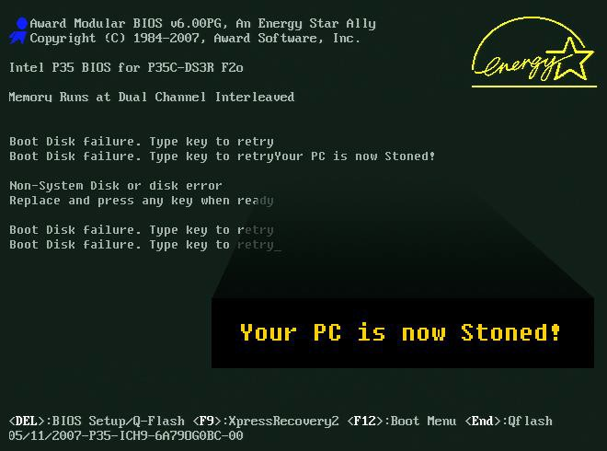
Viruses
A computer virus is a type of malware that, when executed, replicates by inserting copies of itself (possibly modified) into other files.
This process is called infecting.

Slide 25
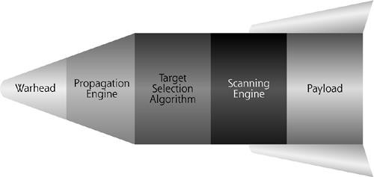
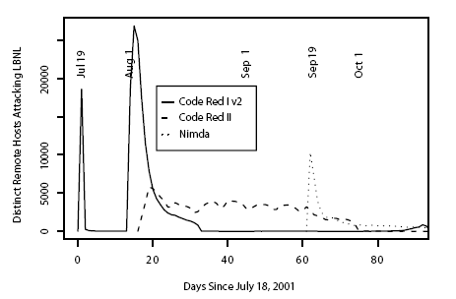
Worms
A worm is a type of malware that spreads itself to other computers.

Slide 26
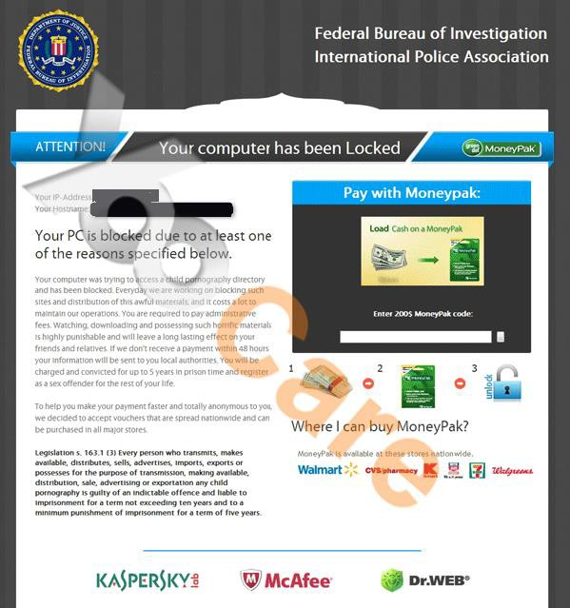
Ransomware
Ransomware is a type of malware that prevents or limits users from accessing their system, either by locking the system's screen or by locking the users' files unless a ransom is paid

Slide 27
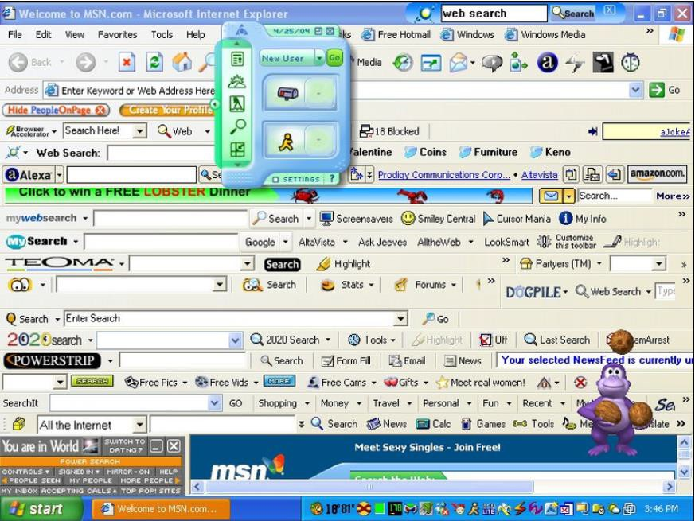
Spyware and Adware

Slide 28
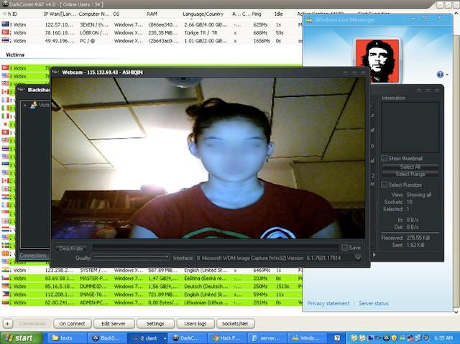
Backdoors
A back door is a means of access to a computer program that bypasses security mechanisms. A programmer may sometimes install a back door so that the program can be accessed for troubleshooting or other purposes. However, attackers often use back doors that they detect or install themselves, as part of an exploit.

Slide 29

Rootkits
A rootkit is a collection of tools (programs) that enable administrator-level access to a computer or computer network. Typically, a cracker installs a rootkit on a computer after first obtaining user-level access, either by exploiting a known vulnerability or cracking a password.
Execution Redirection
File Hiding
Process Hiding
Network Hiding
Backdoor
User Program
Rootkit
Operating System

Slide 30
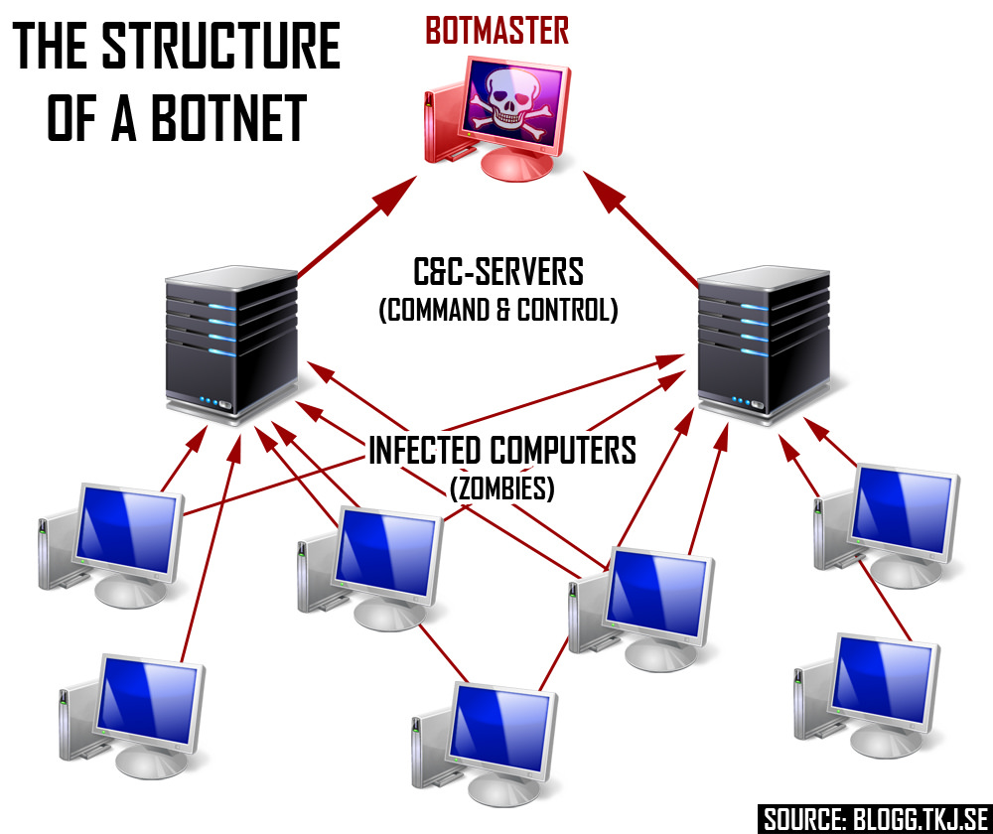
Botnets
A "bot" is a type of malware that allows an attacker to take control over an affected computer. Also known as “Web robots”, bots are usually part of a network of infected machines, known as a “botnet”, which is typically made up of victim machines that stretch across the globe

Slide 31
Vulnerabilities
Vulnerabilities can be found in any software:
PC: Office, Adobe Reader, web browsers
Server: Databases, DNS, mail server software, web servers, web applications, etc.
Mobile: Mobile phone OS, mobile applications
Embedded: printers, routers, switches, VoIP phones, cars, medical devices, TVs, etc.
Third party software: Web browser plugins, Ad affiliate network JavaScript include files, Mobile ad libraries

Slide 32
Patches
A patch is a piece of data or software designed to fix a security vulnerability or bug.
Administrator may have to apply manually.
Some vendors specify certain days to patch, such as “Patch Tuesday,” the 2nd Tuesday of the month when MS releases updates.
Increasingly software auto updates itself with current patches.

Slide 33
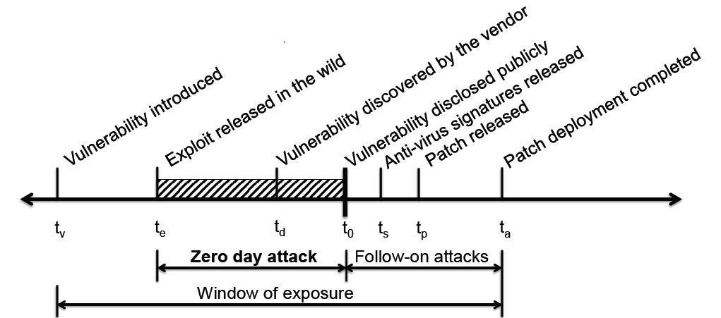
Vulnerability Timeline

Slide 34
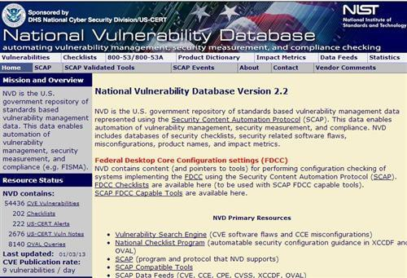
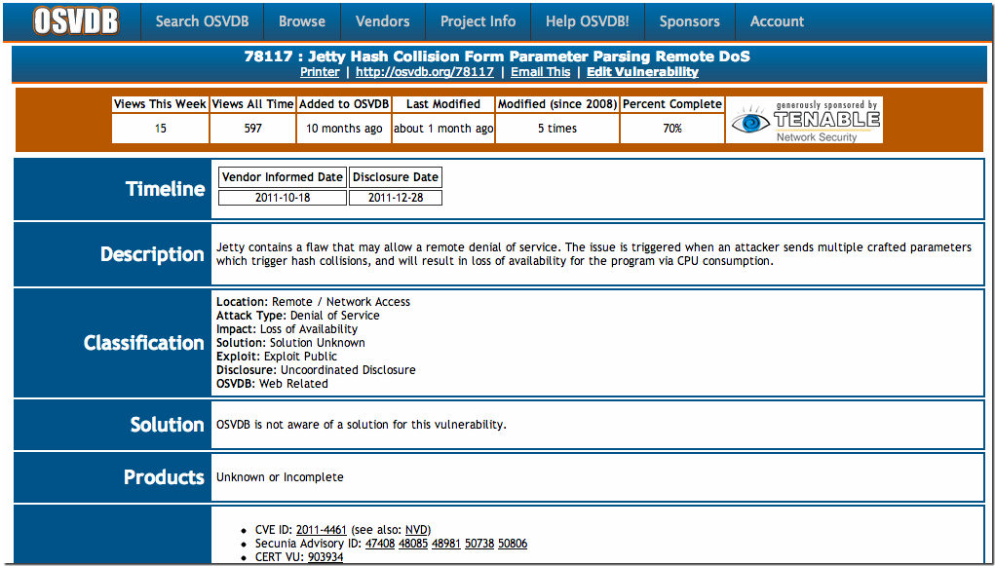
Vulnerability Databases

Slide 35
Summary
Terms: threat, attack, vulnerability, exploit, patch
Threat models
Broad vs. targeted threats
Off-the-shell vs. sophisticated threats
Attack surface
Attacks: spam, phish, spoof, sniff, MITM, DoS
Malware: Trojan, virus, worm
Vulnerability lifecycle
Introduction, zero-day, patch, window of exposure

