Slide 1



5-Item Half-Donut Infographic Slide Template
EDIT TEXT HERE
Edit Text
Here
Edit Text
Here
A cultural idea
spreads from the hearth
The spread of an underlying idea
Edit Text
Here
Edit Text
Here
A cultured idea is spread by migration
Edit Text
Here
A cultural idea spreads from
a person or place of power
A cultural idea
spreads quickly

Slide 2

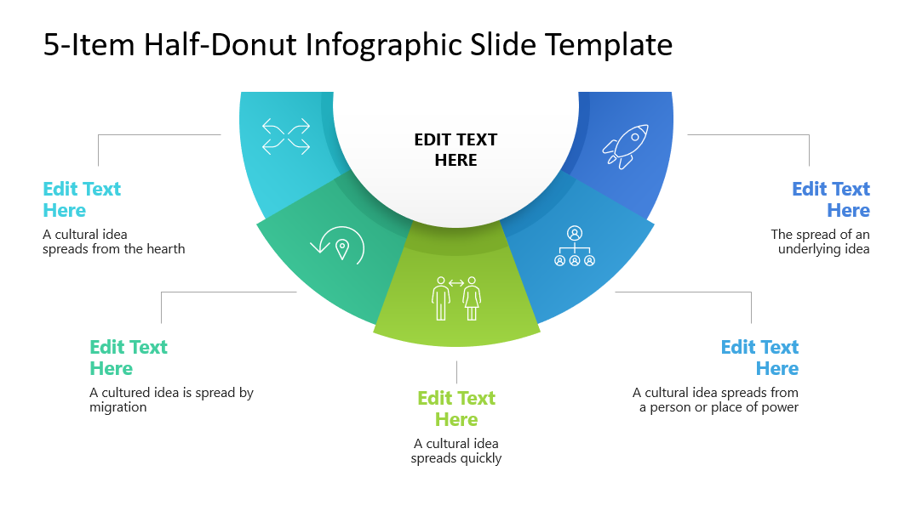
Put Your Screenshot
Here
Get 15% discount from regular price
Coupon Code:
FREEBUNDLE15
Apply this coupon code during sign up
Download PowerPoint templates and save hours of work.
SUBSCRIBE NOW
Easy to use
Fully customizable
Cutting edge designs
Visit slidemodel.com
Notes:
You can safely remove this slide. This slide design was provided by SlideModel.com – You can download more templates, shapes and elements for PowerPoint from http://slidemodel.com/

Slide 3
Notes:
You can safely remove this slide. This slide design was provided by SlideModel.com – You can download more templates, shapes and elements for PowerPoint from http://slidemodel.com

