Slide 1



Esti Halperin – esteehalperin@gmail.com
Goldie Lemberger – goldie9912@gmail.com

Slide 2
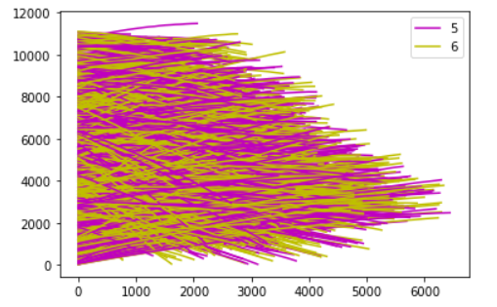
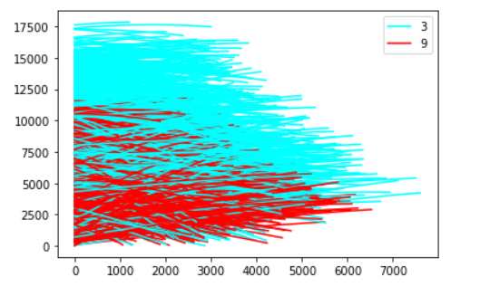
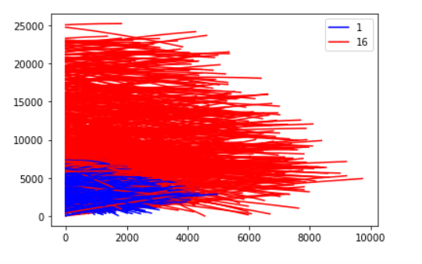
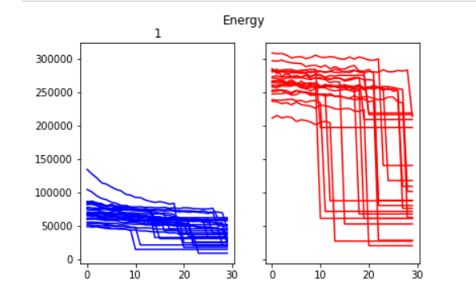
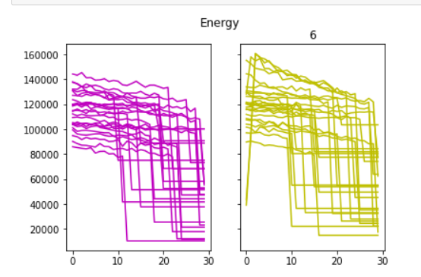
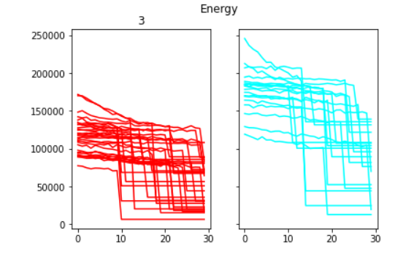

Slide 3
Logistic Regression vs Random Forest
 | logistic | random forest
(12,15) | 94% | 94%
(3,9) | 88% | 99%
(1,16) | 99% | 100%
(5,6) | 53% | 52%

Slide 4
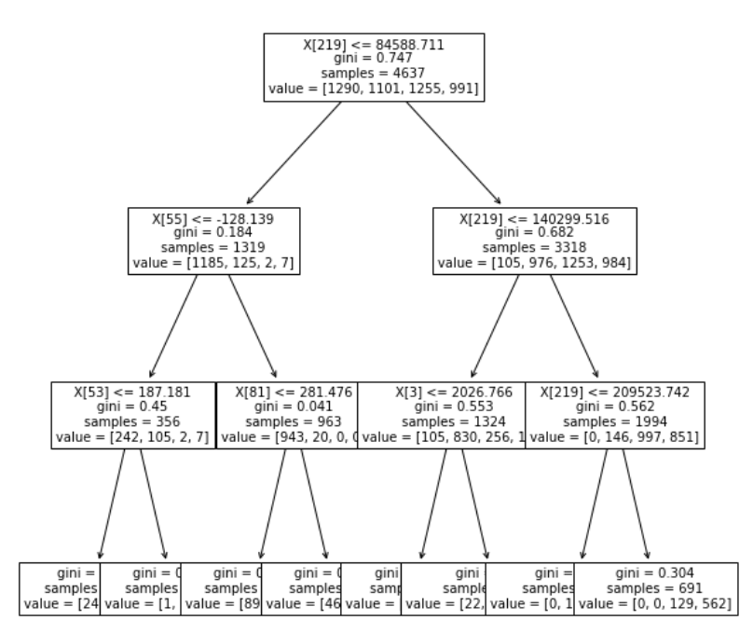
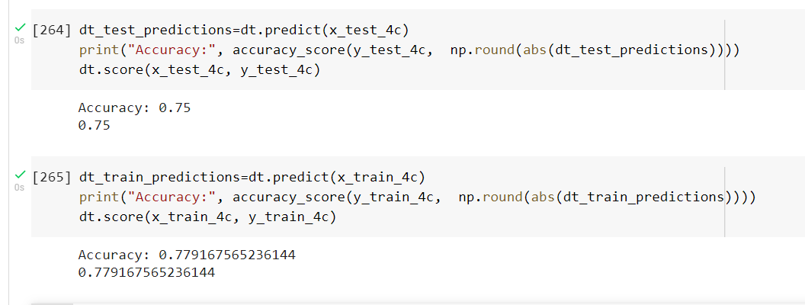
Decision tree
Depth: 3
Score test
Score train

Slide 5
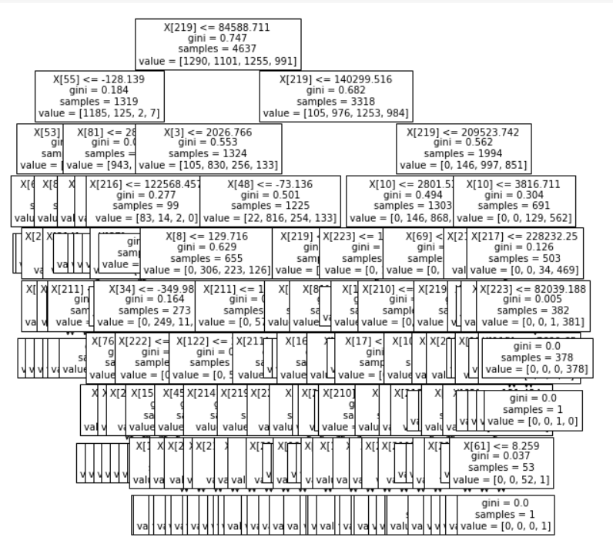


Decision tree
Depth: 9
Score test
Score train

Slide 6


