Slide 1
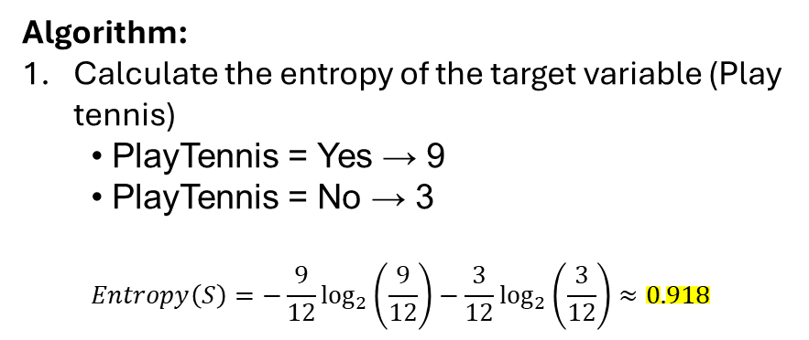
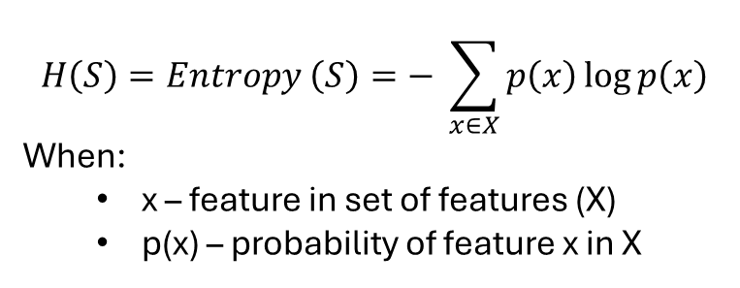
Decision Trees (ID3 Algorithm)
Dataset
$$H\left(S\right)=Entropy \left(S\right)=− \sum_{x∈X}{p\left(x\right)\log{p\left(x\right)}}$$
When:
x – feature in set of features (X)
p(x) – probability of feature x in X
ID | Outlook | Temperature | Humidity | Wind | PlayTennis
1 | Sunny | Hot | High | Weak | No
2 | Sunny | Hot | High | Strong | No
3 | Overcast | Hot | High | Weak | Yes
4 | Rain | Mild | High | Weak | Yes
5 | Rain | Cool | Normal | Weak | Yes
6 | Rain | Cool | Normal | Strong | No
7 | Overcast | Cool | Normal | Strong | Yes
8 | Sunny | Mild | High | Weak | No
9 | Sunny | Cool | Normal | Weak | Yes
10 | Rain | Mild | Normal | Weak | Yes
11 | Sunny | Mild | Normal | Strong | Yes
12 | Overcast | Mild | High | Strong | Yes
Algorithm:
Calculate the entropy of the target variable (Play tennis)
PlayTennis = Yes → 9
PlayTennis = No → 3
$$Entropy\left(S\right)=−\frac{9}{12}\log_{2}\left(\frac{9}{12}\right)−\frac{3}{12}\log_{2}\left(\frac{3}{12}\right)≈0.918$$

Slide 2
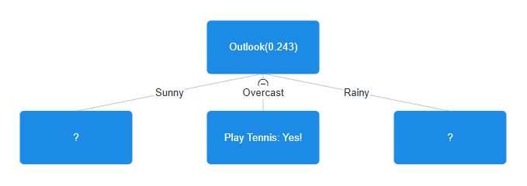
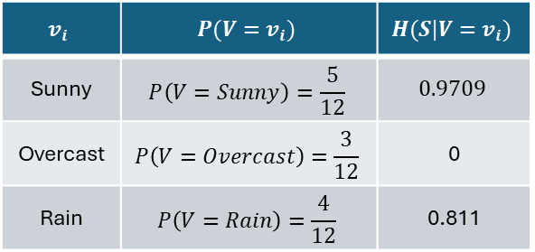
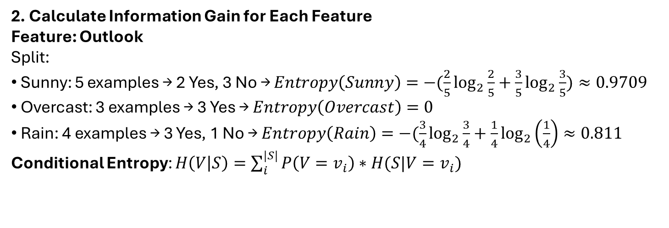
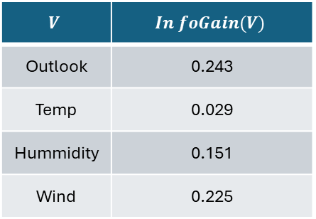
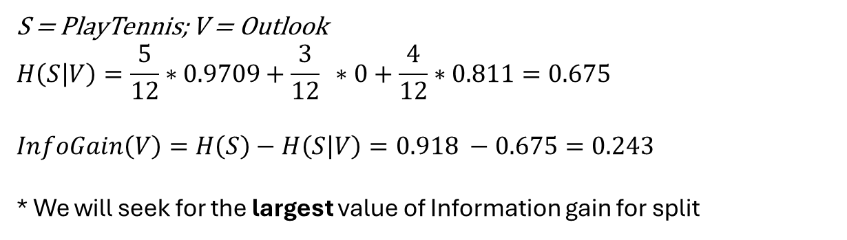
2. Calculate Information Gain for Each Feature
Feature: Outlook
Split:
Sunny: 5 examples → 2 Yes, 3 No → $Entropy\left(Sunny\right)=−(\frac{2}{5}\log_{2}{\frac{2}{5}+\frac{3}{5}\log_{2}{\frac{3}{5}})}≈0.9709$
Overcast: 3 examples → 3 Yes → $Entropy\left(Overcast\right)=0$
Rain: 4 examples → 3 Yes, 1 No → $Entropy\left(Rain\right)=−(\frac{3}{4}\log_{2}{\frac{3}{4}+\frac{1}{4}\log_{2}\left(\frac{1}{4}\right)≈0.811 }$
Conditional Entropy: $H\left(V | S\right)=\sum_{i}^{|S|}{P\left(V=v_{i}\right)∗H(S|V=v_{i})}$
$$v_{i}$$ | $$P(V=v_{i})$$ | $$H(S|V=v_{i})$$
Sunny | $$P\left(V=Sunny\right)=\frac{5}{12}$$ | $$0.9709$$
Overcast | $$P\left(V=Overcast\right)=\frac{3}{12}$$ | 0
Rain | $$P\left(V=Rain\right)=\frac{4}{12}$$ | 0.811
S = PlayTennis; V = Outlook
$$H\left(S | V\right)=\frac{5}{12}∗0.9709+\frac{3}{12} ∗0+\frac{4}{12}∗0.811=0.675$$
$InfoGain\left(V\right)=H\left(S\right)−$ $H\left(S | V\right)=0.918 −0.675=0.243$
* We will seek for the largest value of Information gain for split
$$V$$ | $$In foGain(V)$$
Outlook | 0.243
Temp | 0.029
Hummidity | 0.151
Wind | 0.225
3. Best Split = Outlook (InfoGain = 0.225)
We split on Outlook, then repeat recursively on each branch.

Slide 3
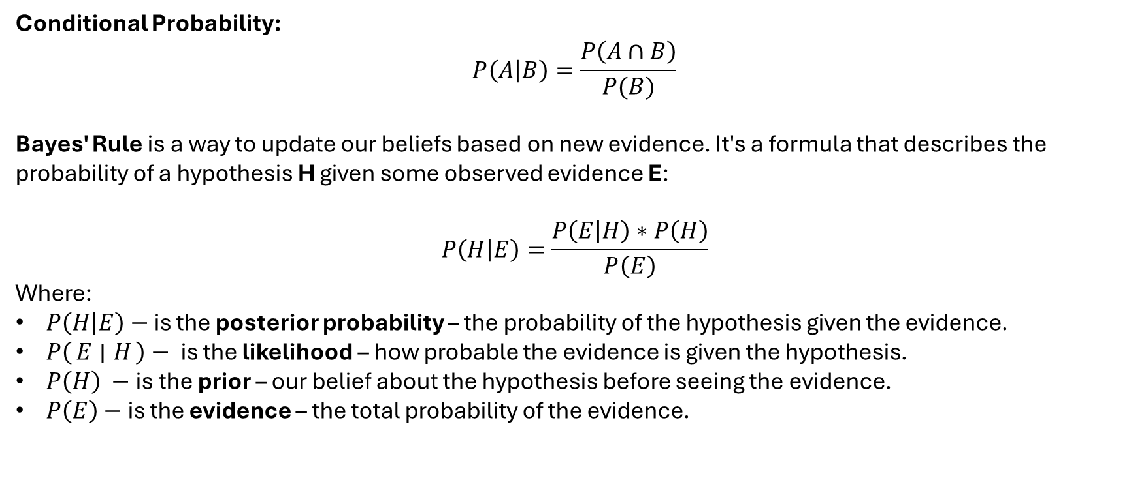
Naïve Bayes and Bayesian network
Bayes' Rule (Bayes’ Theorem)
Conditional Probability:
$$P\left(A | B\right)=\frac{P\left(A∩B\right)}{P(B)}$$
Bayes' Rule is a way to update our beliefs based on new evidence. It's a formula that describes the probability of a hypothesis H given some observed evidence E:
$$P\left(H | E\right)=\frac{P\left(E | H\right)∗P\left(H\right)}{P\left(E\right)}$$
Where:
$P\left(H | E\right)−$ is the posterior probability – the probability of the hypothesis given the evidence.
$P\left(E ∣ H\right)−$ is the likelihood – how probable the evidence is given the hypothesis.
$P\left(H\right) −$is the prior – our belief about the hypothesis before seeing the evidence.
$P\left(E\right)−$ is the evidence – the total probability of the evidence.

Slide 4
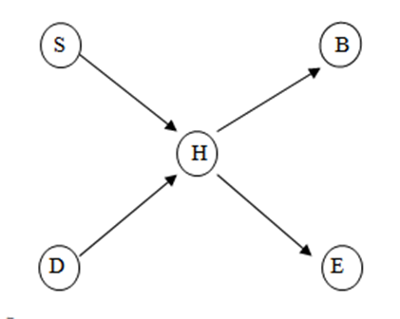
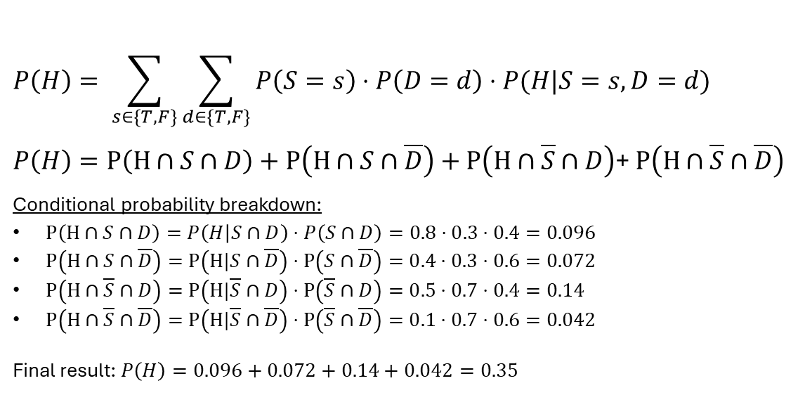
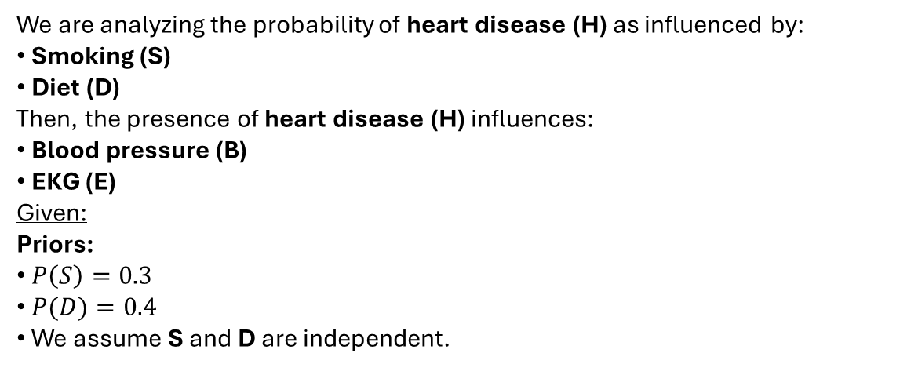
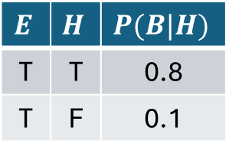
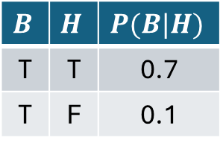
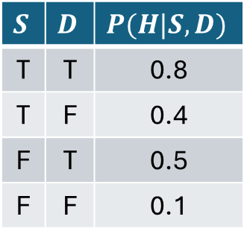
Example:
We are analyzing the probability of heart disease (H) as influenced by:
Smoking (S)
Diet (D)
Then, the presence of heart disease (H) influences:
Blood pressure (B)
EKG (E)
Given:
Priors:
$P\left(S\right)=0.3$
$P(D)=0.4$
We assume S and D are independent.
$$P\left(H\right)= \sum_{s∈\{T,F\}}{\sum_{d∈\{T,F\}}{P\left(S=s\right)⋅P\left(D=d\right)⋅P(H|S=s,D=d)}}$$
$P\left(H\right)=P\left(H∩S∩D\right)+P\left(H∩S∩\overline{D}\right)+P\left(H∩\overline{S}∩D\right)$+ $P\left(H∩\overline{S}∩\overline{D}\right)$
Conditional probability breakdown:
$P\left(H∩S∩D\right)=P\left(H | S∩D\right)⋅P\left(S∩D\right)=0.8⋅0.3⋅0.4=0.096$
$P\left(H∩S∩\overline{D}\right)=P\left(H|S∩\overline{D}\right)⋅P\left(S∩\overline{D}\right)=0.4⋅0.3⋅0.6=0.072$
$P\left(H∩\overline{S}∩D\right)=P\left(H|\overline{S}∩D\right)⋅P\left(\overline{S}∩D\right)=0.5⋅0.7⋅0.4=0.14$
$P\left(H∩\overline{S}∩\overline{D}\right)=P\left(H|\overline{S}∩\overline{D}\right)⋅P\left(\overline{S}∩\overline{D}\right)=0.1⋅0.7⋅0.6=0.042$
Final result: $P\left(H\right)=0.096+0.072+0.14+0.042=0.35$
$$B$$ | $$H$$ | $$P(B|H)$$
T | T | 0.7
T | F | 0.1
$$S$$ | $$D$$ | $$P(H|S,D)$$
T | T | 0.8
T | F | 0.4
F | T | 0.5
F | F | 0.1
$$E$$ | $$H$$ | $$P(B|H)$$
T | T | 0.8
T | F | 0.1

Slide 5
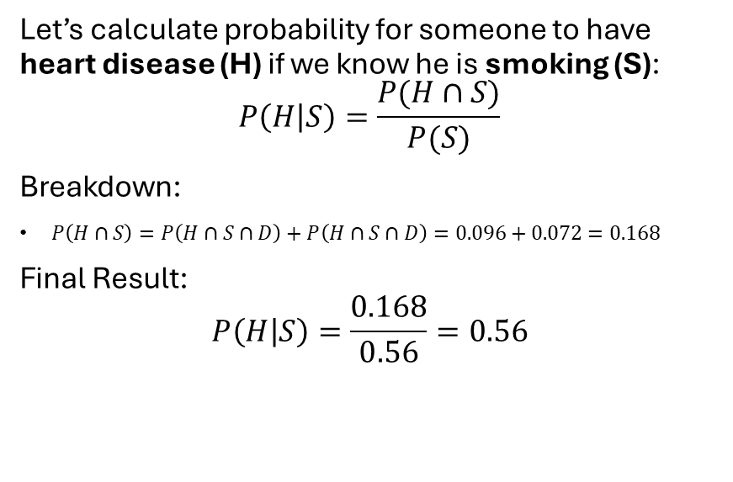
Let’s calculate probability for someone to have heart disease (H) if we know he is smoking (S):
$$P\left(H | S\right)=\frac{P(H∩S)}{P(S)}$$
Breakdown:
$P\left(H∩S\right)=P\left(H∩S∩D\right)+P\left(H∩S∩D\right)=0.096+0.072=0.168$
Final Result:
$$P\left(H | S\right)=\frac{0.168}{0.56}=0.56$$

Slide 6
Association rules
FP-Growth Algorithm (Frequent Pattern Growth)
How it works:
Builds a compact prefix tree structure called FP-tree (Frequent Pattern Tree).
Only two database scans:
First scan to compute support counts.
Second scan to build the FP-tree.
Recursively mines the tree to find frequent patterns without generating candidate itemsets explicitly.
Pros:
Much faster than Apriori on large datasets.
Requires fewer database scans.
Handles dense datasets and long itemsets efficiently.
Cons:
More complex to implement and understand.
FP-tree might not fit in memory for extremely large datasets.
Less intuitive compared to Apriori.
Apriori Algorithm
How it works:
It is an iterative, breadth-first search approach.
Generates candidate itemsets of increasing length (k-itemsets) and prunes those with low support.
Relies heavily on the Apriori property: If an itemset is frequent, all of its subsets are also frequent.
Process:
Count support for 1-itemsets.
Generate candidate 2-itemsets from frequent 1-itemsets.
Repeat until no more frequent itemsets are found.
Pros:
Simple and easy to understand.
Effective for small-to-medium datasets.
Well-established and widely implemented.
Cons:
High computational cost: Generates a huge number of candidate sets, especially for large datasets.
Multiple database scans, one for each itemset size, making it slow on large datasets.
Poor performance on sparse data with long itemsets.

Slide 7
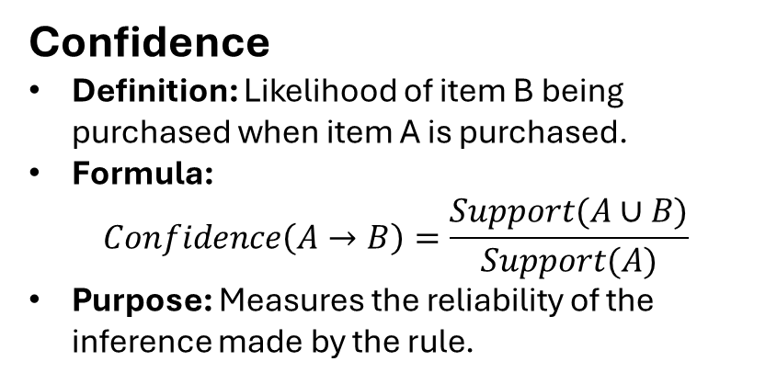
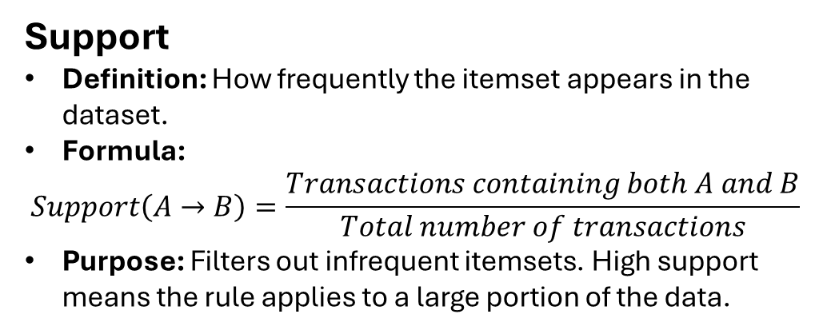
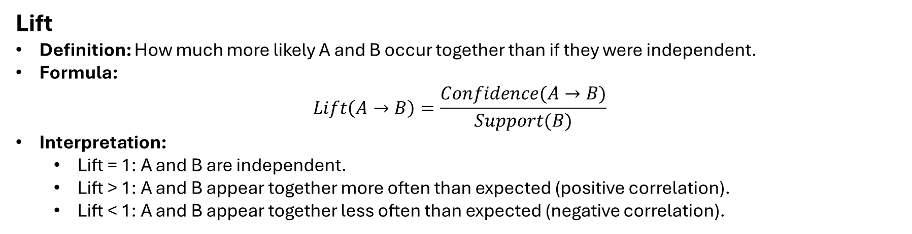
Key Metrics: Support, Confidence, Lift
Support
Definition: How frequently the itemset appears in the dataset.
Formula:
$$Support\left(A→B\right)=\frac{Transactions containing both A and B}{Total number of transactions}$$
Purpose: Filters out infrequent itemsets. High support means the rule applies to a large portion of the data.
Confidence
Definition: Likelihood of item B being purchased when item A is purchased.
Formula:
$$Confidence\left(A→B\right)=\frac{Support(A∪B)}{Support(A)}$$
Purpose: Measures the reliability of the inference made by the rule.
Lift
Definition: How much more likely A and B occur together than if they were independent.
Formula:
$$Lift\left(A→B\right)=\frac{Confidence(A→B)}{Support(B)}$$
Interpretation:
Lift = 1: A and B are independent.
Lift > 1: A and B appear together more often than expected (positive correlation).
Lift < 1: A and B appear together less often than expected (negative correlation).

Slide 8
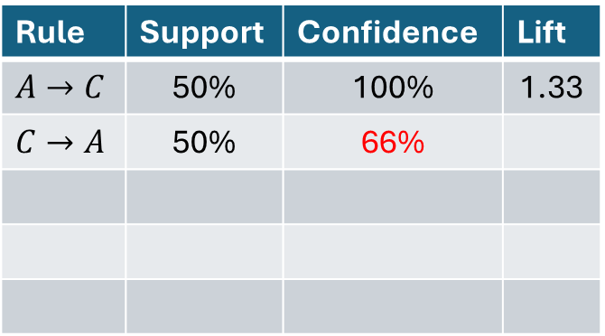
Apriori example(example): Min-confidence>=80%; Min support >= 50%
TID | Items
1 | A,C,D
2 | B,C,E
3 | A,B,C,E
4 | B,E
Itemset | Support
{A} | 50% (2/4)
{B} | 75%
{C} | 75%
{D} | 25%
{E} | 75%
Itemset | Support
{A} | 50% (2/4)
{B} | 75%
{C} | 75%
{E} | 75%
Itemset | Support
{A,B} | 25%
{A,C} | 50%
{A,E} | 25%
{B,C} | 50%
{B,E} | 75%
{C,E} | 50%
Itemset | Support
{A,C} | 50%
{B,C} | 50%
{B,E} | 75%
{C,E} | 50%
Rule | Support | Confidence | Lift
$$A→C$$ | 50% | 100% | 1.33
$$C→A$$ | 50% | 66%
* How to build a rule:
Basically, try all possible combinations of antecedent and consequent as long as:
Antecedent ∪ Consequent = the full itemset
Antecedent ≠ empty,
Consequent ≠ empty
Itemset | Support
{B,C,E} | 50%

Slide 9
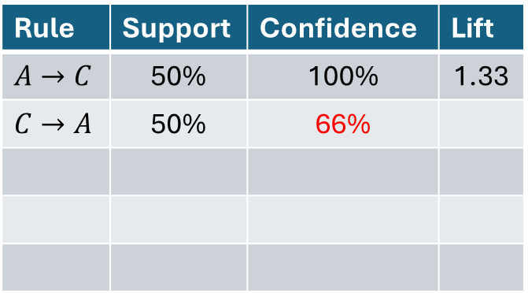
Items | TID
{A, B, C} | 1
{D, E, A} | 2
{A, C, F} | 3
{D, E} | 4
{B, F, D} | 5
{A, C, D, E} | 6
{D, F, A} | 7
{B, C} | 8
{A, C, D, E} | 9
{B, F} | 10
Itemset | Count | Support
{A} | 6 | 60%
{B} | 4 | 40%
{C} | 5 | 50%
{D} | 6 | 60%
{E} | 4 | 40%
{F} | 4 | 40%
Itemset | Count | Support
{A,C} | 4 | 40%
{A,D} | 4 | 40%
{C,D} | 2 | 40%
h1
x
h2
y
Rule | Support | Confidence | Lift
$$A→C$$ | 50% | 100% | 1.33
$$C→A$$ | 50% | 66%
h3

Slide 11
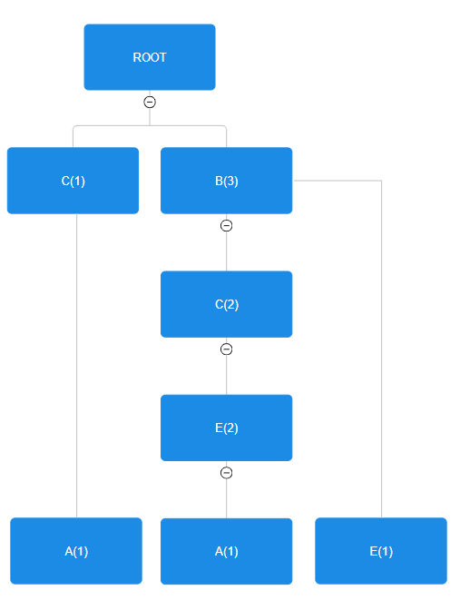
FP-Growth example (example): Min-confidence>=80%; Min support >= 50%
TID | Items
1 | A,C,D
2 | B,C,E
3 | A,B,C,E
4 | B,E
Itemset | Count | Support
{A} | 2 | 50% (2/4)
{B} | 3 | 75%
{C} | 3 | 75%
{D} | 1 | 25%
{E} | 3 | 75%
Itemset | Count | Support
{B} | 3 | 75%
{C} | 3 | 75%
{E} | 3 | 75%
{A} | 2 | 50%
Calculate Item Supports
Start with a null root. For each transaction, add a path in the tree:
TID | Items | Ordered item set
1 | A,C,D | {C,A}
2 | B,C,E | {B,C,E}
3 | A,B,C,E | {B,C,E,A}
4 | B,E | {B,E}
The FP-Growth algorithm sorts items in each transaction by descending frequency in the entire dataset.

Slide 12
Clustering – AGNES Exercise 2 : Hierarchical clustering
 | A1 | A2 | A3 | A4 | A5 | A6 | A7 | A8
A1 | 0 | 5 | 8.49 | 3.61 | 7.07 | 7.21 | 8.06 | 2.24
A2 |  | 0 | 6.08 | 4.24 | 5 | 4.12 | 3.16 | 4.47
A3 |  |  | 0 | 5 | 1.41 | 2 | 7.28 | 6.4
A4 |  |  |  | 0 | 3.61 | 4.12 | 7.21 | 1.41
A5 |  |  |  |  | 0 | 1.41 | 6.71 | 5
A6 |  |  |  |  |  | 0 | 5.39 | 5.39
A7 |  |  |  |  |  |  | 0 | 7.62
A8 |  |  |  |  |  |  |  | 0
Use single-link, complete-link, average-link agglomerative clustering to cluster the following 8 examples:
A1=(2,10), A2=(2,5), A3=(8,4), A4=(5,8), A5=(7,5), A6=(6,4), A7=(1,2), A8=(4,9).

Slide 13
Clustering – AGNES Exercise 2 : Hierarchical clustering
3.61
3.16
2.41
1.41
A7
A6
A5
A4
A1
Single link (minimal distance):
A2
A3
A8
 | A1 | A2 | A3 | A4 | A5 | A6 | A7 | A8
A1 | 0 | 5 | 8.49 | 3.61 | 7.07 | 7.21 | 8.06 | 2.24
A2 |  | 0 | 6.08 | 4.24 | 5 | 4.12 | 3.16 | 4.47
A3 |  |  | 0 | 5 | 1.41 | 2 | 7.28 | 6.4
A4 |  |  |  | 0 | 3.61 | 4.12 | 7.21 | 1.41
A5 |  |  |  |  | 0 | 1.41 | 6.71 | 5
A6 |  |  |  |  |  | 0 | 5.39 | 5.39
A7 |  |  |  |  |  |  | 0 | 7.62
A8 |  |  |  |  |  |  |  | 0
 | A1 | A2 | A3, A5, A6 | A4,A8 | A7
A1 | 0 | 5 | 3.61 | 2.24 | 8.06
A2 |  | 0 | 4.12 | 4.24 | 3.16
A3, A5, A6 |  |  | 0 | 3.61 | 5.39
A4, A8 |  |  |  | 0 | 7.21
A7 |  |  |  |  | 0
 | A2 | A3, A5, A6 | A4,A8, A1 | A7
A2 | 0 | 4.12 | 4.24 | 3.16
A3, A5, A6 |  | 0 | 3.61 | 5.39
A4, A8, A1 |  |  | 0 | 7.21
A7 |  |  |  | 0
 | A3, A5, A6 | A4,A8, A1 | A2,A7
A3, A5, A6 | 0 | 3.61 | 4.12
A4, A8, A1 |  | 0 | 4.24
A2,A7 |  |  | 0
 | A4,A8, A1, A3, A5, A6 | A2,A7
A3, A5, A6 A4, A8, A1 | 0 | 4.12
A2,A7 |  | 0

Slide 14
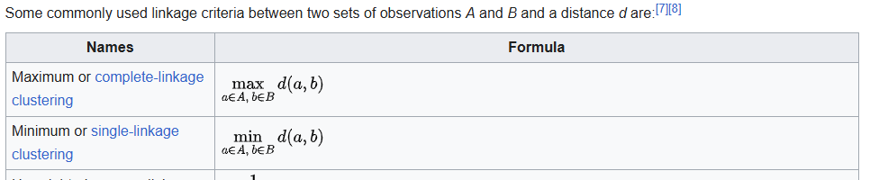

Slide 15
A
S
M
E
C

