Slide 1
PING PONG

Slide 2
Ping Pong
Start Menu
PLAYER VS PLAYER
AI VS PLAYER
INSTRUCTIONS
LEADERBOARD

Slide 3
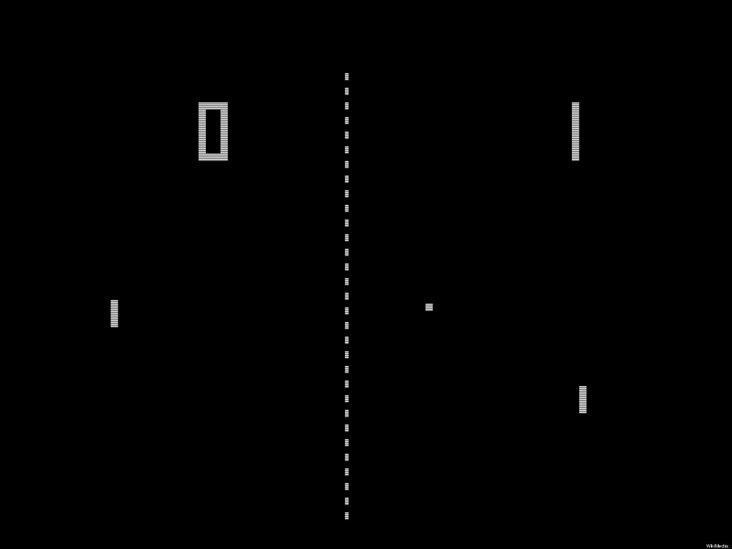

Slide 4
PLAYER 1 WINNER!
SCORES:
PLAYER 1: 10
PLAYER 2: 3
REPLAY

