Slide 1
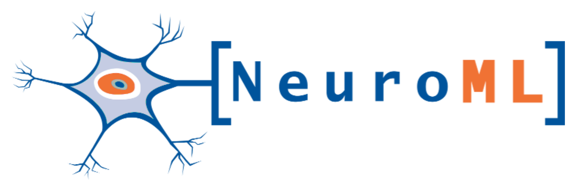
NeuroML is a standardised XML based language for computational neuroscience
Version 1.x allowed specification of:
- Detailed neuronal morphologies
- Ion channels
- Synapses
- 3D network structure
Version 2 features:
- Greater range of models
- Easier to extend using LEMS
Simulators
NEURON
GENESIS
MOOSE
Brian
Where is
NeuroML
used?
Initiatives
OpenWorm
Open Source Brain
Interoperability
PyNN
neuroConstruct
Morphological analysis/ generation
Cx3D
TREES Toolbox
NeuGen
Databases
Channelpedia
BBP NMC
NeuroMorpho
Allen Institute Cell Types DB
Notes:
1

Slide 2
Scope of NeuroML 2: Ion channels, synapses, cells, networks...
Notes:
1

Slide 3
NeuroML2 files set parameters
LEMS files define the dynamics
Notes:
1

Slide 4
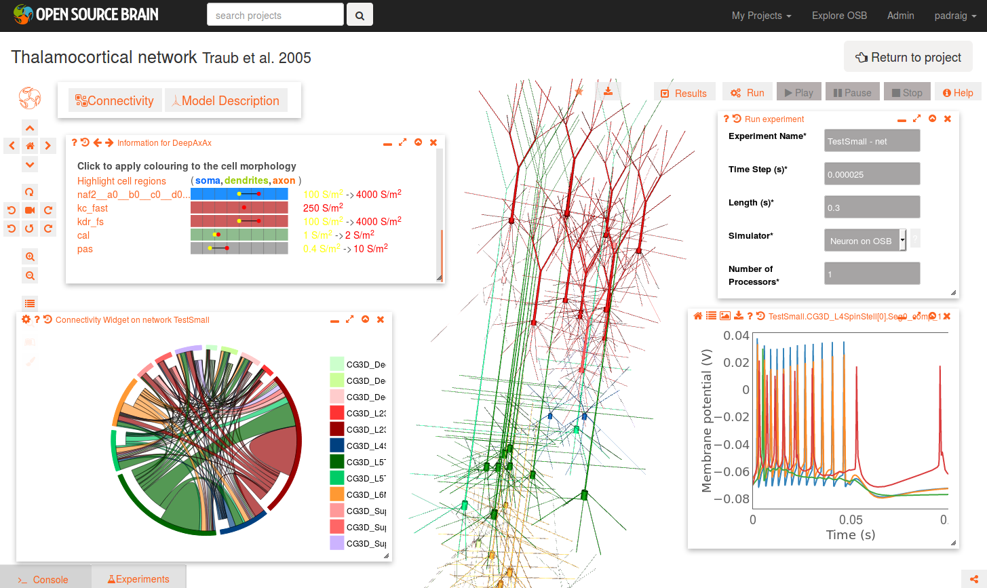
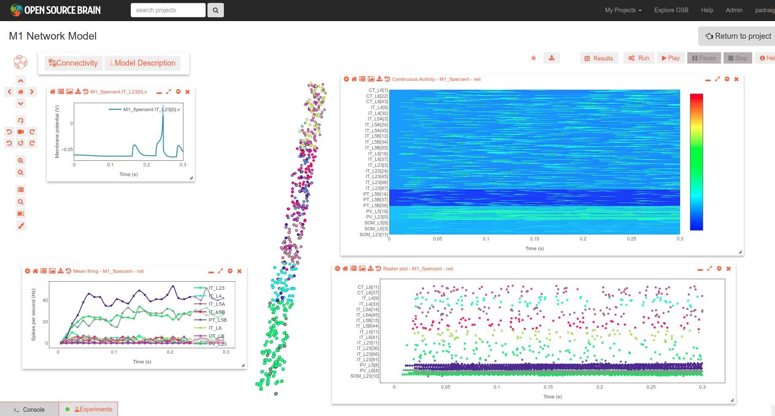
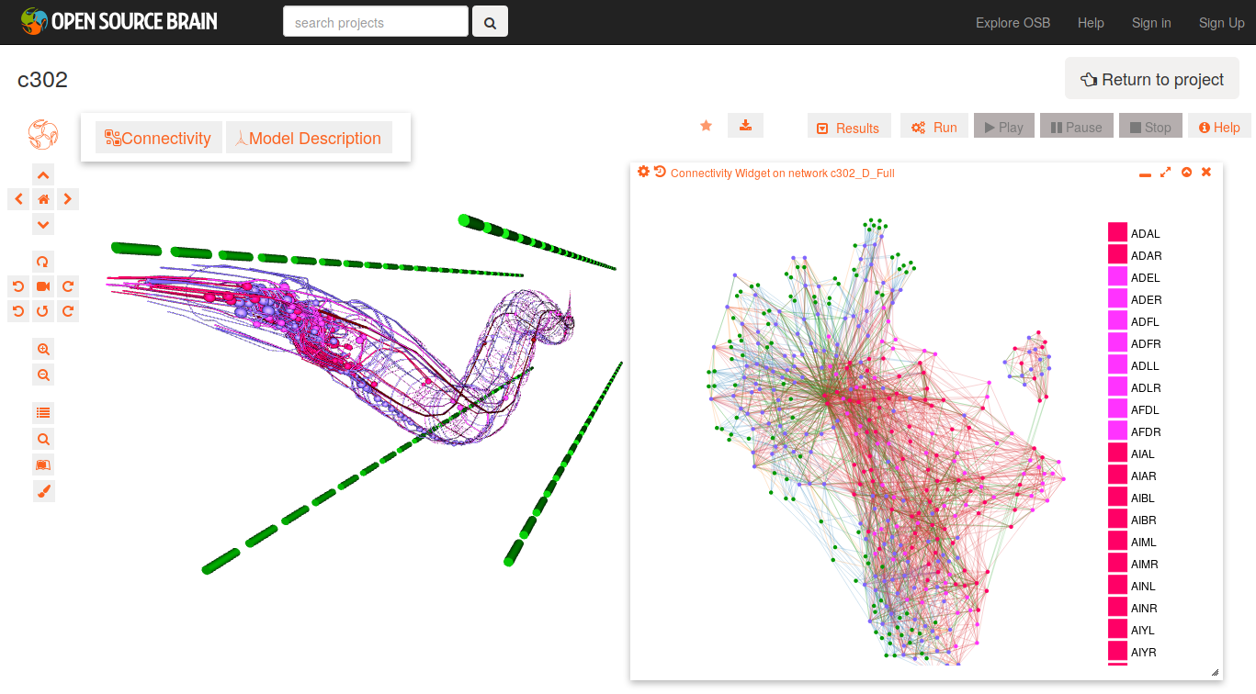
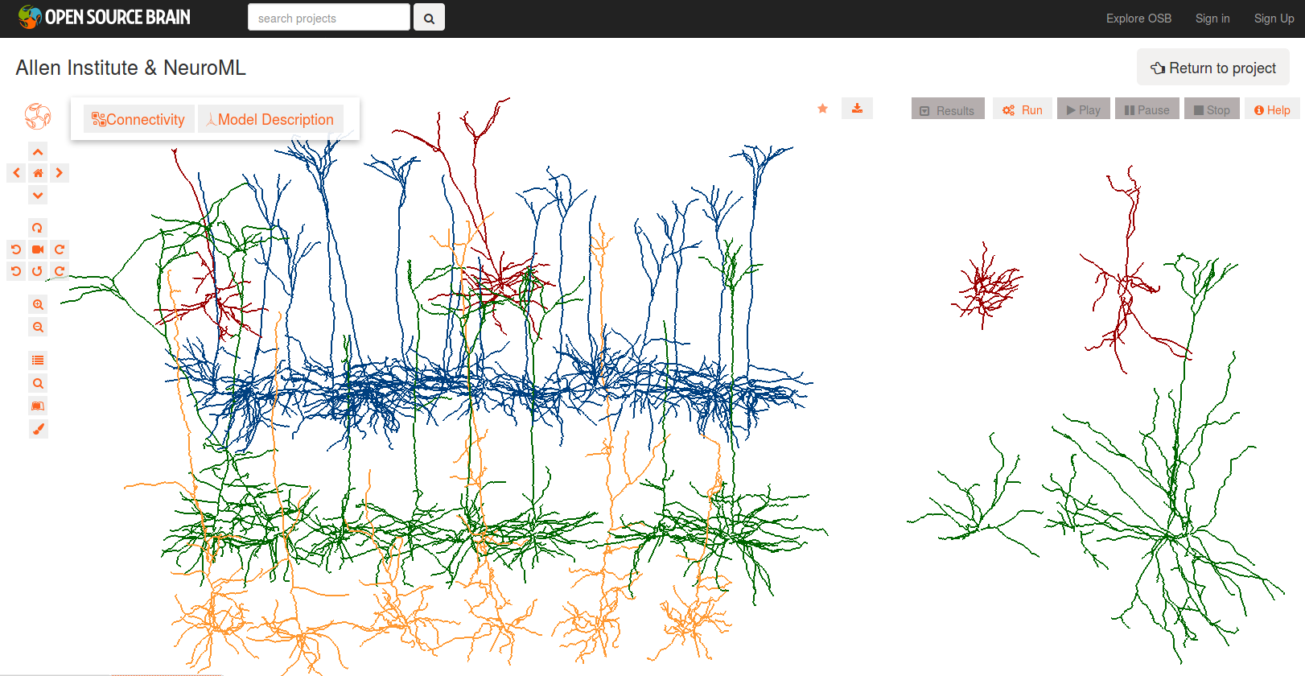

Where can I find (and visualize/analyse/simulate) NeuroML 2 models?
Try http://www.opensourcebrain.org!
Notes:
1

