Slide 1
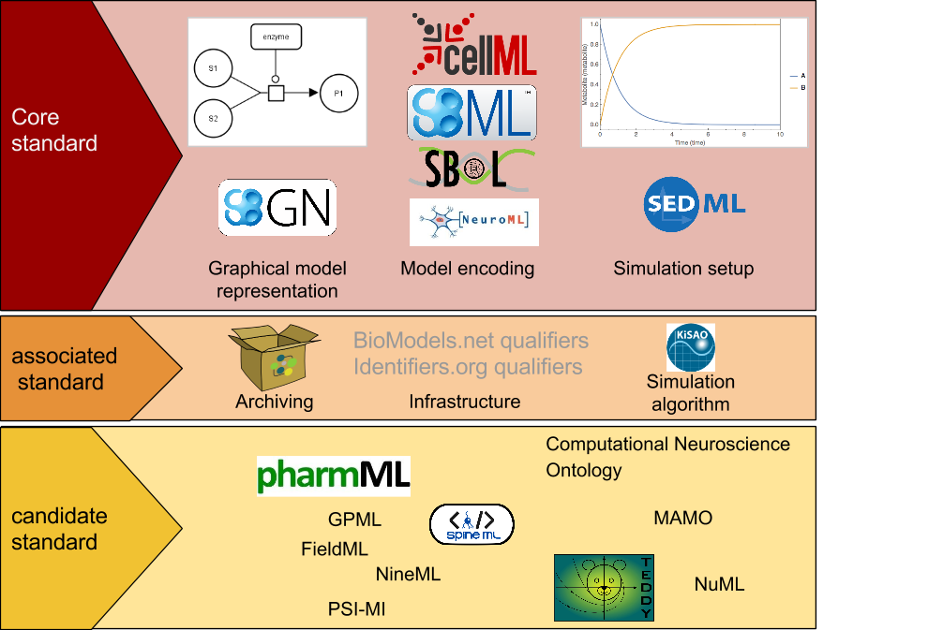
Levels of COMBINE standardisation

