Slide 1
all-in-one overview

Slide 2



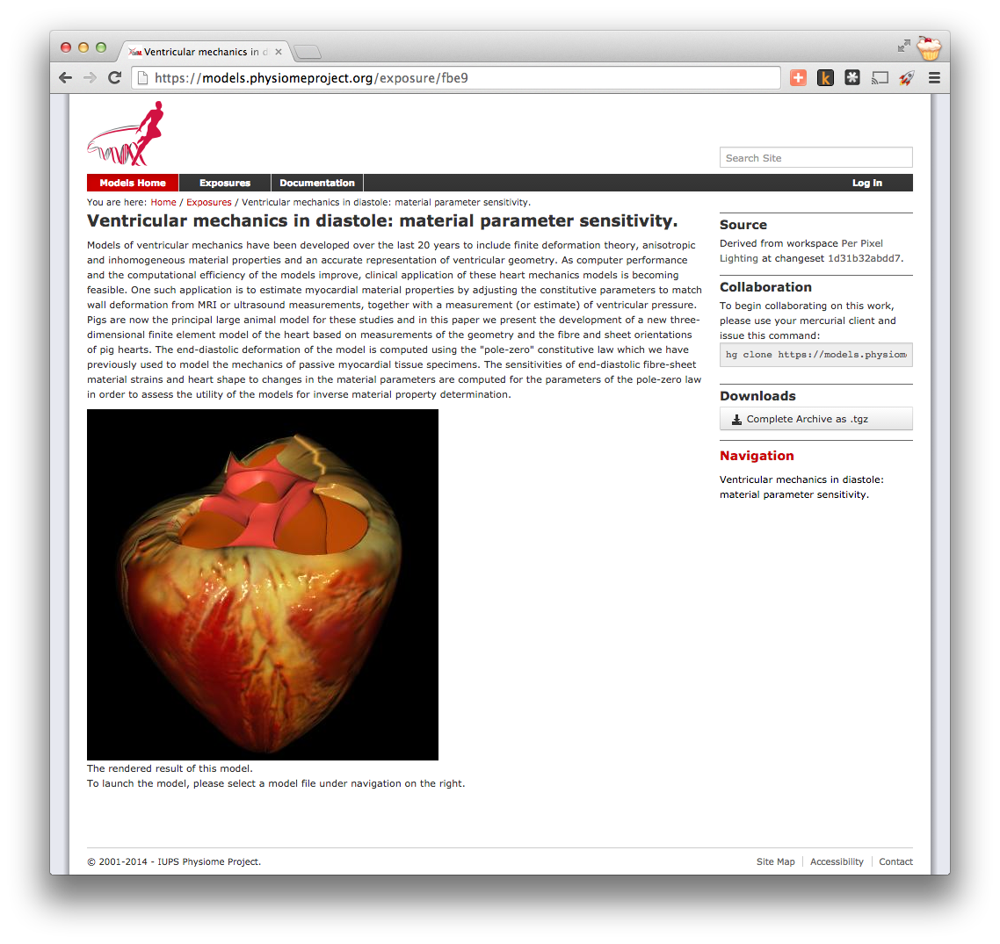
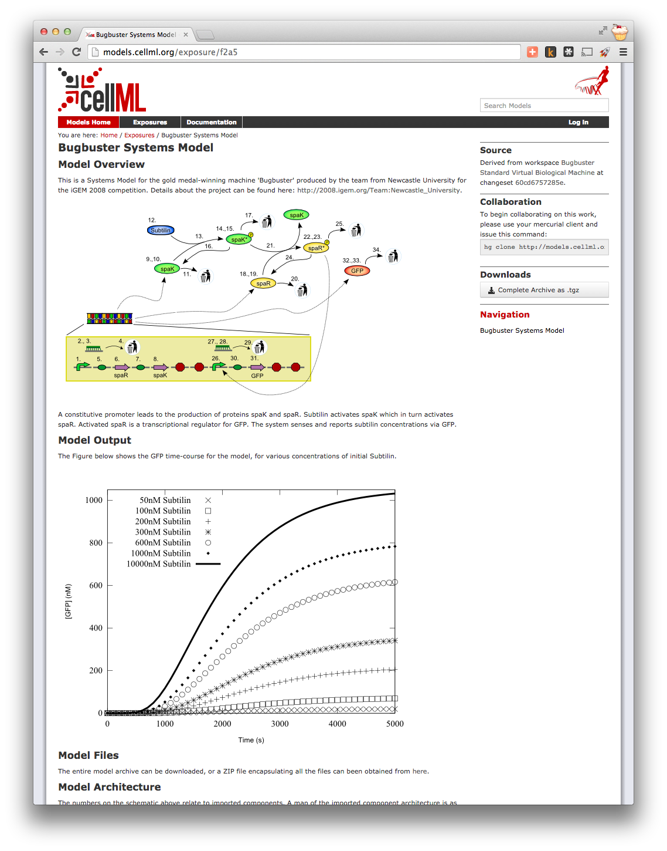
http://cellml.org/
Modular framework for encoding mathematical models:
focus on encoding models consisting of differential algebraic equations using MathML
math is the primary data, biological context, provenance, etc., provided through annotations using RDF
All quantities require physical units ensuring unambiguous conversion of numerical values where required
CellML models able to define hierarchies of modules to enable mathematical abstraction
Hierarchical modules able to be imported from external CellML models enabling reuse
Free and open repository available (https://models.physiomeproject.org/) supporting versioned model reuse, archiving, collaboration…

Slide 3
CellML + PMR + tools

Slide 4
http://cellml.org/
Modular framework for encoding mathematical models:
focus on encoding models consisting of differential algebraic equations using MathML
math is the primary data, biological context, provenance, etc., provided through annotations using RDF
All quantities require physical units ensuring unambiguous conversion of numerical values where required
CellML models able to define hierarchies of modules to enable mathematical abstraction
Hierarchical modules able to be imported from external CellML models enabling reuse

Slide 5

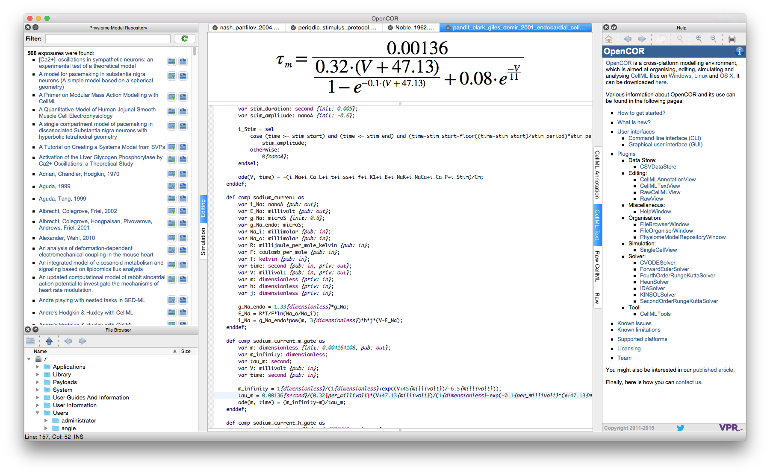
Key resources
Physiome Model Repository
https://models.physiomeproject.org
free and open repository supporting versioned model reuse, archiving, collaboration…
OpenCOR
http://opencor.ws
Open source cross-platform modelling environment
libCellML
https://github.com/cellml/libcellml
aims to become an easy to use library that will be useful to developers of CellML applications
replacement of the CellML API

