Slide 1
Cliff Walking – On/Off Policy
2023/04/12

Slide 2
Environment Introduction
Action
0: move up
1: move right
2: move down
3: move left
Observation
4x12 matrix
[3, 0] as the start at bottom-left
[3, 11] as the goal at bottom-right
[3, 1..10] as the cliff at bottom-center
Action Space | Discrete(4)
Observation Space | Discrete(48)
Reward
Each time step incurs -1 reward, and stepping into the cliff incurs -100 reward.

Slide 3
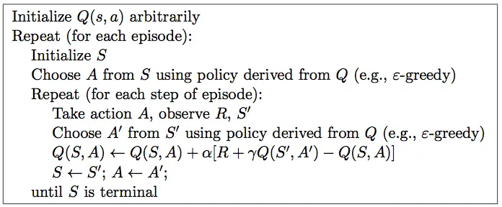
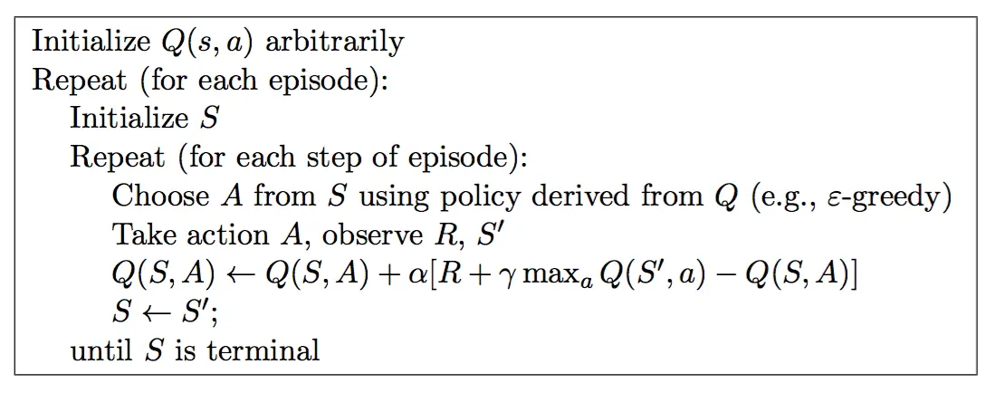
Algorithm
SARSA (on-policy)
Q-learning (off-policy)

Slide 4
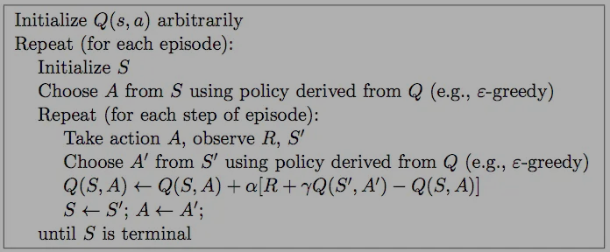
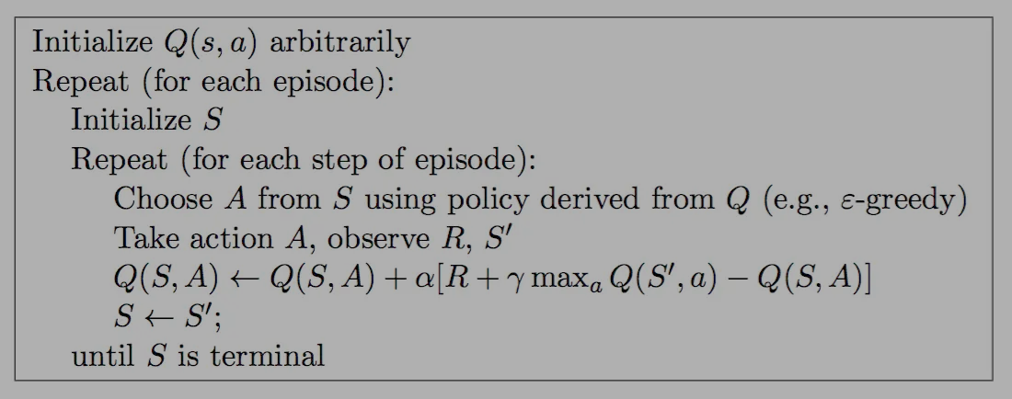
Algorithm
SARSA (on-policy)
Q-learning (off-policy)

Slide 5
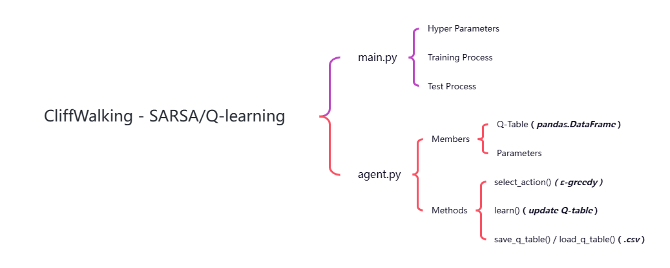
Structure

Slide 6
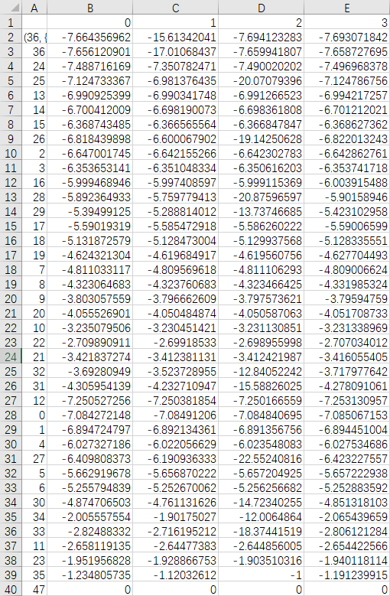
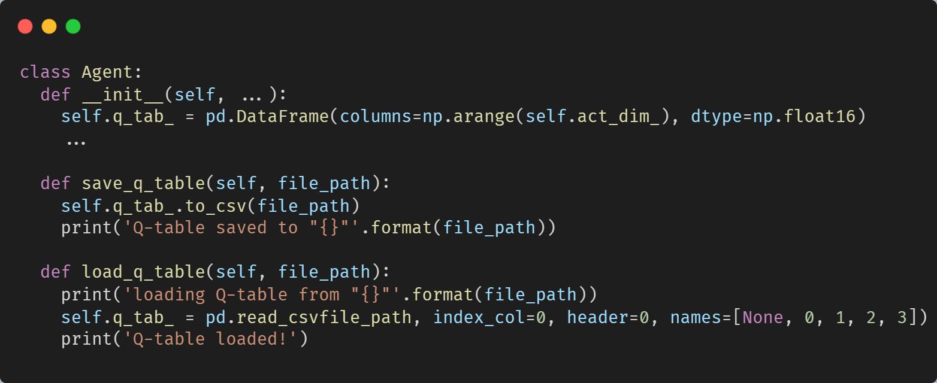
Implementation
Q-Table

Slide 7
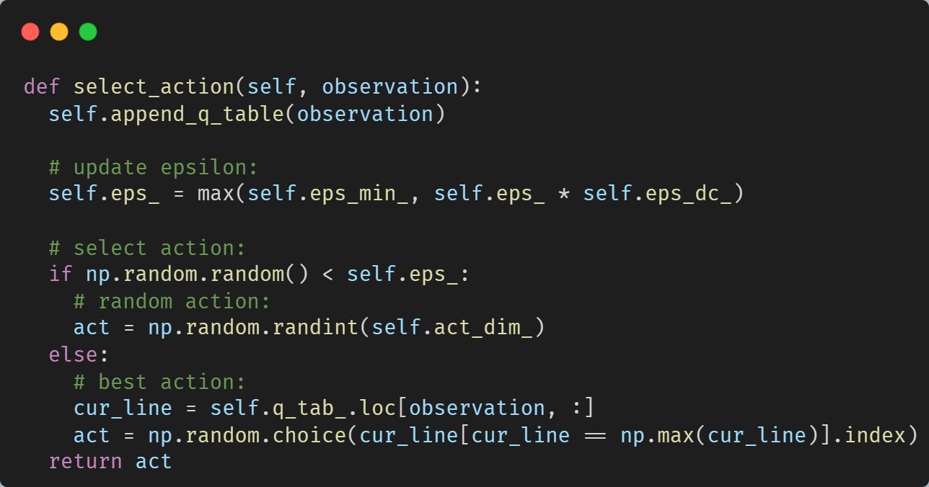
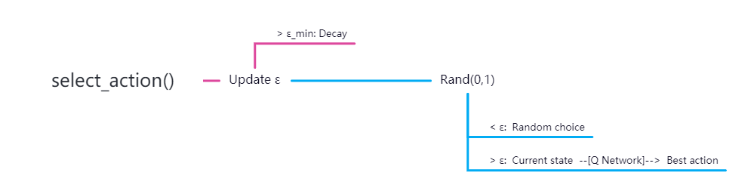
Implementation
Select Action

Slide 8
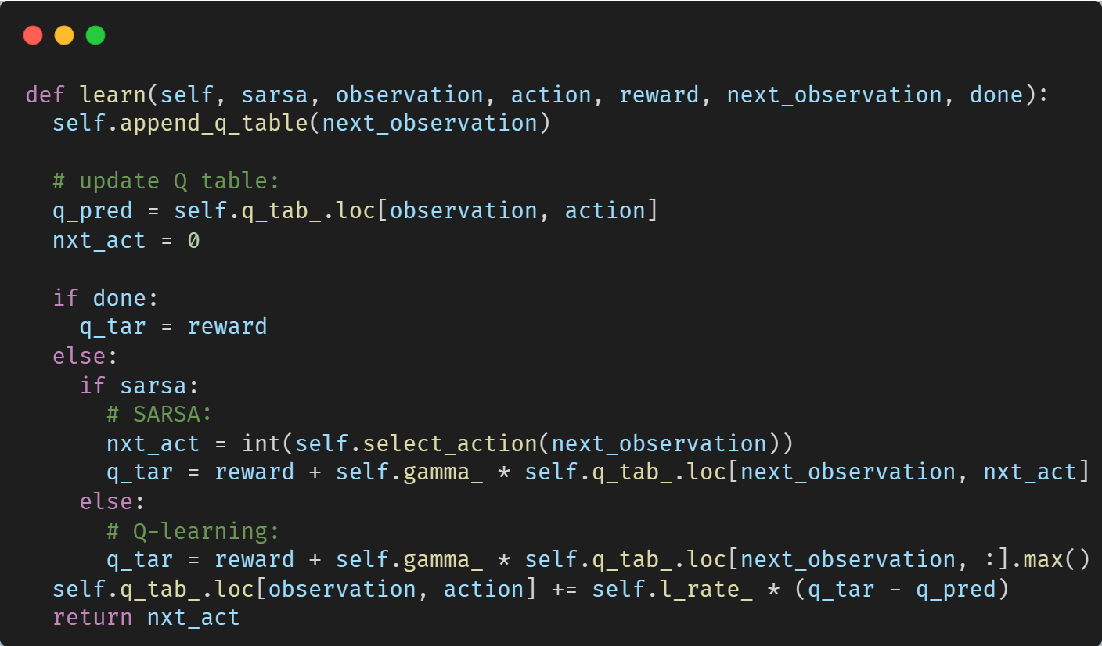
Implementation
Update Q-Table

Slide 9
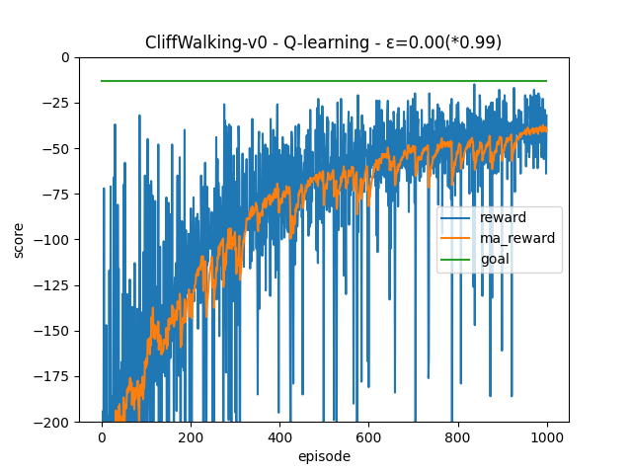
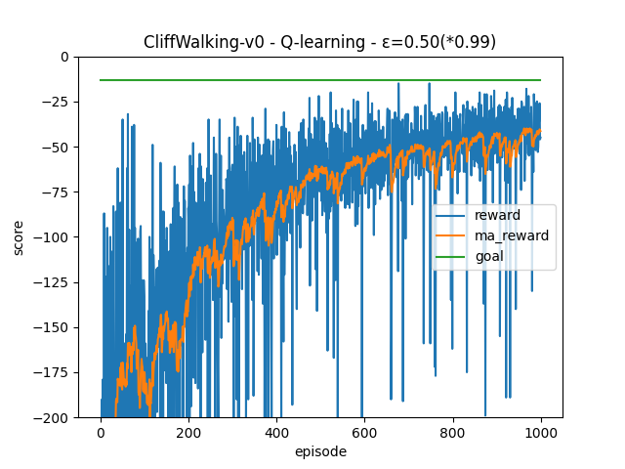
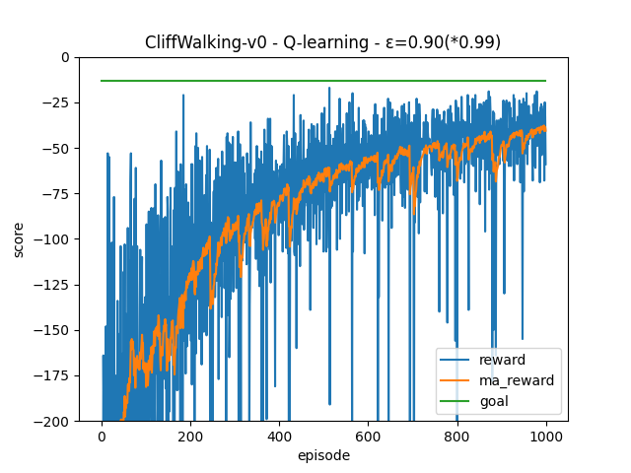
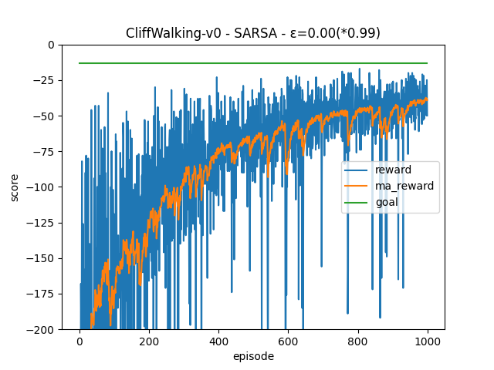
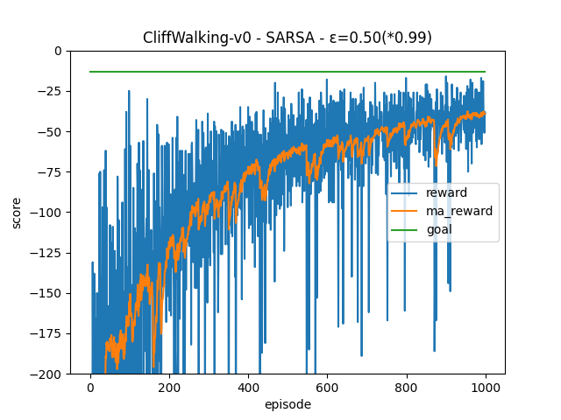
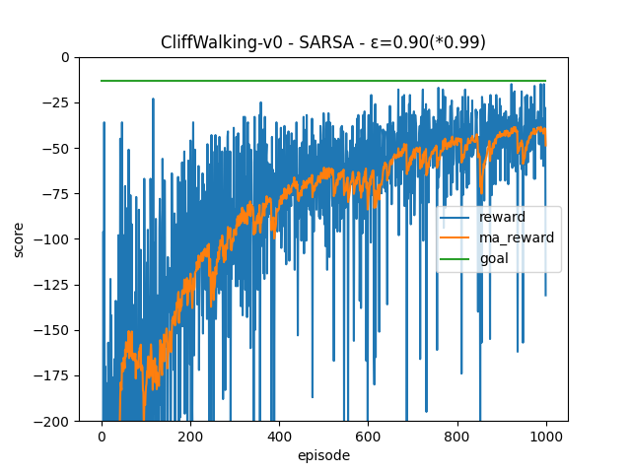
Result Comparison
ε Method | 0.00 | 0.50 | 0.90
Q-learning
SARSA

Slide 10
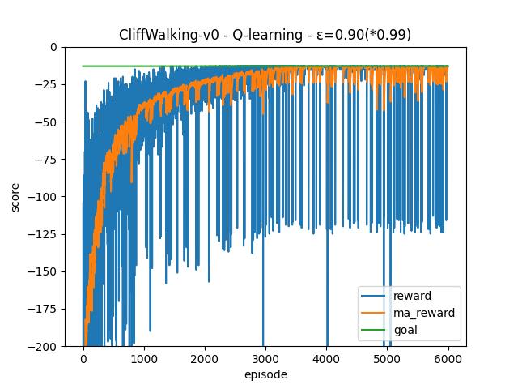
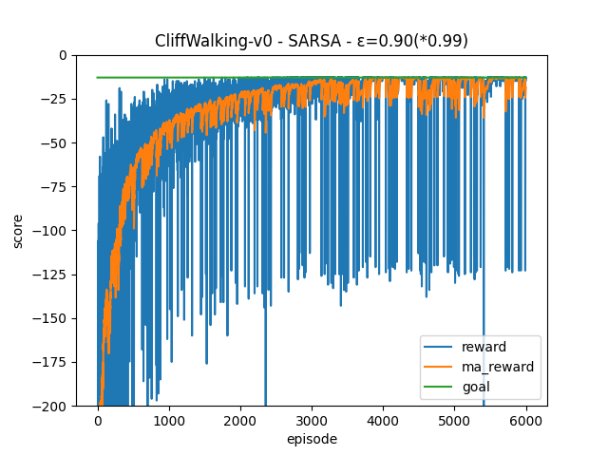
Result Comparison

Slide 11
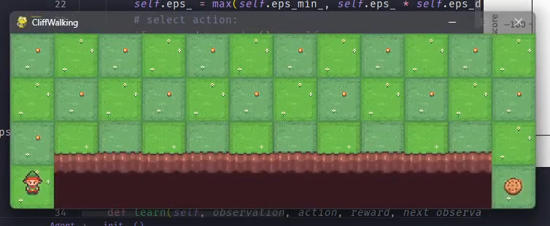
Test

