Slide 1
Rust-ifyng Data Collections for Compiler Optimization
CS Undergraduate Research Showcase 2024 October 17, 2024 (🎉)
Benjamin Ye
Slide content adapted from original MemOIR paper + slides by Tommy McMichen and Simone Campanoni
Notes:
I’m Ben. I’m a third year CS major.
Today is also my birthday, and I don’t think there’s a better way to spend it than yapping about compilers for the next 10 minutes.
This summer, I worked on implementing memory optimizations for [data collections in Rust] at the compiler level.
*** = animation

Slide 2
Compilers are really cool!
They do a lot of magical things we take for granted!
Translation
Abstractions
Variables
Control flow
Lowering
Languages (e.g. C++, Swift)
Architectures (e.g. x86, ARM)
Optimization
Compute
Speed
Energy
Space
Memory
Storage
Notes:
Compilers. They’re pretty cool.
They do a lot of things that we take for granted whenever we write programs.
***For example, they do translation.
At a micro level, they implement various abstractions that we usually don’t think twice about.
We store values in variables with convenient names, instead of registers like %r13 or %rax.
And, they allow us to use nifty control flow structures, like if statements or for loops, which makes it easier to write complex code.
At a more macro scale, they translate programming languages, such as C++ or Swift, to machine code for different architectures, like x86 and ARM.
***Independently, they also perform optimization.
This can be at the compute level, such as runtime speed and energy efficiency.
It can also be at the space level, such as with memory and storage efficiency.

Slide 3
Compilers are really cool!
They do a lot of magical things we take for granted!
Translation
Abstractions
Variables
Control flow
Lowering
Languages (e.g. C++, Swift)
Architectures (e.g. x86, ARM)
Optimization
Compute
Speed
Energy
Space
Memory
Storage
Notes:
Now, memory optimization was the focus of what I worked on this past summer, and it’s historically an underexplored area of compiler optimization.
But what makes it so difficult?

Slide 4
Optimizing memory is hard
std:unordered_map<int, int> &table; table[0] = 10; table[1] = 20;
print(table[0]);
?
No production C/C++ compiler can propagate 10 to the print statement.
Notes:
Let’s take this example program.
It initializes a hash table, maps 0 to 10, maps 1 to 20, and prints what 0 maps to.
Now, can anyone tell me what this program prints? Just shout it out.
(wait for someone to respond)
Hearing a lot of 10s. ***Congratulations! You’re smarter than every production C or C++ compiler.
This might seem like a trivial example, but ***no production C or C++ compiler can propagate 10 forward to the print statement. But why does this occur?

Slide 5
Optimizing memory is hard
std:unordered_map<int, int> &table; table[0] = 10; table[1] = 20;
 | 10
(a) no reallocation
(b) reallocation
realloc?(table, ...); rehash?(table);
20 | 10
10 |  |  | 20
print(table[0]);
Which address?
Notes:
Well, it turns out that what appears as just a simple write action is actually a complex memory operation that is abstracted away.
***Whenever we write to a new index in the hash table, there’s a chance a reallocation of memory and a rehashing is necessary, since the compiler doesn’t know how big it is.
***This process creates ambiguity in what table[0] points to, a problem which the compiler cannot deal with.
Since the pointer could have changed, the compiler can’t propagate 10 forward to the print statement in a deterministic fashion, as this is a runtime problem.

Slide 6
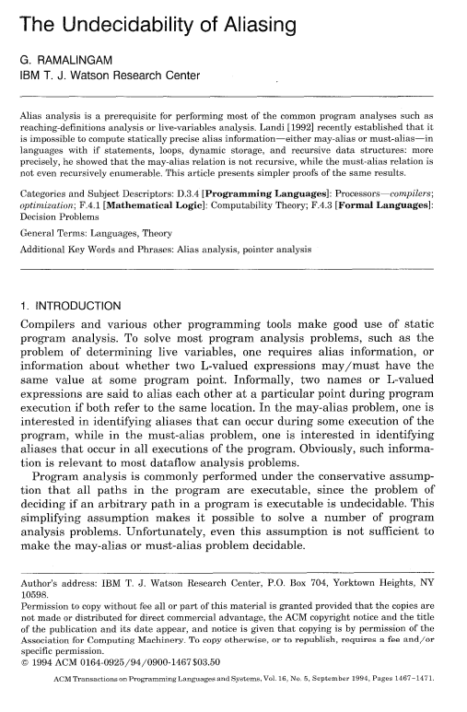
Optimizing memory is hard
std:unordered_map<int, int> &table; table[0] = 10; table[1] = 20;
realloc?(table, ...); rehash?(table);
print(table[0]);
Notes:
This problem of having one reference potentially refer to multiple different pointers is known as the “aliasing problem”.
There is no known way to force your way through it at compile time. It’s been pretty rigorously proven to be undecidable.

Slide 7
Problem
Data collections are high-level abstractions of memory.
These abstractions are prematurely lowered before optimizations occur.
Notes:
Fundamentally, the problem is that data collections are high level abstractions of memory.
From our perspective as programmers, whenever we’re solving leetcode problems, we can just use a dynamic array or a map of some sort.
But at the end of the day, operations on these memory collections encapsulate a lot of composed memory operations.
And, since these abstractions are built into the semantics of a programming language, they’re prematurely optimized into their constituent memory operations before we’re even able to analyze the big-picture logic.

Slide 8
Problem
Data collections are high-level abstractions of memory.
These abstractions are prematurely lowered before optimizations occur.
How can we maintain information about these abstractions at the optimization level?
Notes:
What we need, is a way to maintain information about these data collections that we can use at the optimization level.

Slide 9
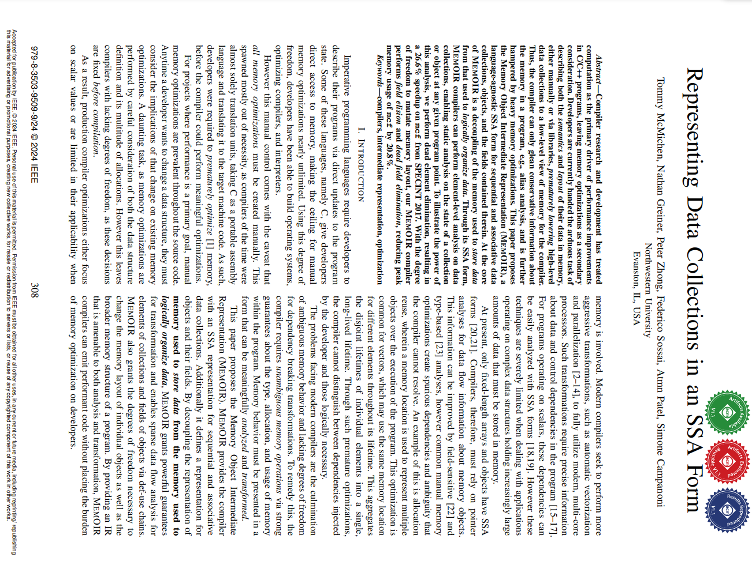
MemOIR
Memory Object Intermediate Representation
Intermediate compilation target designed for memory optimization
Separates memory use from memory structure
Preserves higher-level information
Allows us to explore new optimizations!
Notes:
And this is where MemOIR comes in.
MemOIR is short for Memory Object Intermediate Representation.
It serves as an intermediate compilation target between a language and machine code that is designed specifically for memory optimization.
By separating the use of memory from the structure of memory, we can preserve information about a collection at the optimization layer.
This allows us to leverage the structure of memory to explore previously inaccessible optimizations!

Slide 10
Data collections
List
Set
Array
Map
Sequential
Associative
Notes:
The data structures that we care about can be grouped into two categories.
First, you have data structures that are contiguous in index space, like lists and arrays.
These can be bundled as ***“sequential” data types.
Then, you have data structures that are relational. They store a non-sequential relation between key-value pairs.
We can group these as ***“associative” data types.
There are other data structures, such as trees and graphs that aren’t covered here just for project scope reasons.
But, this still gives us a lot to play with.

Slide 11
Pragmatics: guarantees
Strong memory guarantees required
var
i = 9;
Notes:
However, MemOIR poses a new problem of pragmatics.
For a program to be lowerable into MemOIR, two strong memory guarantees must be satisfied.

Slide 12
Pragmatics: guarantees
Strong static types
Strong memory guarantees required
Fixed, rigorously enforced type
int
i = 9;
Notes:
First is the code must be strongly, statically typed. Variables must have an unchangeable type attached to them, such as sized or unsized number, Boolean, character, etc. And they must be rigorously enforced by the language. Sorry, typescript.

Slide 13
Pragmatics: guarantees
Single reference
Strong static types
Strong memory guarantees required
&i
int
i = 9;
&i
Only one reference that modifies some data at any point
Notes:
Second is the code must be singular reference.
There can only be one active reference that modifies the same data at any point.
***We can make a new one if an existing reference goes out of scope, ***but they cannot exist at the same time.

Slide 14
Pragmatics: C/C++
A little clunky
Strong static types? Yes
Single reference? Manually
Result: annoying for developers to use!
reference
int foo
reference
reference
Perfectly ok! (bad)
Notes:
Now, for C and C++, while it has strong static typing, single reference must be manually enforced.
This is problematic because even if the information about a collection can be kept at the optimization layer, the lack of strict guardrails means single reference must be manually enforced to access the full array of MemOIR optimizations, creating another layer of friction for developers.
If only there was a language that we could use which enforced single reference in some way…

Slide 15
Pragmatics: Rust
Ownership system
Immutable vs mutable variables
Immutable: any number of references
Mutable: only one active reference
Elides aliasing in variables
MemOIR allows us to extend that to collections!
immutable reference
i32 foo
mut i32 bar
mutable reference
immutable reference
mutable reference
immutable reference
Notes:
This is where we turn to Rust. The most admired programming language according to StackOverflow’s 2024 survey, famous for its memory safety.
The feature responsible for this, its ownership system, also turns out to be very useful for us.
Put simply:
Variables in rust may either be immutable or mutable.
Immutable variables may have any number of immutable references, but mutable variables may only have one mutable reference alive at any point.
This property of the language elides aliasing in variables. Immutable references don’t alias because no data is modified, and mutable references don’t alias because only one of them can exist at a time.
This is really good for MemOIR, since we can extend those guarantees for collections. By effectively treating collections as variables, Rust’s single-reference guarantees can be extended to collections, allowing us to run comparatively more aggressive memory optimizations.

Slide 16

Pragmatics: Rust
Checks both boxes
Strong static types? Yes
Single reference? Yes
Borrow checker enforces ownership
Alias checking moves from programmer to compiler
Notes:
Additionally, Rust provides some other features that play quite nicely with MemOIR.
First, it has both strong static typing and single reference properties that are enforced properly, which means it checks both boxes for MemOIR.
Second, Rust’s borrow checker enforces the aforementioned ownership system, which moves the burden of checking for aliasing from the programmer to the compiler. That solves the problem created by MemOIR!
And third, unlike C or C++, it has a really cute mascot :)

Slide 17
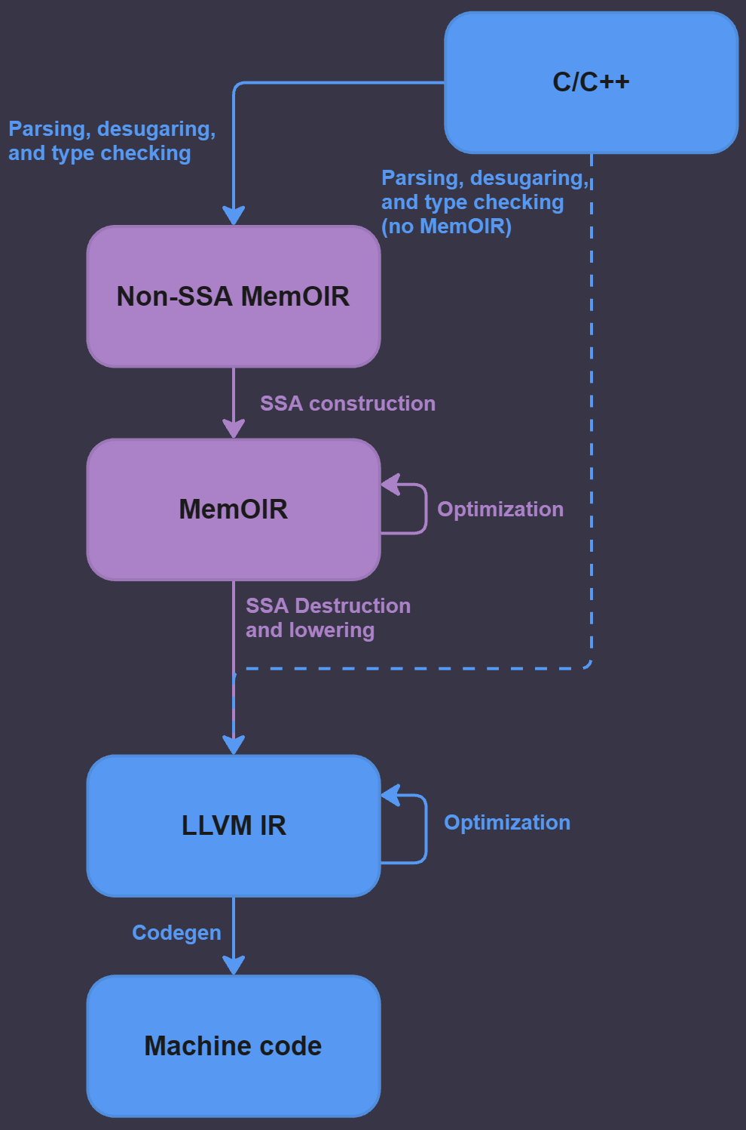
Fitting rust in
This is just Clang!
This lowers to LLVM!
Blue = LLVM/Clang
Purple = MemOIR
(simplified)
Notes:
So, how does Rust fit into MemOIR? We need to start with the compilation chain for C and C++.
Shown here by this scary flowchart is how MemOIR slots into Clang.
I’m not going to get too into the weeds on this, but there are two key observations to be made:
The entry point to MemOIR is also Clang. It is, effectively, just LLVM with MemOIR function symbols.
The exit of MemOIR is to LLVM IR.
These two observations mean that the infrastructure is very plug-and-play, which makes implementation theoretically a breeze.

Slide 18
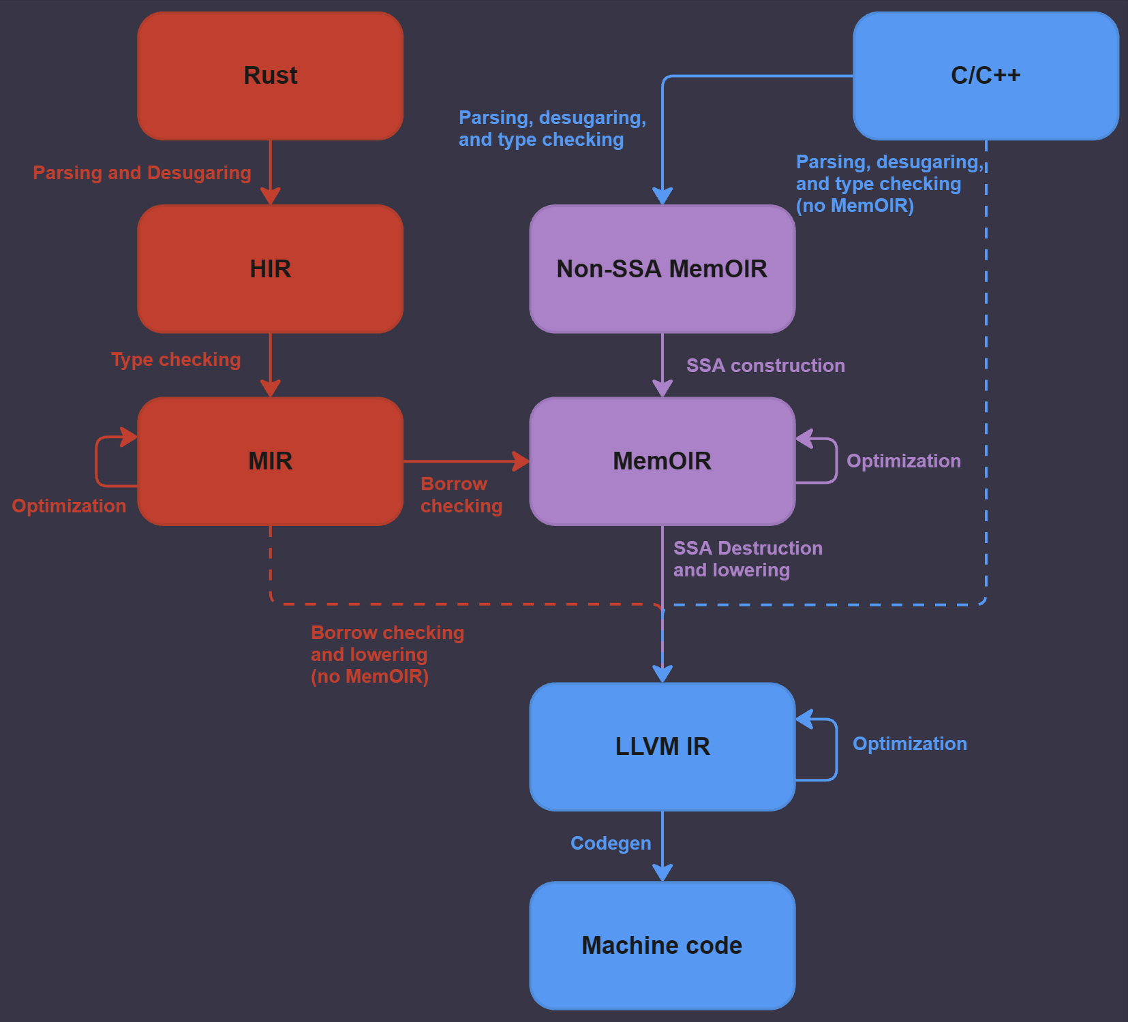
Fitting rust in
Blue = LLVM/Clang
Purple = MemOIR
(simplified)
Orange = Rust
Notes:
The way Rust slots in is very similar.
We can exploit the fact that Rust uses the LLVM toolchain by generating MemOIR symbols using the existing frontend infrastructure.
This is great, because the existing MemOIR compilation infrastructure can be utilized from there.
Additionally, one benefit is that Rust allows us to directly generate SSA MemOIR, which saves us a step in the compilation process!

Slide 19

Fitting rust in
Blue = LLVM/Clang
Purple = MemOIR
Orange = Rust
(simplified)
Green = Ben’s work
Notes:
What I did over the summer involved the green arrows shown here, and making sure it compiled down smoothly.

Slide 20
Implementation mechanics
rust-memoir
Library/language extension
As close to a 1:1 mapping of Vec and HashMap as possible
Generates MemOIR symbols
Occasional extra type specification required
vec![2, 3, 7, 9]
some_vec.iter()
HashMap::new()
some_map.insert(5)
seq_u32![2, 3, 7, 9]
some_seq.iter()
Assoc::<i32, u64>::new()
some_assoc.insert(5)
Notes:
Now, the actual mechanics behind *implementing* the Rust front-end.
Just like with C and C++, a language extension is required, in the form of a library. It’s very creatively named “rust-memoir”.
This is necessary to generate MemOIR symbols so we can reuse the existing infrastructure.
The goal was to get as close to a 1:1 mapping of the dynamic array and hashmap classes offered in Rust as possible.
As shown on the slide, it’s actually very ergonomic! There’s just a little bit of extra type specification required here and there, for Rust-related reasons.

Slide 21
Implementation mechanics
References
Overloading operators is awkward
out = some_vec[0];
some_vec[0] = in;
let mut some_seq_0 = SeqRef::<i32>::new(&some_seq, 0);
out = some_seq_0.get();
some_seq_0.set(in);
Notes:
Of course, there’s one catch due to the nature of Rust.
The language allows you to override operators, so long as the function signature remains the same.
This caused a problem when implementing references, as the function signature had to change a little. Therefore, a proxy object was necessary to make references work properly.
However, that’s a pretty small price to pay to access the entire array of MemOIR optimizations, and since it’s just a semantics issue, we can get around this in the future pretty easily with a Rust-to-Rust transpiler!

Slide 22
Implementation mechanics
Notes:
Now, getting it all to compile properly. This was definitely harder than initially expected
Even though both languages depend on LLVM for their toolchains, there’s a lot of minute differences in the way Rust and C++ handle their compilation processes which caused a lot of pain.

Slide 23
Implementation mechanics
Borrow checking was fine
Pointers as integers????
Notes:
The first place which was annoying was lowering from MIR to MemOIR.
***Borrow checking went fine. So what’s the problem?
***Well, it turns out that there’s unexpected regression in the code that occurred because Rust was treating pointers as integers. This is something that I suspect has something to do with Rust’s FFI doing something weird with pointer types, but more investigation is required.

Slide 24
Implementation mechanics
Rust std stored in .rlib
Missing allocator bindings
Notes:
The second place that there were issues was, surprisingly, code generation.
First, Rust stores its libraries in .rlib (dot r-lib) files, which are its own proprietary format. This was annoying because the standard library was also stored in this file format.
Second, the LLVM that was being lowered was missing memory allocator bindings. This occurred because Rust generates them during codegen, so they needed to be manually created by me and linked in.
But, after working through all of these issues, the compilation chain emits machine code that runs!

Slide 25
Future work
Get formal test runner/benchmarks working
Extend frontend for structs/objects
Misc. rust ergonomics
Notes:
Finally, future steps forward (and what I will be working on for the foreseeable future).
First, the test runner and benchmarking. It’s another situation of rust and memoir not getting along, except this time the issue just hasn’t been fully debugged yet.
Second, extending the library to work with structs or objects. The original paper has a proposal for how this can be implemented, but it’s a little bit of a daunting task because they require another layer of indirection which is messy.
Finally, miscellaneous rust ergonomics. Things such as integrating the compile script into cargo, which is rust’s package manager; reducing the amount of type specification necessary throughout; or writing that reference transpiler I talked about earlier. Just these sorts of things that, while not strictly necessary for function, make it easier to use

Slide 26

Thank you!
https://golf0ned.github.io/
https://mcmichen.cc/files/MEMOIR_CGO_2024.pdf
Notes:
Thank you all for listening!
The rust-memoir repo is currently not opensource yet, but if you’re curious about anything I talked about, feel free to reach out to me.
If you found any of this remotely interesting, I suggest you also give the original MemOIR paper a read. It’s really cool, and provides a lot of context on both the barriers to memory optimization and the actual optimizations performed by MemOIR.
I’ll also probably be posting these slides to my website eventually in case you want to look at these materials more closely.

Slide 27
Image references
https://dl.acm.org/doi/pdf/10.1145/186025.186041
https://mcmichen.cc/files/MEMOIR_CGO_2024.pdf
https://rustacean.net/

