Slide 1
AI Camera Meeting
8/5/2026

Slide 2
Review of Experience
VS Code IDE
GitHub
C++
Arduino / ESP32
KanBan
Software Testing
Agile Methodology

Slide 3
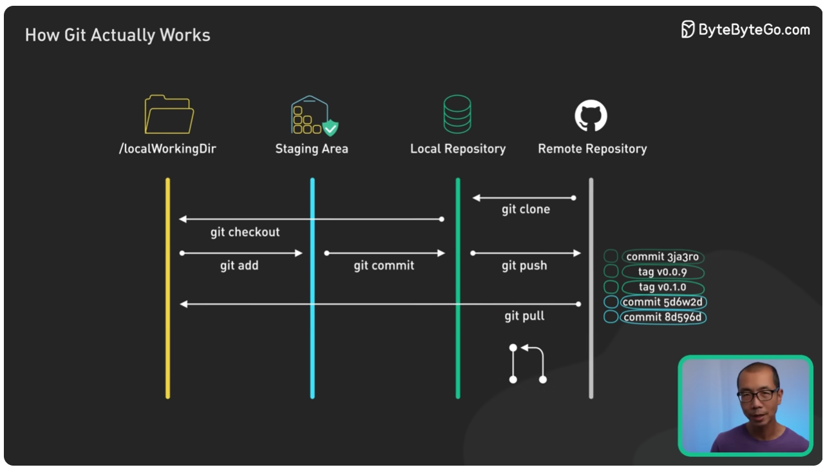
How Git Works: Explained in 4 Minutes

Slide 4
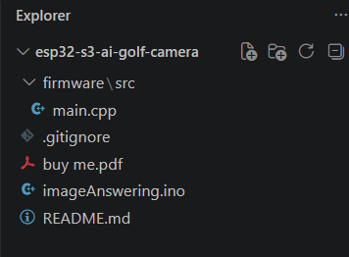
Work Set-Up
Download and install VS Code IDE
  Download Visual Studio Code - Free AI Code Editor for Mac, Linux, Windows
Download and install PlatformIO Arduino Development
  PlatformIO IDE - Visual Studio Marketplace
Connect GitHub Source Control Plug-in
Explorer > Clone Repository > Sign into Github AI Camera (Group)
VS Code > C/C++ Extension Pack

Slide 5
Kanban Board Review
(Placeholder)

Slide 6
Actions 8/5
TDD – Test Driven Development slide (Dan)
Joey re-introduction (first slide)
Do we want to buy hardware and test the example code?
Formal Development Environment Guide (Jonathan)
ESP 32 vs Raspberry Pi trade study (Alex)
  AI, Resolution, cost, weight, size, amazon rating, etc…

Slide 7
Back-up

Slide 8
Code Flow
Score:
5 – inner loop
2 – outer loop
0 - miss
Initialize – include libraries
AI Prompt:
“Is the new ball inside the target”
Set Up: “power on” camera and AI
Ball is Hit (No Longer Identified in “Tee box”)
Ball is Identified in “Tee box”

