Slide 1
Drinking from the Fire Hose
One year into Incident response
Presented by Golgothus (Zach, He/him)

Slide 2
Whoami: Golgothus / Zach (he/him)
Work Experience
Cyber Security Associate Engineer (Incident Response, 1 year)
Previously Endpoint Protection (3 years)
Help Desk UTA (1 year)
Accreditations
CySA+
Pentest+
Social Media
ghost$ (golgothus.tech)
Golgothus (Zach He/Him) (@Golgothus) / Twitter

Slide 3
In the Beginning
Incident Response is a tough, but fun job
Knowing your environment is beneficial
Logs are your life source
Every organization is different
Know your process
“Who, What, When, Where, Why”
Take notes!
“Teamwork to makes the dream work”
Notes:
From personal previous experience, IR has (thankfully) felt a lot like a CTF / Blue vs. Red team Battleground
Having worked / spent time in our end user department, I have the benefit of knowing some of the applications, software, and developers within our environment
Lack of logging? Reach out to application owners to work on log ingestion to your SIEM
Just like grade school “Who, What, When, Where, Why”
This will need to be a bit more defined, such as knowing what logs / resources to review to obtain further information, but this is a super baseline starting point
Markdown, OneNote, Notation, Joplin are your friend
Find a mentor if you’re in need of one (Tanya Janca, Tanya Janca (@shehackspurple) / Twitter, runs #cybermentoringmonday on Twitter)

Slide 4
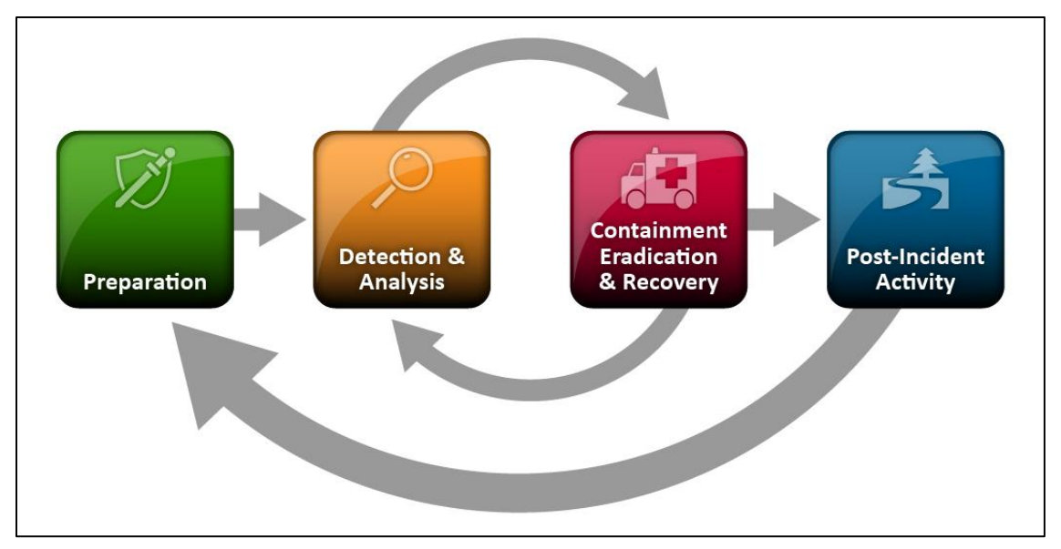
In the Beginning (Cont.)
Incident Response Process:
Notes:
Retrieve useful artefacts from your alerts / detections
Know where to start:
Identify host, user, site info
Review / Verify Network Activity
Take necessary actions (block IOC’s, delete accounts, etc.)
Post-mortem / lessons learned if necessary

Slide 5
Know Your Scope
Advice I’ve received:
Know the difference between a security incident vs. security compliance
Verify your alert activity
Sometimes the “NMAP Scan” won’t be “true positive” activity
No point in burning cycles to investigate known normal / benign activity
Keep communication channels open, and get to know your team
Notes:
Being able to recognize something that’s a security incident is vital
No need to spend a day investigating false positives / benign activity, this time could be spent developing better / tuning detections
“in case of emergency break glass” – if a specific application is exposed to the public, or compromised do you know which team to contact?

Slide 6
Tools of the trade
URL
Remnux + Burpsuite to review re-direct links for payloads
URL Redirect Checker | WhereGoes
URL and website scanner - urlscan.io
Shodan Search Engine
Hash
VirusTotal - Home
AlienVault - Open Threat Exchange
ANY.RUN - Interactive Online Malware Sandbox
Notes:
Retrieve useful artefacts from your alerts / detections
Know where to start:
Identify host, user, site info
Review / Verify Network Activity
Take necessary actions (block IOC’s, delete accounts, etc.)
Post-mortem / lessons learned if necessary
I’d like to draw specific attention to sites like any.run / VirusTotal. Be careful not to upload files which may contain company IP (Intellectual property), data specific to a customer / client, or even data which might contain a potentially unknown malware sample.
These files will be publicly available once they’re uploaded and may require professional / premium support in order to have files removed if they were accidentally added to the specific platform.
VirusTotal - Contact us - private-upload

Slide 7
Work Smarter, Not Harder
If documentation doesn’t exist, make it
Prevent alert burnout by reducing the noise
Incorporate searches / sub-searches to enrich your data
Throwback to notation. Playbooks, ‘case templates’, or case management systems can be priceless to your team
https://twitter.com/Cyb3rSn0rlax/status/1549179670406512641
Notes:
Why re-type the same thing multiple times? If you can make a one-line script, go for it!
Example, one I use often is a get-aduser for powershell, using LDAP filters to get user info
Another example you could look to create, pull the VirusTotal information from an observed hash, or URL
Case / incident management systems such as:
Cortex Incident Case Management - Palo Alto Networks
Splunk SOAR Splunk SOAR | Splunk
TheHive TheHive Project (thehive-project.org)
Why are these valuable? Previous incident correlation, data enrichment, automated workflows
i.e. pulling a hash reputation from VirusTotal
i.e. pulling a user’s information from Active Directory
i.e. pulling an endpoints network information and network objects from your firewall policy

Slide 8
The Future is Now
Don’t spread yourself to thin
It’s OK to specialize, just share the knowledge
Current outlook
Azure Pipelines and Azure DevOps
Azure Kubernetes Service
Azure LAWS / Sentinel
Kubernetes / Docker
Notes:
While investing in “your future” is and can be fun, it’s important to make sure for yourself and your team, that you do not have a “single point of failure”.
After all, we like to take our vacations without notifications from work, right?
Currently working for the Azure 104, Azure Administration
Tons of great takeaways just going through the Learn / Docs.Microsoft.com site - Microsoft Certified: Azure Administrator Associate - Learn | Microsoft Docs
Cloud platforms (Azure, AWS ‘Amazon Web Services’, GCP ‘Google Cloud Platform’), Docker, Kubernetes, ‘Micro-services’
Supply-chain attacks, which are partial to exploitable libraries / packages currently being hosted or deployed in active applications
Pipelines and automated deployments via CI/CD, are all susceptible to attacks which will eventually, if not already, require IR / Security measures being put into place

Slide 9
The Future is Now (cont.)
Detections as Code (DaC)
Splunk has a few solid blog posts on this (referenced in notes)
Usage of streamlined processes to create refined detections
CI/CD Pipeline
Azure Boards help correlate tasks to specific Pull Requests, this can be useful for Change Advisory Boards and metrics
Automate updates and deployments via the DevOps Pipeline
Review modifications to branches, code, environment from a single pane
Notes:
Detections as Code Splunk:
- CI/CD Detection Engineering: Splunk's Security Content, Part 1 | Splunk (https://www.splunk.com/en_us/blog/author/jhernandez.html)
- CI/CD Detection Engineering: Splunk's Attack Range, Part 2 | Splunk (https://www.splunk.com/en_us/blog/security/ci-cd-detection-engineering-splunk-s-attack-range-part-2.html)
- CI/CD Detection Engineering: Failing, Part 3 | Splunk (https://www.splunk.com/en_us/blog/security/ci-cd-detection-engineering-failing-part-3.html)
CI/CD Pipeline:
Continuous integration / Continuous Delivery
Enables defenders to make modifications to their products and configurations, develop, build, test, and deploy as needed
With the use of pull requests, you can perform control validation, keep track of previous modifications, and restore a previous pull request as needed

Slide 10
DevSecOops
Usage of DevOps pipeline / tooling
Git (local repo)
Github
Bitbucket
GitLab
Azure DevOps Services | Microsoft Azure
Terraform
Azure DevOps Hands-On Labs | Azure DevOps Hands-on-Labs (azuredevopslabs.com)
Notes:
Importing a repo into AzureDevOps
Import a Git repo into your project - Azure Repos | Microsoft Docs
Azure DevOps Hands-On Labs seems to be a great resource for practical / hands-on learning of Azure DevOps, Terraform, Kubernetes and a few other resources
Terraform and ARM (Azure Resource Manager) templates can be used to easily launch VMs / resources based on your needs and their configuration
Azure Resource Manager overview - Azure Resource Manager | Microsoft Docs

Slide 11
Resources
Azure Repos documentation - Azure DevOps | Microsoft Docs
Microsoft Certified: Azure Administrator Associate - Learn | Microsoft Docs
Exam AZ-400: Designing and Implementing Microsoft DevOps Solutions - Learn | Microsoft Docs
Exam SC-200: Microsoft Security Operations Analyst - Learn | Microsoft Docs
Honorable Mentions:
SiegeCast: Azure Ad Basics with Alex Norman and Justin Palk – YouTube
Penetration Testing Azure for Ethical Hackers | Packt (packtpub.com)
Welcome to Kubernetes Goat | Kubernetes Goat (madhuakula.com)
12 Days of Defense - Day 1: PDF and Office Doc Malware IOC Extraction - YouTube

