Slide 1
Secure data hiding in image using steganography
CAPSTONE PROJECT
Presented By:
Student Name : Golla Chitraleka
College Name & Department : SR University & CSE

Slide 2
OUTLINE
Problem Statement
Technology used
Wow factor
End users
Result
Conclusion
Git-hub Link
Future scope

Slide 3
Problem Statement
In today's digital era, secure communication is a major challenge due to the risk of data breaches, cyber threats, and unauthorized access. Traditional encryption methods can protect data but often draw attention, making them susceptible to interception. There is a need for a technique that ensures confidential data remains hidden while being transmitted or stored without raising suspicion. This project uses LSB steganography to embed data securely in images while maintaining quality and ensuring imperceptibility, robustness, and easy extraction.

Slide 4
Technology used
Libraries & Frameworks:
OpenCV (cv2) – For image processing (reading, modifying, and saving images).
Tkinter (tk) – For creating the graphical user interface (GUI).
TTK (Themed Tkinter) – For improved UI styling and responsiveness.
OS Module (os) – To execute system commands (e.g., opening images).
Platforms & Tools:
Python – Programming language used for implementation.
Windows/Linux – Compatible operating systems for running the application.

Slide 5
Wow factors
Simple and Effective Steganography– Hides messages in images without altering visual quality.
Password Encryption – Only authorized users can access data
User-Friendly GUI – Intuitive Tkinter-based interface
Fast & Lightweight – Efficient with minimal dependencies
Cross-Platform – Works on Windows & Linux
Auto Image Opening – Instantly displays encrypted image
Minimal Data Loss – Preserves image integrity with pixel manipulation
Scalable & Customizable – Extendable with stronger encryption

Slide 6
End users
Journalists & Activists – Secure communication
Government & Defense – Confidential data protection
Corporate Users – Secure business information
Forensic & Cybersecurity Experts – Digital forensics & data hiding
Students & Researchers – Learn cryptography & steganography
General Users – Encrypt personal messages & files

Slide 7
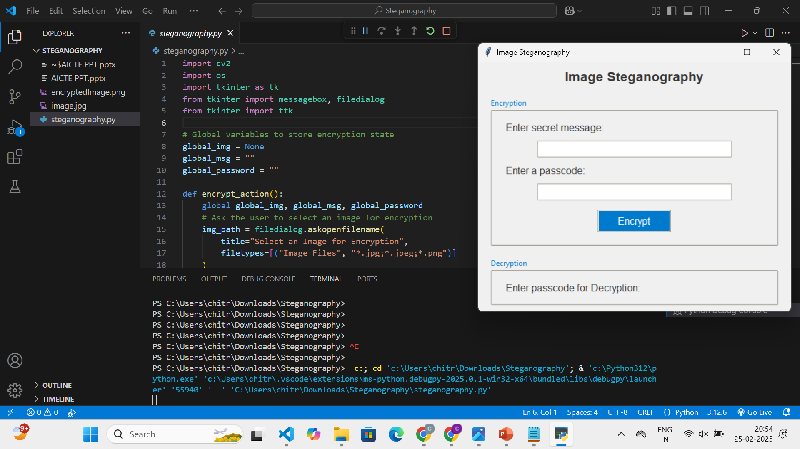
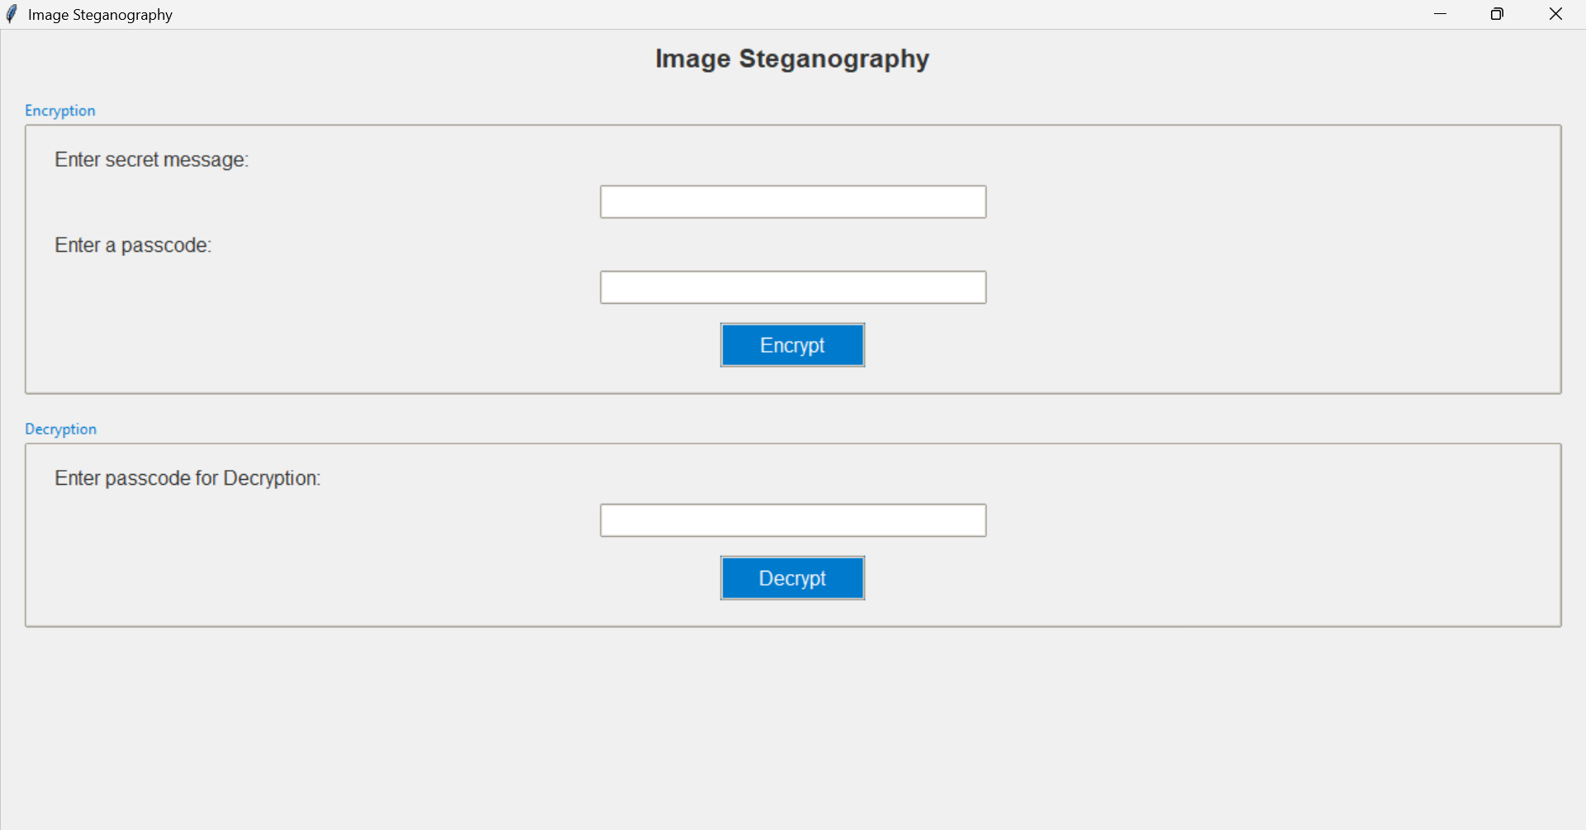
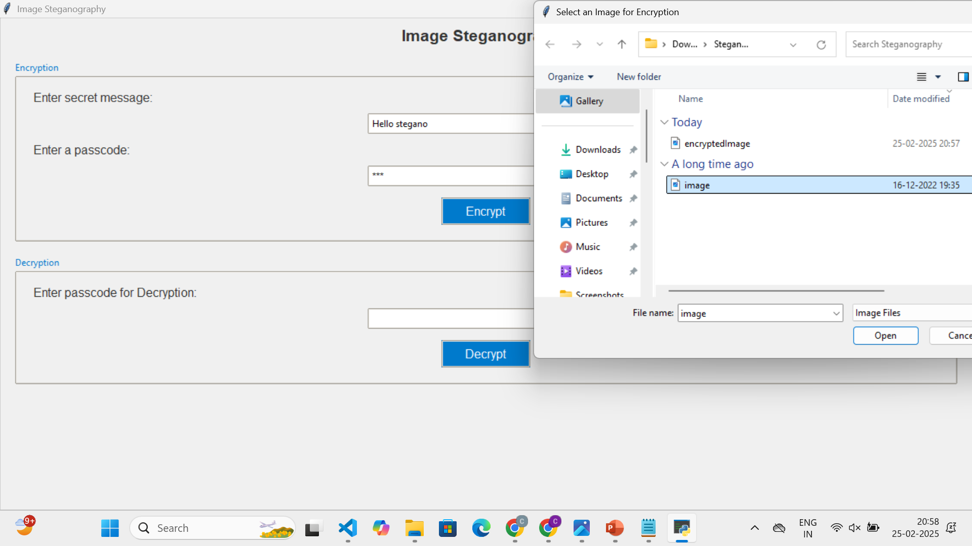
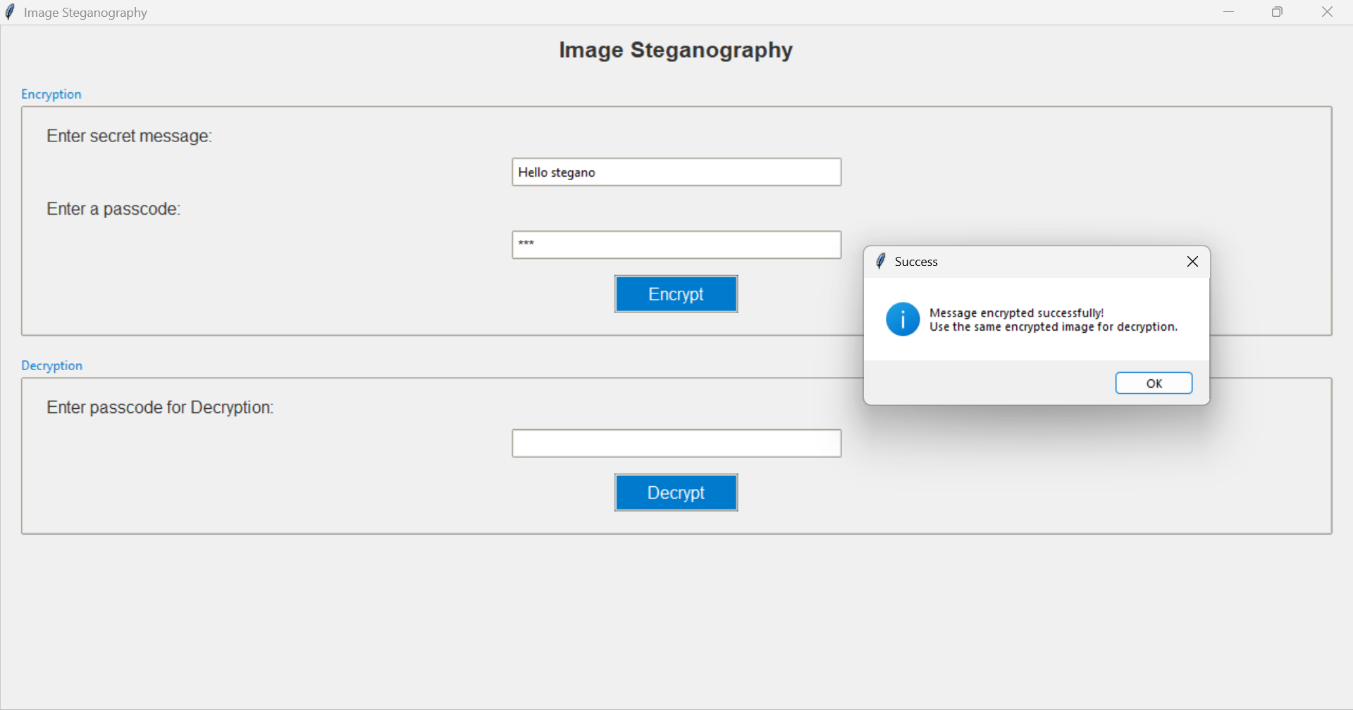
Results

Slide 8
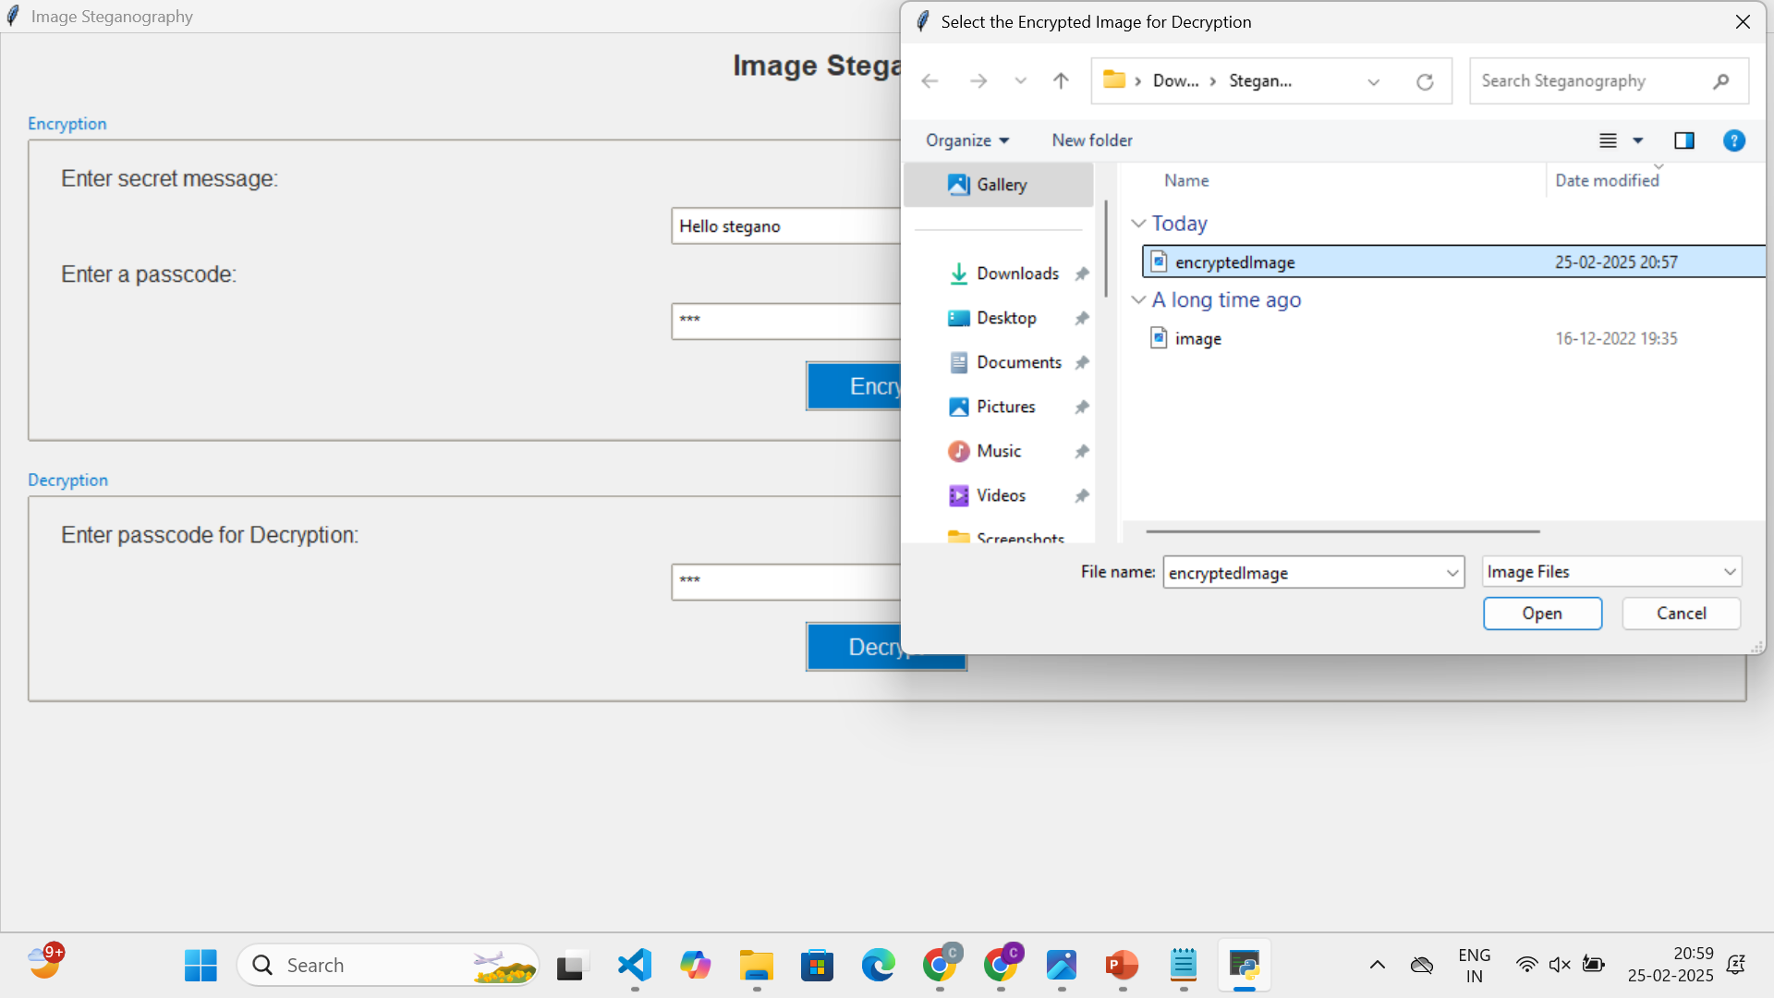
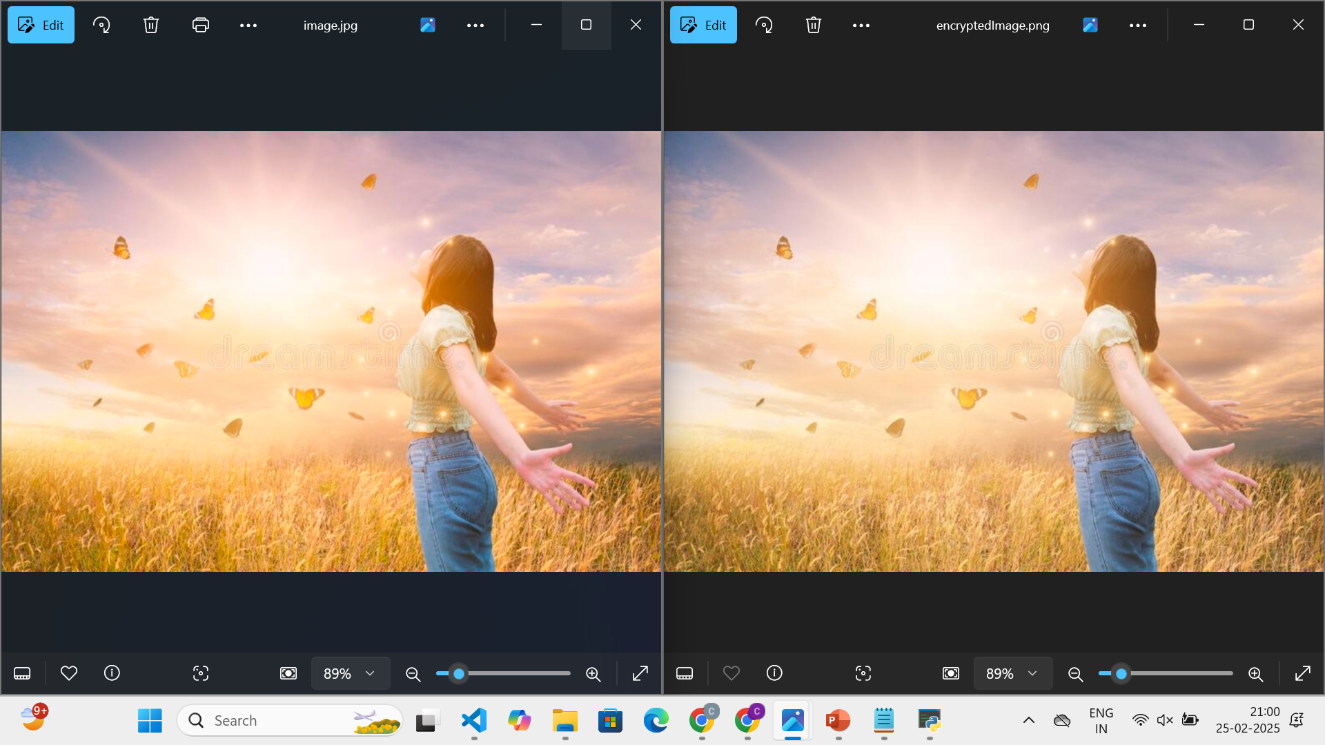
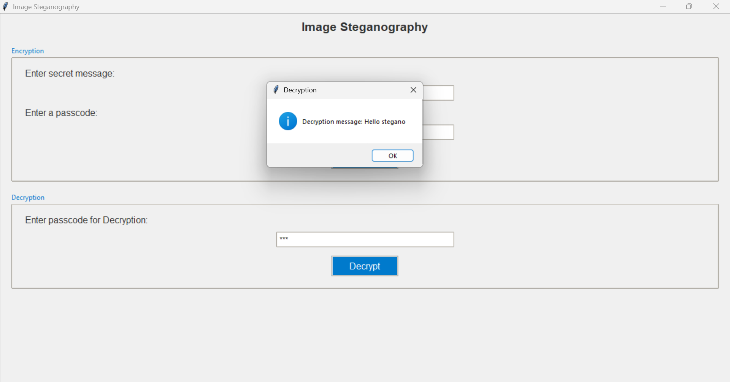
Results

Slide 9
Conclusion
The project successfully addresses the challenge of secure data hiding by implementing an efficient steganography technique. It ensures confidentiality through password-protected encryption while maintaining image quality. With a user-friendly interface and cross-platform compatibility, the solution is accessible and practical for various applications, including cybersecurity, digital forensics, and personal data security. The system’s scalability and minimal data loss approach make it a robust choice for secure communication.

Slide 10
GitHub Link
The below is the GitHub link of my project
https://github.com/GollaChitraleka/Steganography.git

Slide 11
Future scope(optional)
Stronger Encryption – Enhanced security algorithms.
Multi-Format Support – Hide data in audio, video, PDFs.
Cloud Integration – Secure online storage & retrieval.
AI Detection – Prevent unauthorized data extraction.
Mobile App – Secure messaging on Android/iOS.
Blockchain Security – Verify hidden data integrity.

Slide 12
THANK YOU

