Slide 1
PoseEmbroider
Towards a 3D, Visual, Semantic-aware Human Pose Representation
G. Delmas • P. Weinzaepfel • F. Moreno-Noguer • G. Rogez
IRI CSIC-UPC Barcelona | NAVER LABS Europe
Research Paper Review
Multi-Modal Learning

Slide 2
Motivation & Problem Statement
✅
⚠️
❌
Multi-Modal Alignment Works
CLIP Lacks Pose Precision
Incomplete Pairing Problem
Pairing images + text (like CLIP) creates powerful semantic embeddings that fuel image captioning and text-to-image generation.
CLIP handles common poses (standing, sitting) but struggles with uncommon or complex human poses — it lacks fine-grained body awareness.
3D poses have been paired with images (pose estimation) OR text (text-to-pose) — but rarely with BOTH simultaneously.
💡 Solution: Combine 3D poses + person pictures + text descriptions → one unified, enriched pose embedding

Slide 3
Related Works — What Existed Before
PoseScript
Text ↔ Pose
ChatPose
Visual + Text → Pose
Pairs 3D poses with natural language descriptions for text-to-pose retrieval. Strong semantic embeddings — but no visual modality.
Appends SMPL layer to a large vision-language model for pose estimation & text-to-pose generation. Forces pose into textual space — may lose non-textual info.
ImageBind
Multi-Modal Alignment
NExT-GPT
Any-to-Any Generation
Aligns 6 modalities (image, text, audio, depth, thermal, IMU) into one embedding space. Aligns shared info — doesn't combine modalities into a richer single representation.
Any-to-any multimodal LLM using pretrained encoders + LLM + diffusion decoders. Converts modalities through text space — can lose modality-specific information.
FixMyPose
Pose Instruction Gen.
PoseFix
Pose Instruction Gen.
Introduced first dataset for pose correctional captioning. Based on highly synthetic pose pairs from ~20 Unity dance motions.
Generates instructions for correcting 3D poses using a text decoder conditioned on pose pairs. Limited to 3D pose input — cannot handle camera/image input.

Slide 4
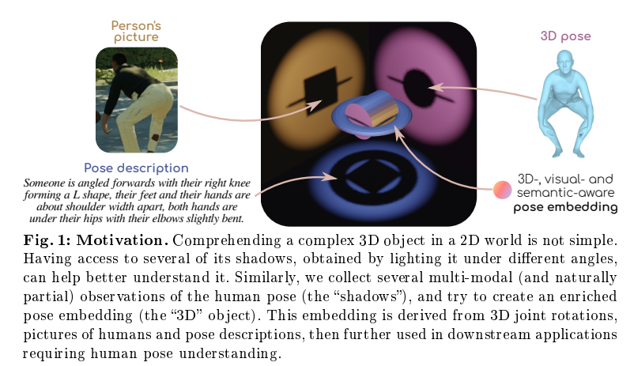
Motivation & Problem Statement
💡 Solution: Combine 3D poses + person pictures + text descriptions → one unified, enriched pose embedding

Slide 5
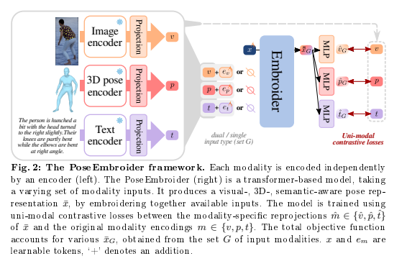
The PoseEmbroider Framework

Slide 6
The PoseEmbroider Framework
ENCODERS (Frozen)
TRANSFORMER
MLP HEADS
LOSS
v
Image Encoder
Input tokens:
{x} + G
G ∈ S (any combination of
v, p, t modalities)
MLP
v̂_G (visual)
ViT tuned on human data
InfoNCE
Contrastive Loss
For each modality m:
ℒ_c(m, m̂_G)
Cosine similarity
between projected
embedding and
original encoding
All 6 input
subsets S
used in training
Modality projection
3D Pose Encoder
→
p
MLP
p̂_G (pose)
VPoser (22 joints)
Output: x̄_G
(Multi-modal
pose embedding)
Modality projection
t
Text Encoder
→ Learnable global
token aggregates
info from all
available modalities
MLP
t̂_G (text)
DistilBERT
Modality projection

Slide 7
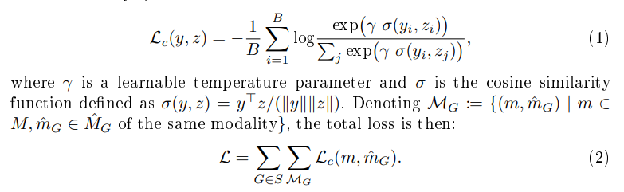
The Math of Embroidering
Uni-Modal Contrastive Loss (InfoNCE)
Total Training Loss
For a batch of size B, the loss for each modality m:
Summed across all input subsets G ∈ S
(single and dual modality combinations):
Where:
Why not compare x̄G directly to m?
γ
Learnable temperature parameter (controls sharpness)
Direct comparison forces all modalities into one shared space → collapse to common info only. Instead, x̄G is projected via MLP to each modality's own space, then compared. This lets x̄G be richer than any single modality.
σ(y,z)
Cosine similarity = yᵀz / (||y|| · ||z||)
Positive pair (same sample, different modality)
Key Design: "Hallucinate" Missing Modalities
yi, zi
Even if only pose {p} is given as input, the loss is applied on ALL modalities {v, p, t}. This forces x̄G to form sensible representations for modalities not present in the input — making the embedding truly multi-modal aware.
yi, zj
Negative pair (different samples)

Slide 8
Training Process & Dataset
Training Steps
📦 BEDLAM-Script Dataset
1
Forward Pass with Subset G
Based on BEDLAM synthetic dataset
For each sample, pick a random subset G of modalities (e.g., just image, or image+text). Feed encoded modalities + learnable global token x into the Transformer.
Rendered clothed humans in diverse environments with ground-truth 3D poses
Project Back to Modality Spaces
Multi-modal triplets
2
The global output x̄_G is projected through modality-specific MLPs to produce v̂_G, p̂_G, t̂_G in their respective spaces.
Each sample = (Human Image, 3D Pose, Text Description of pose)
Scale
3
Compute Contrastive Loss
50K training samples + 10K validation — selected by farthest-point sampling for diversity
InfoNCE loss is computed between each projected output m̂_G and the original modality encoding m. This is summed over all modalities and all input subsets S.
Text generation
3 pose descriptions per image via automatic captioning pipeline from PoseScript
4
Update Learnable Parameters
Training regime
Only the linear projection layers, transformer, and MLP heads are updated. All uni-modal encoders remain frozen throughout training.
All 6 input subsets S trained together for best single + dual query performance

Slide 9
Key Contributions
01
PoseEmbroider Framework
A novel transformer-based model that fuses 3D poses, images, and text into a single rich pose embedding space — trained on the new BEDLAM-Script dataset.
→ Direct side product: Any-to-any multi-modal retrieval
02
Pose Instruction Generation
Generate natural language instructions describing how to correct one pose into another — like an automated fitness coach. Trained on synthetic BEDLAM-Fix data but works on real images.
→ Application: At-home fitness coaching
03
SMPL Regression
Predict 3D body pose/shape parameters from an image, with optional text cue for refinement — no retraining needed when adding text hints.
→ Application: 3D Human Mesh Recovery

Slide 10
Application 1 — Pose Instruction Generation
🏋️ What Is It?
⚙️ How We Do It
Generate natural language text that describes how to move from pose A (trainee's current pose) to pose B (target/trainer pose).
Direct application:
at-home fitness coaching — give automatic real-time feedback from camera input.
• Encode poses A and B with frozen PoseEmbroider
• Fuse the pair using the TIRG module
• Feed to an auto-regressive transformer text decoder
• Train on BEDLAM-Fix (54K synthetic pairs)
• Fine-tune on PoseFix-OOS (real human-written text)
🔑 Key Advantage: Train on 3D poses → Deploy on real images, without retraining!
PoseEmbroider bridges the gap between clean 3D training data and real-world camera input at test time.

Slide 11
App 1 Deep Dive — Instruction Generation
① Input Processing
② TIRG Fusion
③ Text Decoding
Poses A (source) and B (target) are each encoded by the frozen PoseEmbroider.
At test time, any modality works:
• VA from camera (image)
• PB from 3D library (pose)
• Or any mix
The two embeddings x̄A and x̄B are fused using the TIRG module:
ffuse = TIRG(x̄A, x̄B)
This captures the difference and direction from A → B, not just their concatenation.
ffuse conditions an auto-regressive transformer decoder via cross-attention:
Text = Decoder(ffuse)
Generates the correction instruction token by token.
→
→
📊 Evaluation — R-Precision:
A retrieval model checks if the generated instruction correctly identifies the right pose pair from a pool of 200 candidates. This tests semantic accuracy beyond surface-level word overlap (unlike BLEU-4 / ROUGE-L which only check word similarity).

Slide 12
Application 2 — SMPL Regression
What is SMPL Regression?
Our Approach
Predict the SMPL body model parameters — joint rotations and body shape coefficients — from an input of any modality. Known as 3D Human Mesh Recovery when applied to images.
Given: Person's image (+ optional text hint)
Output: Full 3D body mesh reconstruction
• Use frozen PoseEmbroider features from image input
• Iterative residual network predicts joint rotations
• MLP regresses shape coefficients
• Trained on BEDLAM-Script (50K synthetic samples)
• At test time: add text cue freely — no retraining needed!

Slide 13
App 2 Deep Dive — SMPL Regression Math
What the Regression Head Predicts
Text Cue Refinement — No Retraining!
θ — Joint Rotations
Given image v + optional text hint t:
Predicted via iterative residual network.
Starts from mean pose, refines step by step.
Mesh = Regressor( Embroider(v, t) )
β — Shape Coefficients
Example hint: "The right knee is unbent"
→ PoseEmbroider fuses image + text into x̄G
→ Regressor uses the refined embedding
→ Result: 11% better accuracy (pa-MPJPE)
No retraining — just pass extra text at inference!
Regressed via a separate MLP.
Captures body shape (height, weight proportions).
📏 Accuracy Metric — pa-MPJPE (Procrustes-aligned Mean Per Joint Position Error)
What it measures
Procrustes-aligned
Our Numbers
Average distance in mm between predicted 3D joint positions and ground truth. Lower = better prediction.
Before measuring, the predicted mesh is optimally rotated/scaled to match ground truth. Removes global orientation errors.
Aligner: 50mm → PoseEmbroider: 49mm → With text: 44mm. SOTA (SMPLer-X Huge): 43mm.

Slide 14
Implementation Plan
Setup & Data Pipeline
Phase 1
Set up BEDLAM-Script dataset pipeline (images, 3D poses, text descriptions)
Implement frozen encoders: ViT (image), VPoser (pose), DistilBERT (text)
Build modality-specific linear projection layers with ReLU activation
PoseEmbroider Core
Phase 2
Implement the Transformer with learnable global token x and modality tokens e_m
Support variable input subsets G (single and dual modality inputs)
Add MLP re-projection heads for each modality output
Training & Evaluation
Phase 3
Implement InfoNCE contrastive loss over all input subsets S
Train on BEDLAM-Script and evaluate multi-modal retrieval (recall@K)
Test on downstream task: SMPL regression or instruction generation

Slide 15
Summary & Takeaways
🎯
Core Innovation
⚡
Flexibility
PoseEmbroider goes beyond aligning modalities — it combines them to create a richer, multi-modal-informed pose representation not constrained to any single modality's space.
Works with any combination of inputs (image, 3D pose, text) at test time without retraining. A single model handles all combinations gracefully.
🏆
Strong Results
🔮
Future Directions
Outperforms the Aligner baseline by 2.9% mRecall (retrieval), +36–41% on pose instruction generation, and reaches near-SOTA on SMPL regression.
More data, more aggressive losses, broader modalities (depth, 2D keypoints), and learning from mixed uni/bi-modal datasets without full triplets.

