Slide 1
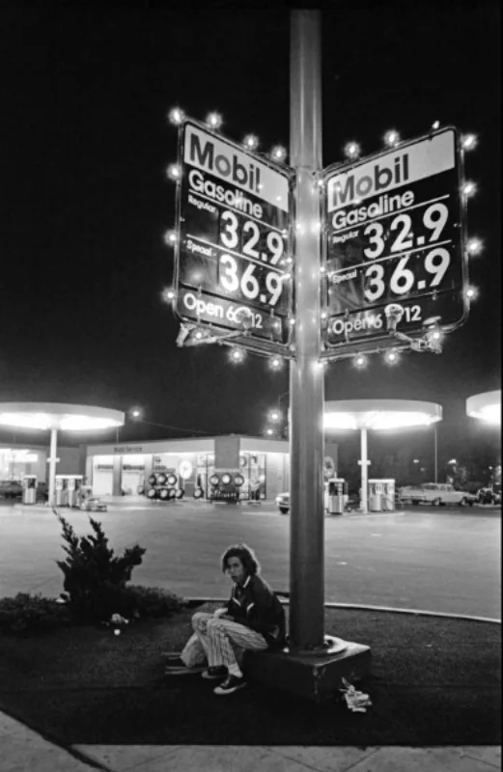
Exploratory Analysis of U.S. Gas Prices: Political Influence vs. Market Dynamics A data-driven investigation into the relationship between economic factors, political party, and gas prices
Cory Golladay
DSC530-T302 Data Exploration and analysis

Slide 2
“The reason gas prices are so high is because the oil is in Texas and Oklahoma and all the dipsticks are in Washington.”
- Yakov SMIRNOFF

Slide 3
Introduction
Statistical Question: Do U.S. Presidents influence gas prices, and are gas prices systematically lower under one administration compared to another administration?
Dataset Sources:
Presidents.csv (Political party and year) original source
Gas_Prices.csv (Historical gas prices) original source
Crude_Oil.csv (Oil prices) original source
CPI-U.csv (Consumer Price Index) original source
GDPC.csv (Real GDP per capita) original source
Objective: To analyze the impact of political party and economic variables on U.S. gas prices from 1950 to 2023.

Slide 4
Data Setup and Key Variables
Dataset Description: Merged data includes gas prices, crude oil prices, GDP, CPI, and Presidential & Political Party data.
Key Variables:
Gas Price (Cost Per Gallon) - The primary variable of interest representing fuel prices.
Crude Oil Price (Cost Per Barrel) - Reflects market conditions and the cost of a key fuel input.
GDP (Real Gross Domestic Product) - Represents economic health, which may influence gas demand and prices.
CPI (Consumer Price Index) - Adjusts for inflation to compare real gas prices over time.
Political Party (Democratic or Republican) - The categorical variable (Democratic or Republican) representing political influence on gas prices.

Slide 5
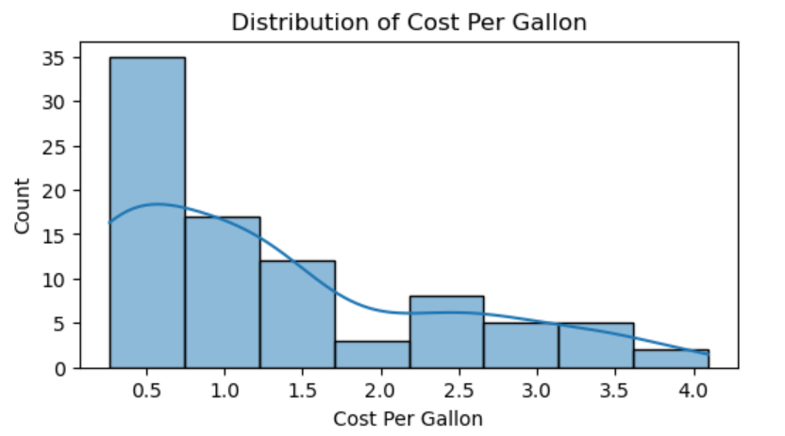
Histograms and Outliers Distribution of Cost Per Gallon (Regular Gasoline)
Histogram Observations:
The distribution is right-skewed, with most values concentrated around $0.5 to $1.5 per gallon.
There are a few higher values exceeding $2.0 per gallon.
Outliers:
Gas prices above $2.0 per gallon may be considered outliers. These likely represent economic crises or spikes due to market disruptions.
Handling Strategy:
Retain these outliers because they reflect real-world events (e.g., oil crises) and provide valuable context for your analysis.

Slide 6
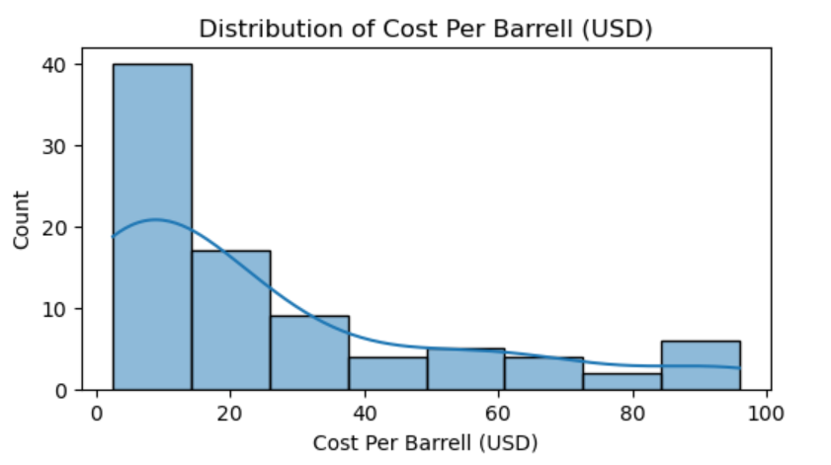
Histograms and Outliers Crude Oil Price (Cost Per Barrel)
Histogram Observations:
Most prices cluster around $10–$20 per barrel.
There are a few extreme values above $50 per barrel.
Outliers:
High crude oil prices above $50 per barrel may be considered outliers. These likely coincide with significant geopolitical or economic events.
Handling Strategy:
Retain these values, as they represent critical historical events influencing gas prices.

Slide 7
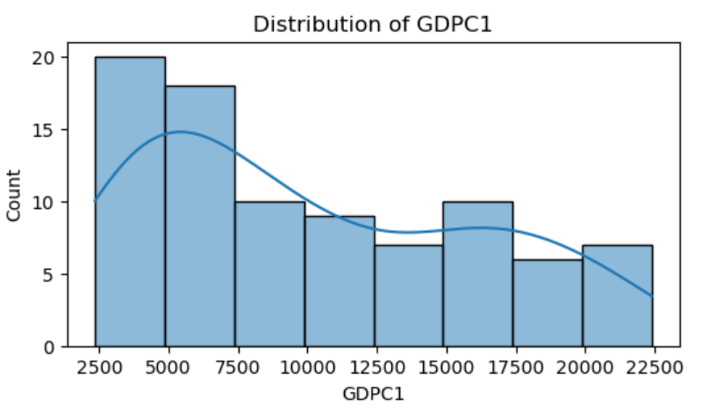
Histograms and Outliers GDP (Real Gross Domestic Product)
Histogram Observations:
The distribution is slightly right-skewed, with most GDP values below $15,000.
A few values exceed $20,000.
Outliers:
Extremely high GDP values above $20,000 might appear as outliers. However, these reflect economic growth rather than anomalies.
Handling Strategy:
Retain all values as they represent valid observations of economic progress over time.

Slide 8
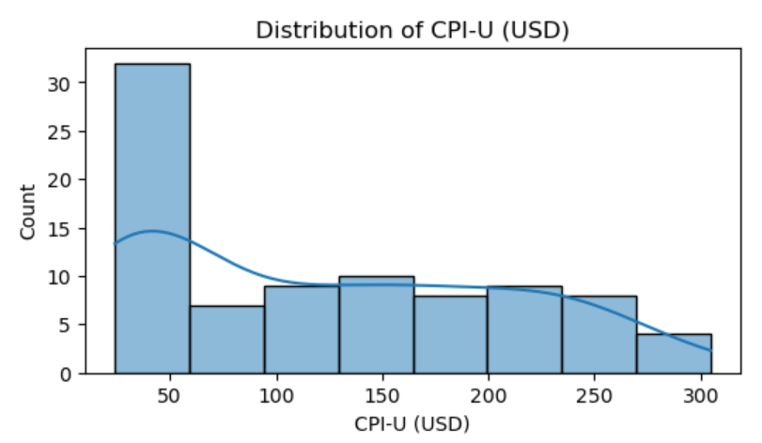
Histograms and Outliers CPI (Consumer Price Index)
Histogram Observations:
Most values cluster at lower levels, with a gradual decline as CPI increases.
A few CPI values exceed 200, which may appear high.
Outliers:
CPI values above 200 may be considered outliers, likely reflecting periods of high inflation.
Handling Strategy:
Retain these values, as they provide essential context for inflation trends.

Slide 9
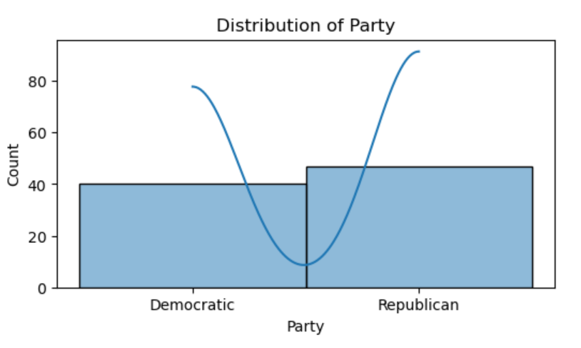
Histograms and Outliers Political Party
Histogram Observations:
The count of terms under Democratic and Republican administrations is relatively balanced.
Outliers:
Not applicable since this is a categorical variable.

Slide 10
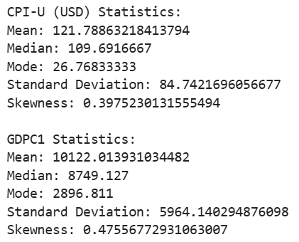
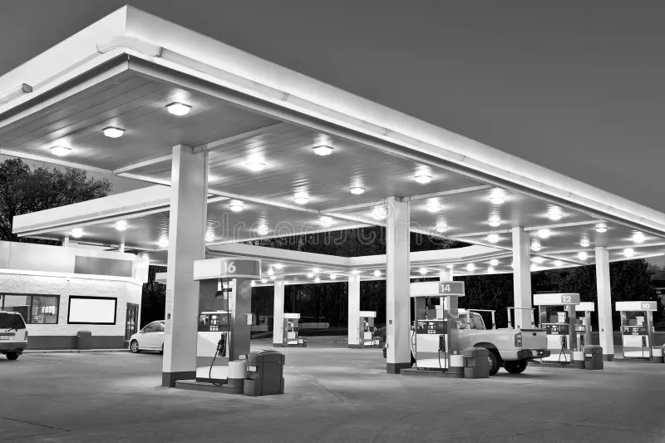
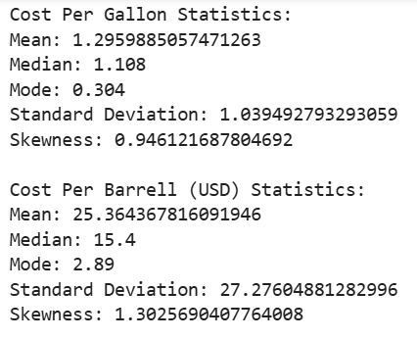
Descriptive Statistics
Descriptive Statistics of four key economic variables: gas prices, oil prices, CPI-U, and real GDP per capita (GDPC1). Gas prices average $1.30 per gallon and are right-skewed (skewness = 0.95), indicating that lower values are more common with occasional higher outliers. Oil prices have a higher mean of $25.36 per barrel, showing greater variability and a more pronounced right skew (skewness = 1.30), reflecting frequent high prices. The Consumer Price Index (CPI-U) averages 121.79 and is moderately right-skewed (skewness = 0.40), suggesting that most values fall below the average. Real GDP per capita (GDPC1) has a mean of $10,122 and a moderate right skew (skewness = 0.48), with occasional higher values. Overall, the variables show right-skewed distributions, indicating that lower values dominate, but with some notable higher outliers.

Slide 11
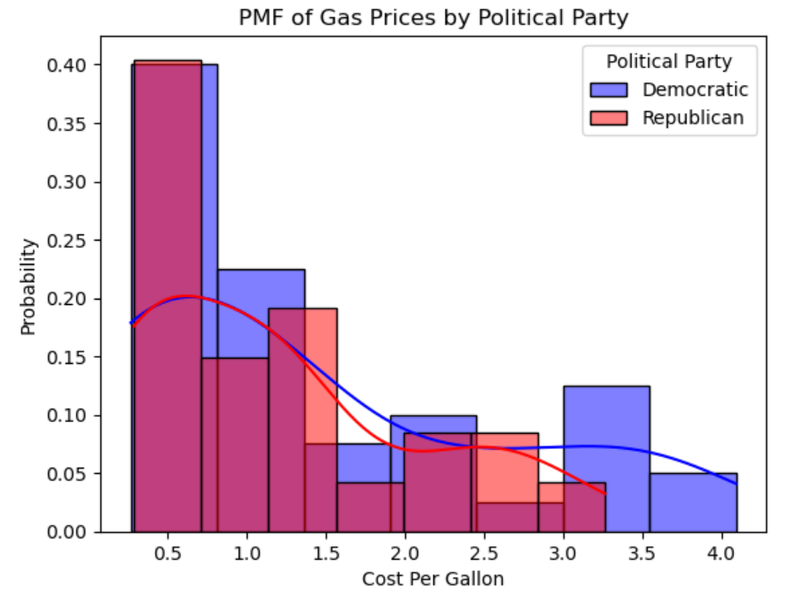
Probability Mass Function (PMF)
This plot compares gas price distributions under Democratic and Republican terms. Prices during Democratic terms cluster at lower levels, peaking around $0.50/gallon, while Republican terms show a wider spread with more moderate to higher prices. While this suggests lower prices under Democrats, further analysis is needed to confirm significance.

Slide 12
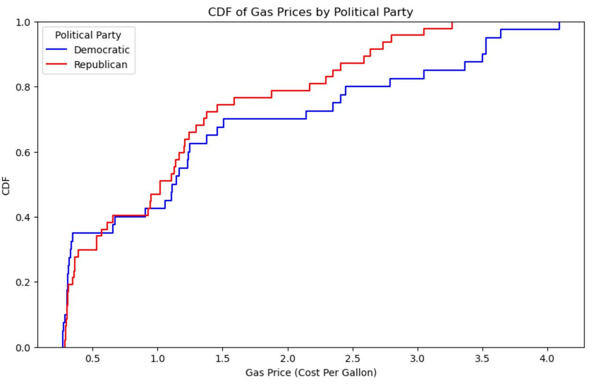
Cumulative Distribution Function (CDF)
This CDF plot compares gas prices under Democratic and Republican terms. The Republican line rises faster at lower prices, indicating they were more common, while the Democratic line overtakes it at higher prices, suggesting higher prices were more likely. The plot highlights a general trend of lower gas prices under Republicans and higher under Democrats, though differences are subtle.

Slide 13
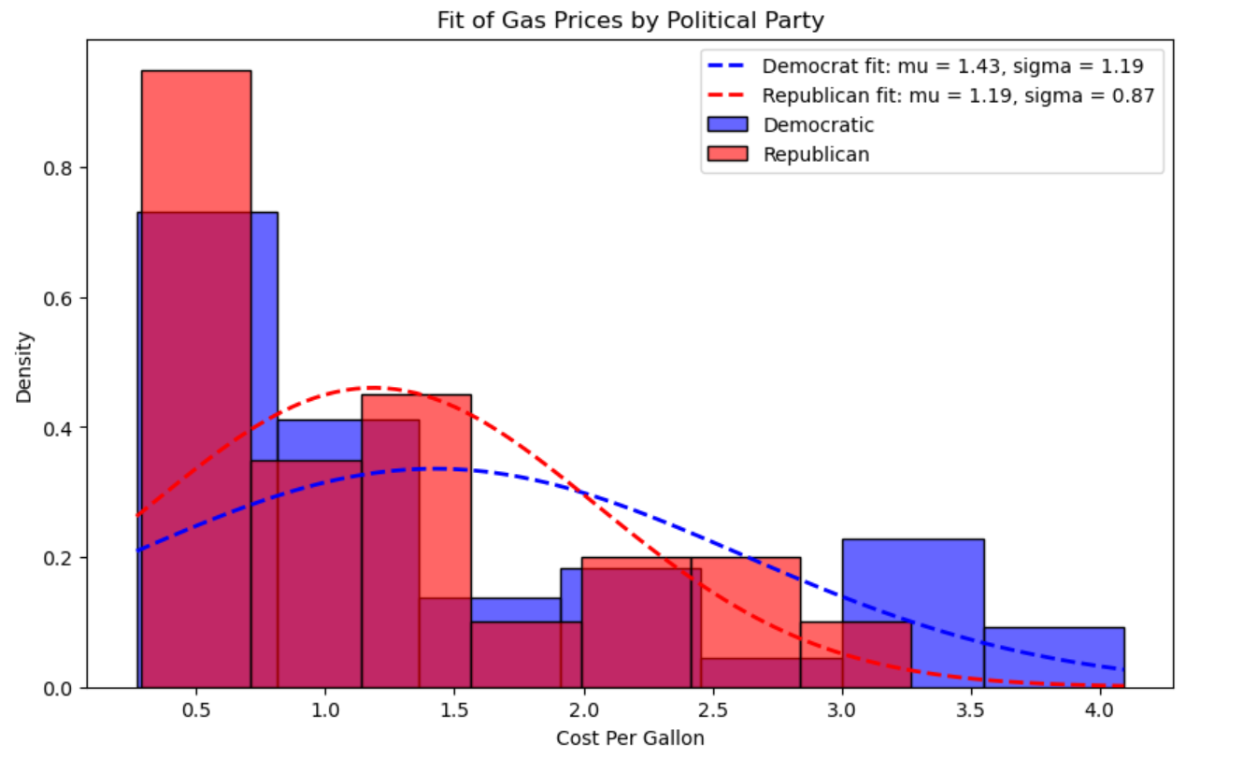
Analytical Distribution
This plot compares gas price distributions under Democratic and Republican terms. Democratic prices have a higher mean ($1.43 vs. $1.19) and greater variability (σ = 1.19 vs. 0.87), resulting in a broader, flatter curve. Republican prices are more concentrated, with a narrower, peaked distribution. Overall, gas prices were generally lower and more stable under Republicans, while Democrats experienced a wider and slightly higher range.

Slide 14
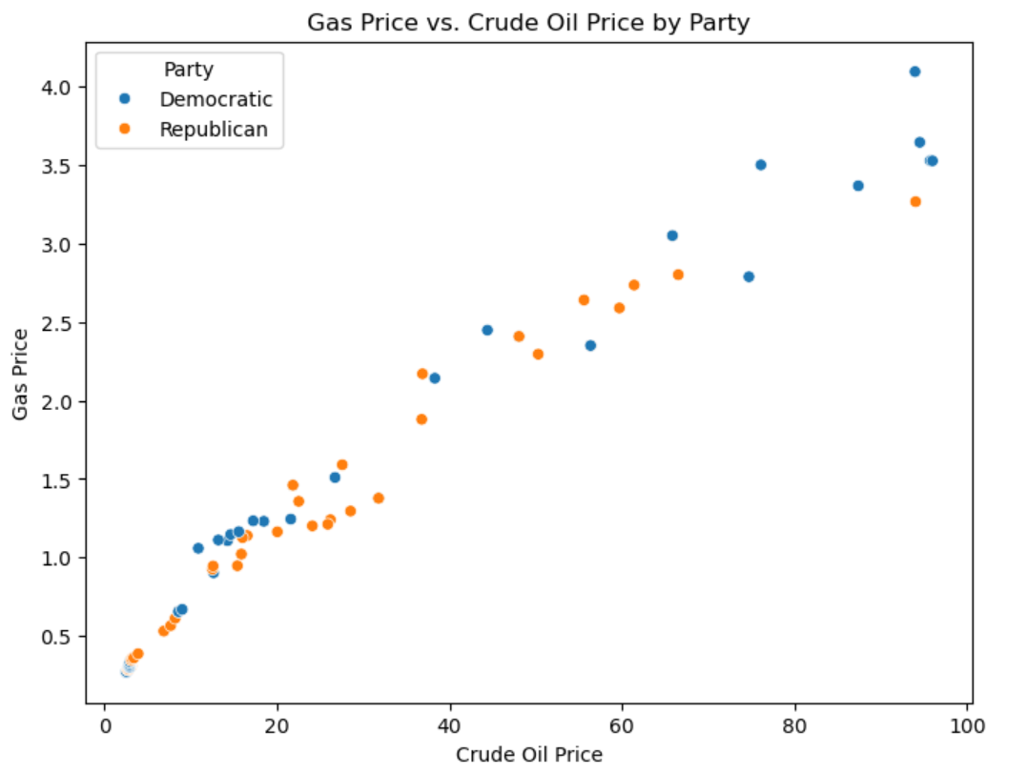
Scatter Plots Gas Price vs. Crude Oil Price by Party
A scatter plot of gas prices vs. crude oil prices reveals a strong positive correlation (Pearson's r = 0.98 for both parties), indicating that as crude oil prices rise, gas prices consistently increase. This relationship holds true across both Democratic and Republican administrations, showing that crude oil prices are the primary driver of gas prices. While slight variations exist in gas prices under different parties, these differences are not statistically significant, emphasizing that economic factors, rather than political affiliations, predominantly influence gas prices.

Slide 15
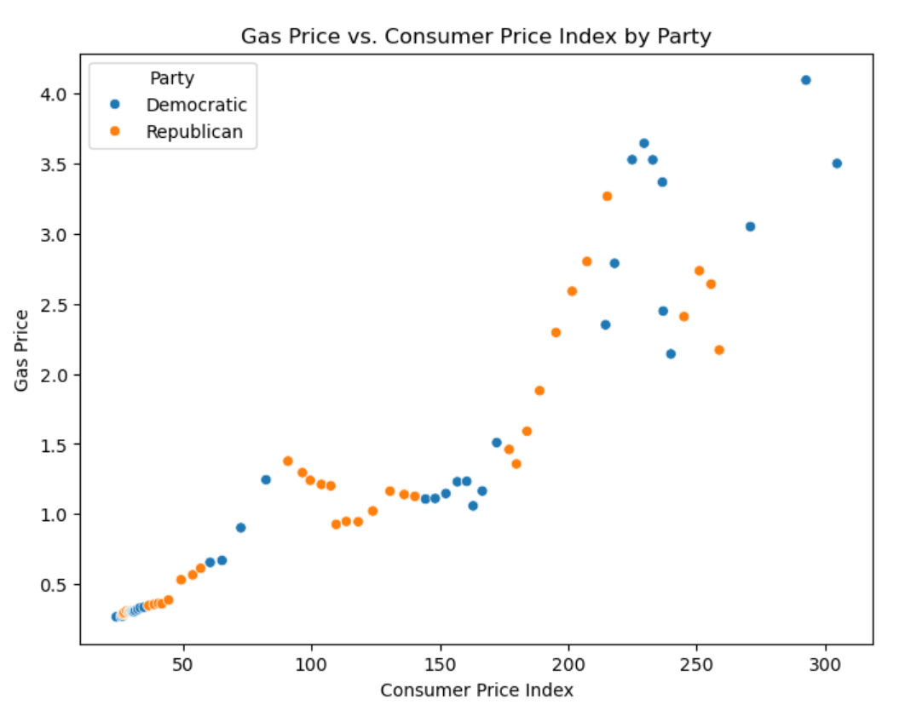
Scatter Plots Gas Price vs. Consumer Price Index
The scatter plot of gas prices vs. CPI shows a strong positive correlation (Pearson's r = 0.93 for Democrats and 0.95 for Republicans), indicating that gas prices tend to rise as the Consumer Price Index increases. This trend reflects the impact of inflation on fuel costs, with similar patterns observed under both Democratic and Republican administrations. While Democratic terms show slightly higher variability at elevated CPI levels, the differences are minimal and not statistically significant. Overall, inflation is a key driver of gas prices, with limited influence from political party affiliation.

Slide 16

Hypothesis Test Difference in Means
A permutation test comparing gas prices between Democratic and Republican administrations yielded a p-value of 0.277, exceeding the significance threshold of 0.05. This result indicates we fail to reject the null hypothesis, suggesting no statistically significant difference in gas prices between parties. The observed variations are likely due to random factors rather than systematic political influence.

Slide 17
Regression Analysis
I included the party variable (Party_Republican) which adds a slight negative coefficient, suggesting that gas prices may be marginally lower during Republican terms, though the effect is small. The high R² value indicates that crude oil price, GDP, CPI, and party affiliation together explain nearly all the variability in gas prices, with crude oil price likely being the most influential predictor. This model demonstrates that gas prices are driven mainly by economic factors, with only a slight possible effect of political party.
Regression coefficients: [ 2.57913999e-02 1.15720696e-05 3.53708052e-03 -1.84973096e-02]
Regression intercept: 0.10388990459025749
R^2 score: 0.9957313993204782

Slide 18
Conclusion
The exploratory data analysis (EDA) revealed clear and significant trends in gas prices and their relationship to key economic indicators: crude oil prices, GDP, and the Consumer Price Index (CPI). Gas prices show a strong positive correlation with crude oil prices, as expected, given that crude oil is a primary input in gasoline production. This relationship holds consistently across different political administrations, as demonstrated by high Pearson and Spearman correlation values. Additionally, gas prices appear to be influenced by broader economic indicators like GDP and CPI, which reflect the overall economic activity and inflation, respectively. This suggests that gas prices rise not only due to oil supply and demand but also as part of larger economic growth and inflationary pressures.
When incorporating political party information, I observed only minor differences in the relationships between gas prices and these economic indicators. While the covariance and correlation analyses suggested slightly higher variability in gas prices with crude oil prices, GDP, and CPI under Democratic administrations, these differences were not statistically significant. A hypothesis test confirmed that the differences in gas prices between Democratic and Republican terms could likely be attributed to random variation rather than any systematic influence of political party. Therefore, this analysis highlights that economic fundamentals—especially crude oil prices—are the primary drivers of gas price trends, with political factors playing a minimal role.

