Slide 1


Timeline
AI-Based Model Development
Visualization
12/5
Evaluation
Data Acquisition
Real-time System
9/23
11/18
11/4
10/4

Slide 2
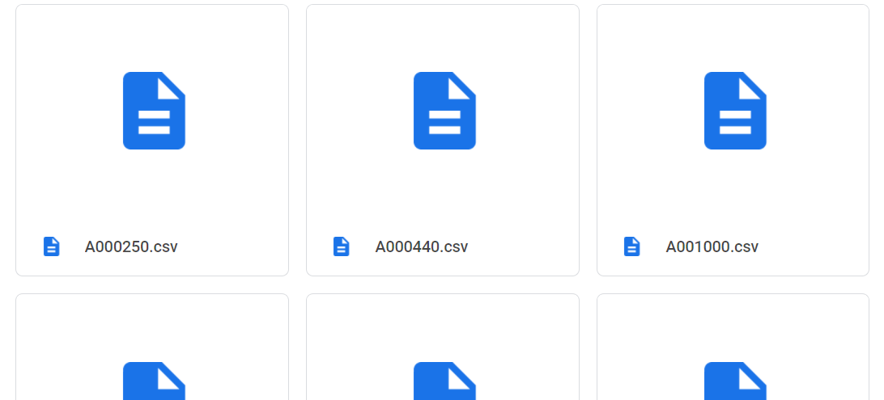
Data Acquisition

Slide 3
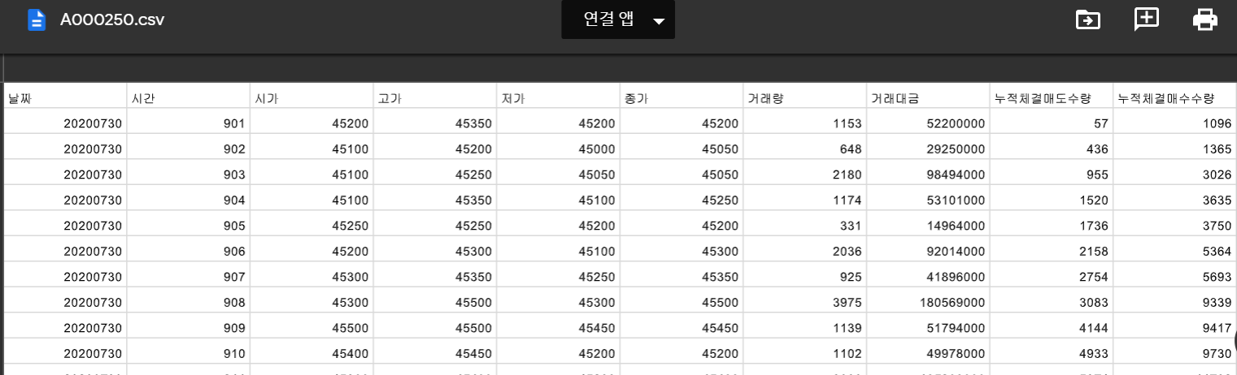
Stock Data Example
Data Acquisition (cont.)

Slide 4
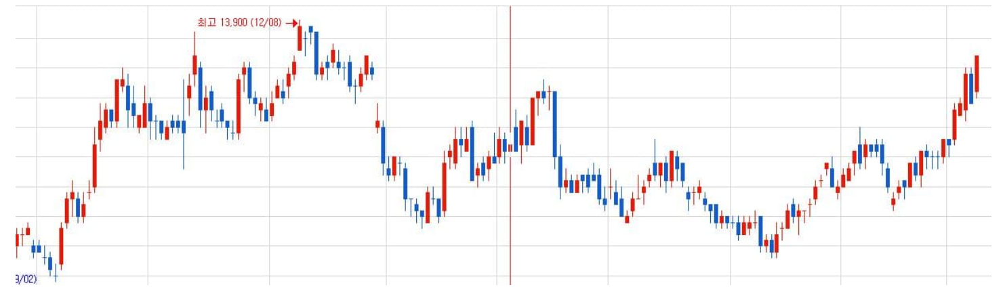

AI-Based Model Development
This can be one of many examples.
Buy?
Based on the data given, the price will go up soon! 😊
Extract data of target shape heuristically
…
Hold?
Based on the data given, the price will go down soon! Don’t buy it. 😨
Deep Neural Network
(1D CNN, GRU, Transformer … )
Collected Data

Slide 5
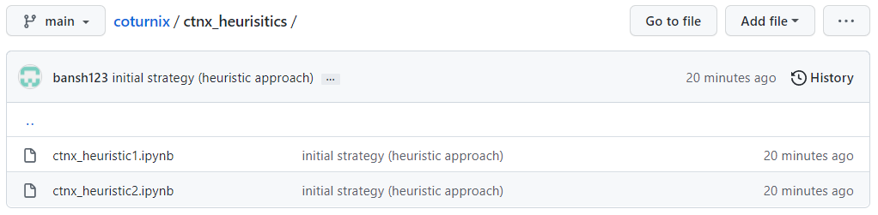
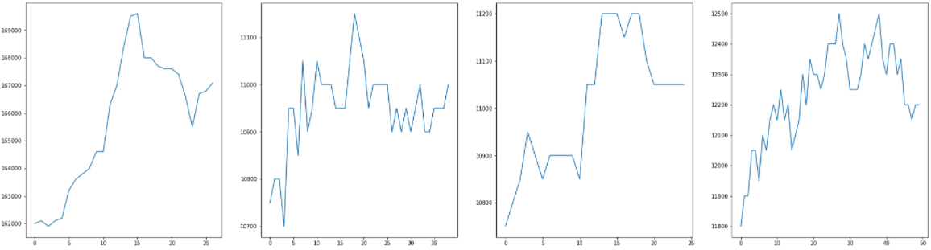
AI-Based Model Development

Slide 6
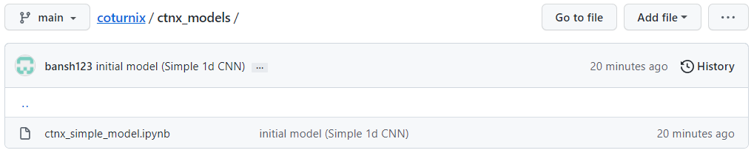
AI-Based Model Development
-> Too small data to train AI model.

Slide 7
Next steps : 1) Find better strategy : Autoencoder (Minseung Lee) 2) Build AI model (cont.) (Seonghyun Ban, Minseung Lee) 3) Develop Real-time System (Dongyoung Choi)

