Slide 1


Timeline
AI-Based Model Development
Visualization
12/5
Evaluation
Data Acquisition
Real-time System
9/23
11/18
11/4
10/4

Slide 2


Real-time System
The person in charge : Dongyoung Choi
How?
Using KIWOOM Open API
Connect Real Time Trading system based on Kiwoom API with AI model
Do Real-time Mock Investment. A true evaluation!
Real Time Stock Data
AI based
Decision
Trained Trading Model

Slide 3
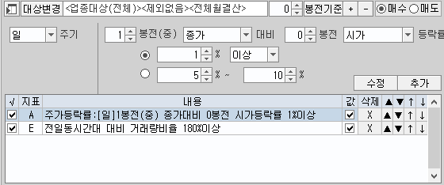
Real-time System
Too many stocks to test through AI model in real time (more than 3000)
-> Use Conditional Search supported by 키움 API
Search the most popular and active stocks that satisfies certain conditions
-> The market price rose more than 1% from the previous day’s closing price
-> The trading volume to the same time zone is more than 180% compared to previous day

Slide 4
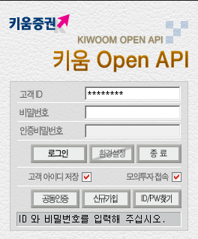
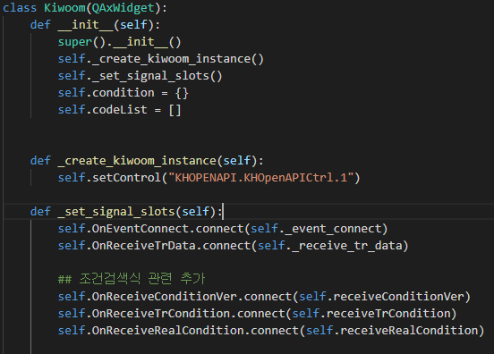
Kiwoom API
PyQt5 based Open API
Various functions of Kiwoom objects can be used through ‘dynamic call’

Slide 5



Kiwoom API (cont.)
Load conditional search result
Subscribe the result stock to get real time trading information
Wait and Get realtime data
Searh the active stocks list
Subscribe those stocks
Get real time data

Slide 6
Real-time System (cont.)
Kiwoom API only only supports 32-bit , while Pytorch supports only 64-bit
-> Use two virtual environment and communicate with two programs through packet
Virtual environment
Virtual environment
Loopback socket
Trained Trading Model
Python 32 bit
Python 64 bit

Slide 7
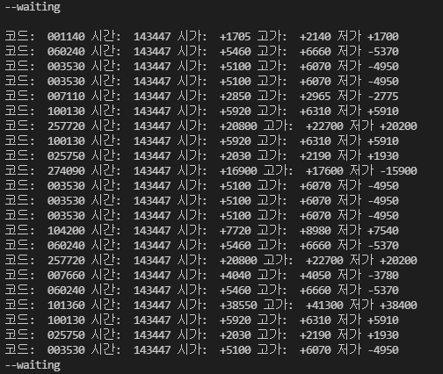
Real-time System (cont.)
Real time trading information of subscribed stocks

Slide 8
AI Model Development
Zero-pad Empty time serial data
Data Labeling:
With Hyper parameter
rising (-1%), dropping percentage(+1%), Length of looking forward (3)
Data cut:
With Hyper parameter
Data length (6), Sampling frequency (2)

Slide 9
AI Model Development
Auto-encoder Network (Vanilla FC layers)
AutoEncoder(
(encoder): Sequential(
(0): Linear(in_features=48, out_features=32, bias=True)
(1): ReLU()
(2): Linear(in_features=32, out_features=16, bias=True)
(3): ReLU()
(4): Linear(in_features=16, out_features=8, bias=True)
(5): ReLU()
(6): Linear(in_features=8, out_features=4, bias=True)
)
(decoder): Sequential(
(0): Linear(in_features=4, out_features=8, bias=True)
(1): ReLU()
(2): Linear(in_features=8, out_features=16, bias=True)
(3): ReLU()
(4): Linear(in_features=16, out_features=16, bias=True)
(5): ReLU()
(6): Linear(in_features=32, out_features=48, bias=True)
)
)

Slide 10
Next Steps
Find better model : 1D - CNN , transformer
Analysis on Trained unsupervised Model
Like t-SNE, PCA on latent vectors.

