Slide 1


Timeline
AI-Based Model Development
Visualization
12/5
Evaluation
Data Acquisition
Real-time System
9/23
11/18
11/4
10/4

Slide 2
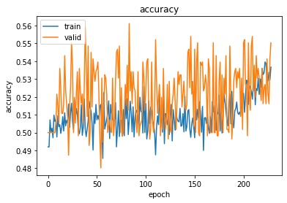
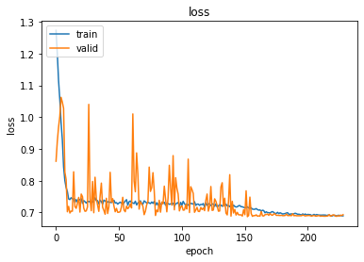

Contributor : Lee Minseung
Trial and error (AI Model Develop.)
Subdivision of transaction situation (Heuristic approach)
Heuristic approach
60.5% Precision | Expected Annual Yield: 54%
Not enough data (Total 5867 data)
Unreliable result
To get a profitable data distribution
Which has a high probability of yield case
We need more data !
Data should contain specific patterns.

Slide 3
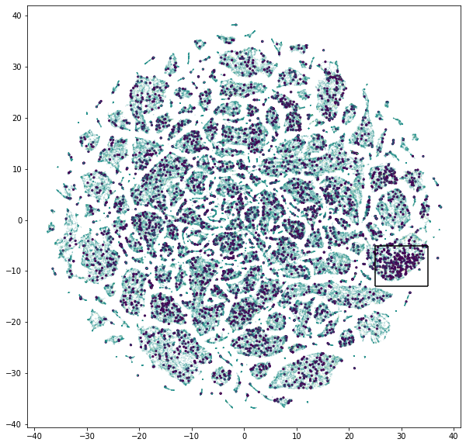

Contributor : Lee Minseung
Trial and error (AI Model Develop.)
Subdivision of transaction situation (problem of Heuristic approach)
Heuristic approach
Pattern clustering using Auto-Encoder
Basic Idea
figure out specific clusters where many yield cases exist
Expected to get much more data for model training
Data would contain specific patterns within its cluster

Slide 4
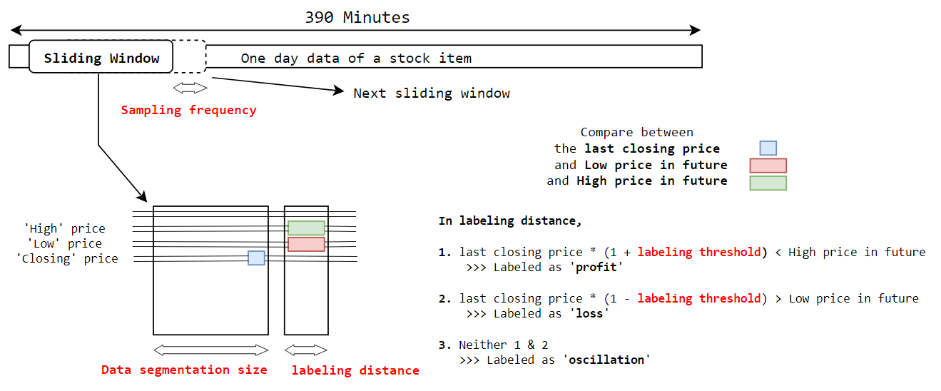
Contributor : Lee Minseung
Trial and error (AI Model Develop.)
Subdivision of transaction situation (Data Preprocessing - Label)
Four Parameters for preprocessing :
Sampling frequency, Data Segmentation size, Labeling Distance, Labeling Threshold
We use ( 2 ), ( 6 ), ( 6 ), ( 0.0075 - 0.75% )

Slide 5
Contributor : Lee Minseung
Trial and error (AI Model Develop.)
Subdivision of transaction situation (Data Preprocessing - Scaling)
Open | High | Low | Close | Volume | S.V | P.V
0
1
2
3
4
5
Divide by the first Open price of that day
Divide by average trading volume for recent 5 days.
Convert cumulative data to temporal difference data
C.S.V > Δ C.S.V
C.P.V > Δ C.P.V
Time
S.V : Sales Volume
P.V : Purchases Volume
C.S.V : Cumulative Sales Volume
C.P.V : Cumulative Purchases Volume

Slide 6
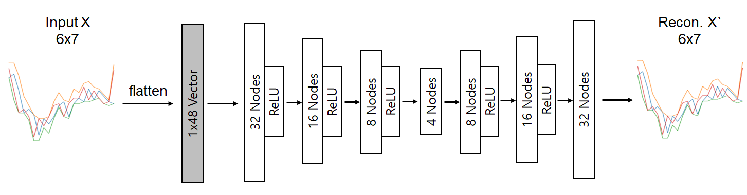
Contributor : Lee Minseung
Trial and error (AI Model Develop.)
Subdivision of transaction situation (Pattern clustering using Auto-Encoder)
Train AutoEncoder
t-SNE

Slide 7
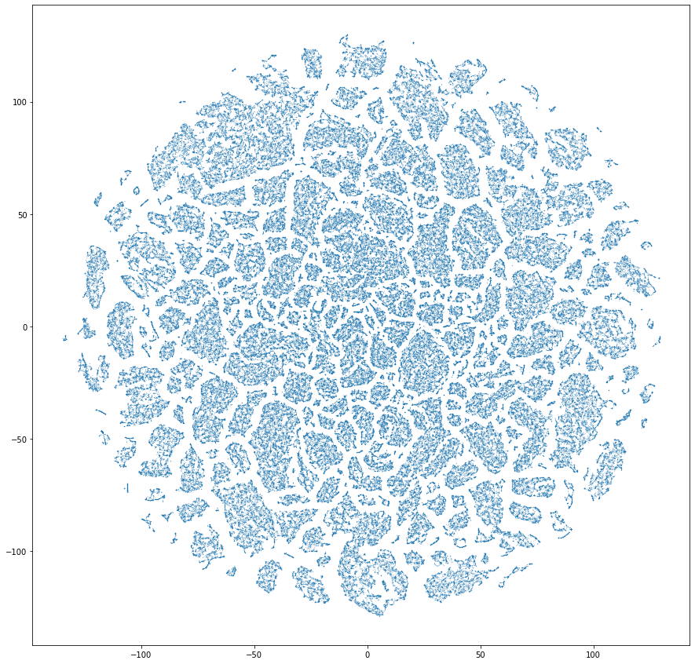
Contributor : Lee Minseung
Trial and error (AI Model Develop.)
Subdivision of transaction situation (Pattern clustering using Auto-Encoder)
Train an Auto-encoder model
Train data : 30,000,000 X 6 X 7
Validation data : 3,800,000 X 6 X 7
t-SNE (5,000 iterations) with 3,800,000 latents vector (from validation data)
t-SNE on latent vectors from trained Encoder

Slide 8
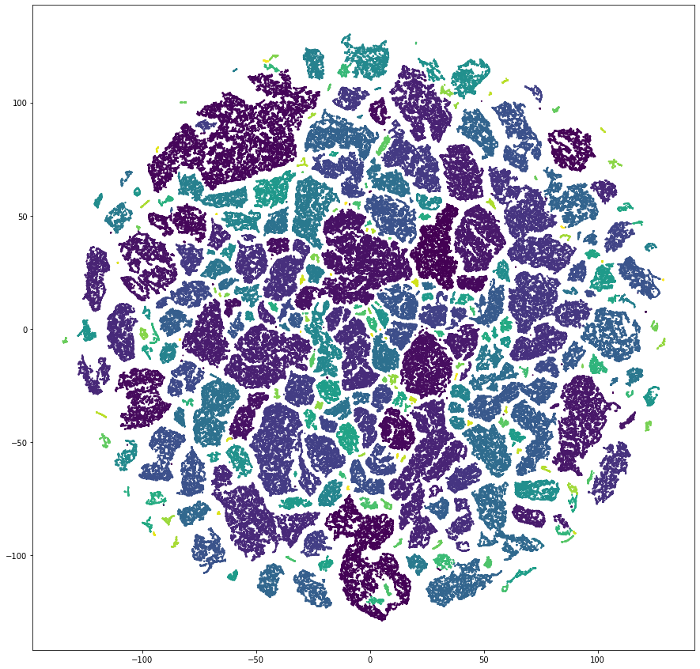
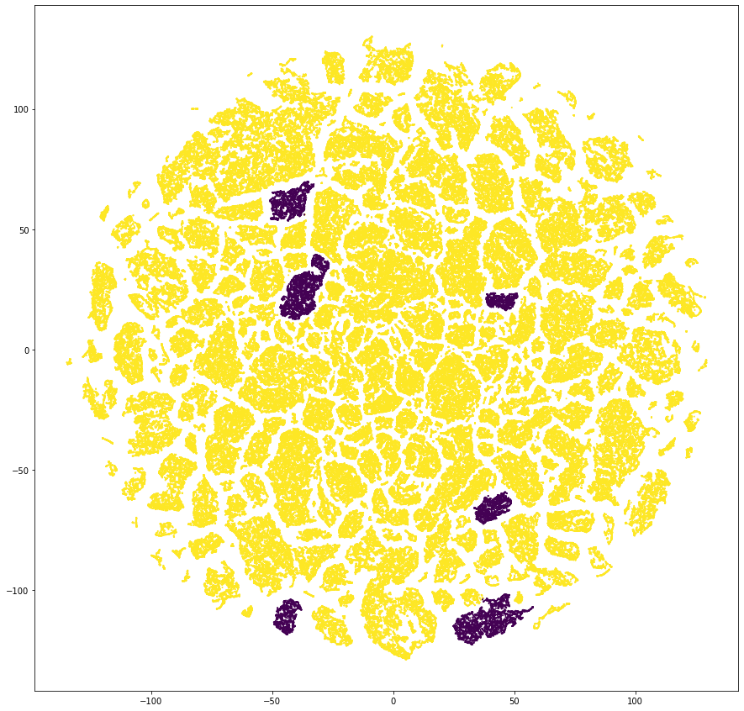
Contributor : Lee Minseung
Trial and error (AI Model Develop.)
Subdivision of transaction situation (Pattern clustering using Auto-Encoder)
Using DBSCAN, 300 clusters found.
Time and Space complexity : O(n)
Suitable Algorithm for Large data !
Sort all clusters in order of size and yield data density
whose sizes are over 1,000 minimally.
Result of clustering (301 Clusters total)
Selected clusters for training trader model.

Slide 9
Contributor : Lee Minseung
Trial and error (AI Model Develop.)
Subdivision of transaction situation (Problem of using Autoencoder)
Takes too much time and efforts
Training model 100 epochs (4 Hours)
Get latent vectors from validation dataset
t-SNE over 10% of latent vectors for 5000 iterations (5 Hours)
Memory Issue
Cluster 2D Data (result of t-SNE) using DBSCAN
Not much effective
Why we used it
Find out data cluster with high density of success case
With relatively enough data
 | N (Data) | Loss case ratio | Yield case ratio | Else
Before | 380,000 | 5.2 % | 4.6 % | 90.1 %
After | 20,000 (- 94.7%) | 8.5 % (+ 63 %) | 8.7 % (+ 89 %) | 82.8 % (- 8.1 %)

Slide 10
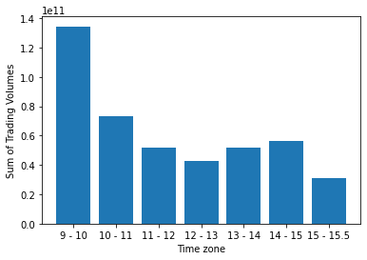
Contributor : Lee Minseung
Trial and error (AI Model Develop.)
Subdivision of transaction situation (Much simpler way)
Still most important factors
Data Amount
Data distribution advantageous for model training
Choose the time zone with the highest trading volume during the day.
(09:01 AM - 10:00 AM)
We can deal with two factors at the same time!

Slide 11
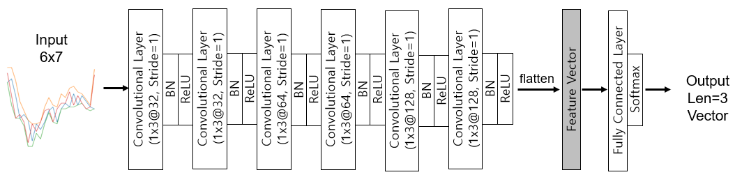
Contributor : Ban seonghyun
Trial and error (AI Model Develop.)
2. Train a Trading Model (1D-CNN)
1D-CNN model

Slide 12
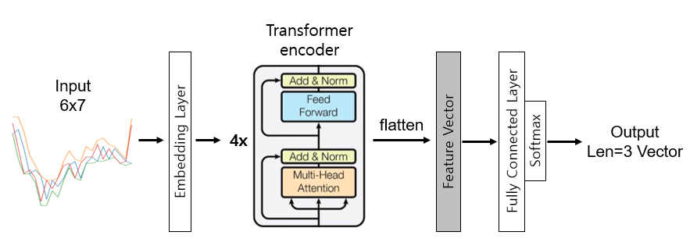
Contributor : Ban seonghyun
Trial and error (AI Model Develop.)
2. Train a Trading Model (Transformer)
Transformer model

Slide 13
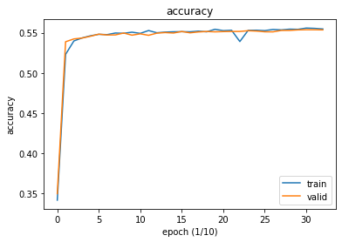
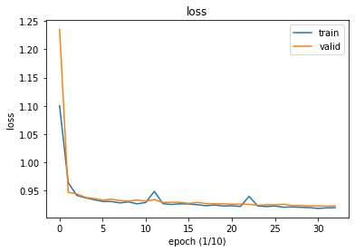
Contributor : Ban seonghyun
Trial and error (AI Model Develop.)
2. Train a Trading Model (Result of 1D-CNN Model)
1D-CNN model
Total data size : 5,760,000 (80% train, 10% valid, 10% test)

Slide 14
Contributor : Ban seonghyun
Trial and error (AI Model Develop.)
2. Train a Trading Model (Result of 1D-CNN Model)
1D-CNN model (test set size = 576,011)
 | +0.375% gain | between | -0.45% loss
BUY | 91896 | 27086 | 42753
HOLD | 107781 | 147950 | 158535
Win rate = 91896/(91896+27086+42753) = 56.8%
Loss rate = 42753/(91896+27086+42753) = 26.4%
Expected Annual Yield = 15.4% (1 Purchase per day)

Slide 15
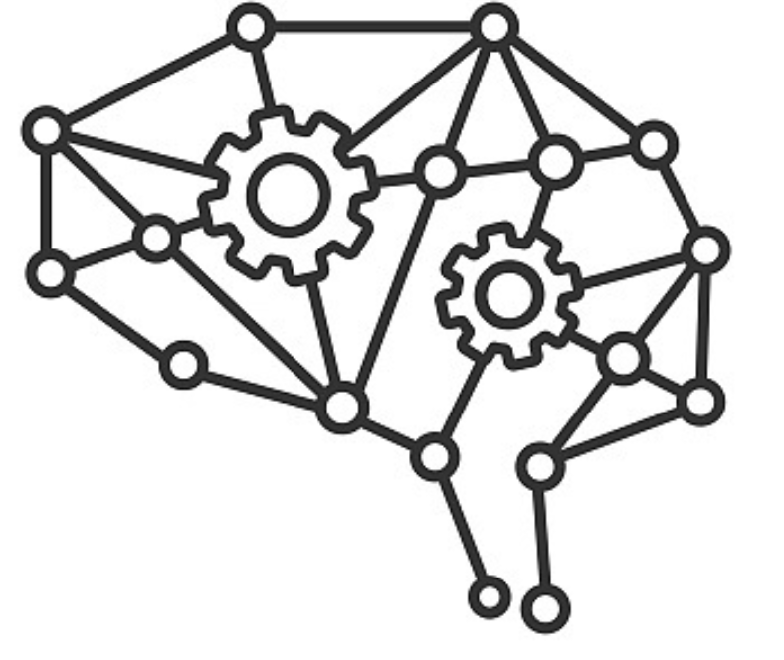

Contributor : Choi Dongyoung
Real-time System
GOAL
Real time trading based on AI model
Display explanation of model’s decision
Connect Real Time Trading GUI based on Kiwoom API with AI model
Use socket programming to communicate GUI and AI model Server
GUI Client
AI model Server
Socket
Trained Trading Model

Slide 16




Contributor : Choi Dongyoung
Real-time System(Cont.)
Load conditional search result
Subscribe the result stock to get real time trading information
Get real time data and display it on GUI
Send real time data to pretrained AI model after preprocessing
Send model result to GUI
GUI will buy or ignore target stocks followed by AI decision
Search active stocks
Subscribe those stocks
Get real time data
and display it on GUI
Send real time data to AI model
Send model result to GUI

Slide 17
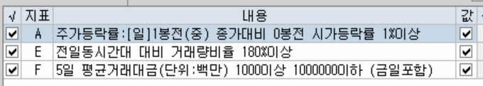
Contributor : Choi Dongyoung
Conditional Search
Too many stocks to test through AI model in real time (more than 3000)
-> Use Conditional Search supported by 키움 API
Search the most popular and active stocks that satisfies certain conditions
-> Market Price > 1.01 x closing price of yesterday
-> Trading volume > 1.8 x Trading volume of yesterday (at the same time zone)
-> Average stock trading amount > 1 Billion won

Slide 18
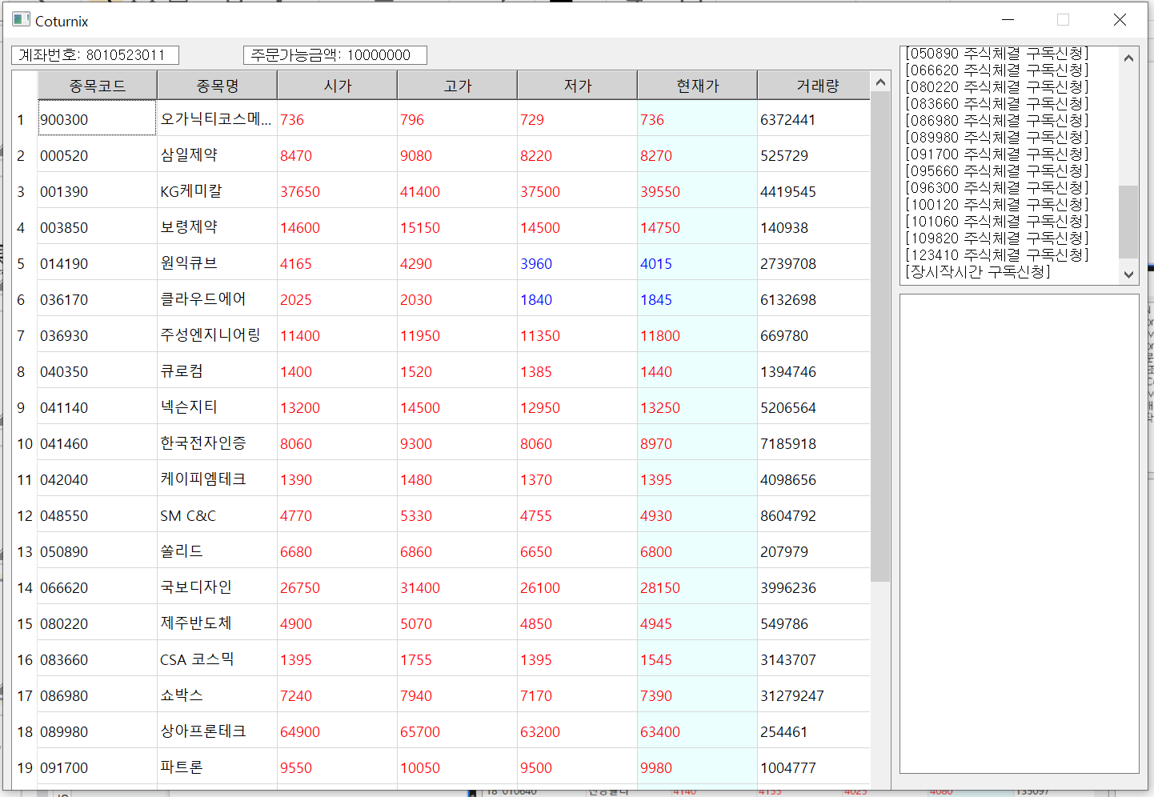
Contributor : Choi Dongyoung
GUI
PyQt5 based GUI
Account number and Deposit
System Log
Stock table
Stock Trading Log

Slide 19

Contributor : Choi Dongyoung
GUI
PyQt5 based GUI

Slide 20
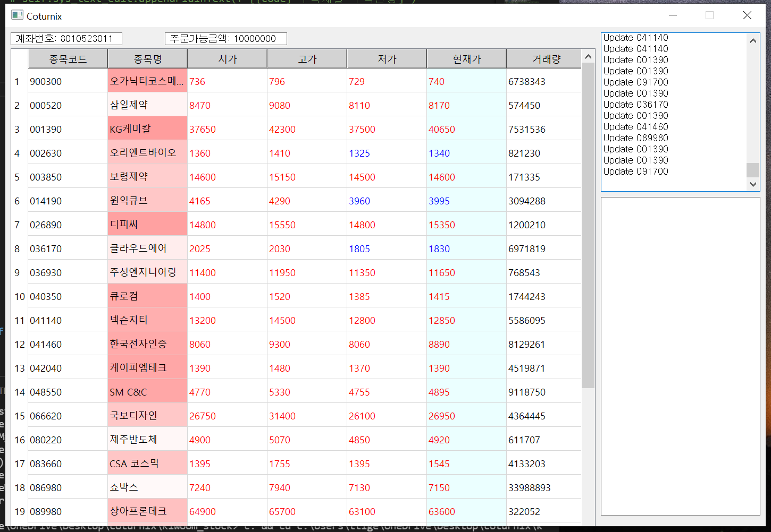
Contributor : Choi Dongyoung
GUI (Scheduled)
We will express the degree of confidence that it will rise through colors
Don’t buy
Buy

Slide 21
Contributor : Choi Dongyoung
GUI (Scheduled)
Show the cumulative stock data that is double clicked and display the weight of variables to explain the reason of decision
Don’t buy
시간 | 종목코드 | 종목명 | 시가 | 고가 | 저가 | 현재가 | 거래량
09:04 | 003850 | 보령제약 | 14600 | 15150 | 14500 | 14700 | 171335
09:05 | 003850 | 보령제약 | 14700 | 15000 | 14400 | 14600 | 171420
09:06 | 003850 | 보령제약 | 14600 | 14900 | 14600 | 14800 | 171511
09:07 | 003850 | 보령제약 | 14800 | 15300 | 14800 | 14900 | 171665
09:07 | 003850 | 보령제약 | 14900 | 15200 | 14900 | 15100 | 171794
...
Buy

Slide 22
Next Steps
Fine tuning
Hyperparameters (data preprocessing)
Transfer learning
2. Verification (Mock investment)
3. Explainability (Grad-CAM or Attention)

Slide 23
Appendix
How to calculate the expected annual yield.
e.g) Precision for +1% yield : 60.5%
0.03% Fee
250 Transactions (250 weekdays in a year)
Win : 250 * 0.605 = 151
Loss : 250 * 0.395 = 99
(1 + 0.01 - 0.0003)¹⁵¹ x (1 - 0.01 - 0.0003)⁹⁹ = 1.54
>> 54% Annual Yield

