Slide 1
COLLEGE CANTEEN
MANAGEMENT SYSTEM
A digital solution for menu, orders, payments and inventory
Presented by: Sankara Gomathi R
CSE | Rajalakshmi Engineering College

Slide 2
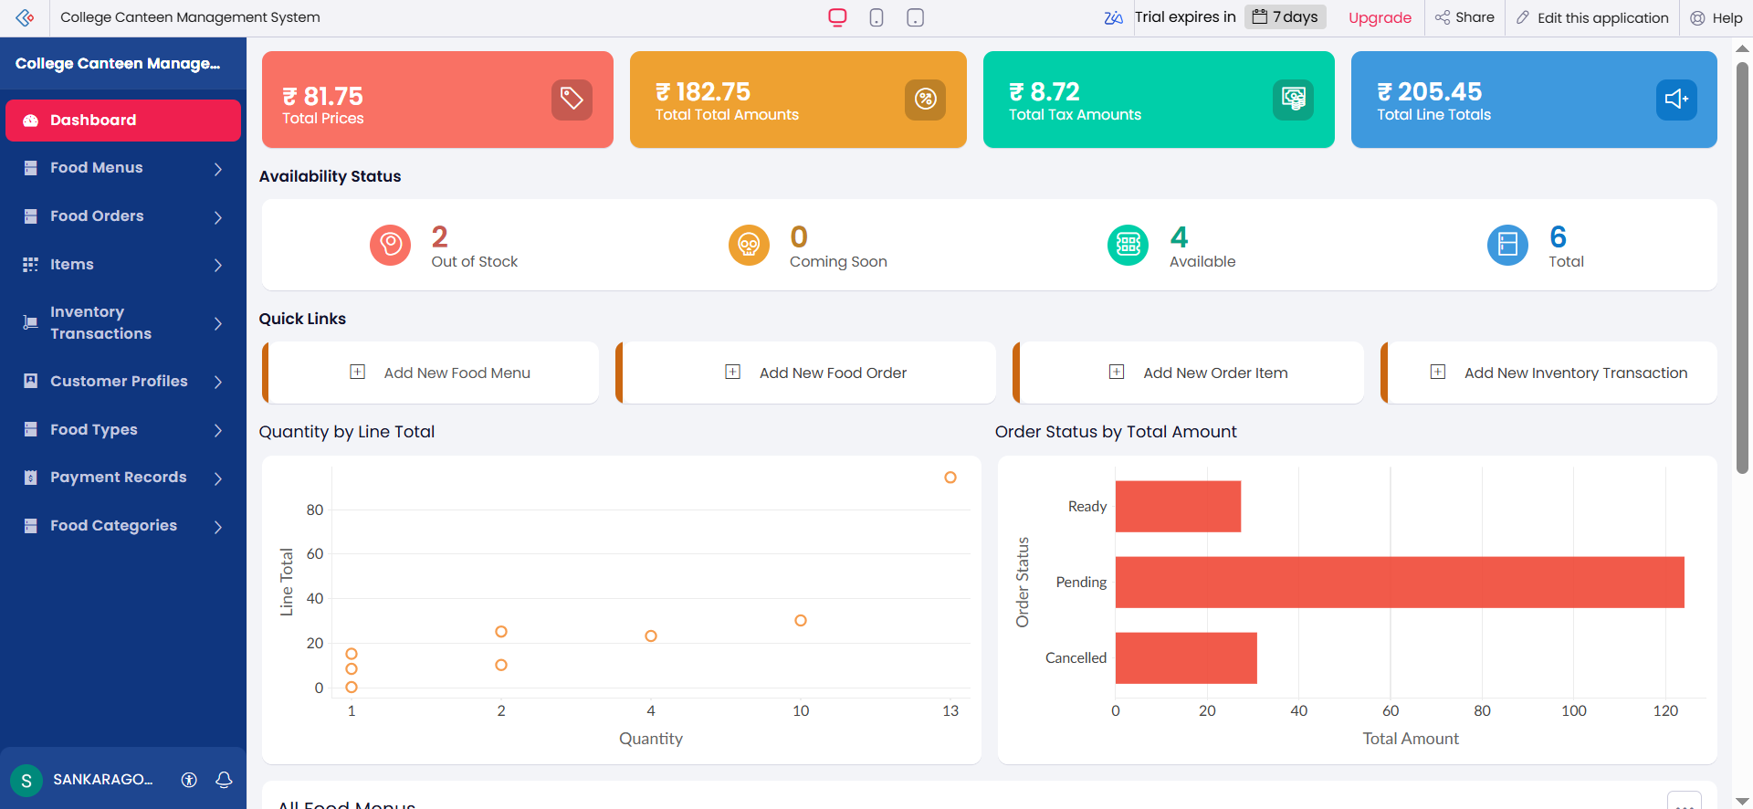
Project Overview
Live dashboard from the Zoho Creator application
02

Slide 3
Problem Statement
Challenges in managing canteen operations manually
Manual record keeping
Limited visibility
Scattered records make customer, order, payment and stock tracking difficult.
Staff may not have a single view of menu availability, order status and inventory.
Calculation errors
Delayed notifications
Manual item totals and order totals can cause mistakes and delays.
New orders, payment updates and low-stock conditions may not be communicated promptly.
03

Slide 4
Objectives & Proposed Solution
What the application aims to achieve
Digitize customer registration and food menu management.
Create and track food orders with linked order items.
Calculate item line totals and consolidate order amounts.
Maintain payment records and inventory transactions.
Send automated email notifications for important events.
Provide reports and a dashboard for operational visibility.
04

Slide 5
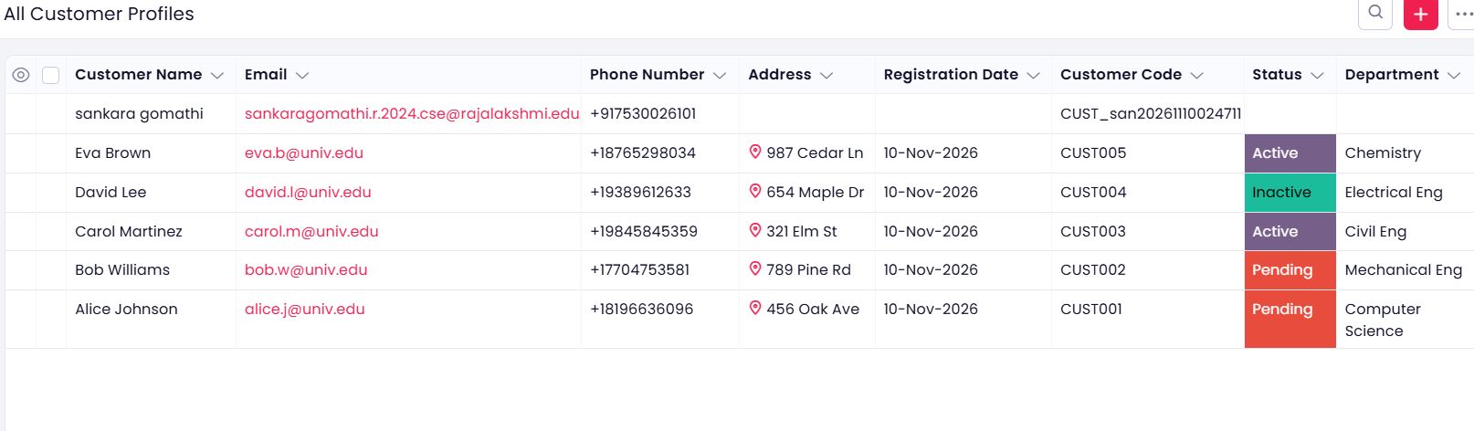
Customer Management
Customer Profile report with saved customer records
Customer details, contact information, registration date and automatically generated customer codes are displayed.
05

Slide 6
Workflow & Automation
Automating repetitive tasks with Deluge
Automatic identifiers
Order calculations
Email notifications
Generates customer codes and order-item numbers through workflows.
Calculates line totals using unit price and quantity; order total is based on related items.
Supports new-order, payment-confirmation and low-stock email alerts.
Workflows are configured around record creation or updates.
Deluge scripts implement application logic.
Email recipients can be configured for testing and live use.
06

Slide 7
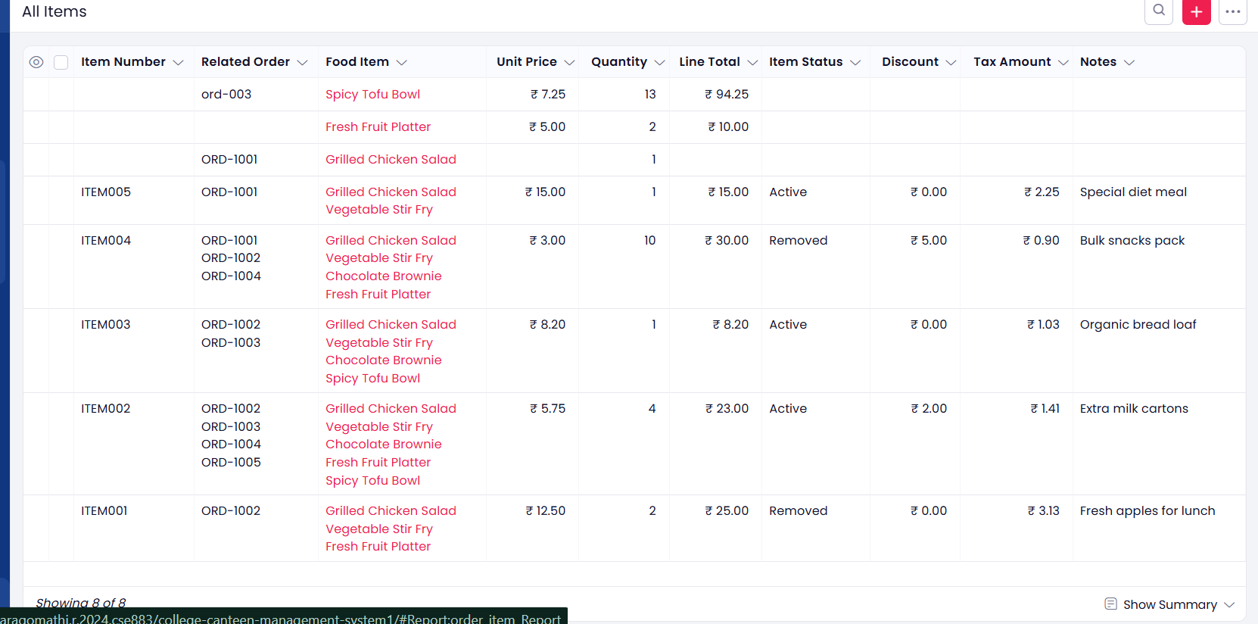
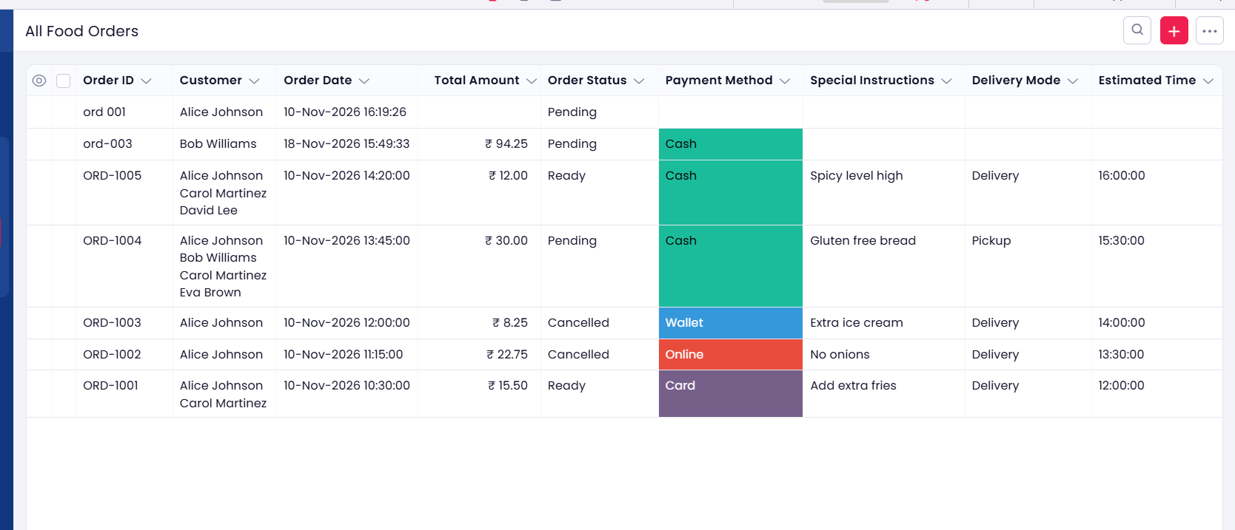
Order Processing & Items
Food Orders and their associated Order Item records
FOOD ORDERS
ORDER ITEMS
Orders are recorded first; individual food selections, quantities and line totals are maintained as related items.
07

Slide 8
Reports & Dashboard
Structured reports support monitoring of canteen operations
Dashboard summarizes totals, availability and order status.
Customer Profile report stores registered customers.
Food Order report tracks order status and payment method.
Order Item report shows food selections, quantities and line totals.
08

Slide 9
Testing & Validation Plan
Scenarios to demonstrate the application
Customer & menu
Create a customer and food item; verify both in reports.
Order & item
Create an order, add an item and verify food selection and quantity.
Calculation
Check unit price, line total and consolidated order amount.
Notifications
Trigger new-order, payment and low-stock workflows; verify email delivery.
Reports
Open dashboard and reports to confirm saved records are visible.
09

Slide 10
Conclusion & Future Enhancements
The system brings key college canteen activities into one application.
Forms, reports, workflows and email alerts support more organized operations.
Future enhancements may include online payment integration, live stock deduction, role-based access and customer-facing ordering.
THANK YOU

