Slide 1
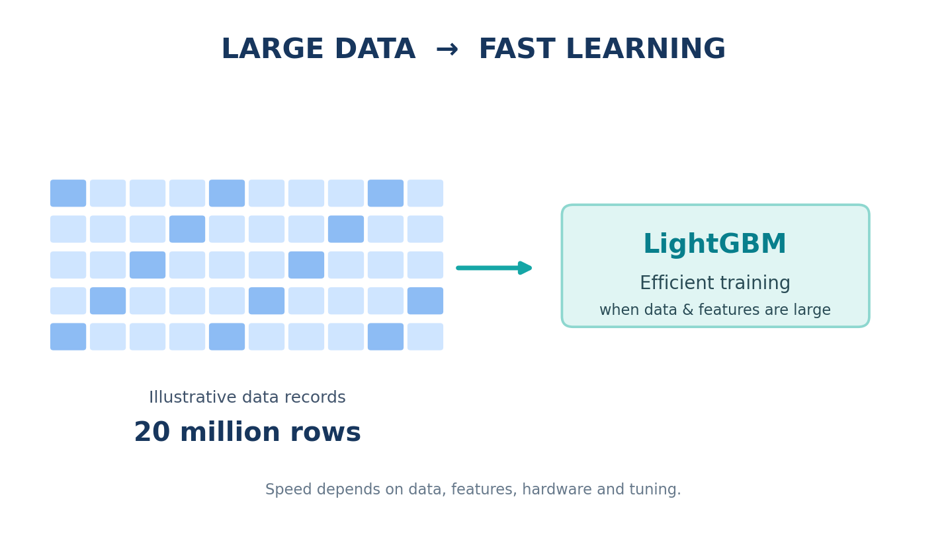
LightGBM Algorithm
A fast, scalable gradient-boosting framework for large tabular datasets
Designed for efficient learning at scale
• Handles large datasets; 20 million records is a useful example scale.
• Often faster than conventional gradient-boosting implementations such as XGBoost, depending on workload and settings.
• Developed at Microsoft Research to improve training efficiency and scalability.
Key message: efficient training comes from several complementary design choices.
1/7

Slide 2
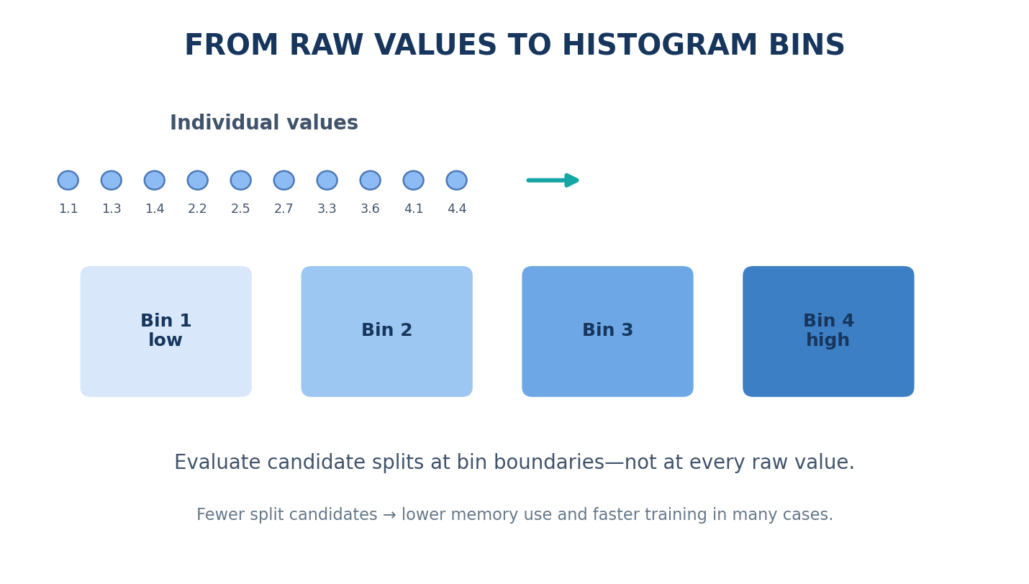
1. Histogram-Based Learning
Reduce the number of split candidates by grouping continuous values into bins
How it works
• Continuous feature values are discretized into a limited number of bins.
• The algorithm evaluates splits at bin boundaries rather than every unique value.
• This reduces memory use and split-search cost in many datasets.
Example: values such as 1.1, 1.3 and 1.4 may map to the same bin.
2/7

Slide 3
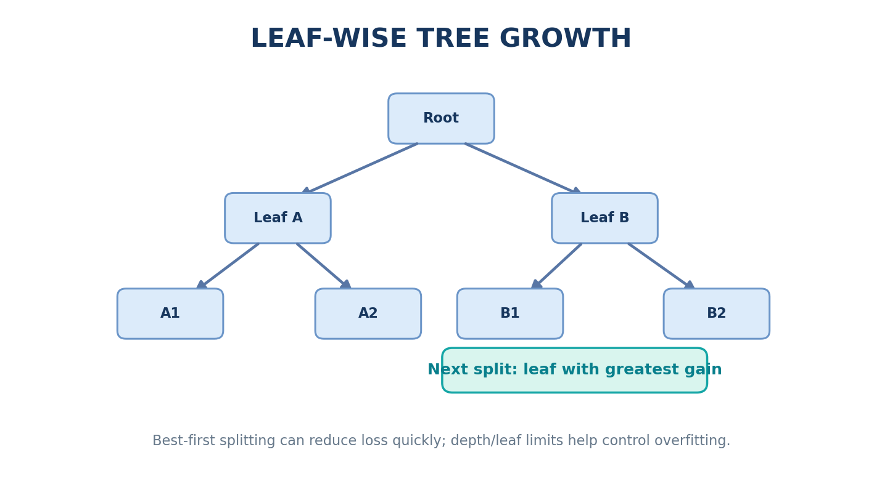
2. Leaf-Wise Tree Growth
Choose the leaf with the greatest expected reduction in loss
How it works
• At each step, evaluate candidate splits across current leaves.
• Grow the leaf that gives the largest gain in the objective.
• Other leaves wait until selected; they are not permanently stopped.
Important: leaf-wise growth can overfit. Control it with num_leaves, max_depth, min_data_in_leaf and validation.
3/7

Slide 4
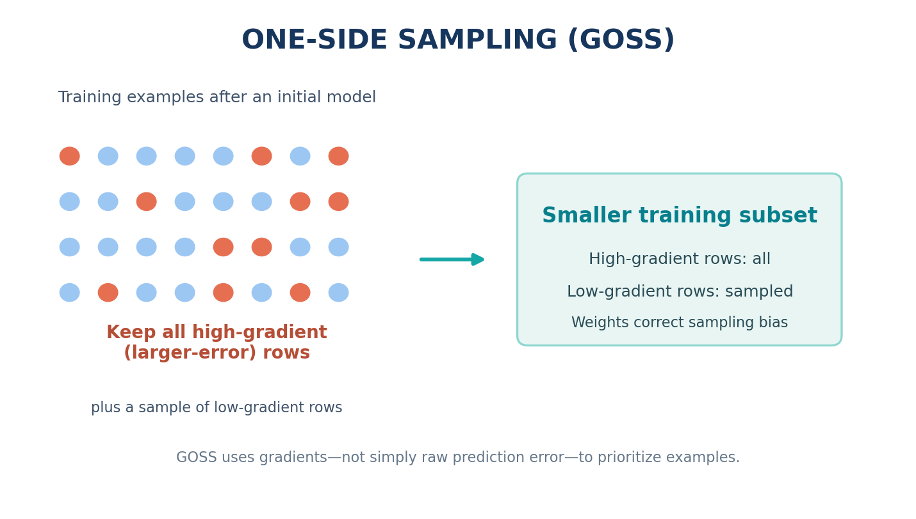
3. Gradient-Based One-Side Sampling (GOSS)
Prioritize examples with larger gradients while sampling from the rest
How it works
• After an initial prediction, calculate gradients for training examples.
• Keep all examples with large gradient magnitudes.
• Randomly sample some lower-gradient examples; apply correction weights to reduce sampling bias.
Large gradients often indicate examples the current model has not fitted well.
4/7

Slide 5
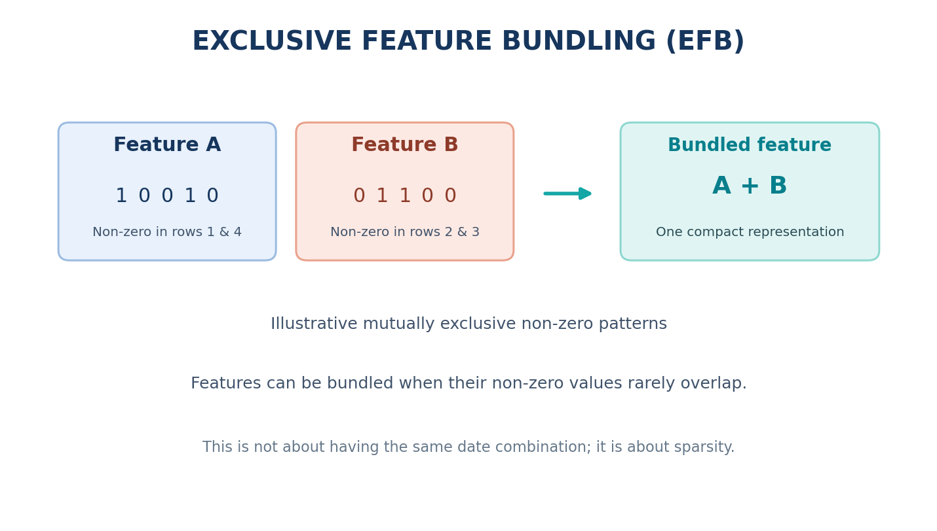
4. Exclusive Feature Bundling (EFB)
Reduce effective feature dimensionality for sparse data
How it works
• Many sparse features are zero for most rows.
• If features are mutually exclusive—or rarely non-zero together—they can be bundled into a compact representation.
• This can reduce the number of features the learner needs to process.
Correction to the original phrase: EFB is about non-overlapping non-zero patterns, not matching dates or identical combinations.
5/7

Slide 6
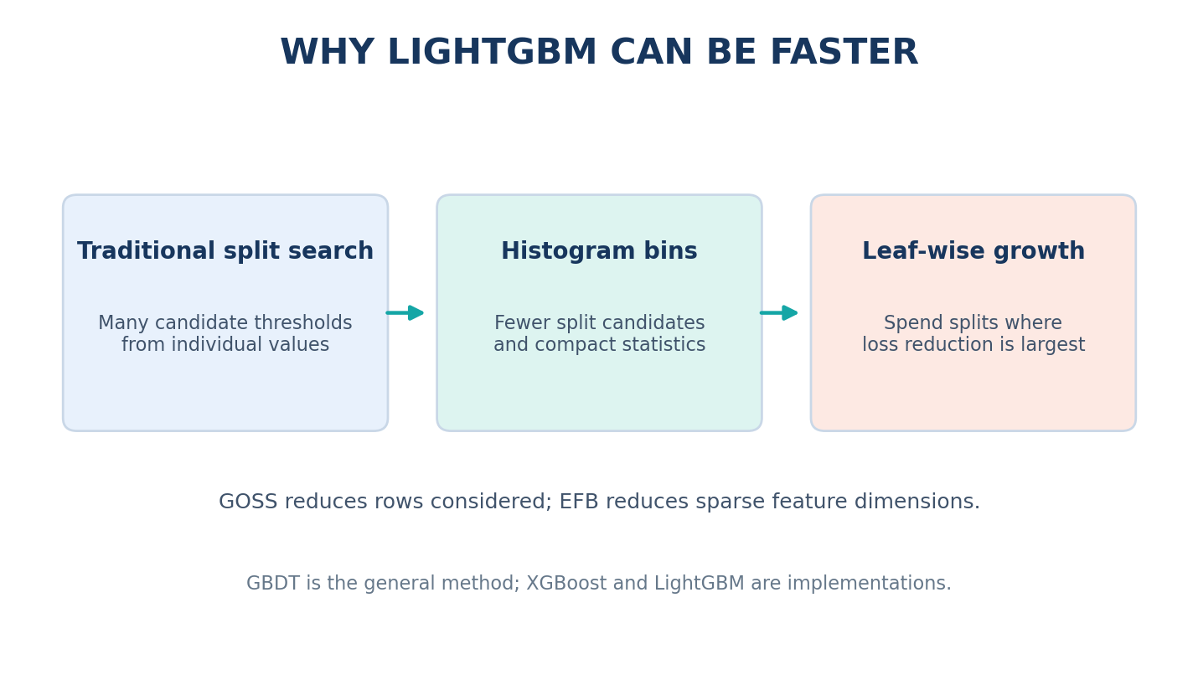
Why LightGBM Can Be Faster
Efficiency comes from the combination of histogram learning, leaf-wise growth, GOSS and EFB
Compared with other GBDT tools
• Histogram bins reduce split-search work.
• GOSS can reduce the number of rows used for split evaluation.
• EFB can reduce work on sparse feature sets.
• Actual speed depends on data shape, hardware, parameters and implementation.
6/7

Slide 7
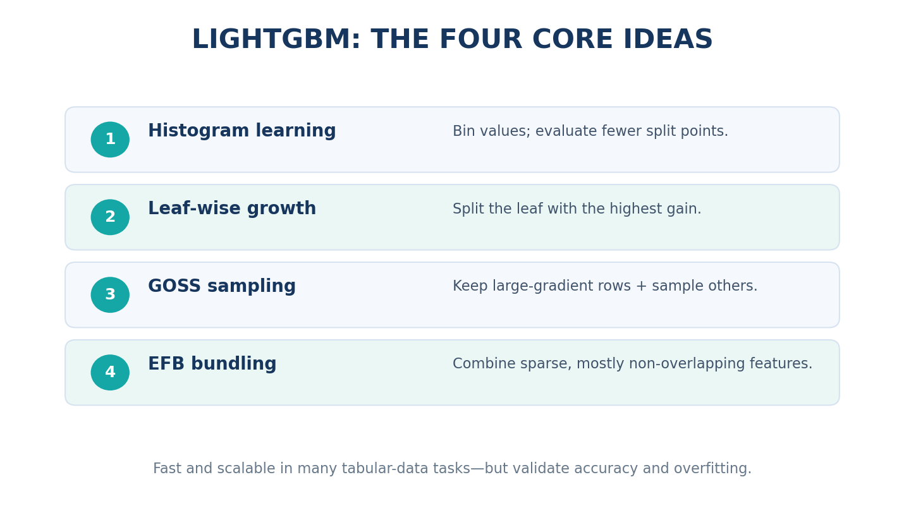
Summary: Four Core LightGBM Ideas
A practical mental model for scalable gradient boosting
Remember
• Histogram learning: bin values.
• Leaf-wise growth: split where gain is highest.
• GOSS: keep high-gradient examples and sample the rest.
• EFB: bundle sparse, mostly non-overlapping features.
Always compare validation performance, training time and memory on your own dataset.
7/7

