Slide 1

Jaisalmer

Slide 2

Khargone

Slide 3

Ladakh

Slide 4

Jaisalmer_Contig_ARG

Slide 5

Khargone_Contig_ARG

Slide 6
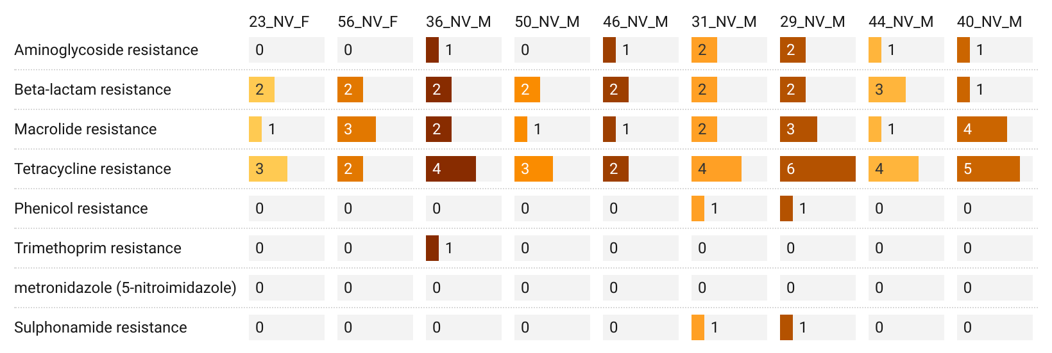
Ladakh

Slide 7
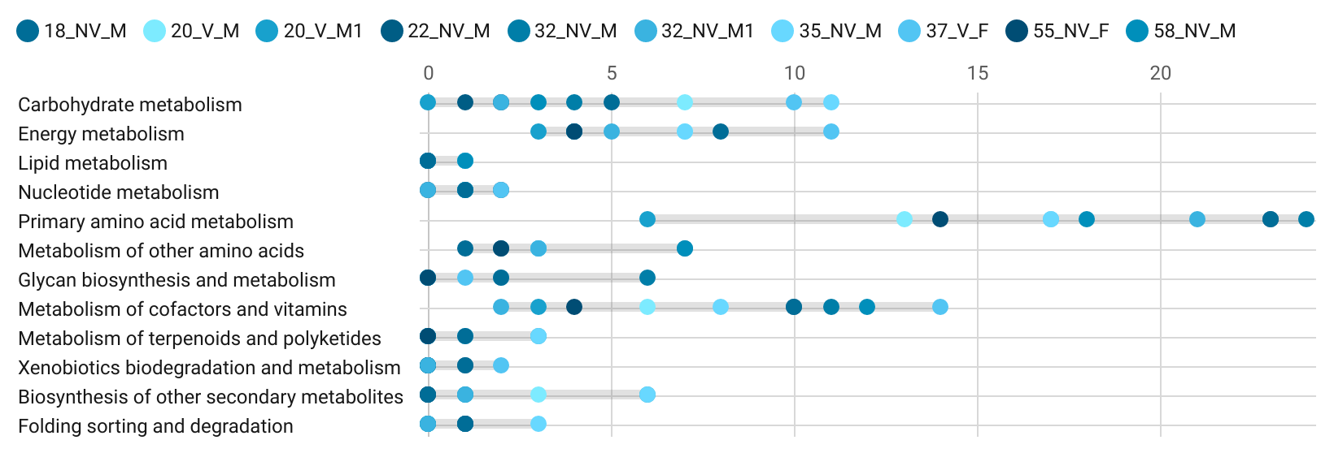
Jaisalmer

Slide 8
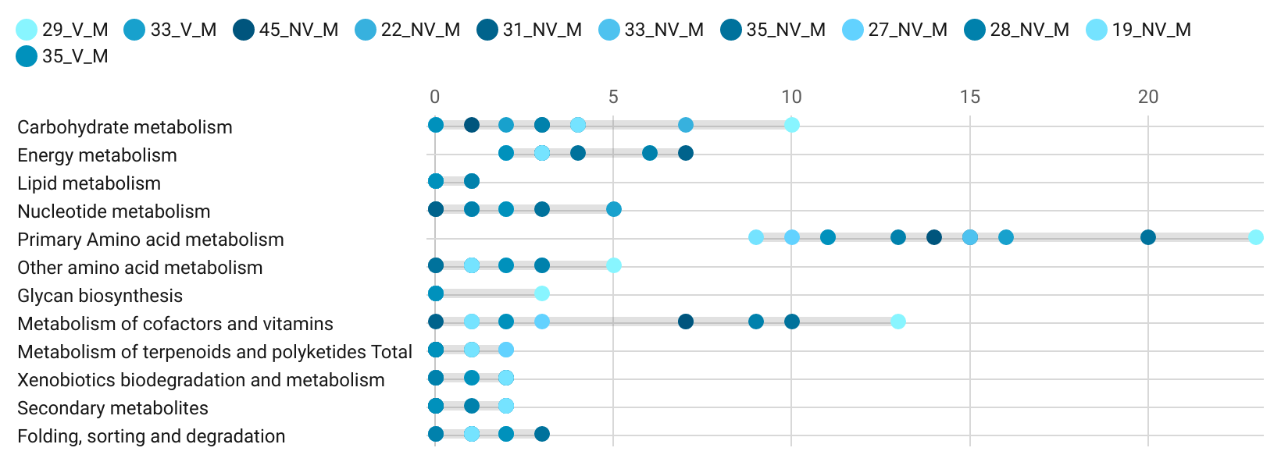
Khargone

Slide 9
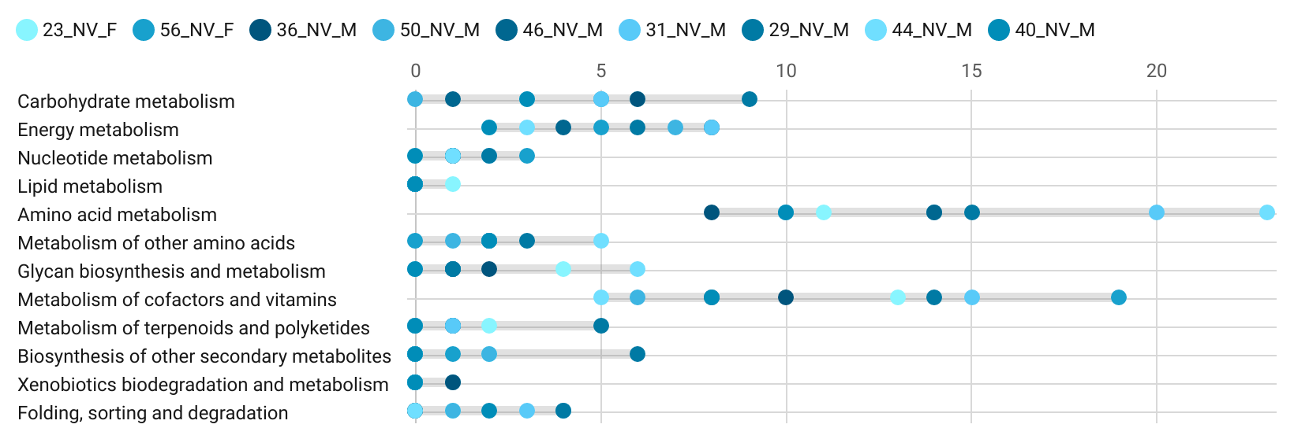
Ladakh

